Slide 1
Welcome !!
DULASP M3 Intermédiare.
Week 1

Slide 2
Aims of the Course & Outline
Focuses on business English; more specifically how to carry out negotiations
Key expressions and phrases for negotiation and doing deals
Expressing arguments
Summarizing and clarifying
Small talk
Figures
Accuracy in grammar and pronunciation
Useful vocabulary concerning business situations
Proposing and suggesting
All through
role-play activities!

Slide 3
Assessment
Written exam (50%):
Week 10
Oral exam (50%):
in class (week 7 approximately)
based on role-plays we’ll have done in class
5 mins of talking each
Groups of 4
Notes:
Tell them that this is yet to be decided; but will be a type of vocab test or some sentence writing etc
Will tell them in a few weeks to be certain
Will send out a list for them to sign up once week 3 has passed and I have my official class list

Slide 4




Expectations
Be on time!
No phones please!
Computers are allowed but please concentrate on work-related stuff.
Please don’t talk over me or others.
As this is an English class, all talking with each other, and me, should be in English.

Slide 5
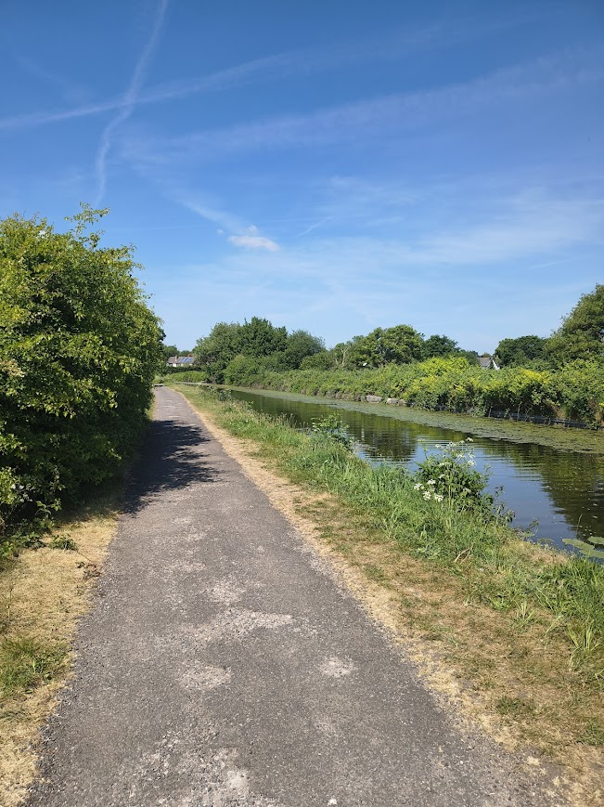
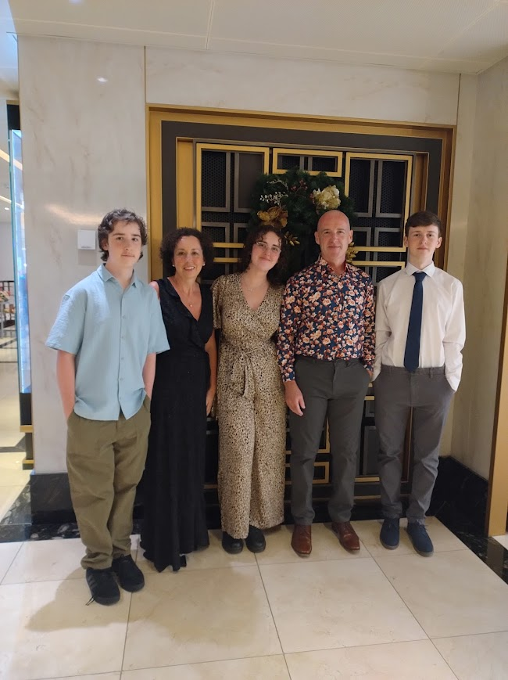
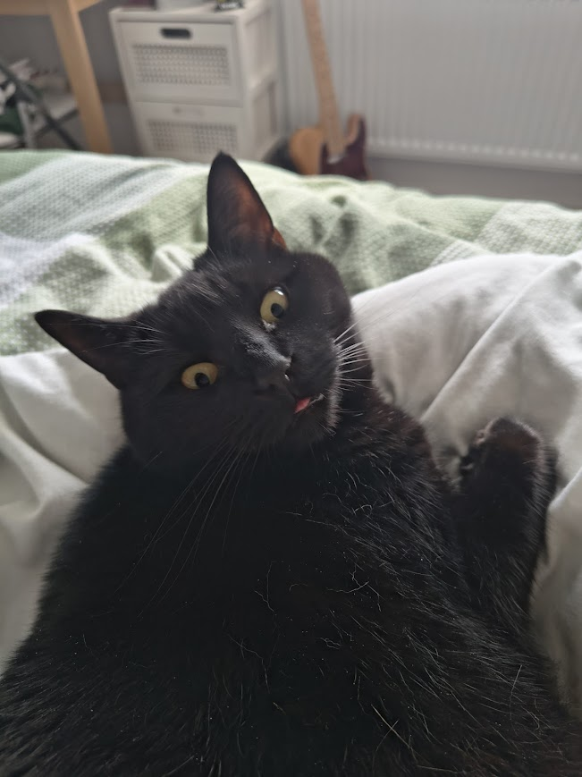

A little bit about me…

Slide 6

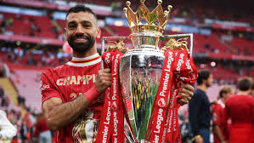
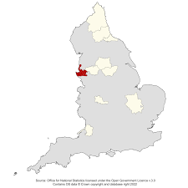



Slide 7

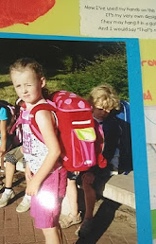

A bit more about me…
I’m from the UK, but I actually spent most of my childhood abroad!
I have many hobbies; I like going to the gym, running, swimming, reading, and drawing!
My next language goal is to learn German again, since I used to know it but have since forgotten!
I absolutely love listening to music, I constantly have it on!
I have just graduated from university!

Slide 8


A bit about Liverpool…
It has the oldest Chinatown in Europe!

Slide 9


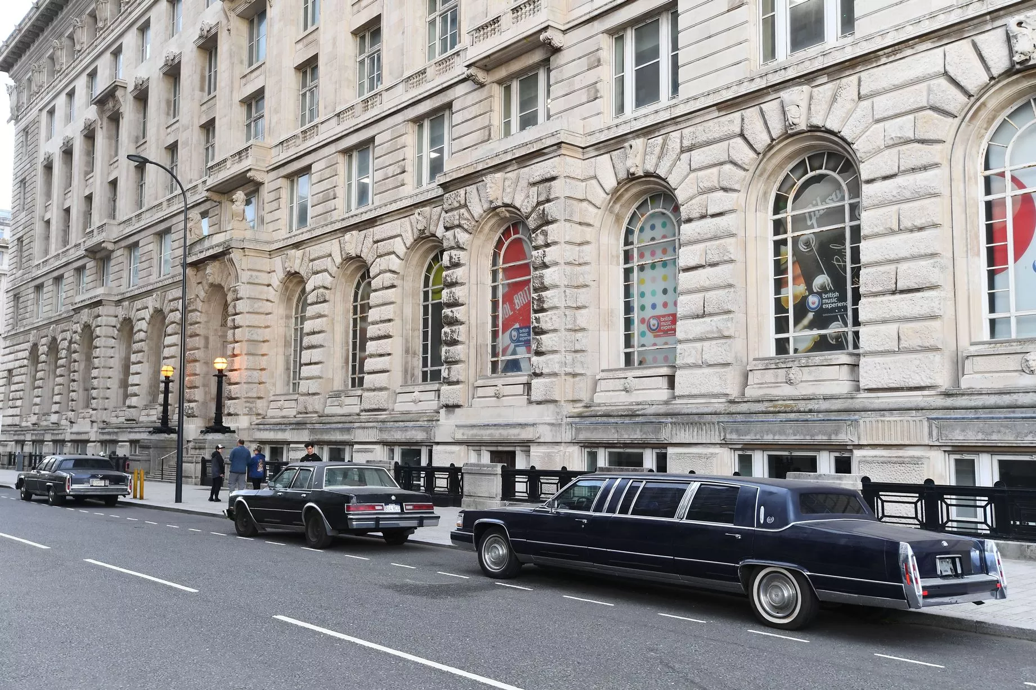
The city has been used in many famous movies and TV shows. For example, right now it is being used again for The Batman 2!

Slide 10



The city has 2 cathedrals; one of which is the largest in the UK!

Slide 11

The 2 creatures on the top of the Liver Building are mythological creatures, called Bella and Bertie; Bella looks out at sea, welcoming sailors into the port, whilst Bertie looks over the city, protecting its people.

Slide 12
Icebreaker Activity: Interview!
Present your partner to the rest of the class.
Questions:
What’s your name?
Where are you from?
Why did you choose to study English?
Notes:
Find a partner that you don’t already know
Interview that person
Give them 5-10 mins

Slide 13
Starter Activity
Discuss in small groups for a five minutes the following questions:
1. What makes a good and bad negotiator?
2. When do you think you may need to use negotiation in your career? And with whom may you need to negotiate?
Please be prepared to share your ideas with the class afterwards.
Notes:
Find a partner that you don’t already know
Interview that person
Give them 5-10 mins

Slide 14
A good negotiator:
Don’t look stressed
Show confidence
Look professional
Active listening
Have knowledge about the subject
Win-win solution (both sides win)
Explain in , in detail
Knowing how to convince
Don’t show your weakness
Clear communication
Always have an answer
A bad negotiator:
Being aggressive
Don’t be disrespectful
Refuse to understand

Slide 15
Starter Activity
One of the most important skills anyone can hold in daily life is the ability to negotiate. In general terms, a negotiation is a resolution of conflict. We enter negotiations in order to start or continue a relationship and resolve an issue.
In the world of business, negotiating skills are used for a variety of reasons, such as to negotiate a salary or a promotion, to secure a sale, or to form a new partnership. Here are a few examples of different types of negotiations in the business world:
manager and clerk: negotiating a promotion
employer and potential employee: negotiating job benefits
business partners A and B: making decisions about investments
company A and company B: negotiating a merger
customer and client: making a Sale
Notes:
Find a partner that you don’t already know
Interview that person
Give them 5-10 mins

Slide 16
Good Negotiation Skills
Understand the situation from the other party’s point of view
Firmness and assertiveness are important – however, not to humiliate the other party
Listen attentively to the arguments and concerns of the other party and take them into account
Ability to find creative solutions which are of mutually beneficial for the two parties
Notes:
Find a partner that you don’t already know
Interview that person
Give them 5-10 mins

Slide 17
Other Good Negotiation Skills
Avoid negotiating against yourself
Listen to the other party before you counteroffer
Giving a minimum or maximum you’re willing to reach
Consult with your superior
Try to reach a deal in the meeting
Keep in mind the culture & know who you’re negotiating with
Especially important when dealing with international offices
Do some research before entering the meeting
Find any common ground with your partner

Slide 18
Starting the Negotiation
Shall we get started?
We’re here today to discuss…
Our main goal is to…
What are your priorities in this negotiation?

Slide 19
Making Proposals
We propose that…
Our suggestion would be…
One option could be…
We’d be willing to consider…
From our perspective, the best solution is…

Slide 20
Agreeing / Showing Alignment
That sounds reasonable.
We’re happy to accept that.
I think we can work with that.
Yes, that meets our needs.

Slide 21
Disagreeing / Rejecting Politely
I see your point, but…
I’m afraid that won’t work for us.
That’s not really acceptable on our side.
We’d prefer to avoid that option.
That might be difficult to agree to.

Slide 22
Compromising / Trading
What if we…?
We could agree to X if you agreed to Y.
We’re flexible on [delivery], but firm on [price].
Let’s try to find some middle ground.
Would you be open to a compromise on…?

Slide 23
Clarifying / Checking Understanding
Just to clarify, are you suggesting…?
If I understand you correctly, you’d like…
Could you explain what you mean by…?
So, you’re saying that…

Slide 24
Persuading
This would benefit both sides because…
Our data shows that…
If you look at the long-term advantages…
This option gives you the best value for…

Slide 25
Closing the Deal
Shall we review what we’ve agreed?
So, we have decided on…
I think we can finalise the deal on those terms.
That sounds like a fair agreement.
We’re happy to confirm this arrangement.

Slide 26
Example Negotiation
https://www.youtube.com/watch?v=hKMz1-9ogm8
https://www.youtube.com/watch?v=UECwcvsWL7o
What do you notice about the negotiating styles?
Were the people in the videos equally skilled in negotiations?

Slide 27
Why do we negotiate?

Slide 28
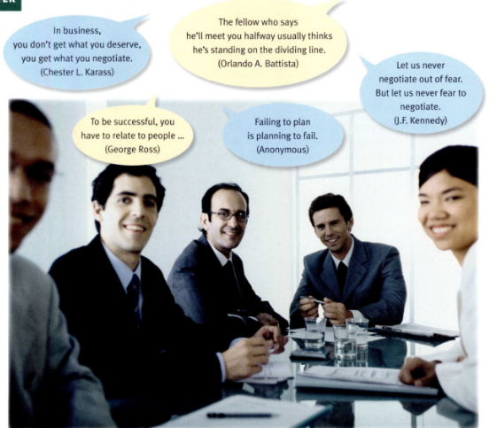
Notes:
Do they agree with these quotes? Explain why. Give examples from own experience if can.

Slide 29
Scenario:
On the 23rd June 2016, the people of the United Kingdom (foolishly) voted to leave the European Union. You will work in groups of 4 and all take a different role in negotiating the rights and regulations of the UK within the EU post-Brexit, and try to come to a deal that satisfies all parties involved. You must end this meeting having made a decision.
You will each have 20 mins to prepare your role and then you will begin your negotiation.
I would like you to be speaking in your groups for 15 mins.

