Slide 1
Week 3:
M3 Intermédiare
niamh.lafferty@univ-lorraine.fr
Notes:
Have the sheet of phrases ready and prepared to give them all one, but have them help me fill it out in class so that they all understand rather than just giving them it.

Slide 2
Plan for today:
Recap of some vocabulary from last week.
Some tips and tricks for negotiating.
How a negotiation is split up into different parts: introduction to some useful phrases.
Practice! Using these phrases.
Group roleplay.
Notes:
5 mins
10 mins
10 mins
20 mins
45 mins

Slide 3
What are the corresponding nouns for these verbs?
To propose
To calculate
To transport
To inform
To meet
To negotiate
To discuss
To quote
a proposal
B. a calculation
C. transportation
D. information
E. a meeting
F. a negotiation
G. a discussion
H. a quotation/a quote

Slide 4
As well as having good vocabulary, using the appropriate polite language is also important…

Slide 5

In pairs, I’d like you to act out a 2 minute scenario using one phrase from each box!
The topic of the negotiation is:
What you will have for dinner this evening.

Slide 6

Now you’re going to have a go at a slightly longer scenario, in pairs again.
Scenario: Buying a second-hand* phone.
Student A: you will be the seller of the phone, you want to sell it for €200.
Student B: you are the buyer, and you want to get it for €150.
The task is to use at least one phrase from each of the 4 stages again.
I will walk around the class and listen to you all!
*not new; something that has already had an owner and is being resold.

Slide 7
Strategy Roundtable
What strategies worked?
What phrases felt useful?
Did you notice any mistakes, especially ones that happened more than once?

Slide 8

Good Negotiating Skills…

Slide 9
Be polite and professional
Say “thank you,” “I understand,” even if you disagree.
Example: “I see your point, but…”

Slide 10
2. Listen carefully
Don’t just talk → ask questions.
Example: “Could you explain your position?”

Slide 11
3. Be clear and simple
Short sentences are best.
Example: “We need delivery in 5 days.”

Slide 12
4. Show flexibility
Try compromise, not only your own way.
Example: “What if we meet in the middle?”

Slide 13
5. Summarise at the end
Make sure everyone agrees.
Example: “So, we agreed on…”

Slide 14
Pick the most appropriate phrase
Based on the skills we have just looked at, what phrase do you think would be the best option in each instance and why?
“No you’re wrong” / “Well I disagree but okay”
“Let me talk for a minute” / “I see, I’ve said my point, now what do you think?”
“We would like that to happen by next week” / “We think next week would be the best outcome for what we want to happen”
“Could we compromise on that a bit?” / “We need it to be this way”
“So just to be clear…” / “Okay we understand, so that brings the meeting to an end”

Slide 15
Pick the most appropriate phrase
Based on the skills we have just looked at, what phrase do you think would be the best option in each instance and why?
“No you’re wrong” / “Well I disagree but okay”
2. “Let me talk for a minute” / “I see, I’ve said my point, now what do you think?”
3. “We would like that to happen by next week” / “We think next week would be the best outcome for what we want to happen”
4. “Could we compromise on that a bit?” / “We need it to be this way”
5. “So just to be clear…” / “Okay we understand, so that brings the meeting to an end”

Slide 16
Group Roleplays.
Groups of 3-5 people.
Each group will get a different scenario, which will have a few different cards with roles on for you all to play.
After you have read the scenario at the top of the sheet, and your role at the bottom, I am going to give you time to do that roleplay.
You will have 10 minutes to prepare your role and think of what you could say, and then I will let you do the roleplay in your group.
Notes:
Dress Code: 5 people
A place to smoke: 6 people
The environment: 5 people
Personality Clash: 5 people
Employment of disabled people: 6 people
Corruption: 4 people

Slide 17
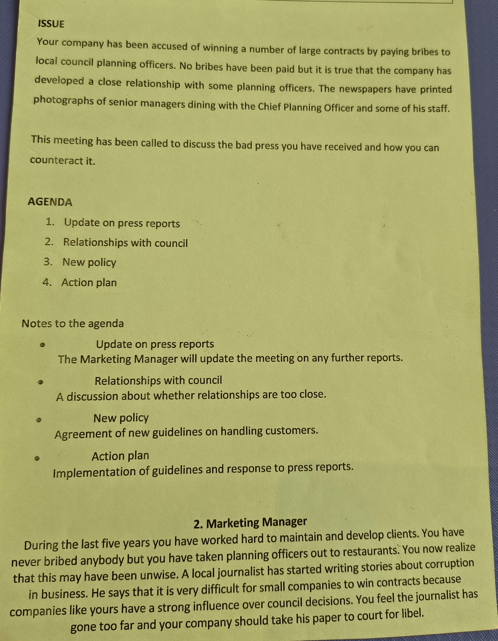
This is the scenario: the issue/topic that you will be deabting
This is what is on the agenda: what you need to discuss throughout your meeting, and what you need to negotiate.
This is your role which gives you some context

Slide 18
In your negotiation role plays today, try to use at least two of these skills. I will listen and check which skills you use.

