Slide 1
Modélisation des gisements miniers
- Mining geomodelling -
TD 1 – Stratigraphic & Structural Modeling
Implicit vs Explicit Approach
Lou Declercq

Slide 2
Exercise 1
Open « TD1_MODELISATION.sprj »
Observe available data
Approach 1 : Explicit modelling
  Build the differents horizons using curves / constraints (at least one)
  Manage horizons erosion by topography surface
  Refine obtained surfaces
Approach 2 : Implicit modelling
  Build a stratigraphic column
  Use SnS (Structure & Stratigraphy Workflow)

Slide 3
I. General reminders
Open/Create a project
User interface
Object Tree
Object types
Features

Slide 4
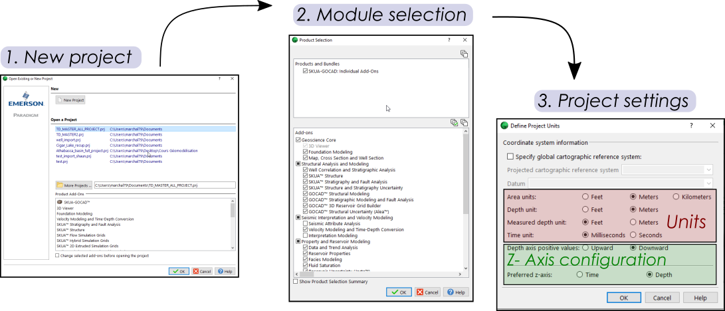
I. Open & Create Projects
Selection of add-ons : here ensure you have Structure & Stratigraphy and Reservoir Properties (+ Geoscience Core)
When starting a project, be careful with :
Depth axis orientation
Units
Coordinates systems

Slide 5
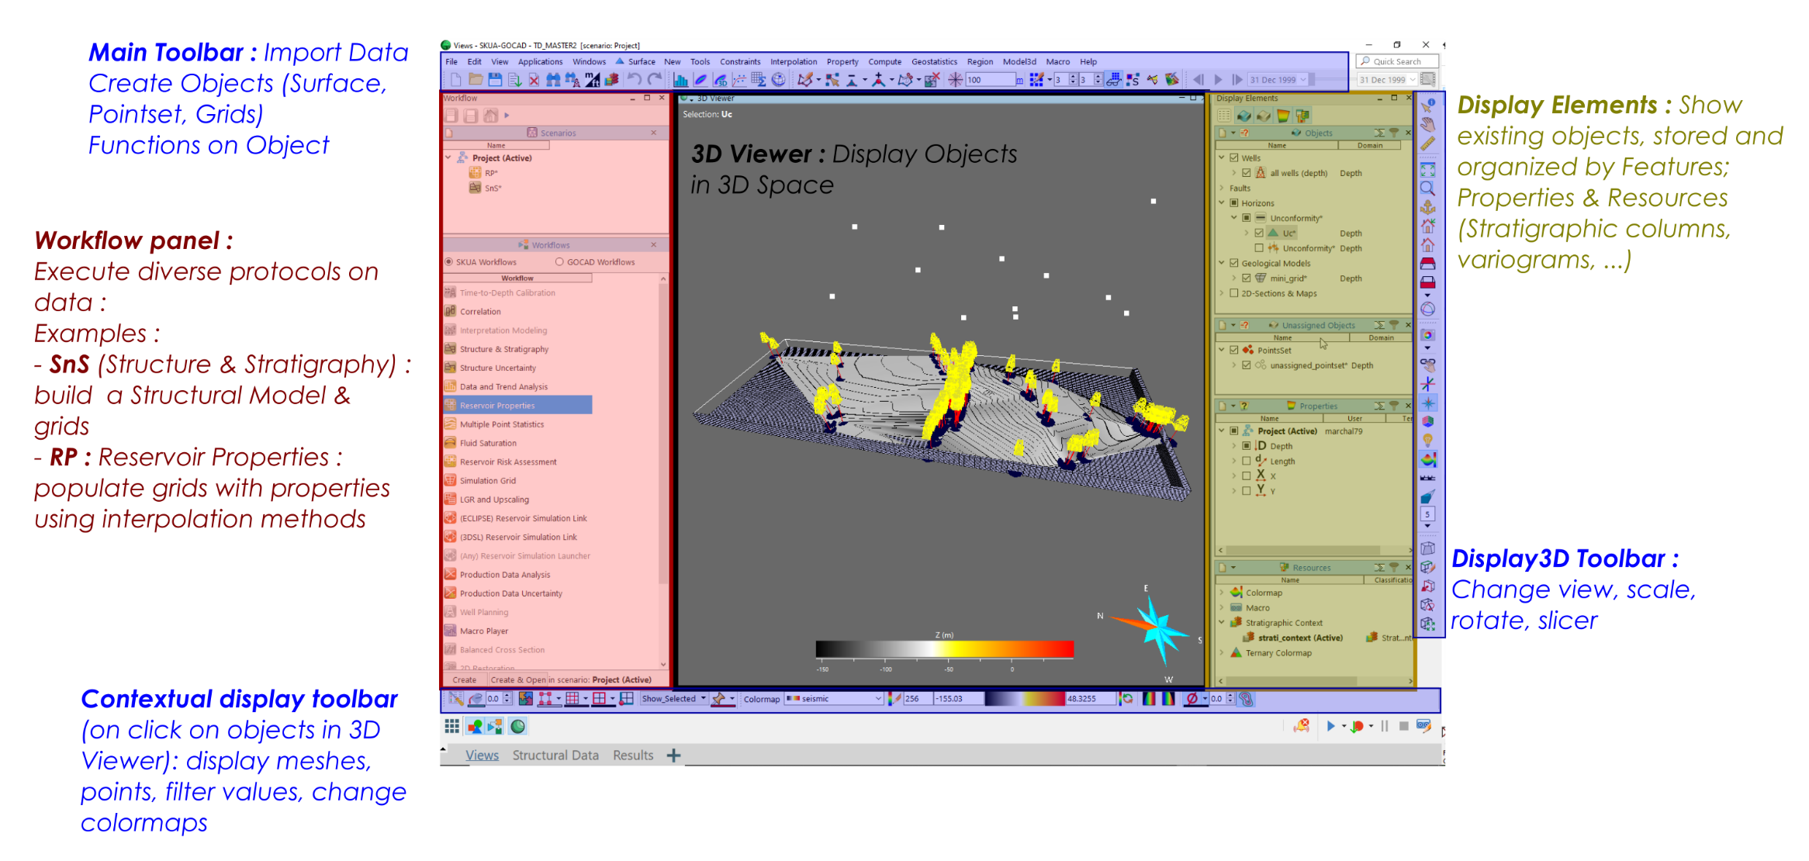
I. SKUA-Gocad UI

Slide 6
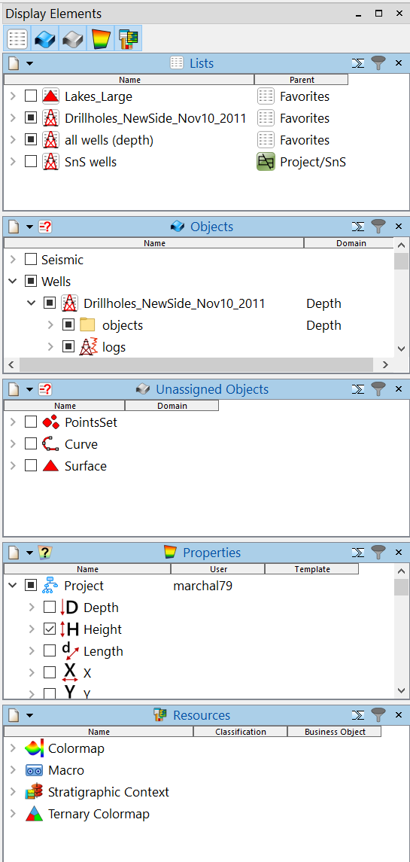
I. Object Tree
1. Object Tree : Activate/Deactivate diffrents views using tabs
1
Lists : all objects as a list
2
Objects : tall objects sorted by Features
2
Unassigned Objects: all object without features
Properties : all properties on all objects (also available from objects directly)
Ressources : other ressources (classifications, variograms, stratigraphic columns, histograms, …)

Slide 7
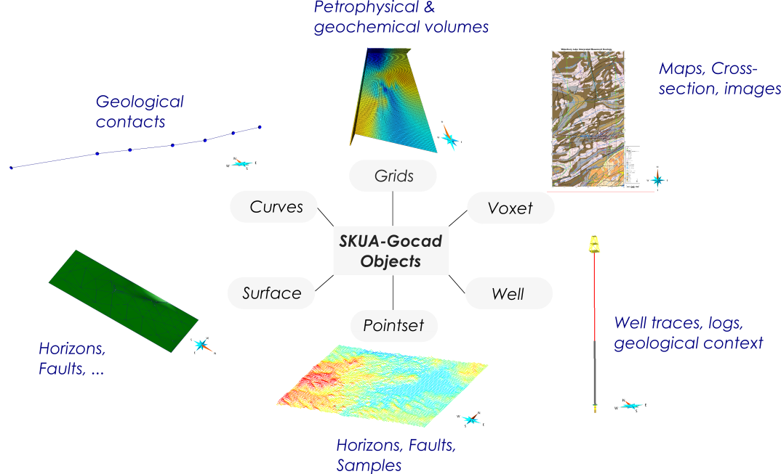
I. Objects types

Slide 8
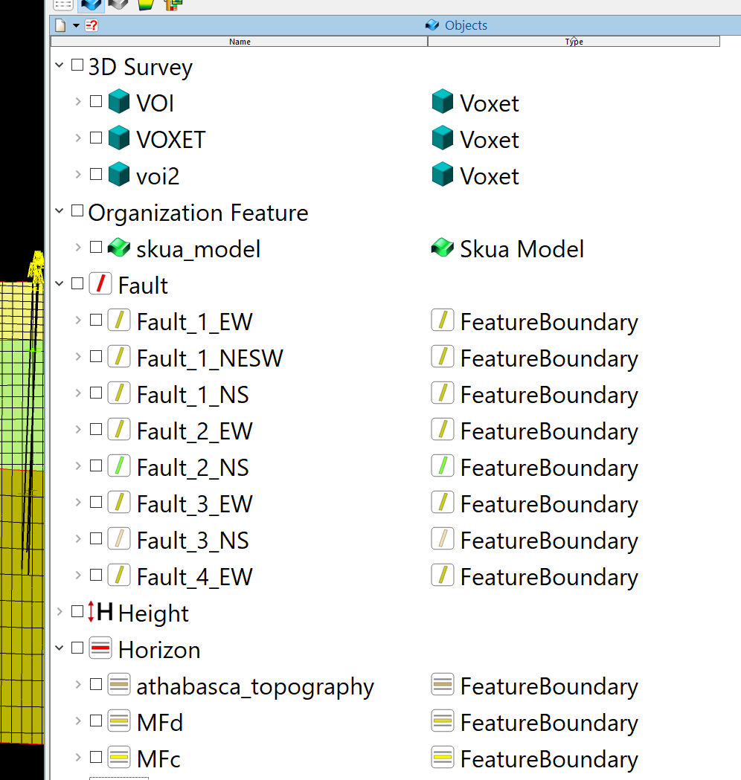
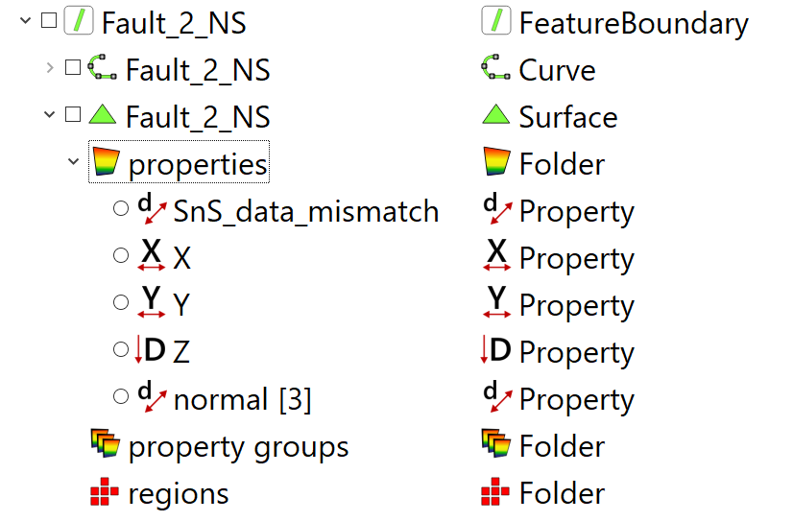
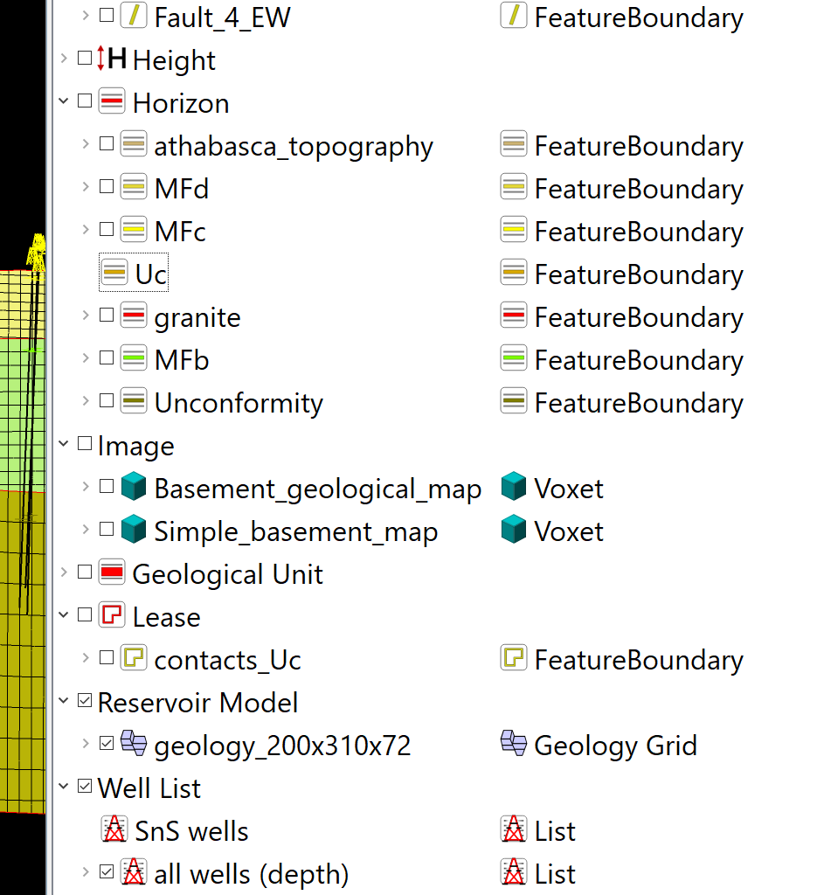
I. Objects
Objects; assigned objects to a feature
Voxets / 3D volumes
Seismic data
Stratigraphic models
faults
horizons
2D voxets, maps, images…
For each Feature : assigned objects
For each object : properties related, regions, …
Limits, prospects zones
Geological grids
Wells

Slide 9
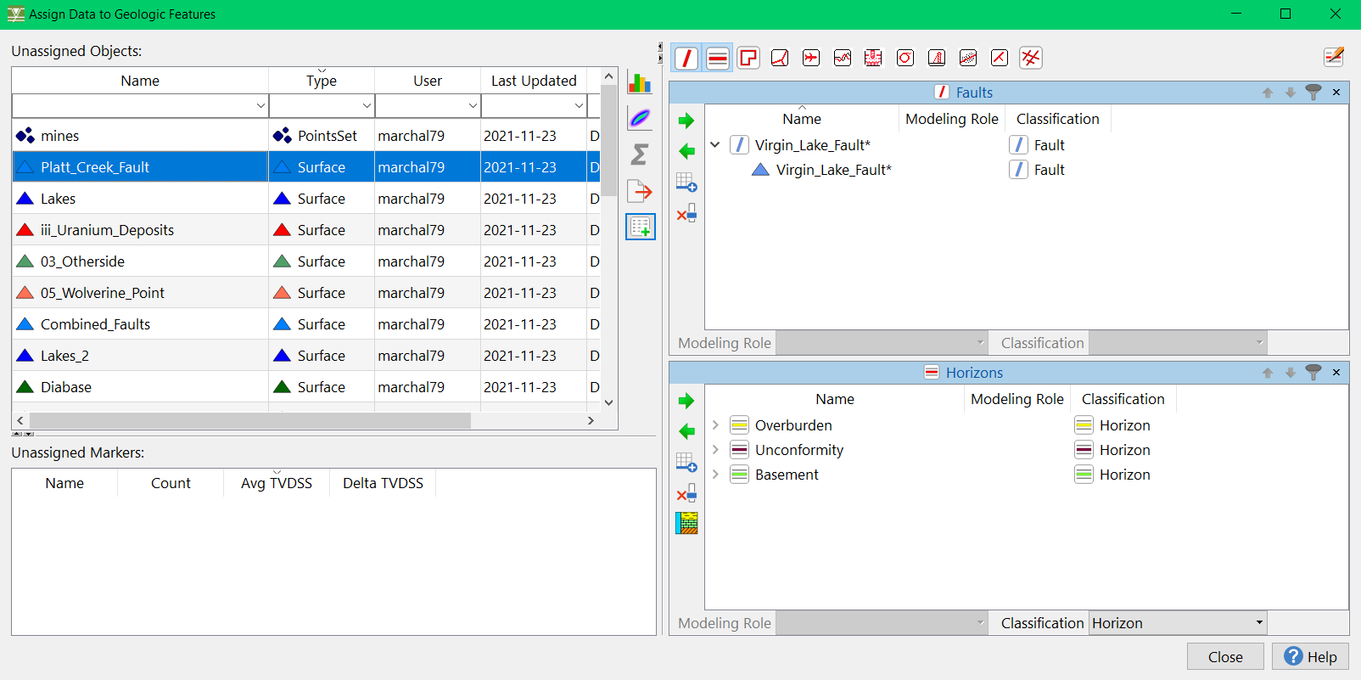
I. Assign features
2. Button « Assign an Objet to a feature »
Table with unassigned objects
Table of unassigned markers (in wells)
Feature type selection menu (fault, horizon, boundary, etc.)
Fault assigned objects, d1: transfer menu between non-assigned & faults; feature creation & deletion
Same but with horizons
A
C
D
D1
E
B
E1

Slide 10
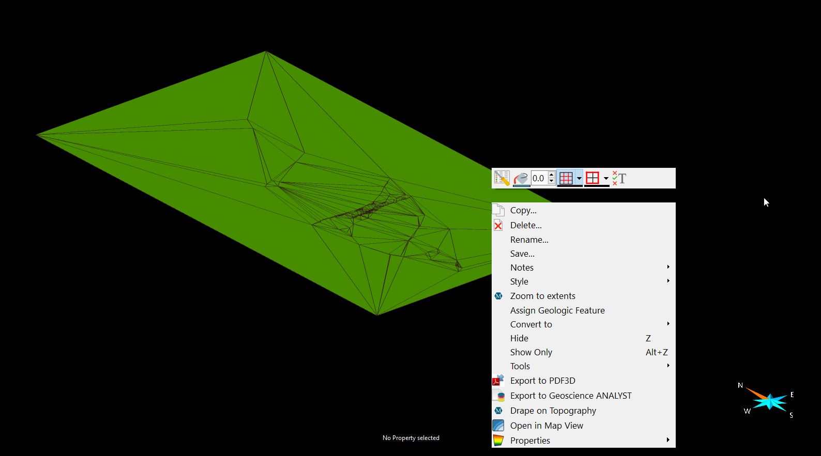
I. Contextual menu in 3D viewer
Right click on an Object
Display parameters (colors, mesh, nodes…)
Display properties on Object
Hide/Show
Assign Features
…

Slide 11
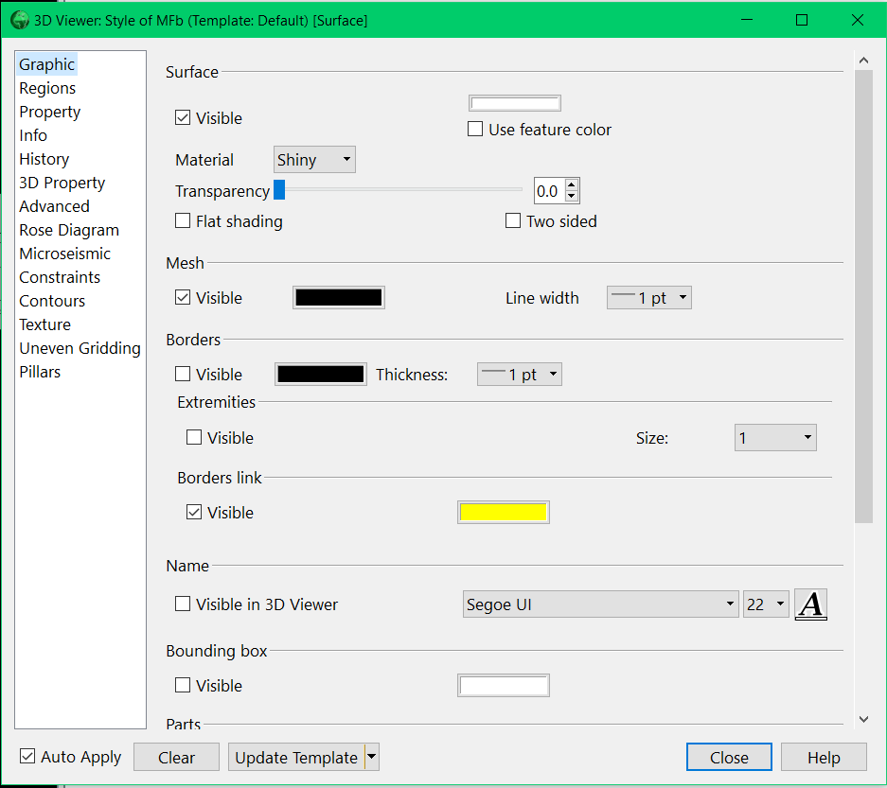
I. 2nd contextual menu
Displayed in bottom left corner when object is clicked in 3D view
Display nodes
Display mesh
Display parameters
Change color
Display borders
Display parts
Transparency

Slide 12
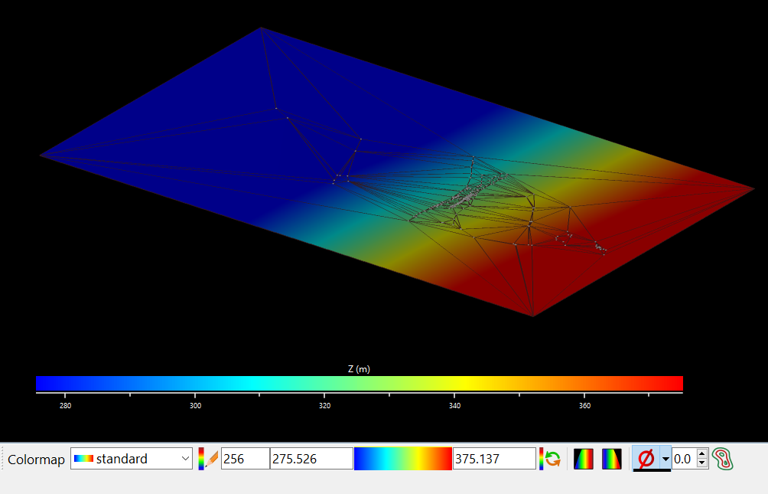
I. Property bars
An option bar appears at the bottom when a property is displayed
Change colormap
Change clipping values
Draw isovalues

Slide 13
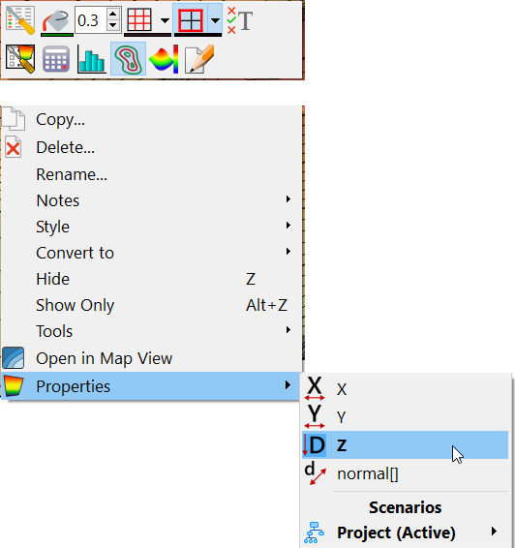
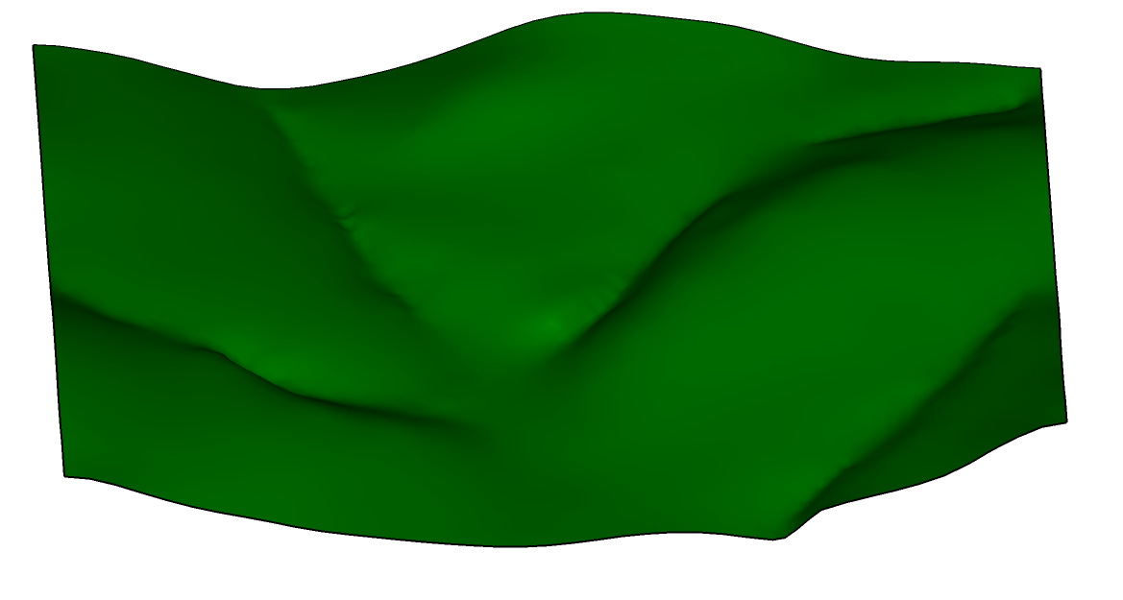
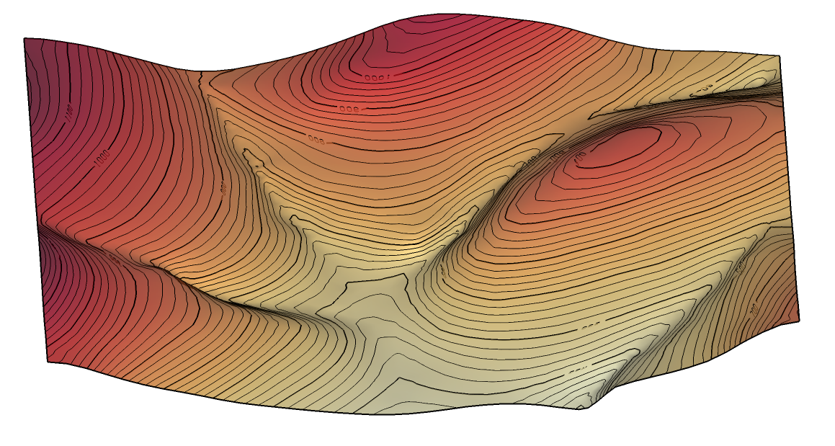
I. One example of restyling topography
Trace isolines
Right-click

Slide 14
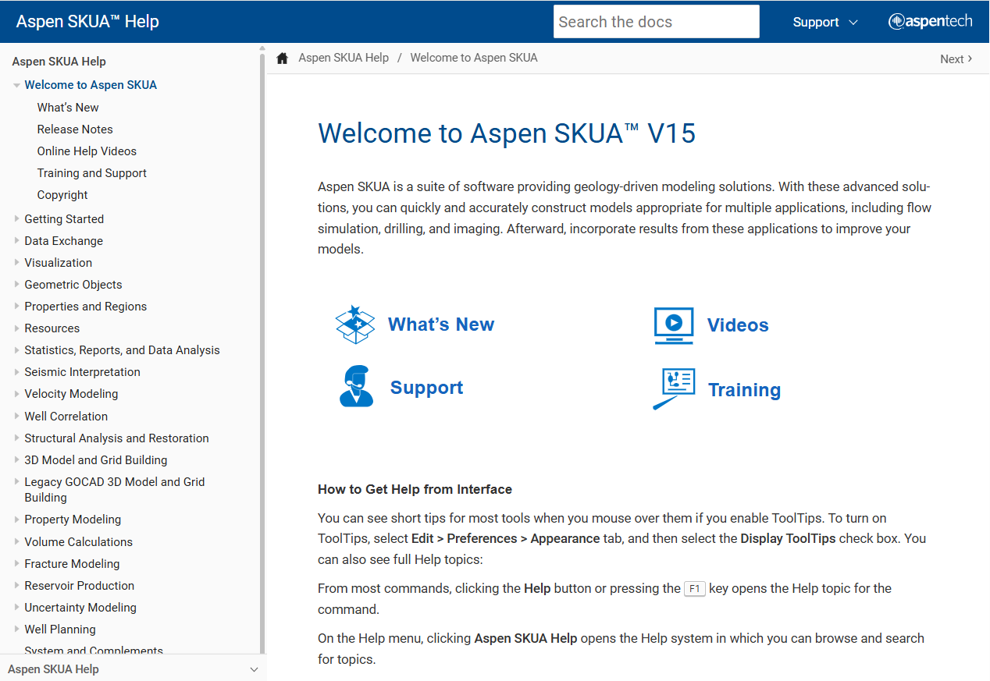
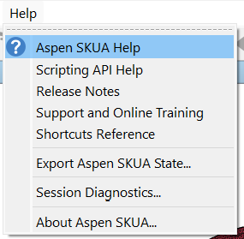
I. Help menu
Direct access via Help

Slide 15
II. EXPLICIT MODELING APPROACH
Create objects
Edit objects
Cut surfaces
Set constraints / Interpolate surfaces
Cut surfaces
QC

Slide 16
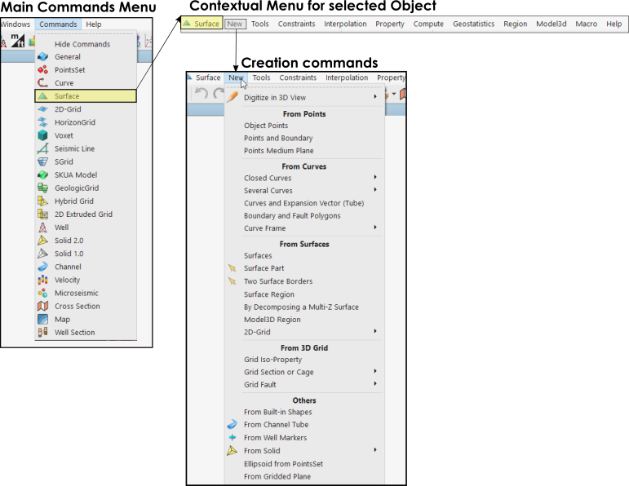
II. Create objects; edit objects
Every kind of SKUA-Object has its own contextual command menu
Create this kind of object from several type of data
Edition tools
Property Editor
Region Editor
Computation tools…

Slide 17
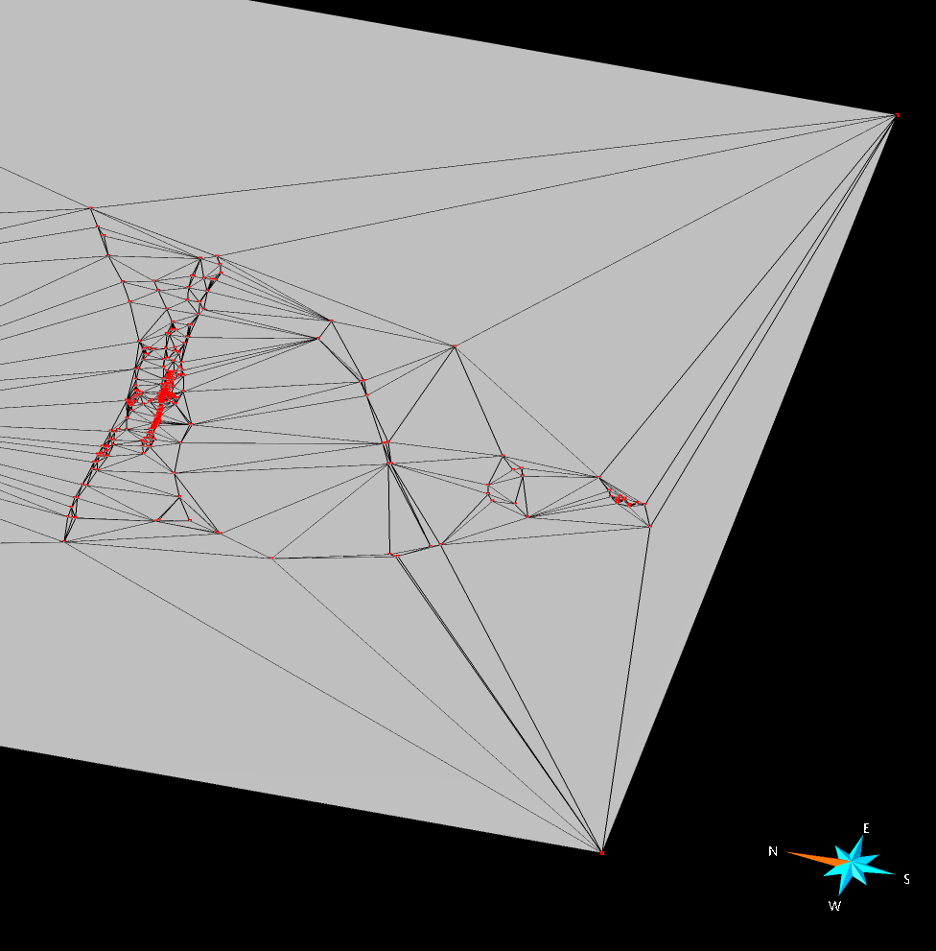
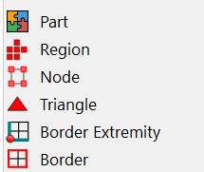
II. About object vocabulary
Parts : if object is split in several parts (ex: surface by another)
Regions : area of interest in an object defined by user
Nodes : mesh nodes
Triangle (object mesh elements)

Slide 18
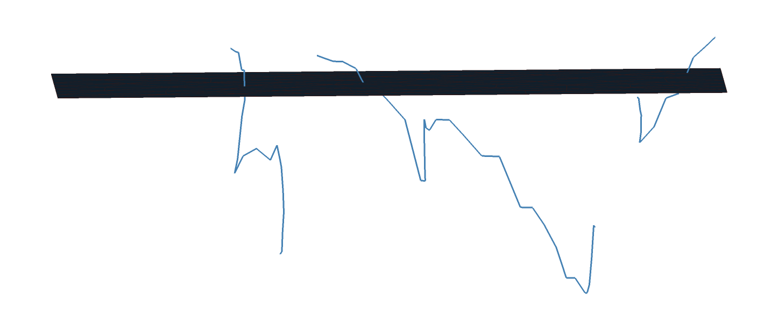
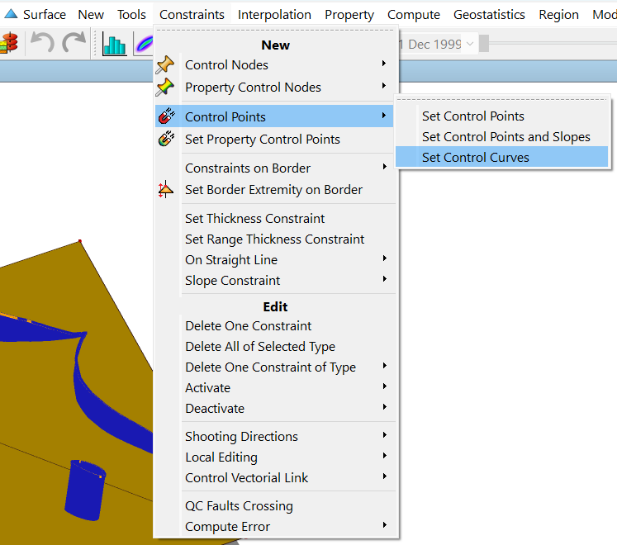
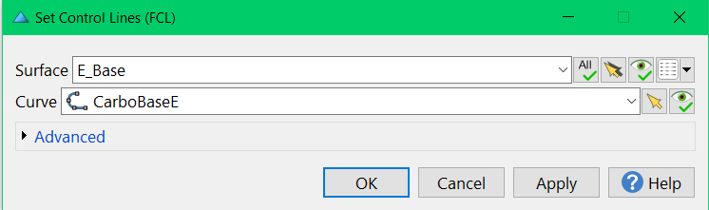
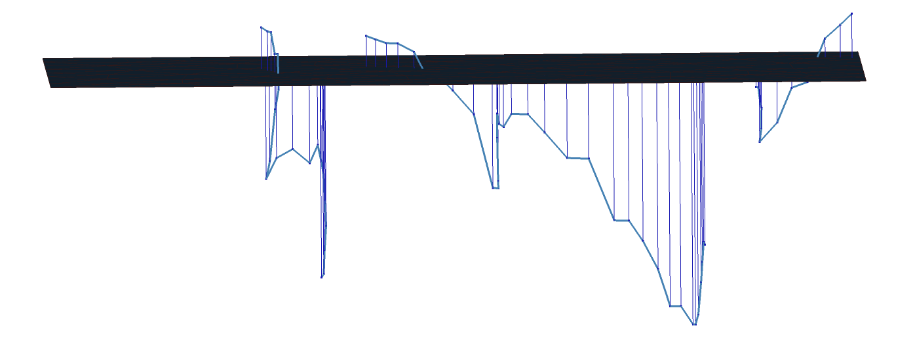
II. About Constraints
Constraints can be applied between object to fit one to the other

Slide 19
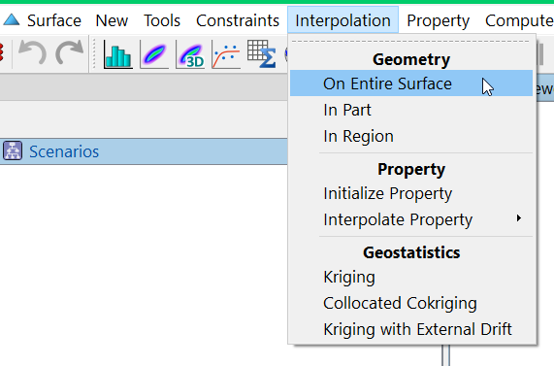
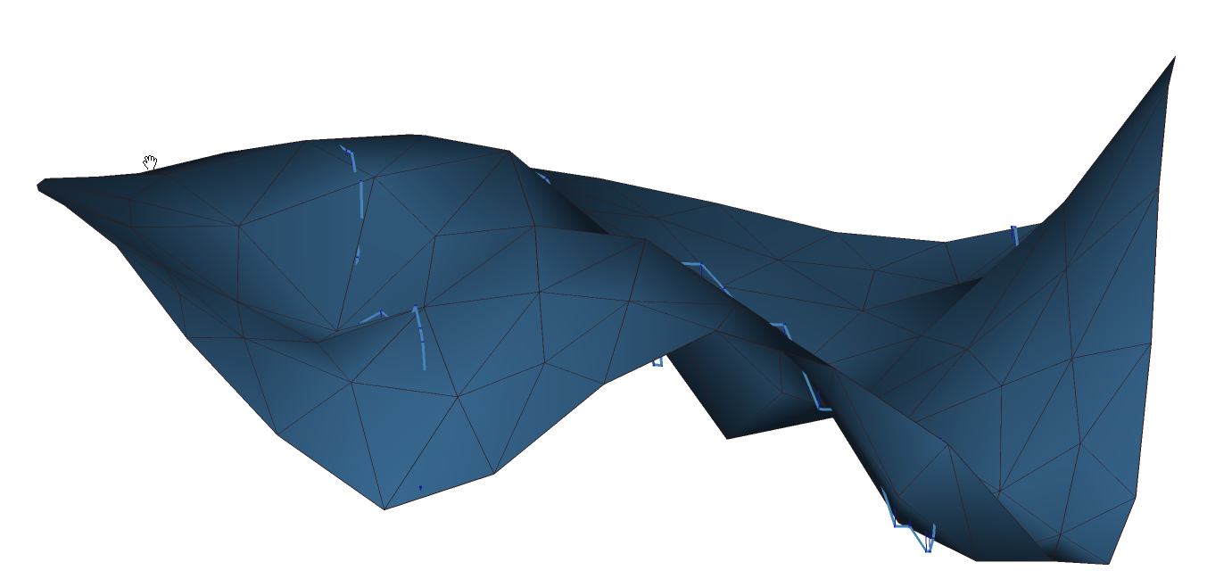
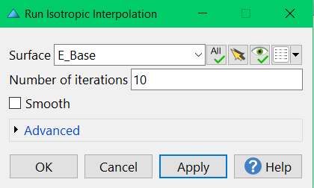
II. Interpolation of surfaces using constraints
Then you can interpolate surface using these constraints

Slide 20
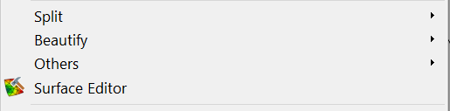
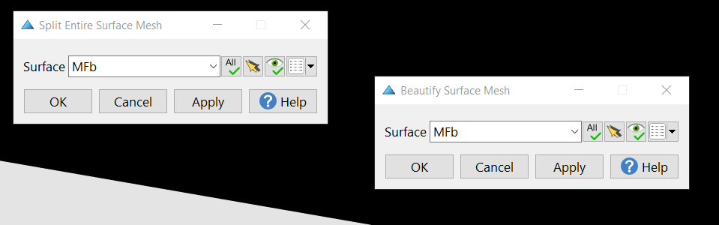
II. Edition tools : refine surfaces
Tools commands in object menu
Example:
Split => split mesh in smaller éléments
Beautify: try to respect equilarity of mesh triangles

Slide 21
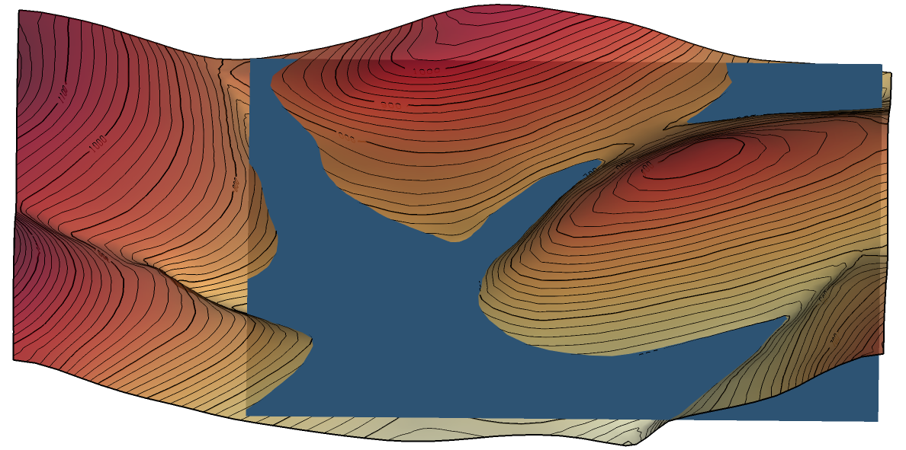
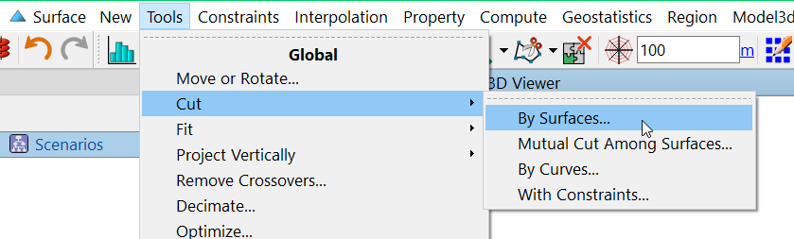
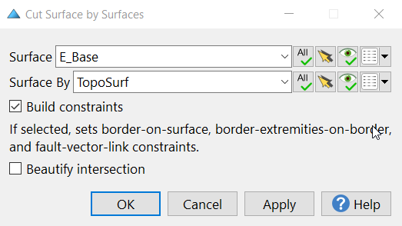
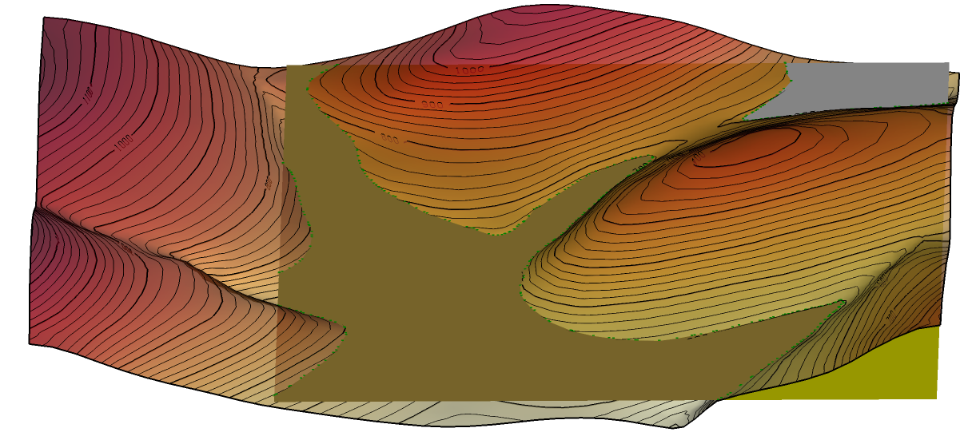
II. Erosion ? What about cutting surfaces ?
If you want to take erosion into account you’ll have to cut your surface by your topography
Part 2
Part 1
Part 3

Slide 22
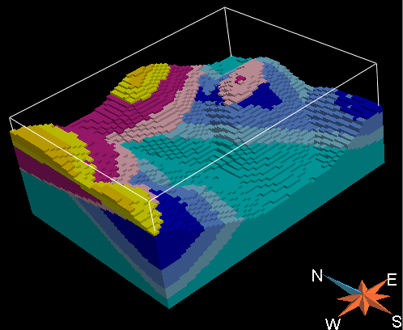
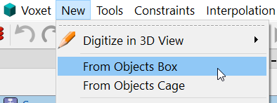
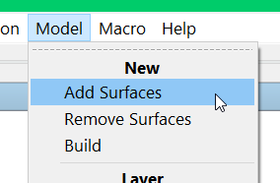
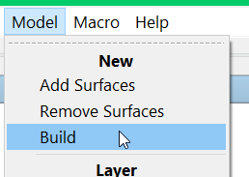
II. Create a volumetric model from surfaces
When you have created your surfaces => you can create a geological grid
Create a new Voxet
Add Surfaces to the Voxet
Build the model

Slide 23
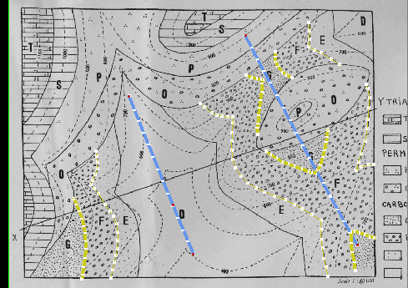
II. Quality control on your surfaces
Significant variation of layer thickness due to lack of data
Strategy 1:
Add interpretive data (hinge lines, cross-sections…)
Reinterpolate
Strategy 2:
Move individual nodes to the desired
position (as arbitrary than drawing a cross section)
Set them as Control Nodes
Re-interpolate
Strategy 3:
Use Thickness or Range Thickness constraints
NB: thickness is signed (negative above the reference surface)

Slide 24
III. IMPLICIT MODELING APPROACH
Create a stratigraphic column
Workflow SnS
Build Geologic grid

Slide 25
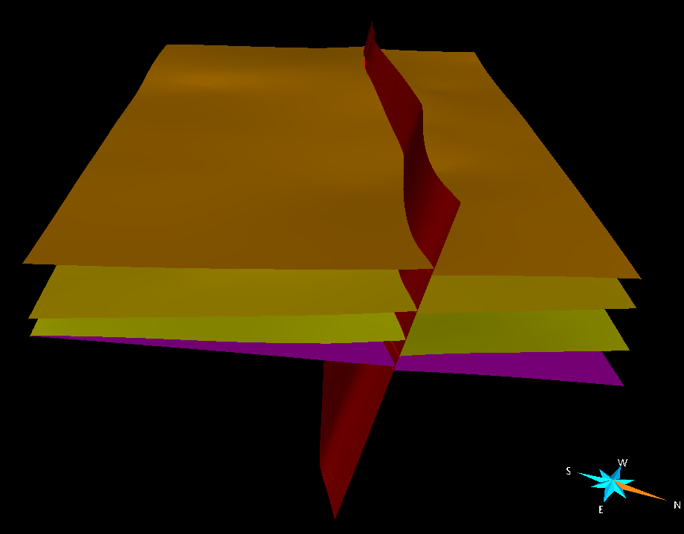
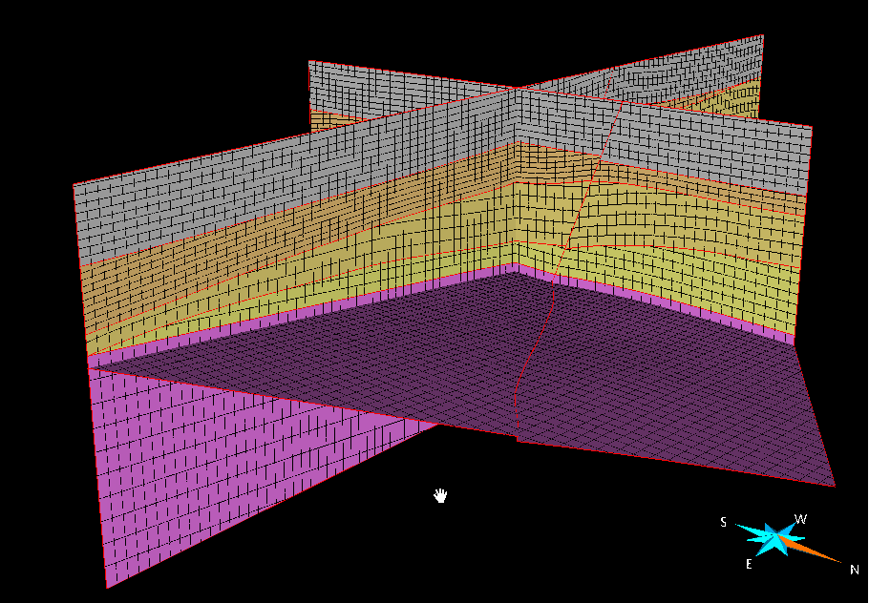
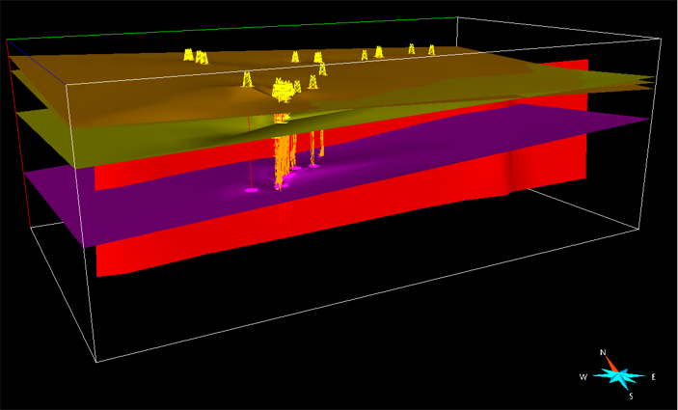
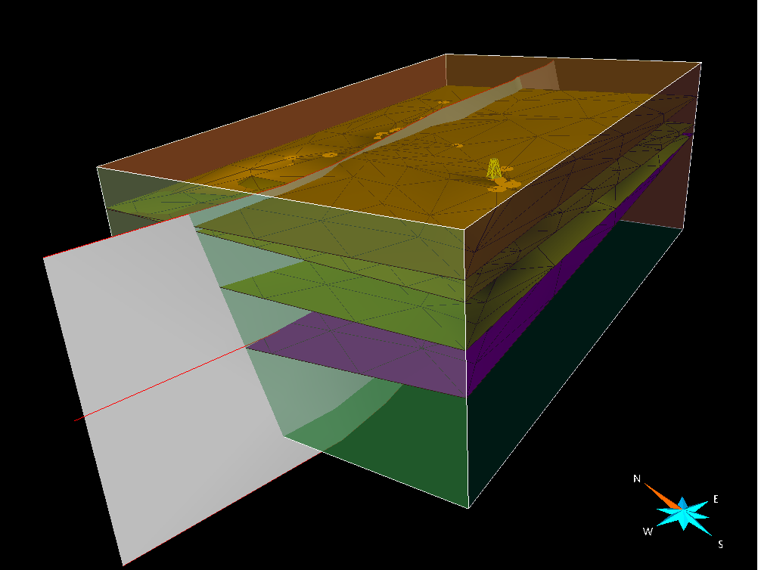
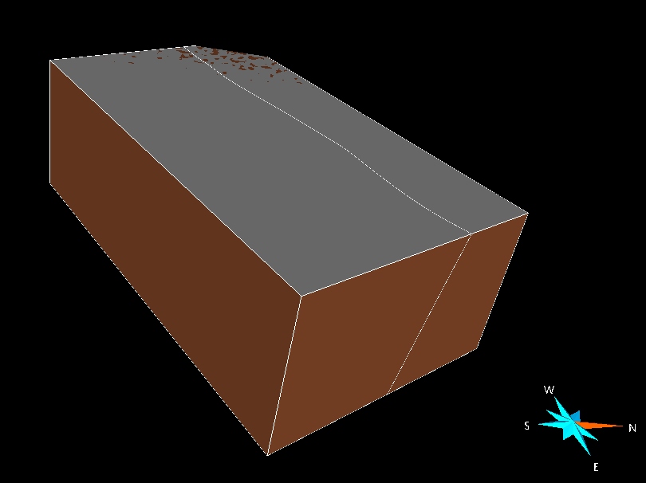
Workflow SnS
3.Build stratigraphic & structural model
5.Build Reservoir grid
1.Input data
2.Define VOI
4.Generate Fault blocks

Slide 26
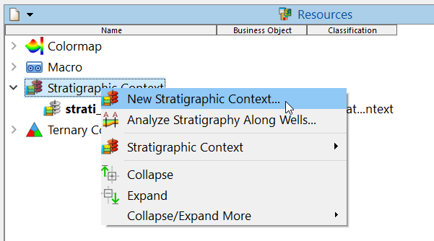
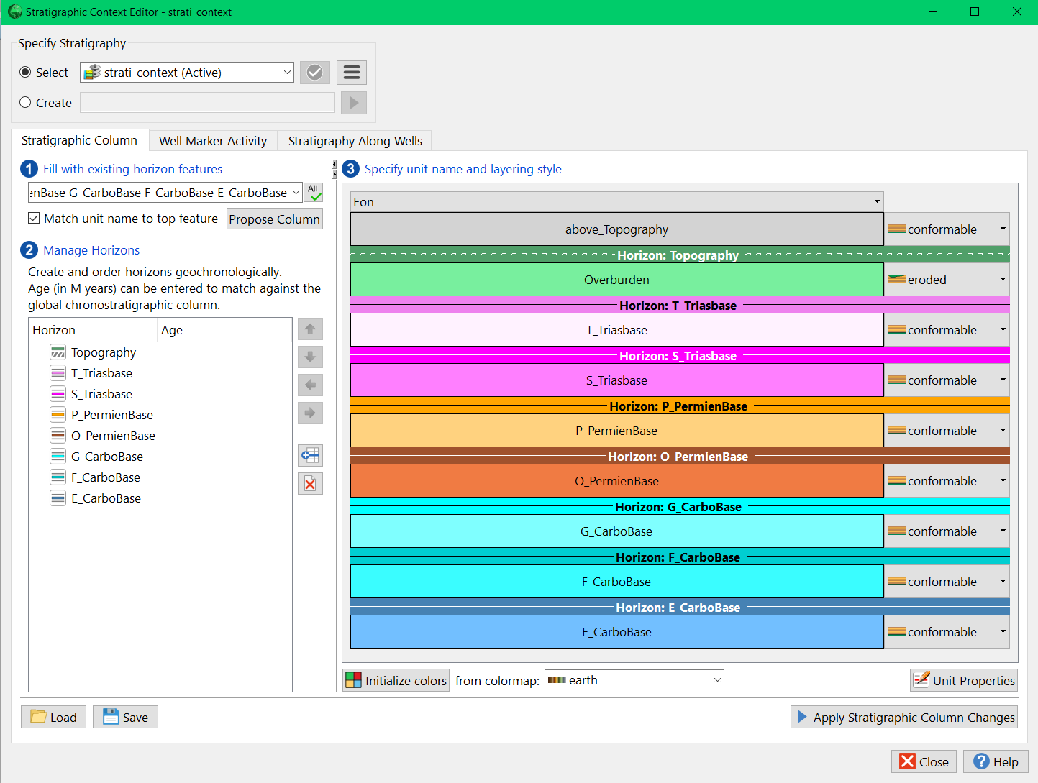
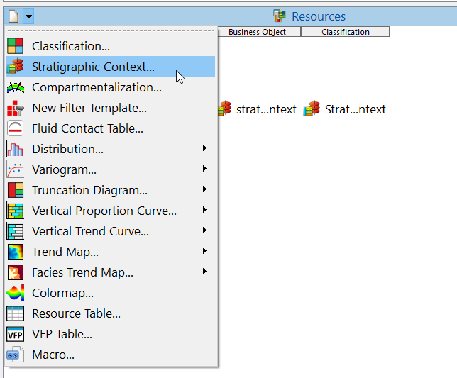
III. Create a stratigraphic column
Create a stratigraphic column: ! Your data must be stored in Features
Or
Aim is to define relationships between your stratigraphic elements

Slide 27
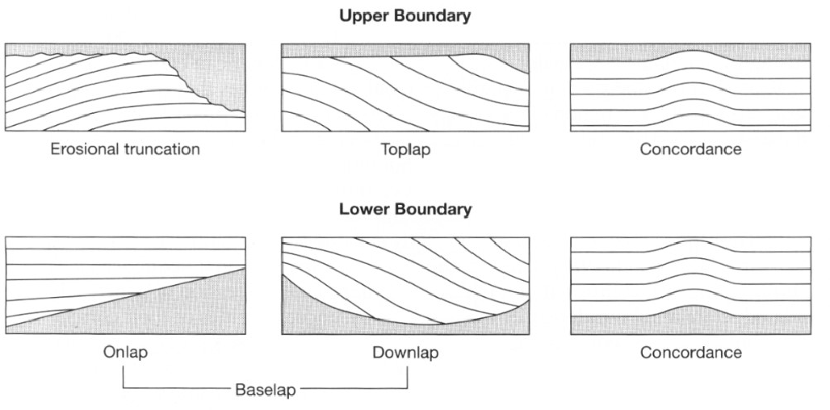
Relationships between Horizons
Conformable
Conformable

Slide 28
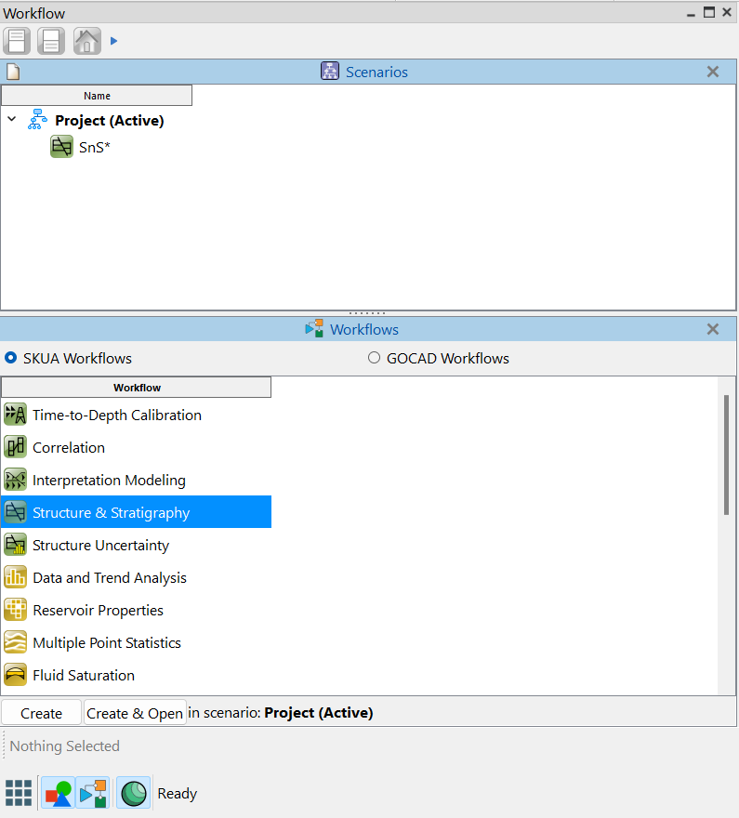
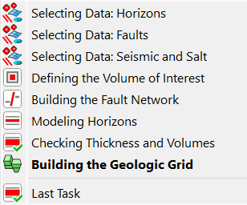
III. Worflow SnS
Open the Structure and stratigraphy workflow
SnS workflow steps

Slide 29
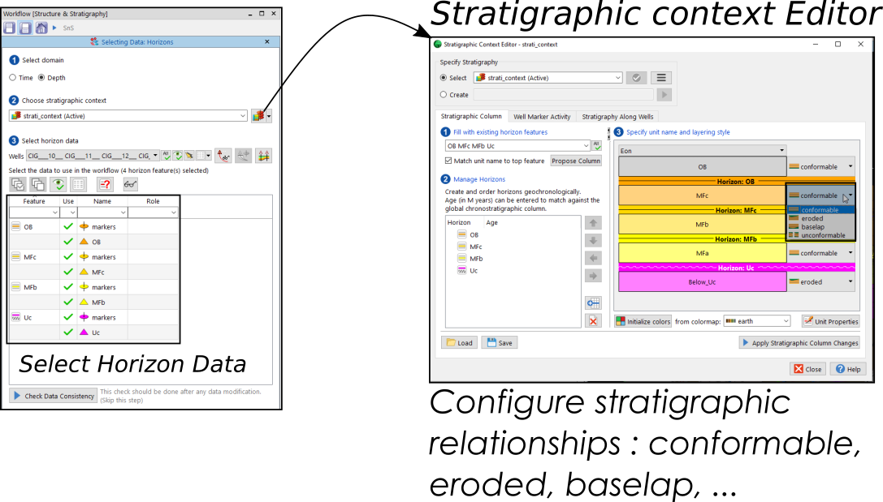
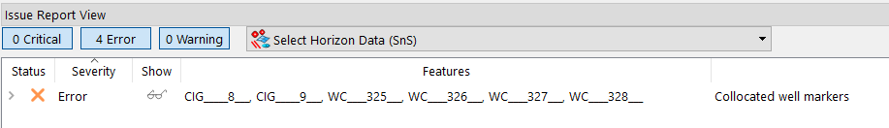
III. Worflow SnS
1.
Select Horizon data (surfaces and/or markers)
Build a Stratigraphic context
Check for unconsistencies

Slide 30


III. Worflow SnS - Exercise
Select horizon data:
Select only the constraints that are used (not the surfaces)

Slide 31

III. Worflow SnS
2. Select Fault Data you want to use
+ define Fault types
3. Define a VOI

Slide 32

III. Worflow SnS - Exercise
2. Select Fault Data you want to use
+ define Fault types
3. Define a VOI

Slide 33

III. Worflow SnS
4. Build Fault Network & Fault Blocks

Slide 34

III. Worflow SnS
Modeling Horizons:
Choose confidence on Well Markers
Choose to ignore data close to Faults

Slide 35


III. Worflow SnS - Exercise
Modeling Horizons:
Choose confidence on Well Markers
Choose to ignore data close to Faults

Slide 36

III. Worflow SnS
Checking volumes of each horizons

Slide 37

III. Worflow SnS - Exercise
Checking volumes of each horizons

Slide 38

III. Worflow SnS
Build the geologic grid: choose what horizons to build, cell size, number of cells, etc.

Slide 39

III. Worflow SnS - Exercise

Slide 40

III. Worflow SnS - Exercise

Slide 41


III. Worflow SnS - Exercise

