Slide 1
Modélisation des gisements miniers
- Mining geomodelling -
TD 2 – Reservoir properties & Ore Body construction
Lou Declercq

Slide 2
Exercise 1
Open « Projet_San_Nicolas_2022.sprj »
Import file « Well_traces_and_logs.csv » as Well Data with Path & Log
Import « Markers.csv » as Well Markers
Try to trace the horizons using explicit methods. Don’t forget to use features
Try to trace the horizons using SnS workflow
Create regions on wells corresponding to « INSIDE » property (0 outside mineralized zone, 1 inside)
Create Rock Classification for Lithology property
Change display of this property
Observe other available data (metals_assays, geochem, properties on SN_CEM) using histograms tools
Trace correlograms of assay elements : what do you observe ?

Slide 3
Exercise 2
Create Region on geochem based on distance to fault La Panza (s.21/22/23)
We want to model Cu_percent property all around the SN_CEM grid using RP (Reservoir properties) workflow.
We want to see the estimated ore body of Cu_percent in previous exercise : it means build an iso-surface of Cu_percent
How do you choose iso-property value(s) ? Compare to the reference body (the surface in Intrusive Boundary Feature)
Try & Compare volumes using different methods (iso-surfaces & use of regions)

Slide 4
Exercise 2
Geophysical Data on SN_CEM :
  - app_resistivity_DSI
  - chargeability_DSI
  - hs_inversion_density
Try to draw isovalues of interest of these data & compare to reference orebody model.

Slide 5
3D Geomodeling applied to mining studies
TD 2 – About Well data

Slide 6
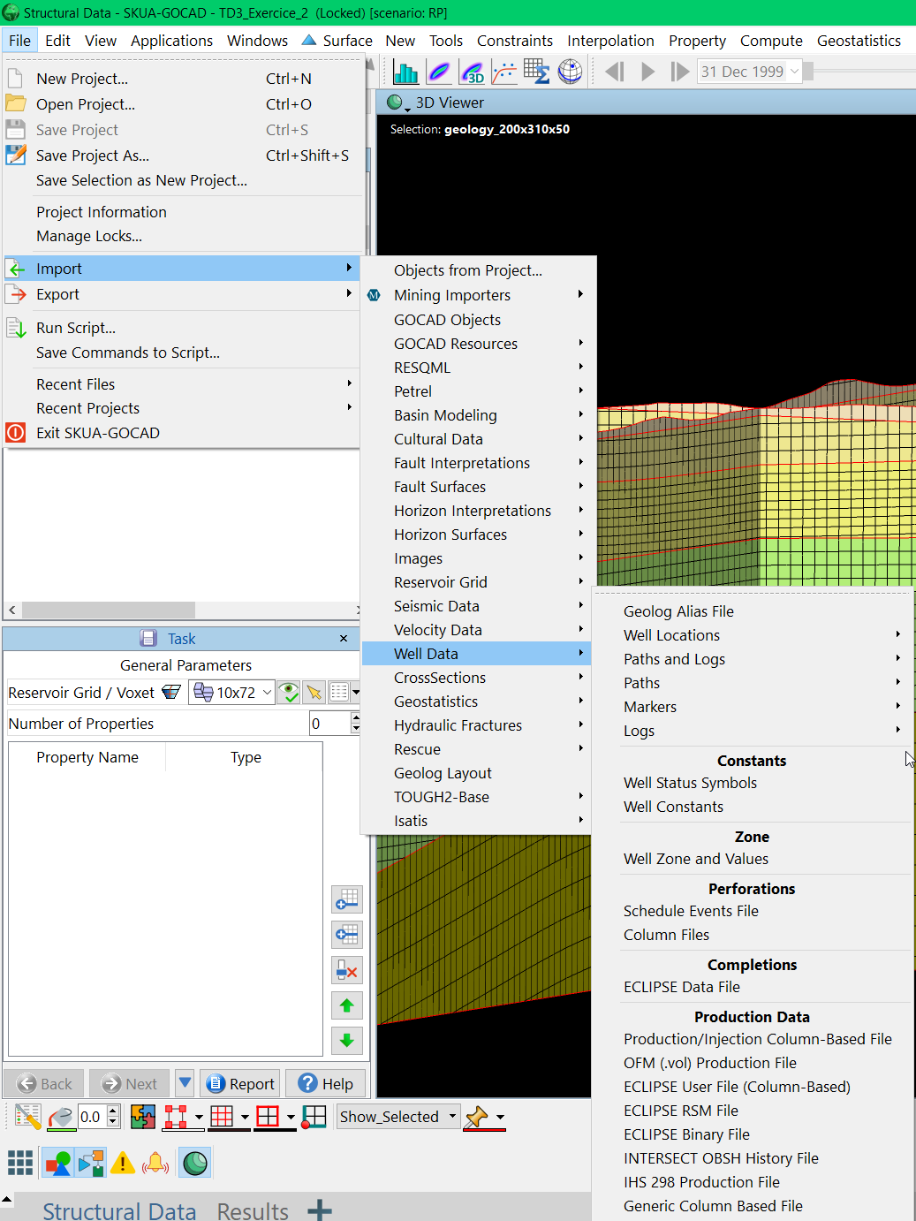
Well data
Well Location: Collars (têtes de forage)
Well Paths: Well traces
(TVDSS: true vertical depth subsea for z)
Well Logs: data stored as well logs ( ex: geochemical data, gamma ray, …)
Well zones: well intervals (ex: lithologies, area of interest, …)
Markers: ponctual elements (horizon contacts, faults…) => might be oriented with dip and azimuth values

Slide 7
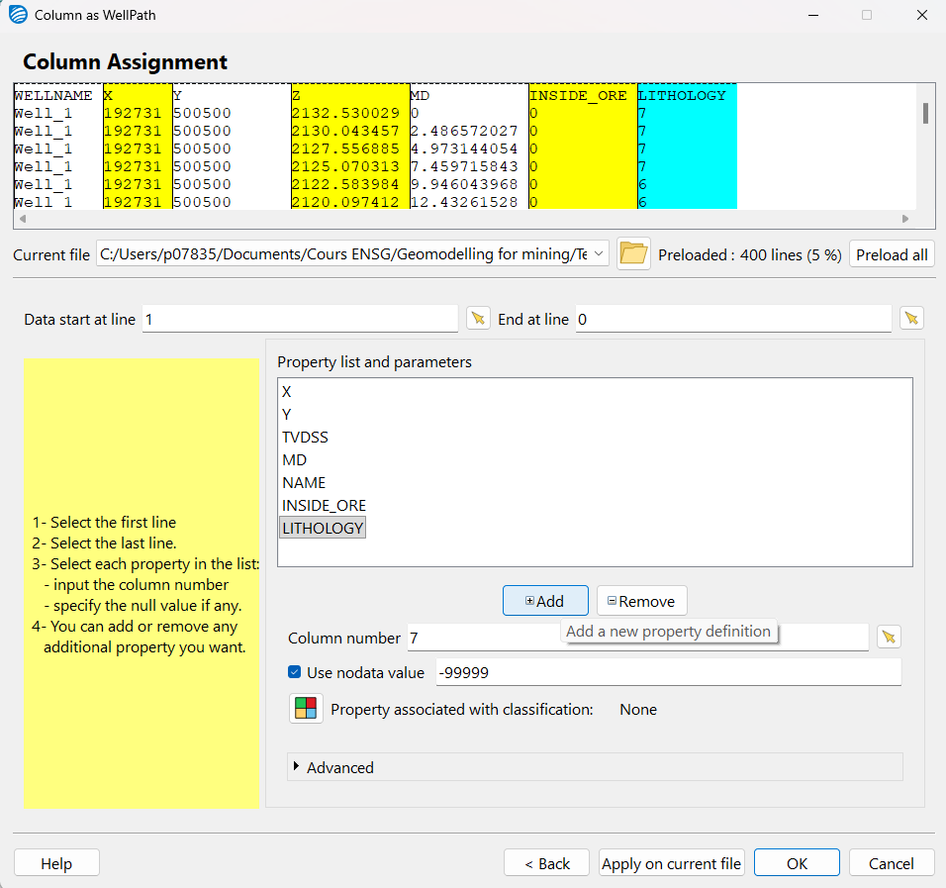
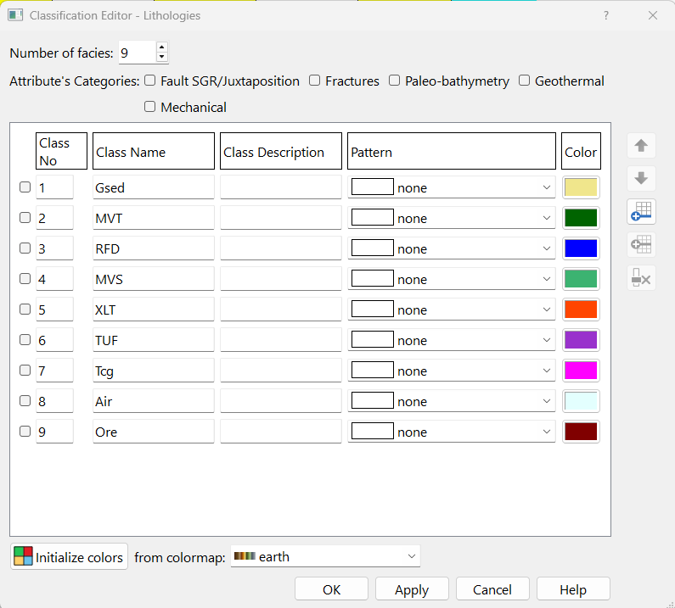
Well data import: Paths and logs

Slide 8
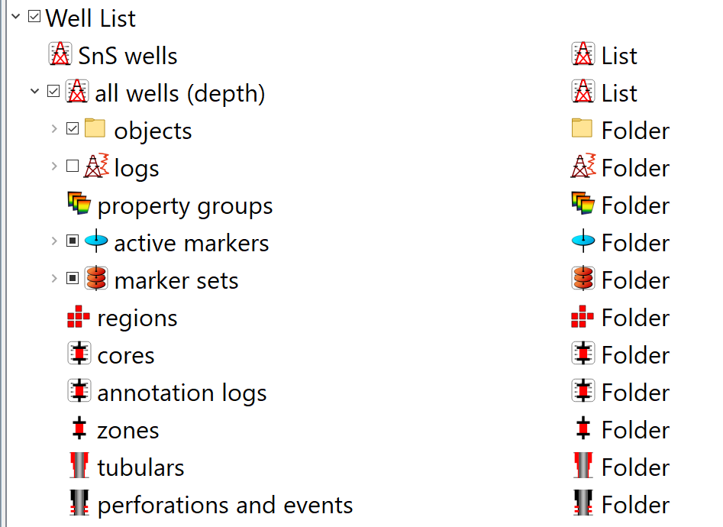
About Well data
Wells in Object Tree
Well Location: Collars (têtes de forage)
Well Paths: Well traces
Well Logs: data stored as well logs ( ex: geochemical data, gamma ray, …)
Well zones: well intervals (ex: lithologies, area of interest, …)
Markers: ponctual elements (horizon contacts, faults…) => might be oriented with dip and azimuth values

Slide 9
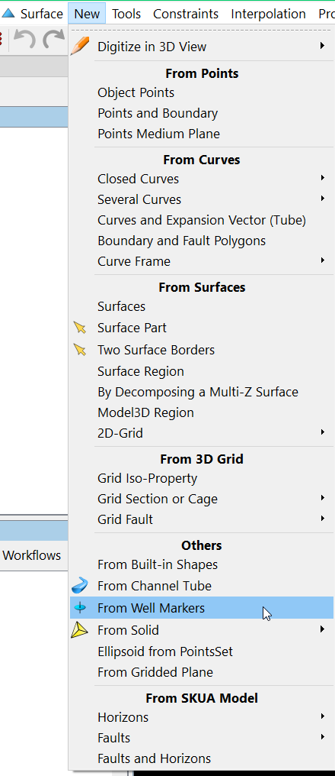
Create horizons from markers
Create coarse surfaces from well markers

Slide 10
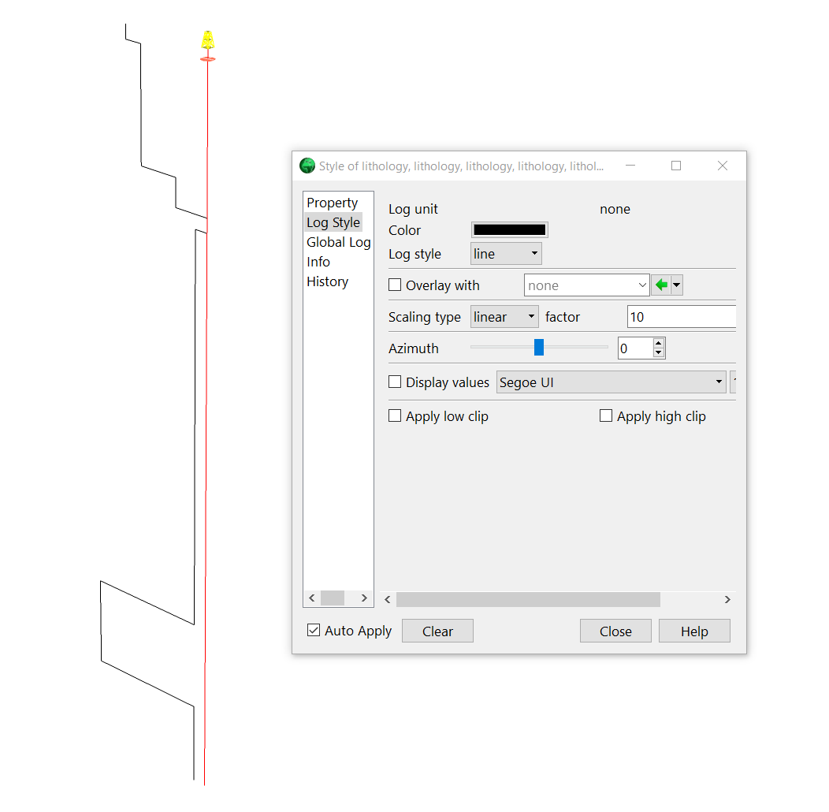
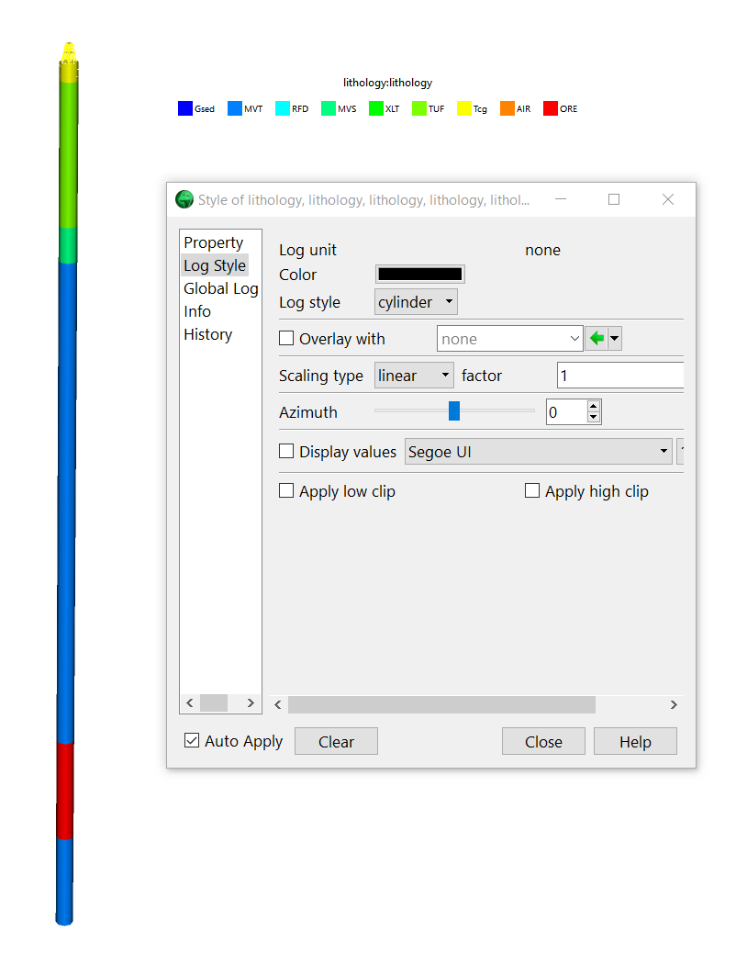
Change Discrete property display in Wells
You can change style of property to better vizualize discrete properties using cylinders
Factor is the size of the displayed data on tracks

Slide 11
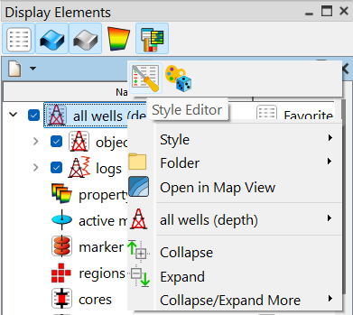
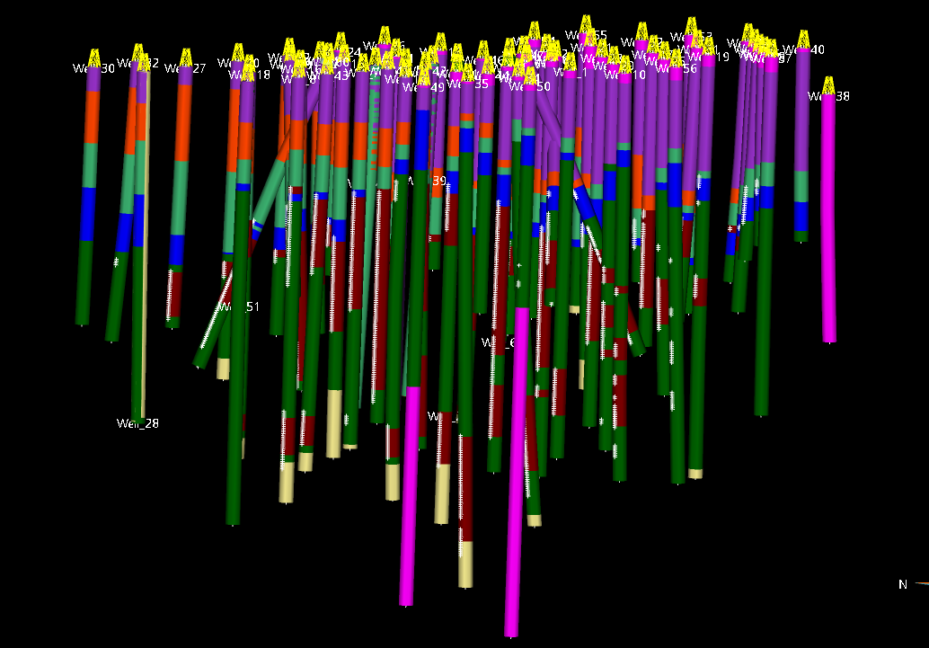
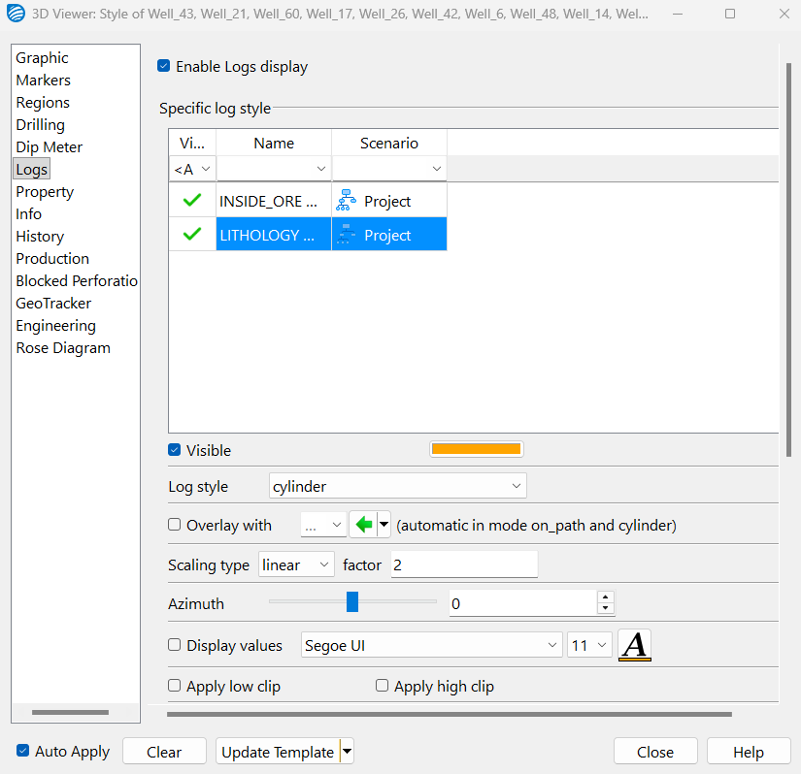
Change Discrete property display in Wells
Right-click > Style editor

Slide 12
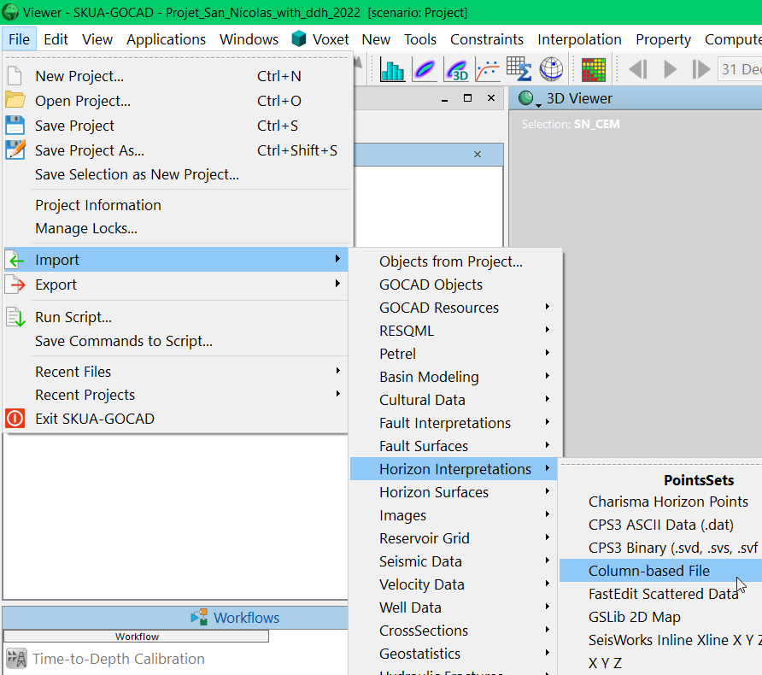
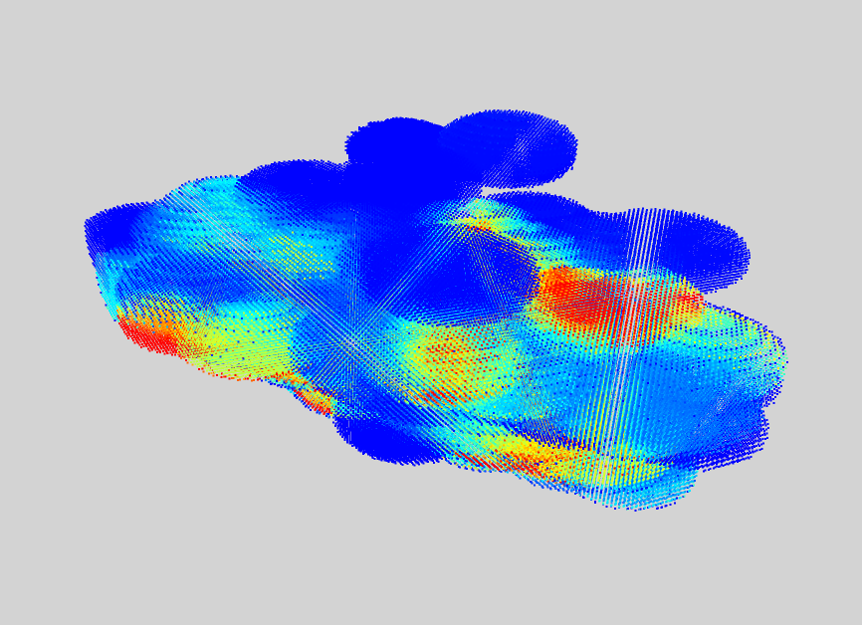
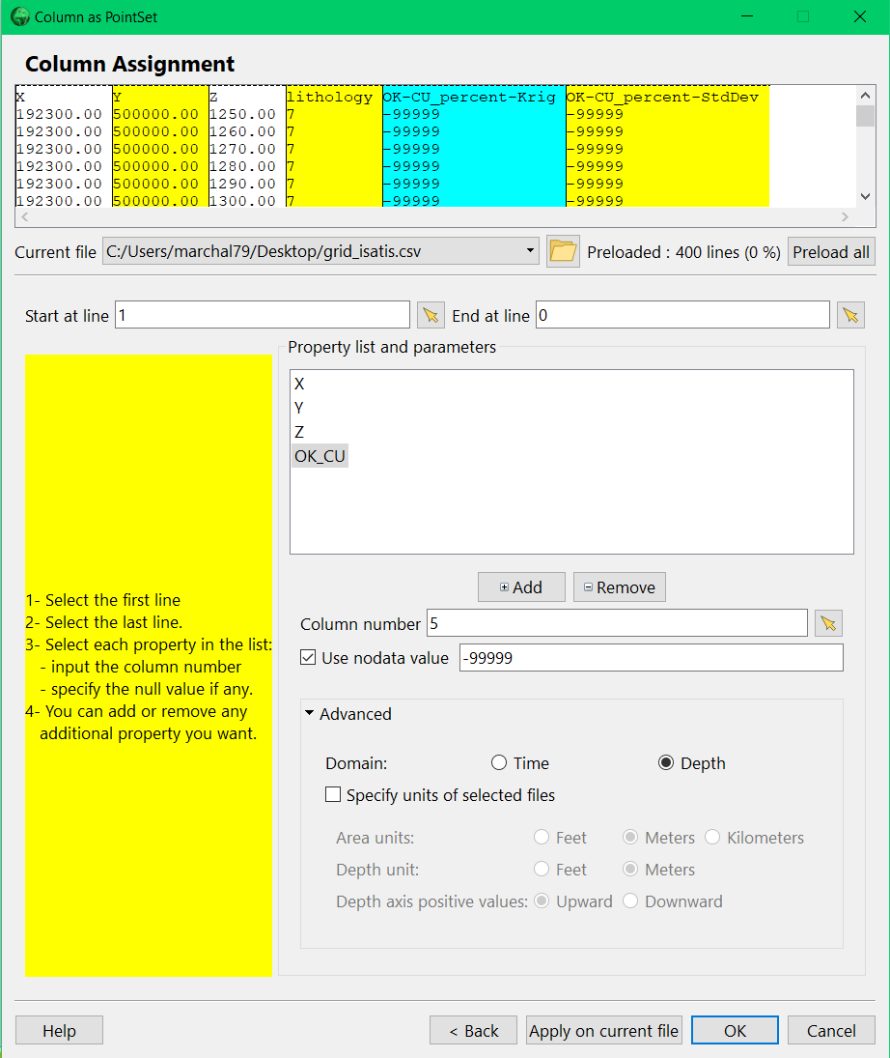
Import Isatis data (without license)

Slide 13
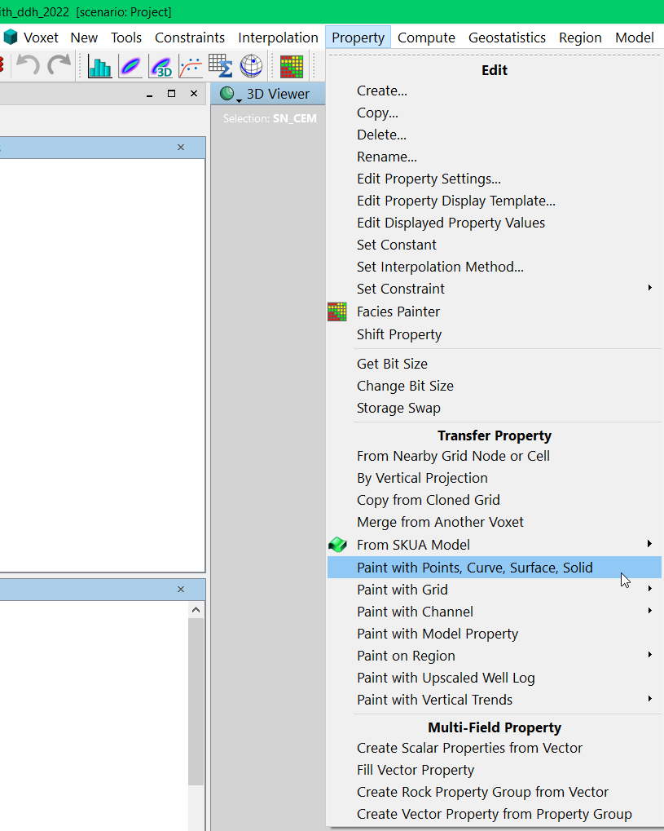
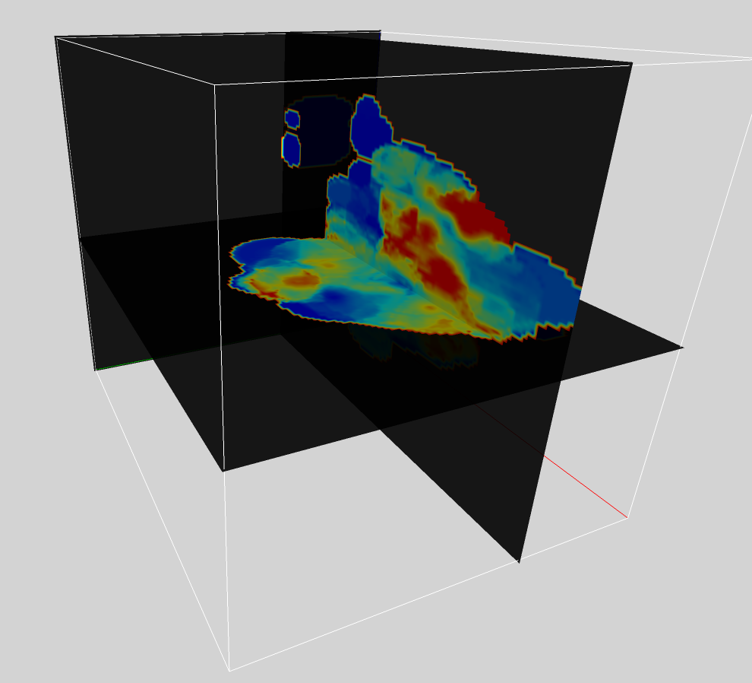
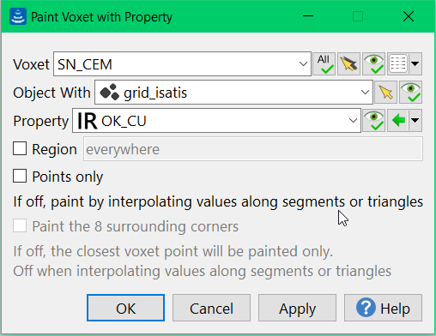
Paint Pointset on Voxet

Slide 14
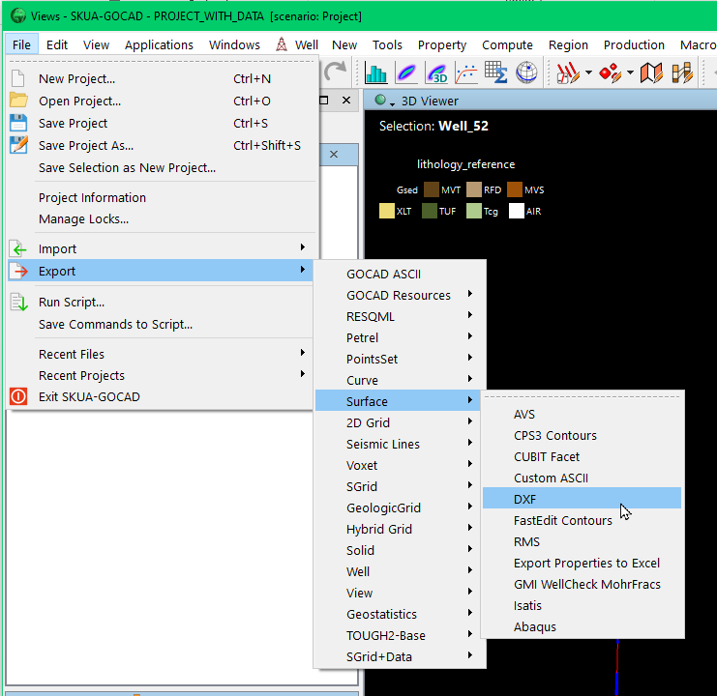
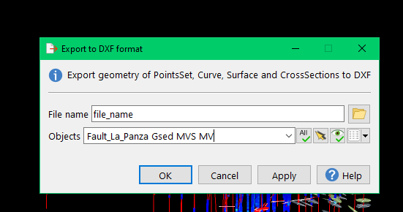
Export surfaces to dxf (to import in isatis)
If you need to save surfaces or to export them for another software

Slide 15
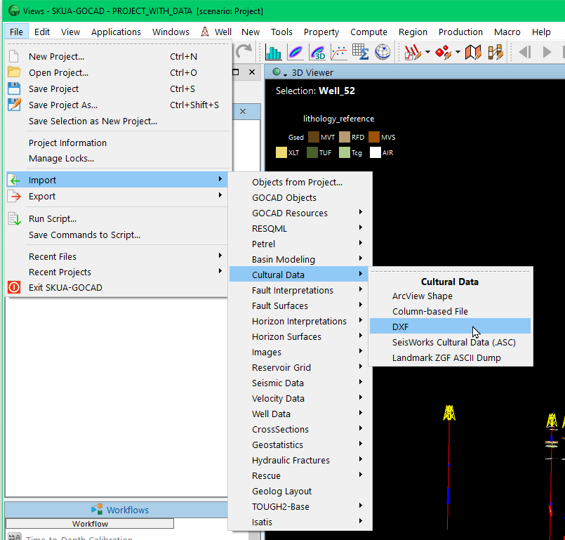
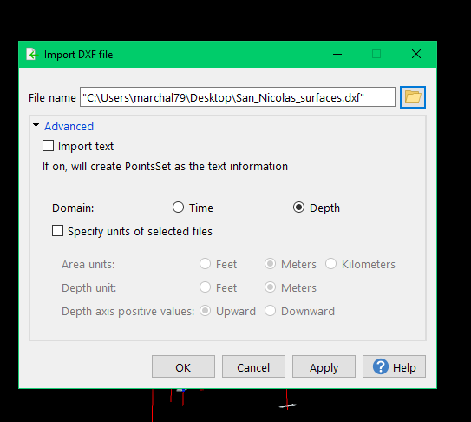
Import surfaces as dxf
If you need to import dxf surfaces into gocad

Slide 16
3D Geomodeling applied to mining studies
About Rock Classifications

Slide 17
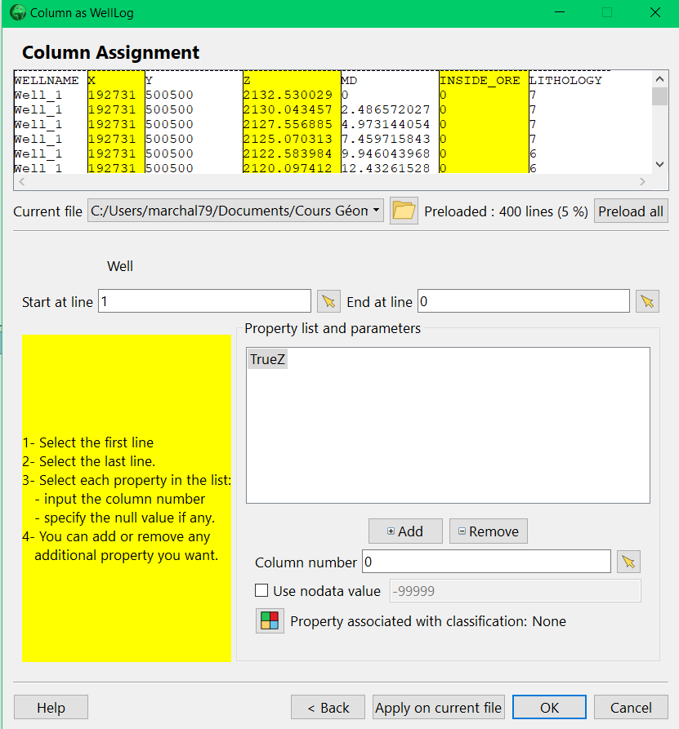
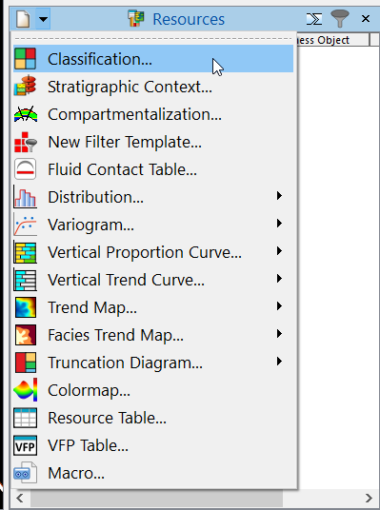
Create a Rock Classification
  You can create a Rock classification directly while importing well log data or via the Resources menu in the Display Element

Slide 18

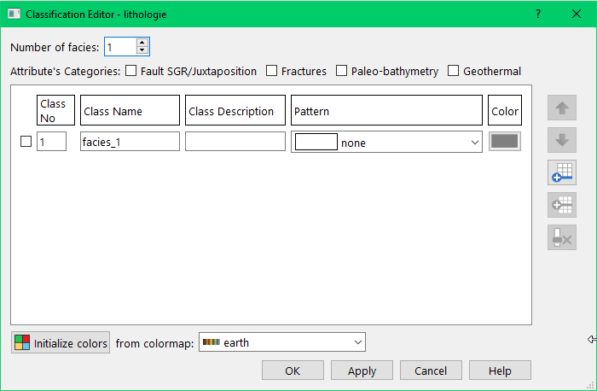
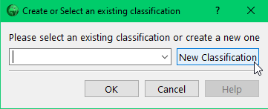
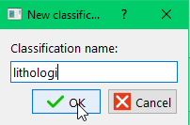
Create « Rock Classification »
Here you can create your facies and assign colors / legends

Slide 19
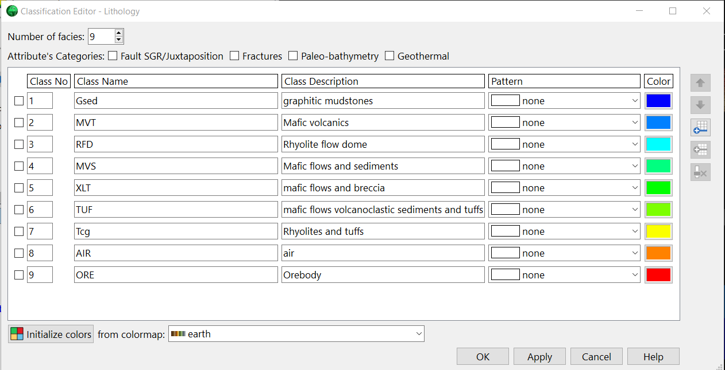
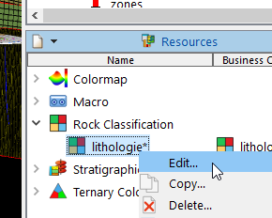
Create Rock Classification
You can edit your classification in Resources menu

Slide 20
3D Geomodeling applied to mining studies
Create Regions

Slide 21
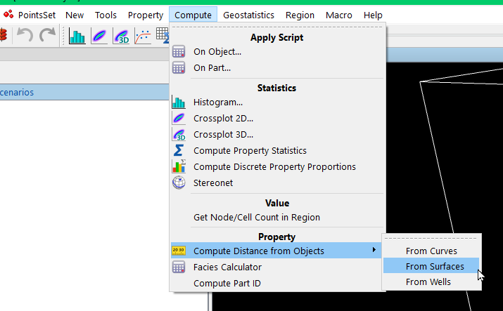
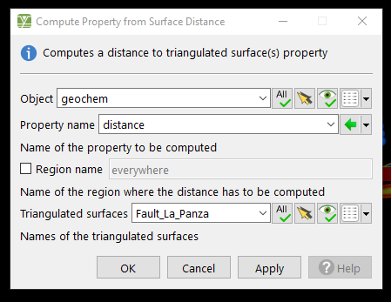
Create Region based on Distance
You can compute distance to an object on another object

Slide 22
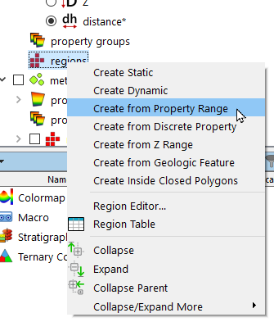
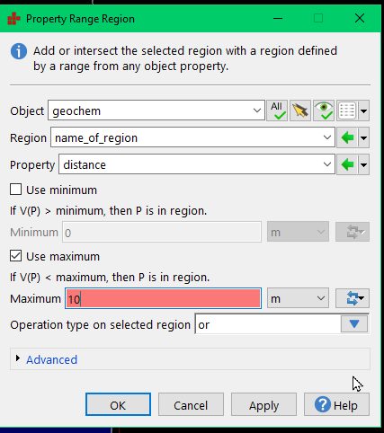
Create Region based on Distance
And then you can create a region from a property value by clicking on the object > region > create from Property Range

Slide 23
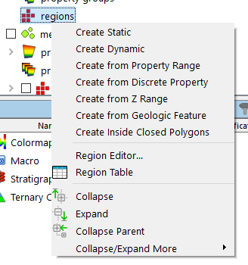
Other Type of region
You can also create region from horizons (geological features), using lines/boundaries (closed polygons), …
Regions in wells > Property range region

Slide 24
3D Geomodeling applied to mining studies
Statistics in SKUA Gocad

Slide 25
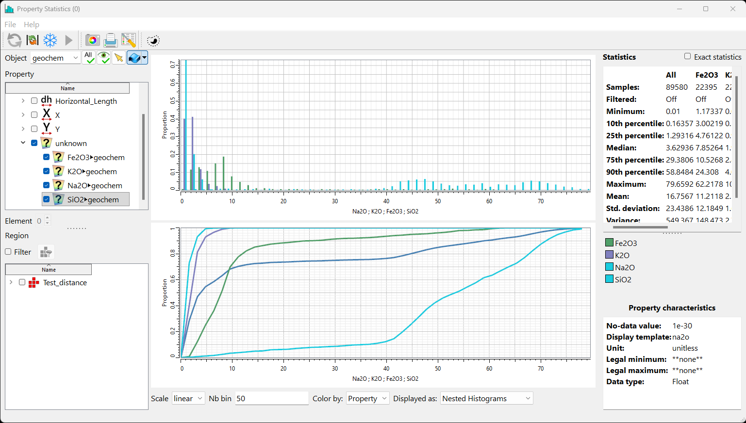
Histograms in Gocad

Slide 26
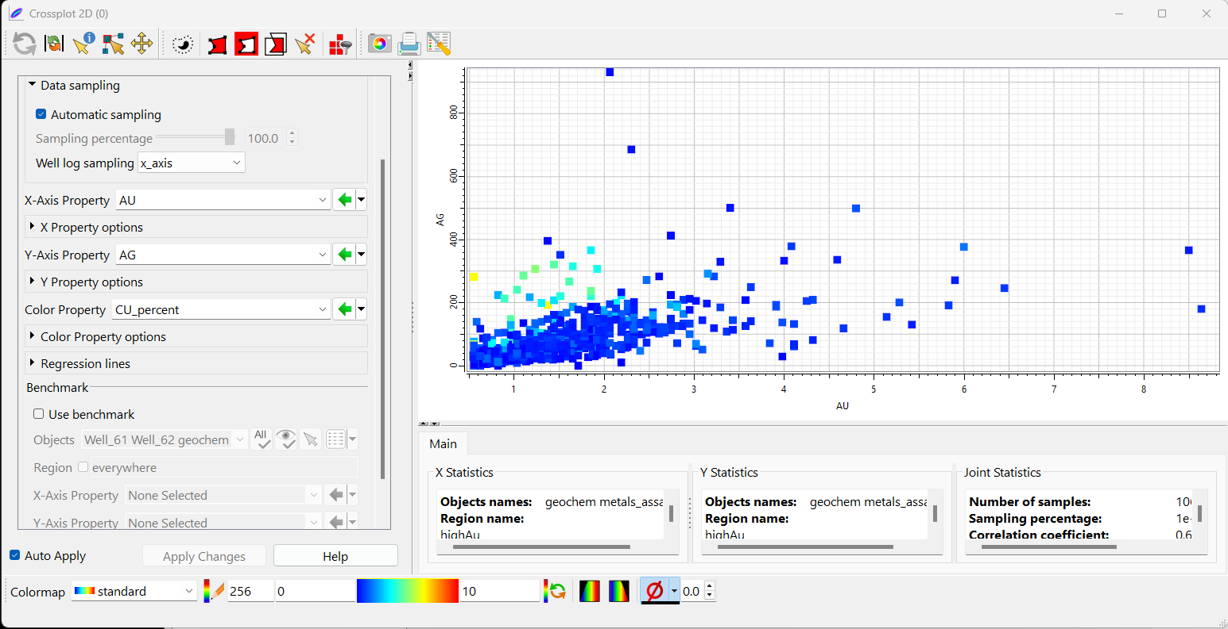
Crossplots in Gocad

Slide 27
3D Geomodeling applied to mining studies
About variograms in SKUA Gocad

Slide 28
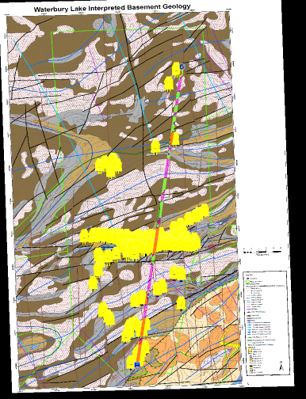
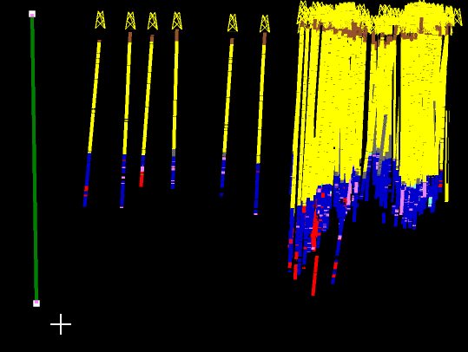
How to choose variogram’s parameters
Minimal spacing between your data points ?
Total extent of your dataset ?
+ ! You might have different resolution for vertical & areal variogramm
38 km
900 m

Slide 29
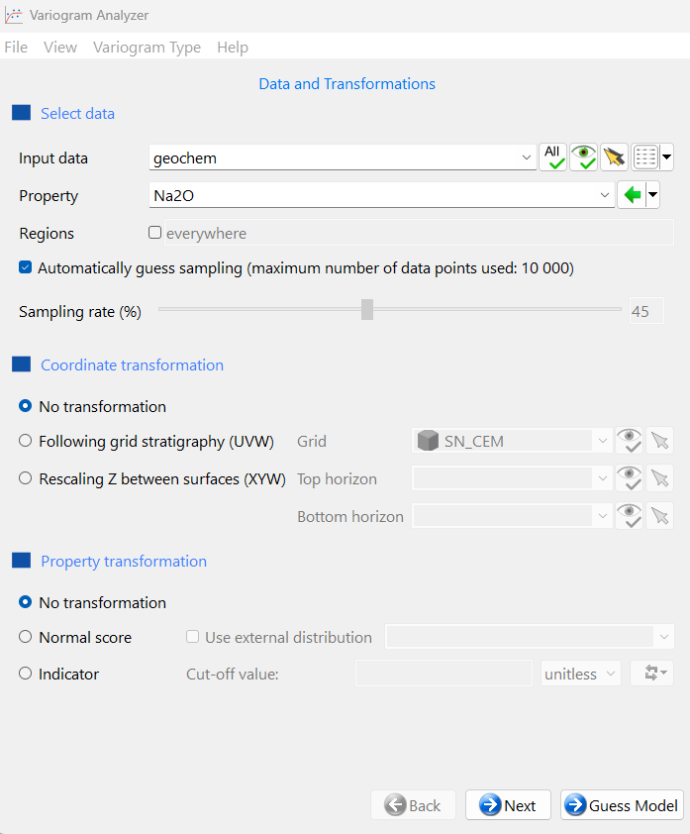
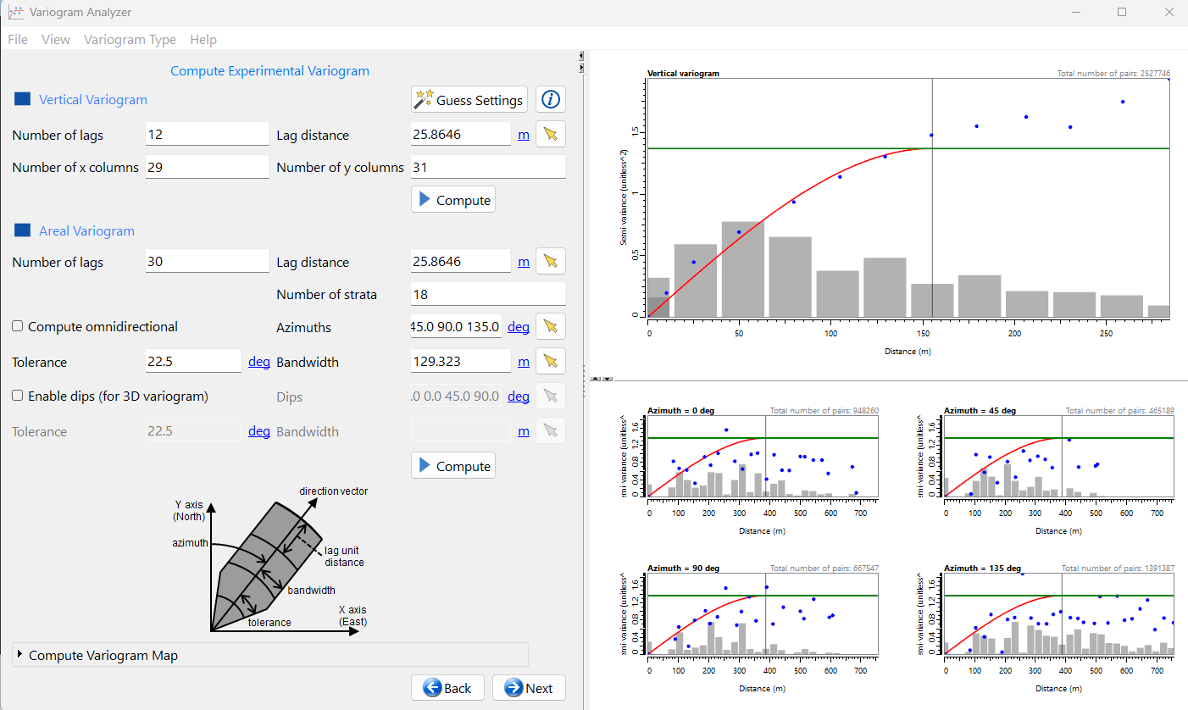
Variograms in Skua Gocad

Slide 30
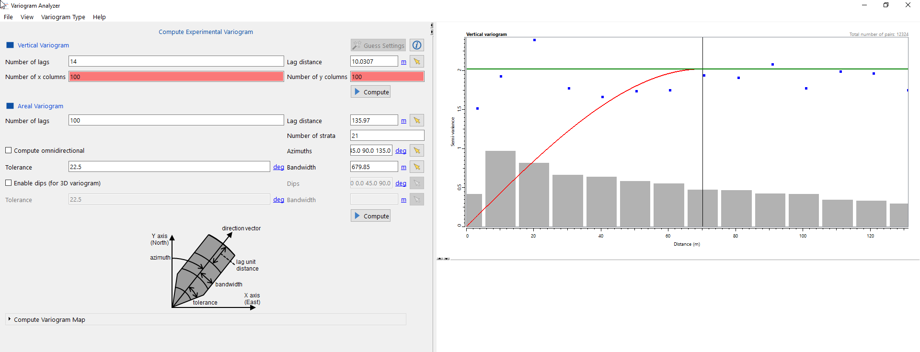
Variogram parameters in Skua Gocad
On Z axis
In XY plan
The distances between pairs at which the variogram is calculated are called lags. (+/- tolerance)

Slide 31
Variogram parameters in Skua Gocad
The distances between pairs at which the variogram is calculated are called lags. (+/- tolerance)
Number of lags: Specifies how many lags of the variogram to calculate.
This, together with the distance between lags, determines the maximum distance between pairs of points at which the variogram is calculated.
This maximum distance is called the variogram coverage.
The variogram coverage should be less than the site size (½ - ¾ )
Distance between lags: The intervals to calculate lags.
A good distance between lags should be no smaller than the shortest distance between data points and should be close to the average spacing of samples.
Nb of X columns & Y columns /Nb of strata: clustering tools

Slide 32
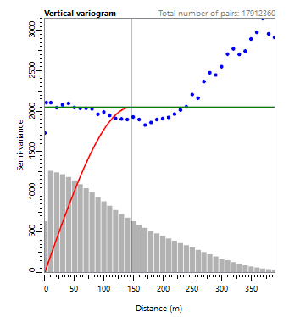
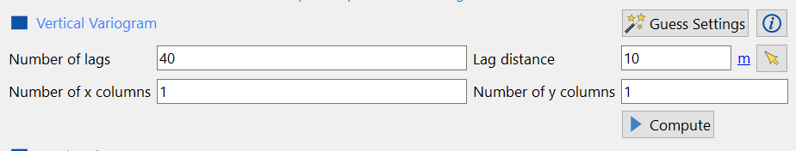
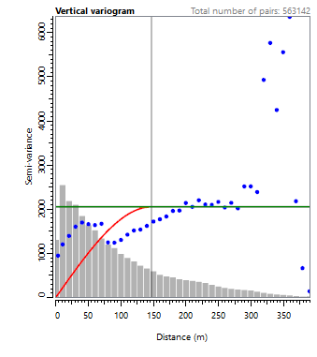
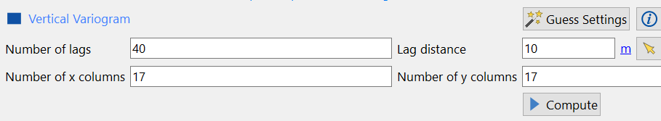
Clustering smooth nugget effect

Slide 33
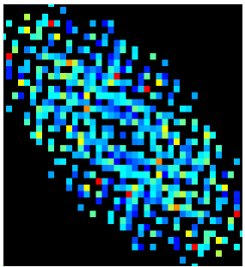
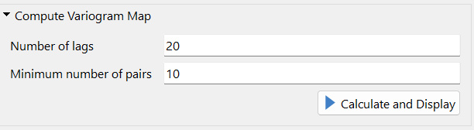
Variogram map
You can also compute variogram maps in the variogram analyzer.
(Better in isatis.neo)

Slide 34
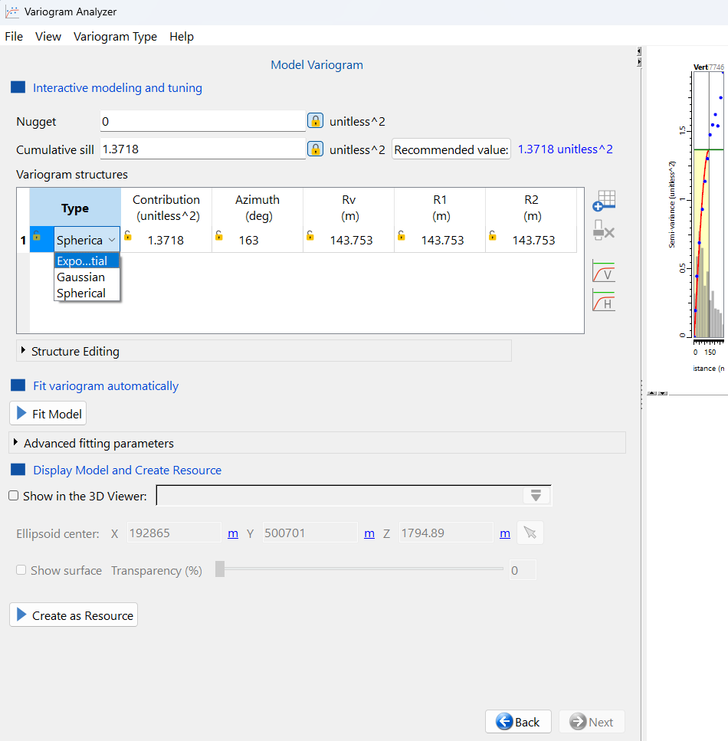
Model variogram and export for later use

Slide 35
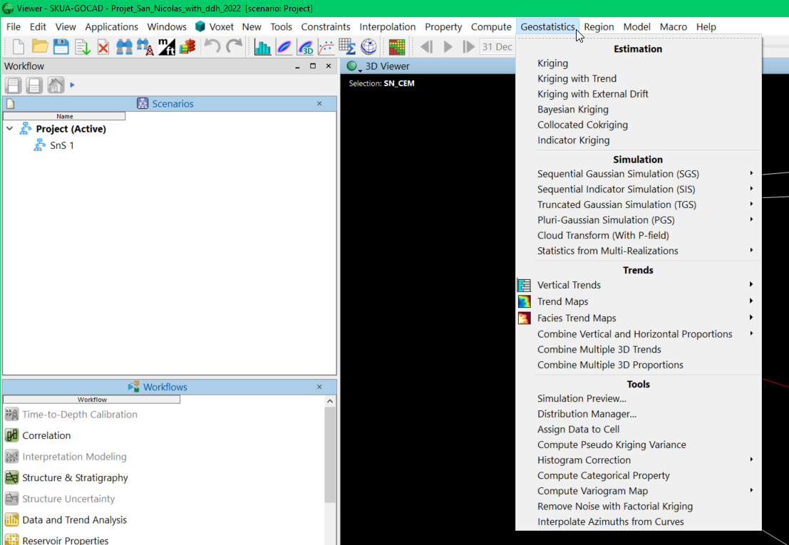
Geostatistics tools
In your object contextual menu you have Geostatisticals tools

Slide 36
3D Geomodeling applied to mining studies
About RP workflow

Slide 37
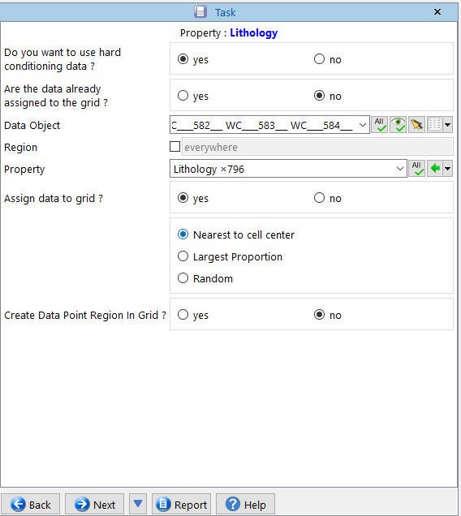
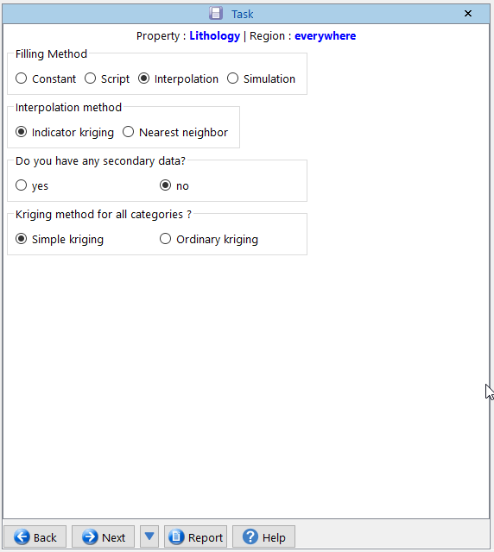
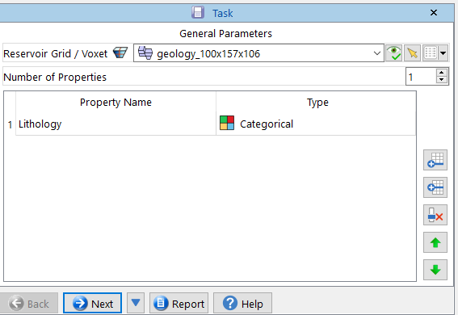
Workflow RP
Be careful to select the petrophysical grid generated at the end of the SnS workflow.
Test the difference between “Nearest to cell center” and “Largest Proportion” on the final results
Indicator kriging = kriging on an “indicator” variable = categorical in this case

Slide 38


Workflow RP
Initialize proportions → from well data

Slide 39


Two possibilities: a single variogram for all lithologies or one variogram per lithology

Slide 40



Workflow RP: choice of filling method
Test other interpolation methods and compare with kriging
Object-based methods → based on the use of geological features with parameters (e.g., meanders with embankments, floodplains, etc.)

Slide 41



Voronoï diagram
Neighboor-based methods
Euclidian Distance
Manhattan Distance

Slide 42



TD 3 : Property Modeling
Properties filling methods
DSI: Discrete Smoothing Interpolation : 3 Dimensional interpolation method
Inverse Distance: interpolation method based on a weight function related to $\frac{1}{d}$
Krigin: interpolation method based on variance minimization
Moving average (moyennes glissante): moving an average calculation window

Slide 43

Simulations vs Estimations
“Kriging provides estimations that model geologic trends specified by variograms. Geostatistical simulations add a random residual to the kriged value at any given point to simulate the uncertainty of that value.” (skua help)
Simulation vs Estimations ?
SGS : Sequential Gaussian Simulation is a commonly used geostatistical method for populating a grid with a Gaussian random field

Slide 44


Crossplot 2D & 3D
Correlograms

Slide 45
3D Geomodeling applied to mining studies
How to compute volumes & trace iso-surfaces

Slide 46




TD4 : Ore Body & Volumes
1. Create an iso-surface from a property in a grid
Property value you want to use to build the surface

Slide 47

TD4 : Ore Body & Volumes
2. Get volume from closed surface

Slide 48



TD4 : Ore Body & Volumes
1.Bis. Create a region from a property range in a grid

