Slide 1
DULASP Intermediate
M1Lire & écrire l’anglais pratique
Mondays 4.00pm-6.00pm claire.soitin@univ-lorraine.fr

Slide 2
Welcome Team!
Dates | Classes
Sept. 15th | W1 Part 1. Press Articles
Sept. 22nd | W2 Part 1. Letters to the Editor
Sept. 29th | W3 Part 1. Cartoons & Ads
Oct. 6th | W4 Recap session
Oct. 13th | W5 Test
Oct. 20st | W6 Part 2. Professional letters
Mid-term break
Nov. 3rd | W7 Part 2. Professional emails
Nov. 10th | W8 Part 2. Forms
Nov. 17th | W9 Recap session
Nov. 24th | W10 Test

Slide 3

Part I. Press Reading & Writing

Slide 4

1.Press Articles

Slide 5

What types of print media
are you most likely to
come across
out there?

Slide 6
Different types of print media
Newspapers:
      Broadsheet vs. Tabloid
      Dailies vs. Weekly papers
Magazines:
      Literary;
      Sports, leisure;
      etc…

Slide 7
Media Mind Map
1. Write down the types of media you read (newspapers, magazines, websites).
2. Then, classify them into categories: tabloid, broadsheet, lifestyle, sports, etc.

Slide 8

Examples

Slide 9





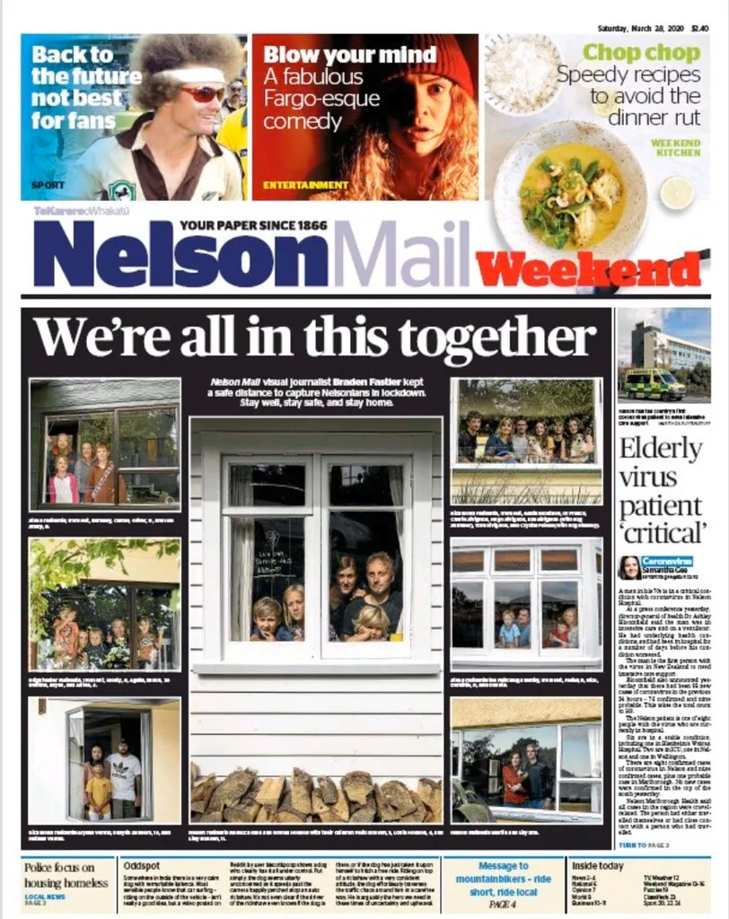




Slide 10






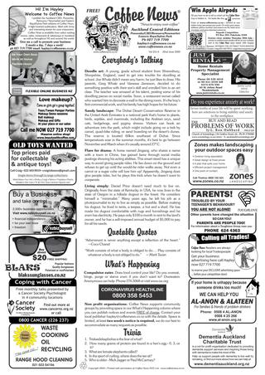



Slide 11
Tabloid vs. Broadsheet
A smaller than standard newspaper which focuses on less "serious" content, especially celebrities, sports, and sensationalist crime stories
A standard or full sized newspaper that takes a serious look at major news stories
Tabloid
Mix fact and emotion
Shorter sentences
Use biased and emotional language
Stories are mixed together
Less complex vocabulary
Focus on famous people, private lives and scandal
Broadsheet
More fact than emotion
Longer sentences
Unbiased and clear language
Divided into clear sections
Complicated Vocabulary
Focus on major national and international events

Slide 12
The biggest difference between the two types of paper is to be found in language
Tabloid
Broadsheet
  Informal
  Use of puns
  Use of alliteration
  Exaggeration for effect
  Colloquial language / slang
  Informal names used
  Short sentences
  Heightened language
  Adjectives often carry sexual overtones
  A focus upon appearance
  Frequent use of elision (e.g. won’t, don’t, …)
  More formal
  Metaphors rather than puns
  Stubtlety
  Formal language
  More complex sentences
  Rhetorical questions
  Descriptions of people tends to relate to personality or position in society
  Statistics

Slide 13

Determining the Readership?

Slide 14
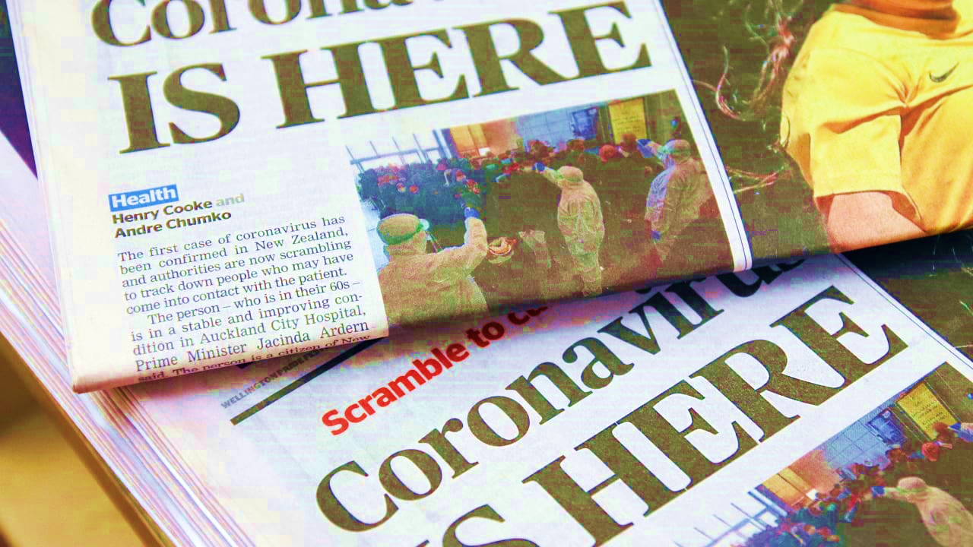

Slide 15
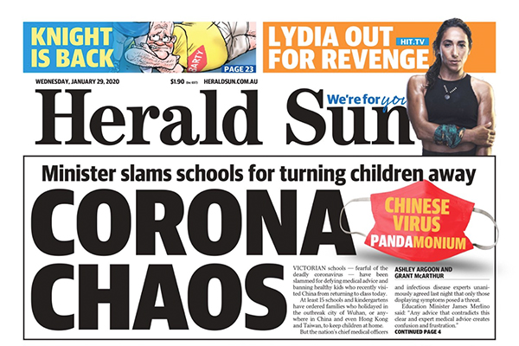

Slide 16
Over to you…

Slide 17
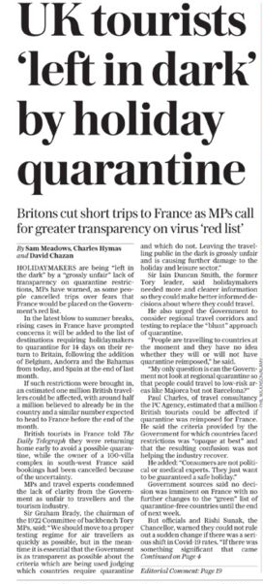
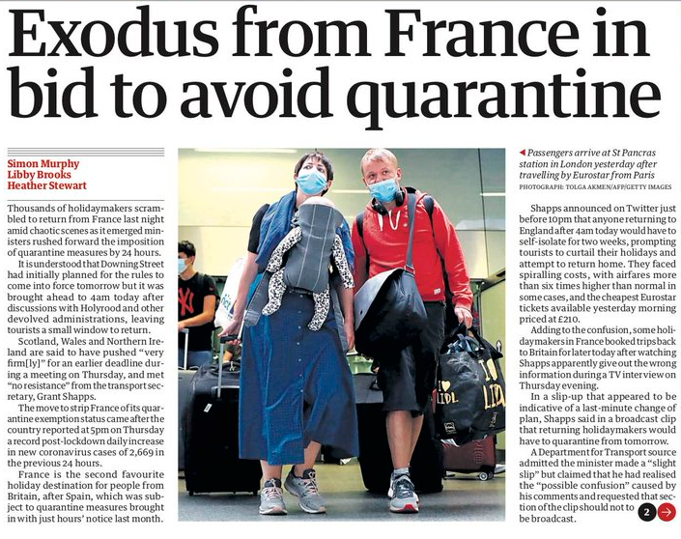


Slide 18
I.i. Writing a Headline
When writing a headline, the most important thing is to make sure it is clear and can be read and understood in a single glance.
The trick is to interest, intrigue and give a real sense of the story to the widest possible audience - without being sensational. Headlines are often short, active sentences, such as the improbable old journalistic favourite: MAN BITES DOG
Headlines can be creative with witty references and wordplay. Alliteration can also be used.

Slide 19
Tabloid or Broadsheet?
  Instructions: Below are short headlines or phrases.
  Work in pairs to decide if each belongs to a TABLOID or a BROADSHEET. Write T or B next to each one.
1. PM faces pressure as inflation hits 6% ______
2. Love Island star in shocking secret reveal! ______
3. New rail strike to affect millions ______
4. Govt. announces tax hike of 3.5% ______
5. Footie hero in love scandal ______
6. Survey shows 62% of teens use TikTok daily ______
7. OMG! You won’t believe what she wore ______
8. Mayor under fire for corruption allegations ______

Slide 20
Writing Headlines
Instructions:
  Read the neutral story below.
  Then write TWO headlines: one in tabloid style and one in broadsheet style.
Neutral Story:
A new public park opened in the center of town today. The mayor attended the opening ceremony. The park has a playground, a fountain, and walking paths.
Tabloid Headline: ___________________________
Broadsheet Headline: ___________________________

Slide 21

I.ii. Writing an Introduction
Writing an intro
  News journalists call the first sentence of a story the ‘intro’, or introduction. The first sentence should summarise the story ‘in a nutshell’ and cover key information.
  At least three of the six classic questions (5 Ws and 1 H) - Who, What, Where, When, Why and How – should be answered in the intro.
  Intros should attract the reader’s attention. News reporters don’t try to build suspense - they do the opposite and give it all away in the first sentence. It can almost seem like starting at the end of the story, rather than the beginning.

Slide 22
Over to you
Based on the same imaginary situation or event:
Task 1: Write the headline and the introduction of a Tabloid style article
Task 2: Write the headline and the introduction of a Broadsheet style article
Bonus: You are most welcome to give it a go, keep on writing and
come up with the whole articles (intro – body – conclusion) ☺

Slide 23
Ready to take up the challenge? ☺

Slide 24
THE BIGEST FAIL OF TESLA!
The CyberTruck was present at the tesla event of Los Angeles by Elon MUSK, during this event they wanted to demonstrate how strong was the bullets proof windows, But unfortunately during the show the windows breaks when they throw metal ball on it. The CyberTruck with the windows not really bullet proof will be sold at $40.000.
Tesla Cybertruck Unveiling Event.
Tesla CEO Elon Musk unveiled the company’s first electric pickup the CyberTruck at an event in Los Angeles, California. During this event he presented the new vehicle and its specifications, he also demonstrated the resistance of the bodywork and the windows. The Cybertruck will start at $ 39,900 up to $ 69,900 with all options.

Slide 25
The third most powerful explosion in the world
On Tuesday, 4 August 2020, a massive explosion happened in Beirut. That explosion was caused by a large amount of nitrate d’ammonium. That substance where at the port of the city of Beirut. That explosion was so strong that destroyed the city of Beirut, causing at least 300 deaths and more than 200000 people homeless.
The explosion made a big earthquake that destroyed a lot of houses and shops, and left the people homeless and unemployed. The houses where damaged from inside out. The glasses and the doors were destroyed. A lot of people died and all the hospitals where full of injured people. The street was completely destroyed there was no car or motorcycle that survived. The Lebanese people want to know if the explosion was by accident or not, and still for now, they didn’t have a response.
A big explosion happened in Beirut that destroyed everything. Will the Lebanese people forget what happened to their city, or will they revolt to know if that explosion was intentional? That question will be answered in time.
Boommm, explosion in beirut
The beautiful city, Beirut, was destroyed do to the explosion at the port of Beirut. A substance named nitrate d’ammonium did that explosion. Those little powder of substance were the cause of that explosion.
The amazing streets of Beirut full of life, are now a streets of zombies. No one knows how, or when will it be renewed. The streets are now a river of blood. A lot of families died along with friends and loved ones. The houses were completely destroyed, even the houses of the rich people like singers and actress. Even, miss Lebanon was injured; her beautiful face was bleeding because of the smashing glass. Those beautiful and innocent kids were terrified and they were crying for losing their parents. All the Lebanese people are angry at the government for letting a lot of that destructive substance near Beirut.
A beautiful city, Beirut, was destroyed. The Lebanese people should start a revolution and they should punish the responsible. Will they succeed on knowing who was the responsible? The time will tell.

Slide 26
Investigation launched on the suspicious rape of a 4 year old girl in Belgium
The event giving way to a suspicious rape on a 4 year old girl induced an opening investigation administration to explain the presence of blood in the panties of the 4 years girl at school. Could it be possible that the little girl has been sexually assaulted the enclosure? A lot of questions have been debated, expanded rumors, false beliefs and social networks.
On that day, a mother takes her infant at primary school in the afternoon and once arrived at home she noticed that her child has blood in her underwear. Worried that her daughter have been sexually assaulted, she decided to return at school to report the facts. The school administration receive the information from the daughter‘s mother and decide to take immediately the child to the hospital and the procedure of investigation has been opened.
According to the researches made by the press and the medical examination by researchers, justice announced that the little girl was not raped. She was may be excised and suffer for infection.
Rape of the 4 year old little girl at school in Belgium
Brussels police have opened an investigation into the rape of 4 year old girl. After picked up his daughter at school in the afternoon, this mother noticed blood in her infant’s underwear and returned immediately to the school. What happened exactly to the girl? How is it possible that it happened?
These facts alerted the school. Schools and municipals authorities decided to send a little girl for examination to the hospital in order to know exactly what’s going wrong. But the parents decided to file a complaint and a series of investigation orders were opened on the next day. The policies and some monitors were deployed to the school. A group of hysteria people caused damages at school, stood up to ask an administration investigation to know how the children spend her day.
According to the source close the investigation; the media conclude that the girl was not rape. But some don’t believe it and just want the closure of school.

Slide 27


Slide 28

2. Letters to the editor

Slide 29

WHAT IS A LETTER TO THE EDITOR?
WHY OR WHEN SHOULD YOU WRITE ONE?

Slide 30

      written way of talking to a newspaper, magazine, or other regularly printed publication;
      generally found in the first section of the newspaper, or towards the beginning of a magazine, or in the editorial page;
      They can take:
      a position for or against an issue,
      inform, or both
      Influence or convince readers by using facts, or emotions
      Usually short and tight, rarely longer than 200 words or so.

Slide 31

Short (max ~200 words)
public
persuasive,
opinion-based,
max ~200 words.

Slide 32
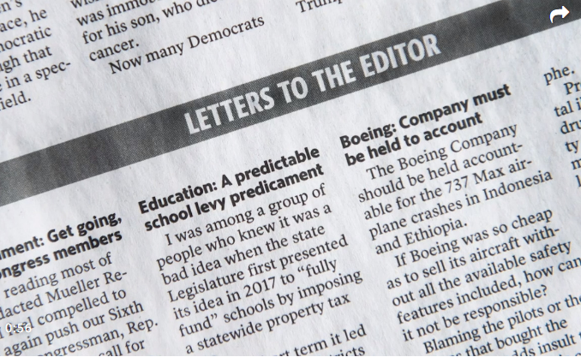

Slide 33
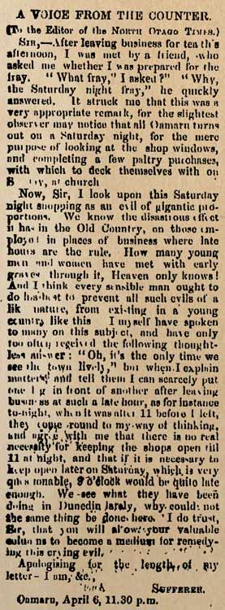
5 Responses
Agreement/disagreement with the ideas in the text.
Reaction to how the ideas in the text relate to your own experience.
Reaction to how ideas in the text relate to other things you've read.
Your analysis of the author and audience.
Your evaluation of how this text tries to convince the reader and whether it is effective.

Slide 34

How to write a Letter to the Editor
OPEN THE LETTER WITH A SIMPLE SALUTATION: if you don't know the editor's name, a simple "To the Editor of the Daily Sun," or just “To the Editor:” is sufficient. If you have the editor's name, however, you should use it to increase the possibilities of your letter being read.
GRAB THE READER'S ATTENTION: your opening sentence is very important. It should tell readers what you’re writing about, and make them want to read more.
EXPLAIN WHAT THE LETTER IS ABOUT AT THE START.
EXPLAIN WHY THE ISSUE IS IMPORTANT.
EVIDENCE FOR ANY PRAISE OR CRITICISM.
STATE YOUR OPINION ABOUT WHAT SHOULD BE DONE.
KEEP IT BRIEF: Generally, shorter letters have a better chance of being published
SIGN THE LETTER: Be sure to write your full name (and title, if relevant) and to include your address, phone number, and e-mail address. Newspapers won't print anonymous letters
PROOFREAD YOUR LETTER and make sure it goes straight to the point right until the end.
A newspaper may not print every letter it receives, but clear, well-written letters are likely to be given more serious consideration.

Slide 35
Writing Your Response
You can agree with the article and explain two or more why you agree.
You can disagree with the article and explain two or more reasons why.
You can agree with some parts of the article and disagree with other parts and explain why.
You can analyze the rhetorical situation (occasion, purpose, audience, and context) of this article and explain why the author’s personal experience causes them to write this piece.
You can take one part of the essay, agreeing or disagreeing with it, and expand on that idea, giving reasons for your reader to agree with you.
You can explain your reaction to the article and then analyze how the writer’s style, tone, word choice, and examples made you feel that way.
Tip: Remember that all essays have three main parts: introduction, body, and conclusion.

Slide 36
Warm up: Sharing your opinion
Ban TikTok for teenagers?
Should the libraries be open later at night?
Should the city build more bike lanes?
Should pets be allowed in restaurants?
Is school uniform a good idea?

Slide 37
No A/C for Olympic athletes in Paris? Good intention, but bad idea
Wally Skalij / Los Angeles Times
July 27, 2024 3 AM PT
The organizers of the Paris Olympics, which began Friday, have done a lot of things right in their efforts to make the 2024 Summer Games the greenest in history.
They are using mostly existing stadiums and sports venues instead of building new ones, locating them as close as possible to the Olympic village to cut travel miles. They’re taking measures to cut food waste and single-use plastics and to offer local, plant-based food to slash the Games’ carbon footprint.
One thing they got wrong, though, was expecting athletes to go without air conditioning in their rooms.
Instead of installing A/C to keep housing safe and comfortable for thousands of athletes staying in the Olympic village, organizers planned to rely on a geothermal system that pipes in cool water underneath the floors. But their assurances that the system was capable of keeping indoor temperatures about 11 degrees cooler than outdoors did not inspire much confidence during a year that’s on track to be the hottest on record.
The plan prompted concerns from many countries — including the United States — that runners, gymnasts, swimmers and other athletes in the biggest competition of their lives would not get the rest and recovery they need to perform their best as temperatures reach the upper 80s and 90s. As Matt Carroll with the Australian Olympic Committee put it last year, “We’re not going for a picnic.”
It’s hard to think of anything more important than fighting climate change, and conservation has an important role in that battle. But organizers’ insistence on a A/C-free Olympics was unnecessarily austere and shortsighted — a case of good intentions gone too far. And it’s an odd position, given that France has a pretty low-carbon electrical grid due to most of its power coming from nuclear as well as experience with devastating heat waves, such as the ones that killed 5,000 people last summer and in 2003.
In the lead-up to the Games, French officials were uncompromising in their view that A/C would be unnecessary and unacceptable because of the impact of energy consumption on the climate. “I have a lot of respect for the comfort of athletes, but I think a lot more about the survival of humanity,” Paris Mayor Anne Hidalgo told a French radio station last year.

Slide 38
Given the high temperatures expected in July and August, the U.S., Canada, Australia, Japan and a number of other wealthy countries decided to provide portable air conditioners for their athletes. That raised questions of fairness, because poorer countries may not be able to afford air conditioners, and their athletes could be at a disadvantage from sleeping in higher temperatures.
In the end, organizers’ plans to save energy by not providing A/C evaporated with a compromise that allowed teams to order thousands of A/C units and bring them into the Olympic village at their own expense. Let’s hope they will sleep easier and be able to recuperate properly.
Lack of A/C is not the only environmentally related concern that’s been raised about Olympic competitors’ comfort and safety. Still unanswered is whether the polluted Seine River will be safe for athletes to swim in. And many athletes are unhappy about the return of those recyclable cardboard beds that were used in Tokyo.
Europe has vastly different views on air conditioning than the U.S. Few French homes are outfitted with A/C and France has in recent years tried to crack down on overuse of A/C, including fines aimed at getting air-conditioned shops to keep their doors closed to keep the cooled air from escaping. It’s a huge contrast with the U.S. where offices, malls and movie theaters are often blasted by frigid levels of A/C. That’s not something for the whole world to aspire to either.
Still, there’s the alarming reality of how much the climate has changed. Annual temperatures in Paris have increased more than 3 degrees since it last hosted the Olympics in 1924, according to a report a group of climate scientists and athletes released before the Games that warned about the dangers extreme heat poses to competitors.
Confronting a crisis like climate change means doing many things at once, such as helping people cope with extreme heat while reducing the fossil fuel consumption that’s causing global warming. But you can’t ignore one in pursuit of the other.
We hope future Olympics, including the 2028 Summer Games in Los Angeles, find the right balance by expanding on Paris’ commitment to sustainability and climate action but not becoming so doctrinaire that the efforts backfire.
Rather than taking small symbolic actions, such as denying athletes appropriate accommodations, host nations should use the global spotlight to make big and lasting commitments to cutting fossil fuel consumption. The sooner that happens, the sooner Olympic athletes and everyone else can run the A/C as much as they need without any regrets.

Slide 39
Letters to the Editor: No matter what Paris does, a ‘green’ Olympics is impossible
July 31, 2024 3 AM PT
To the editor: I get a good laugh at the thought of Paris or any other city attempting to engineer a “green” Olympics. (“No A/C for Olympic athletes in Paris? Good intention, but bad idea,” editorial, July 27)
The mere notion of transporting more than 10,000 athletes — not to mention coaches, staff, officials, dignitaries and fans — the thousands of miles (mostly in carbon-spewing jet planes) to Paris to hold an Olympics is antithetical to efforts to combat climate change.
But, could humans live without an Olympics every couple of years? No way! Sacrilege!
Eventually, when there are no humans, there will be no Olympics.
Andrew Tilles, Studio City
(108 words)
To the editor: In its piece lamenting the lack of air conditioning provided to athletes, The Times’ editorial board cites a report showing that the annual temperature in Paris has increased more than 3 degrees since it last hosted the Olympics in 1924.
There was no air conditioning for Olympic athletes in 1924, and no doubt they did their best then. Can they not do the same today without A/C?
Many of today’s athletes, most notably from wealthy countries, already have all sorts of additional advantages. Perhaps it is simply that these nations, including the U.S., continue to want and take more, more, more.
I for one commend France on its effort to make these games the greenest in history and agree with Paris Mayor Anne Hidalgo’s statement, “I have a lot of respect for the comfort of the athletes, but I think a lot more about the survival of humanity.”
And it may help level the playing field too.
Peter O’Neil, Burbank
(163 words)

Slide 40

Over to you
Write a Letter to the editor to the article Afghan women hit the treadmill at first female gym

Slide 41
Afghan women hit the treadmill at first female gym
In Afghanistan's southern province of Kandahar, rights activist Maryam Durani has found a fresh outlet for her decades of advocacy - a new fitness centre for women.
Afghan women are flexing their muscles at the first female-only gym in their country's southern province of Kandahar.
It's the latest effort by Maryam Durani, a fierce campaigner of women's rights, recognised by Michelle Obama in 2012 with the International Women of Courage Award.
Durani says women have welcomed the gym's opening, but men are not so impressed: "The reaction of the ladies was very positive because they needed it, but unfortunately, what bothered me was the reaction of the men, especially the men who were educated and thought they were intellectuals. These men were the ones who reacted negatively to our club and even insulted me because they thought our club was in opposition to the Sharia."
The gym draws about 50 women a day.
Customer Fatima Hashimi says stepping into the centre to hit the treadmill is an exercise in risk.

Slide 42

"Undoubtedly, (coming here) is not without fear and everyone knows that in such a situation, women are more afraid. But if we look at it from another angle, exercise is beneficial to our health and thus brings happiness."
Durani is always on the lookout for fresh ideas to advocate for women's rights and when she isn't working out, she runs a radio station for women and has also served on the provincial council.
With the troop withdrawal signed between the U.S and the Taliban, after fighting a 19-year bloody war, women are still worried that the Taliban may exert its influence through formal political channels.
Under their previous time in power, women and girls were banned from education and could not leave the house without a male relative.
"Our concern is that if the Taliban return and reunite with the government, what will be the restrictions they will impose? Because given what I have been following on the news, I think the Taliban's mindsets and ideas have not changed much."
For now, Durani is pushing forward with the club, helping Afghan women from housewives to those working jobs outside the home to feel safe and strong in their bodies.”
Source: REUTERS. https://www.reutersagency.com/en/reuters-connect/afghan-women-hit-the-treadmill-at-first-female-gym/. Sept. 24th, 2020

Slide 43

3. Cartoons & Ads
Analysing visuals

Slide 44


Ads and Cartoons: analysing visuals

Slide 45
Introduction:
Presenting the document
Ads
Cartoons
What (is the product advertised?)
What (is it for?)
Who (is the promoter)?
Who (is the target)?
When (was it published)?
Where (was it published)?
Who (drew it) ?
Who (is the target?)
When (was it published -> context?)
Where (was it published)?
Why? What (is it aiming at -> goal?)

Slide 46
Commentary: i. Describing the layout
Ads
Cartoons
Brand/Advertiser
Logo
Catchphrase
Slogan
..
Illustrator
Title
Publication Date
Text/Caption
..

Slide 47
Commentary: ii. Analysing the visual
Ads
Cartoons
How does it catch the reader’s attraction?
Concepts/Values/Feelings it appeals to?
Elements used to depict these concepts, trigger these feelings?
Approach used by the illustrator/Nature of the drawing
Language used
References, settings, colours, etc used

Slide 48
On the lighter side
Below are some famous slogans, can you guess the brand?
Just Do It
I’m lovin’ it
Think Different
Because You’re Worth It
Taste the Feeling

Slide 49





On the lighter side
Match the slogans with their logo
Save the planet
For every child, everywhere
Give blood, save lives
Make love, not war
No justice, no peace

Slide 50
Conclusion: Giving your personal opinion
What impact does the ad or cartoon have on the potential customer/reader?
Is the ad or cartoon reaching its goal?
What is your personal opinion? Why?

Slide 51

Useful Vocab?

Slide 52
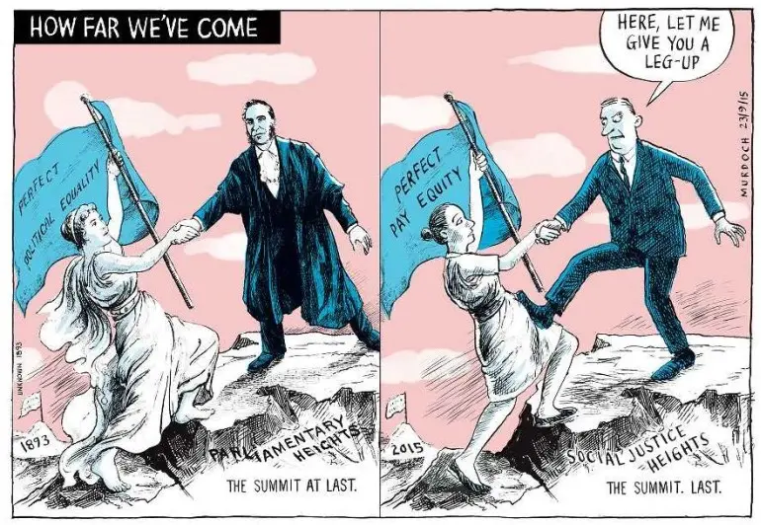

Slide 53
JOINT EFFORT
- Describe the visual? (comic? Ad? Colours? What does the visual depict? Display? …)
- What did your eyes focus on first? Why? Do you think this is intentional?
- Discuss the significance of the way the 2 people in the 2015 version are dressed. For example, why is the man wearing a suit? The woman on the left has bare feet, while the woman on the right is wearing flat shoes. How might the cartoon’s message be different if the 2015 woman also had bare feet? Or was wearing high heels?
- What are the key differences between the 2 images? Why has the cartoonist compared 2015 to 1893?
- Why do you think the cartoonist called the cartoon 'How Far We’ve Come’?
- Why did the cartoonist include a speech bubble for the man in the 2015 version?
- What is the purpose of this cartoon? Who might be the intended audience?

Slide 54
Over to you
Following the above, you will analyse the ad or the cartoon of your choice: please note that you are most welcome to pick any of the following visuals or find your own one and analyse it.

Slide 55
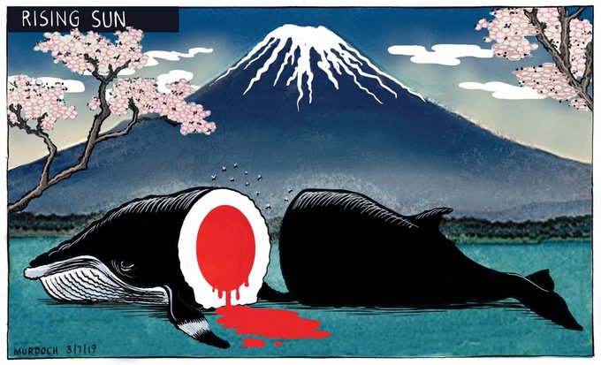

Slide 56


Slide 57


Slide 58
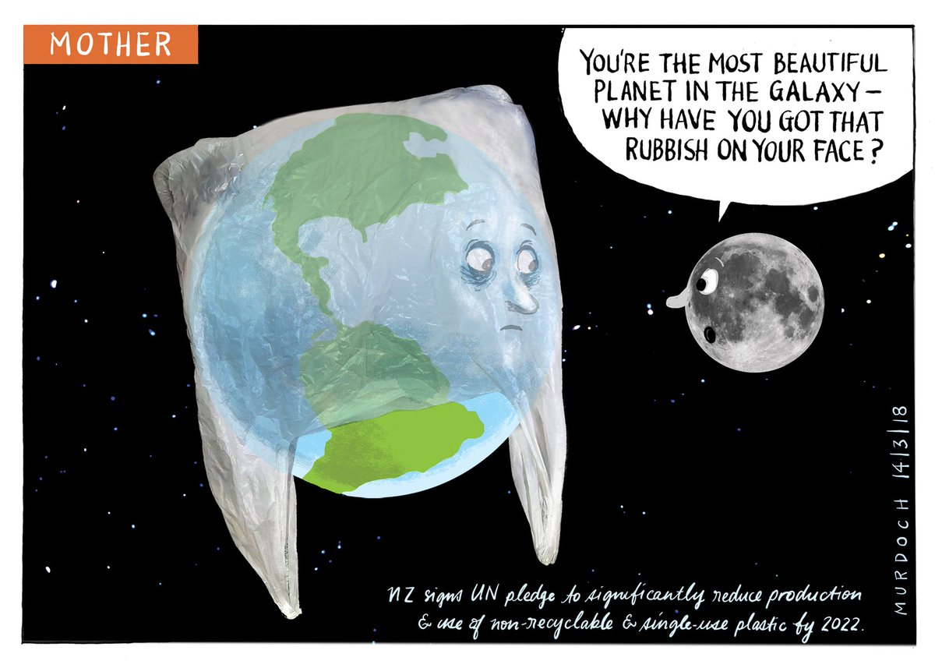

Slide 59


Slide 60



Slide 61
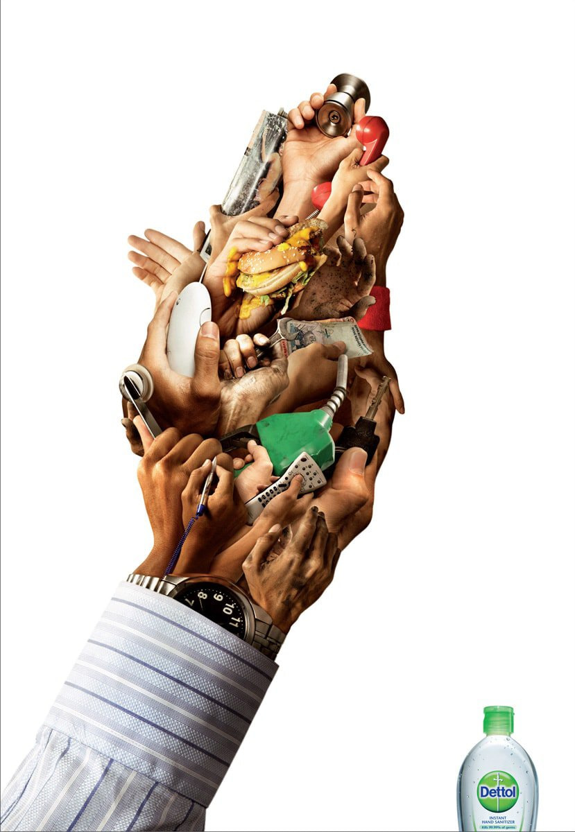


Slide 62

4. Recap session

Slide 63

Task #1:
Write both a Tabloid style and a Broadsheet style articles (100-150 words) on the effects of climate change on the biodiversity.

Slide 64

Task #2:
Write a Letter to the Editor

Slide 65
Woman who stole 'cursed' artefacts from Pompeii returns them after 15 years of bad luck
Andy Gregory Monday 12 October 2020 Independent.co.uk
‘I took a piece of history captured in time that has so much negative energy attached to it,’ writes Canadian tourist
A tourist has returned artefacts she stole from Pompeii 15 years ago, claiming the items are “cursed”.
The Canadian penitent said that bad luck had “plagued” her and her family ever since she stole tiles from the site of the infamous ancient calamity in her early 20s.
In a bid to assuage the fury of “the Gods”, the woman – who called herself Nicole – returned the objects to a travel agency in an envelope also containing the letter of apology, local media reported.
Nicole said she feared the theft of two mosaic tiles, a chunk of ceramic, and parts of an amphora were responsible for her family’s financial misfortune and for her, now 36, having twice been diagnosed with breast cancer, resulting in a double mastectomy.
“We can’t seem to ever get ahead in life. We are good people and I don’t want to pass this curse on to my family, my children or myself any more,” she wrote in a letter, an image of which was published by Il Messaggero.
“Please forgive my careless act that I did years ago. I really have learned my lesson.”
The letter was received by a travel agency who then handed the objects over to Pompeii’s gendarmerie police, the Carabinieri, the Corriere della Sera reported. They have been returned to the park safely.

Slide 66
Thousands were killed in the ancient Roman city of Pompeii when neighbouring Mount Vesuvius erupted in 79 AD, preserved in their final throes by the millions of tonnes of volcanic ash that buried the city and hid it from humankind until it was rediscovered in the late 16th century.
The lost city’s discovery was critical in furthering modern understanding of the era – providing a frozen glimpse into daily life in Pompeii and its residents’ final moments.
Prior to this, historians had been largely reliant upon the account of Pliny the Younger, whose letters detailing the atrocity told of residents being robbed of their faith in the gods in their fear of witnessing what they believed to be “the final endless night”.
“I wanted to have a piece of history that couldn’t be bought,” wrote Nicole, nearly two millenia later.
“I never realised or thought about what I was actually taking. I took a piece of history captured in time that has so much negative energy attached to it. People died in such a horrible way and I took tiles related to that kind of destruction.”
Thefts by tourists have long posed a problem for officials at the archaeological site.
In the past few years, however, “hundreds” of stolen items have been returned, with the park’s director general Massimo Osanna telling Il Messaggero in 2014: "People write expressing regret, having realised they have made a terrible mistake and that they would never do it again and for this reason they are sending the stolen pieces back.
“But the most curious thing, from an anthropological point of view, are the letters that accompany the stolen fragments which reveal a cross-section of people worth studying.”

Slide 67
Task #3:
Visual analysis
(100 words minimum)

Slide 68

Over to you
1Presnting the layout :
The informations that we could have from this Ad are :
The largest, central picture is represnting a multipul hands holding a various things of daily life represented by one hand.
In the corner, we see a bottle of famous brand hand sanitizer « Dettol »
2 Description the layout :
This hands are holding a diffrent items like food (hamburgur), Medical items (stethoscop), daily life objects (remote, phone, money…) this objects we touch most of the time make us exposed to germs and bacteria, the brand which is placed in the corner is related to disnfection, protection and hygiene.
3 Analysing :
Hands are exposed to germs so the use of « Dettol » keeps you clean and safe, that’s why the Ad is using the cause and the soution on the same time (dirty hands full of germs Vs a famous brand of cleannesse)
4 Opinion :
I think this combination of the dirty hands and the most trusted brand is so logic, it’s encourages people to be more healthy and safe.

Slide 69
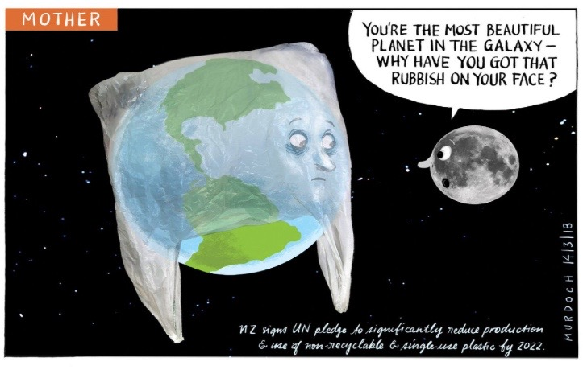
Over to you
Title: Mother Earth. Top left corner.
Date: 14/3/2018 – March 14th 2018.
Illustrator: Murdoch.
Text/Caption: You’re the most beautiful planet in the galaxy – Why have you got that rubbish on your face?
Description: Planet Earth covered by a plastic bag, the moon, stars, and Galaxy.
Goal : Reducing the production and use of non-recyclable and single-use plastic by 2022.
Opinion: Denouncing pollution, and the production and use of non-biodegradable bags.

Slide 70

Over to you
Analysis
The cartoon was published on July 3, 2019.
It shows a dead whale with blood forming the red circle of the Japanese flag.
In the background, we see Mount Fuji and cherry blossom trees, symbols of Japan.
The artist wants to criticize Japan’s decision to return to commercial whaling in 2019.
The message is that this tradition of whaling damages Japan’s international image.

Slide 71
Over to you
The title is "Happy Labor Day" which if just consider the title it means people who works. But, in the center of poster we have an artificiel hand or robotic hand with a tool of a worker in it ,and a text on the hand that is artificiel intelligence. The hand’s picture has been put in foreground of the poster but the title is in the background that shows this technology has replaced humans .
The color that is used in this picture is mostly a mixture of orange and yellow that both are the colors of technology.
As a simple analysis and based on the date of the poster that has been posted I can say it is about how artificial intelligence has been used mostly instead of people in many and different sectors.

Slide 72
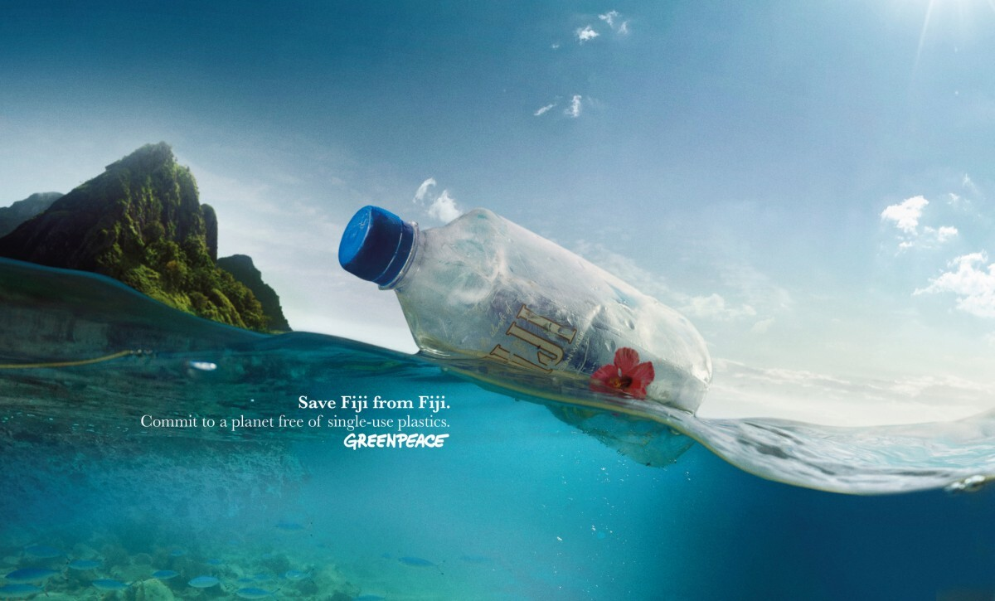

Slide 73

FRIENDLY REMINDER:
the first assessment is next week!

Slide 74
To be continued…

Slide 75

Part II. Professional communication

Slide 76

2.1. Professional Letters

Slide 77
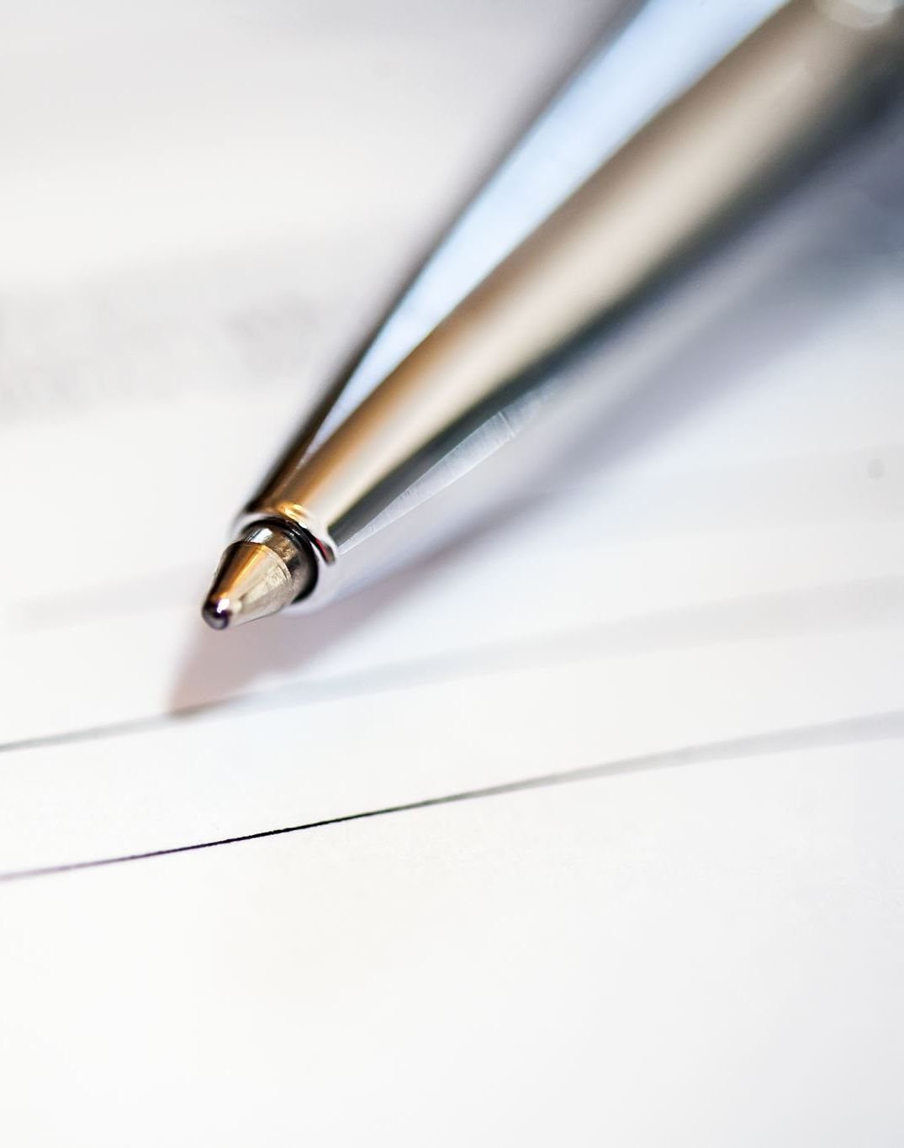
In what situations are you likely to
have to write a formal letter in daily life?

Slide 78

Interest
Request
Complaint
Appeal
Apology
…

Slide 79

And job-wise?...

Slide 80

Cover Letter (application)
Resignation
Reference/Recommendation

Slide 81

Let’s start right from the beginning…
Letter heading

Slide 82
What information and where on the page?
All in line, on the left-hand side, start with :
your name and address (return address)
the date
the recipient’s name and address (inside address)

Slide 83

Then, come:
the salutation;
the subject;
the body of the letter (different paragraphs);
complimentary close;
signature (printed);
enclosures (if applicable).

Slide 84
Examples
Sender’s name
Return Address
Date (Month Day, Year)
Mr./Mrs./Ms./Dr. Full name of recipient.
(Title/Position of Recipient)
(Company Name)
Recipient's Address Line (including zip code, city and country when different from yours)
Dear Ms./Mrs./Mr. Last Name:
Subject: Title of Subject
Body Paragraph 1 . . . . . . . . . . . . . . . . . . . . . . . . . . . . . . . . . . . . . . . . . . . . . . . . . . . . . . . . . . . . . . . . . . . . . . . . . . . . . . . . . . . . . . . . . . . . . . . . . . . . . . . . . . . . . . . . . . . . . . . . . . . . . . . . . . . . . . . . . . . . . . . . . . . . . . . .
Body Paragraph 2 . . . . . . . . . . . . . . . . . . . . . . . . . . . . . . . . . . . . . . . . . . . . . . . . . . . . . . . . . . . . . . . . . . . . . . . . . . . . . . . . . . . . . . . . . . . . . . . . . . . . . . . . . . . . . . . . . . . . . . . . . . . . . . . . . . . . . . . . . . . . . . . . . . . . . . . .
Body Paragraph 3 . . . . . . . . . . . . . . . . . . . . . . . . . . . . . . . . . . . . . . . . . . . . . . . . . . . . . . . . . . . . . . . . . . . . . . . . . . . . . . . . . . . . . . . . . . . . . . . . . . . . . . . . . . . . . . . . . . . . . . . . . . . . . . . . . . . . . . . . . . . . . . . . . . . . . . . .
Complimentary Close (Sincerely...),
Signature
Your Name (Printed)
(Your Title)
Enclosures (when applicable)
Jacob Ready
6G Carlton Gore Rd, Grafton Auckland 1023
October, 19th, 2024
M. John Nixon
Human Resources Manager
Rialto Cinemas
100 Broadway
Newmarket, Auckland
Dear M. Nixon
Subject: customer service position available
Your recent advertisement in the Herald made it clear that customer satisfaction is an integral part of The Rialto Cinemas In addition, my close friend, Paul Smith who is an employee at The Rialto Cinemas suggested that my expertise might benefit your customer service department.
Part of my success is because I place a high value on personal integrity and represent both my employer and myself in an ethical and respectable manner. Also, I have a diligence in paying close attention to detail; as a representative of your company I would bring focus not only to the value of your services but also to quality of customer service. Furthermore, I am a hard, smart-working, self-starter who works well in a team environment.
I will call you on November 1st to answer any questions about this letter or my resume in the hope of scheduling an interview. If you prefer, please contact me by phone 021 068 0041 or e-mail, j.ready@xtra.co.nz
Thank you for your time in considering my qualifications.
Sincerely,
Jacob Ready

Slide 85

Warm up: exercise 1
Complete each sentence with a suitable word or phrase:
i. I would be _________ if you could send me more information about the program.
ii. I am writing to _________ information about your online courses.
iii. Please do not _________ to contact me if you need further details.
iv. I would like to _________ whether scholarships are available.
v. I am _________ interested in applying for the internship.
vi. I would _________ it if you could confirm the deadline.
vii. I am looking _________ to hearing from you soon.
viii. Could you _________ me to the person in charge of applications?
ix. I am writing _________ to your recent advertisement.
x. I would be happy to _________ any further information if necessary.

Slide 86
Warm up: exercise 2
Match the following greetings to their correct closings:
Openings | Closings
1. Dear Sir or Madam, | a. Yours sincerely
2. Dear Mr. Brown, | b. Yours faithfully
3. To whom it may concern, | c. Kind regards
4. Dear Ms. Smith,
5. Dear Human Resources Manager,

Slide 87
Warm up: exercise 3
Rewrite the informal sentences in a formal way
i. Can you send me info about your courses?
ii. I wanna know the price
iii. Thanks a lot!
iv. I’m really into your programme.
v. I hope you get back to me soon!!
vi. I don’t get what I need to do.
vii. I can’t go to the interveiw next week.
viii. Here’s what I want to know.
ix. I’m gonna send my CV later.
x. Bye for now

Slide 88
Over to you
Exercise #1
You have planned to get back to your studies and are interested in a particular degree at an international university.
Write a request letter to the university international officer requesting information about the course. In your letter, write:
1. Why you are writing;
2. Which course you are interested in and when you plan to study;
3. Why you want to study this course;
Tip: you are most welcome to browse through real offers online!
Exercise #2
You wish to apply to get into a particular degree in an international university.
Write your application letter to the boards of examiners. In your letter, write about:
1. Yourself;
2. Your education;
3. Your reasons for applying;
4. What the degree will bring to your career
Tip: you are most welcome to browse through real offers online!

Slide 89

2.2. Professional Emails

Slide 90
How to write
successful and efficient professional emails

Slide 91

A good hundreds of billions emails are being sent and received every day, so make your ones stand out!

Slide 92

A few keys to a successful email
IDENTIFY your GOAL (aim of the email) as well as your AUDIENCE
Note that an email that is not being addressed to the right person may end up… in the bin!
KEEP it CLEAR, CONCISE & COURTEOUS
Address the point immediately;
Use short and simple sentences;
Avoid vague or unspecific words, remove excessive details, redundant ideas, etc.
PROOFREAD your email
An mistake-free email will demonstrate your professionalism:
Pay attention to details, re-read your email before sending it and make sure that the attachment(s) that may be mentioned in your email are included.
FOLLOW-UP
Consider re-sending your email after in a few days if you have not received any reply (give it some time for the recipient to reply though!)

Slide 93
Organise your email
SUBJECT LINE | must be as informative as possible
SALUTATION | must be polite and appropriate
BODY | (optional) you may have to briefly introduce yourself address the point straight away
CLOSING | provide the recipient with your contact details and information close with appropriate greetings
SIGNATURE | your full name Identification (e.g. she/her/hers your title, the name of your Company if applicable

Slide 94
Exercise 1: “Fix That Email!” Challenge
Objective: Spot and fix tone, layout, and grammar issues.
From: Wednesday@theaddamsfamily.com
To: jane.doe@univ-lorraine.fr
Subject: HELP NEEDED FAST
From:
To: jane.doe@univ-lorraine.fr
Subject:
hey prof,
i forgot to send u my essay and now i need extension bc my computer broke lol
pls tell me if its ok
thx bye
Task: edit the complaint email on the left to make it look more acceptable !

Slide 95
Exercise 2: “Email Puzzle”
Task: Put the parts in the correct order and justify your choice.
1️⃣ I look forward to hearing from you soon.
2️⃣ I am writing to inquire about the internship positions your company offers each summer.
3️⃣ Dear Human Resources Manager,
4️⃣ Thank you for your time and consideration.
5️⃣ Yours faithfully, John Doe
6️⃣ Could you please confirm whether the internship is available for international students?

Slide 96
Exercise 3: “Inbox Race”
Objective: Choose or create the most professional subject line for each real-life situation below
#
1 | You want to ask your boss for one day off.
2 | You are sending your CV for a job offer.
3 | You want to thank a guest speaker.
4 | You are asking a professor for a reference letter.
5 | You are confirming a meeting.
6 | You are apologizing for missing a deadline.
7 | You need to follow up after no reply.
8 | You need to request payment confirmation from an organization.
9 | You want to thank someone after an interview.
10 | You are inviting colleagues to a meeting.

Slide 97
Exercise 4: “Reply or Forward?” Game
i. Read (or project) each short scenario.
ii. Choose the best action between: 👉 Reply 👉 Reply All 👉 Forward 👉 No Reply
iii. Choose a most appropriate tone (formal / neutral / friendly).
# | Scenarii | Best Action | Tone
1 | Your professor emails only you asking for your project update.
2 | Your professor emails the whole class about a deadline extension.
3 | Your manager sends a meeting invite to 10 people.
4 | You receive feedback from HR after an interview.
5 | You receive travel details for a conference and want to share them with your colleague.
6 | You get an angry customer email that also includes your boss.
7 | Your classmate sends you useful internship info. You want to share it with your group.
8 | You receive a general announcement from “no-reply@university.edu.”
9 | Your team is planning a group presentation. You need to confirm time and materials.
10 | You accidentally receive a confidential email not meant for you.

Slide 98
Exercise 5: Emoji → Email
Objective: Transform informal, emoji-filled messages into clear, polite professional email sentences.
# | Informal Message (with Emojis) | Professional Email Equivalent
1 | 😬 Sry I’m late for the meeting lol | I apologize for being late to the meeting. Thank you for your understanding.
2 | 🎉 Thx so much for the opportunity!!
3 | 😡 Still no reply??
4 | 👍 Got it, see ya!
5 | 😅 Forgot to attach the file, oops!
6 | 🙄 U didn’t answer my question again…
7 | 🎉 Yay, can’t wait to start working with u guys!
8 | 😔 Sorry but I can’t make it tomorrow
9 | 💡 Hey, just a quick reminder about our project thing!
10 | 💬 Can u send me that info ASAP?

Slide 99
2.3. Forms

Slide 100

How to fill out forms effectively

Slide 101
Different types of forms… for different purposes
Forms need to be filled in for lots of different reasons; To name but a few:
Application (visa, job, scholarship, …);
Enrolment (University, course, …);
Refund (insurance, …);
Complaint;
Refund;
…

Slide 102
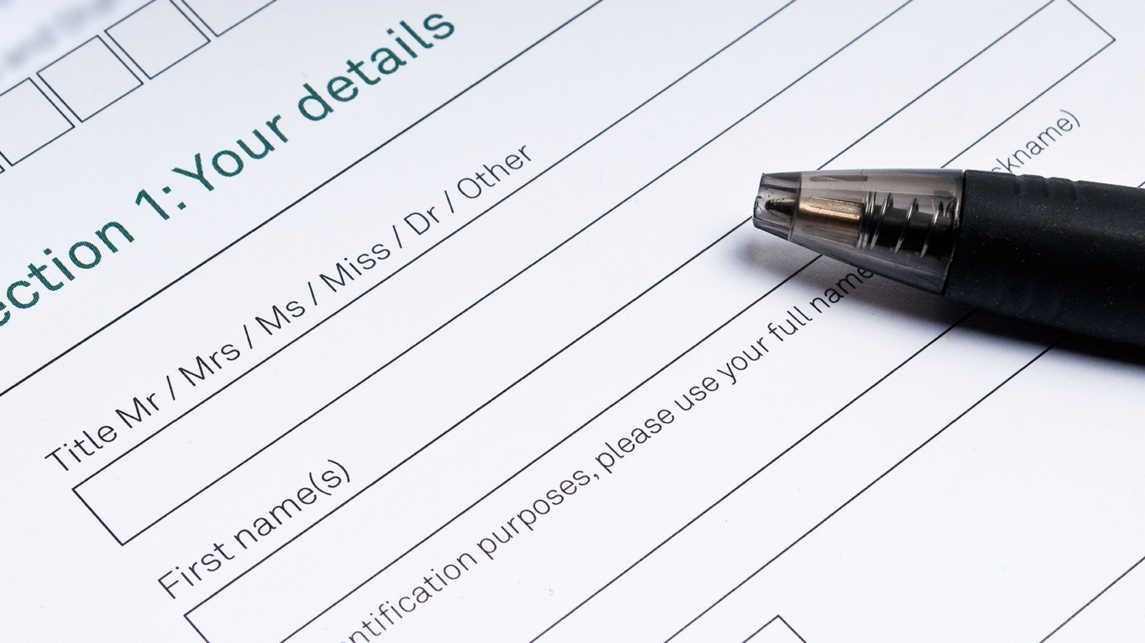
Sections
What does it contain?

Slide 103
The most common sections consist of asking you more details about:
Personal details | Yourself!
Education | Your curriculum
Qualifications | Your degrees
Employment | Work history/work experience
Health | Health or mental conditions to declare if any
References | e.g. A former employer or establishment
Do not make things up!
Be assured that all your information and references will be checked

Slide 104
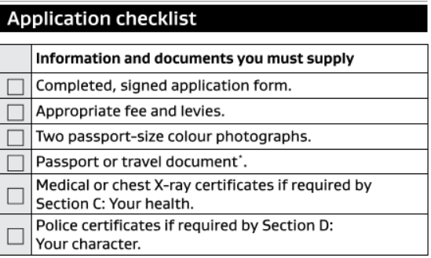
Follow the instructions
Read the form carefully in the first place: it is pointless rushing into filling it out;
Go through the application guidelines (when provided);
Prepare all your supporting documents (ID, Passport, Health Insurance, bank statement, transcript of records, police records, cover letter, photographs, …)
Once you have got all the information and document handy:
Go on with your application form. Remember, fill it out thoroughly!
Before signing it, make sure you understand what you’re committing yourself to;
Do proofread your form before submitting it: any mistake or discrepancy may cause your application to be denied.
Tip: It’s also a very good idea to print and save a copy of the form so you have a record of what you’ve completed and sent
.

Slide 105
The language of forms
Exercise 1: match the term or abbreviation (left) to its meaning (right)
For office use/official use only
Block capitals
N/A
Forenames
Signature
Next of kin
Titles
N.I. No
Marital status
Employment status
Education
Bank statement
Dependants
DoB
Your nearest or closest relative
Your date of birth
Any family members who rely on you for financial support
Your National Insurance Number
Are you employed, unemployed, self employed
Are you single, married, in a civil partnership, divorced or separated
Not to be filled in. This section is completed by the organisation.
Mr/Mrs/Ms/Miss/Dr…
Your curriculum, your degrees and qualifications
A style of writing in which each letter is written separately and clearly
A printed record of the balance in your bank account
The name(s) that precede(s) your surname
How you sign your name
Not applicable

Slide 106
Give it a go!
Exercise 2: Open up ‘DULASP form ex2’
Consider the document: how many sections are there?
When you’re ready, fill it out with the relevant information
Email it through to me when you are done
Exercise 3: Open up ‘Student Visa Application inz1012’
This form is meant to take only 15 minutes to be filled out.
Will you take up the challenge? If you did, let me know how long it took you!

Slide 107
2.4. Recap session

Slide 108
Best of Luck, Everyone!
Open up ‘Week#9 Recap Session’ to train and brainstorm together

Slide 109
FRIENDLY REMINDER:
the second and final assessment is next week!

