Slide 1
GEOSTATISTICS APPLIED TO MINING STUDIES
Part 2.
P. MARCHAL

Slide 2
Geostatistics : spatial statistics
“Geo” does not stand for “geology” but “geographic”
Statistics for studying spatial & spatio-temporal datasets
Regionalized variable, i.e. spatial variability of the variable
Var(Z) = f(X, Y, Z, t)
Multiple & various purposes …
29

Slide 3

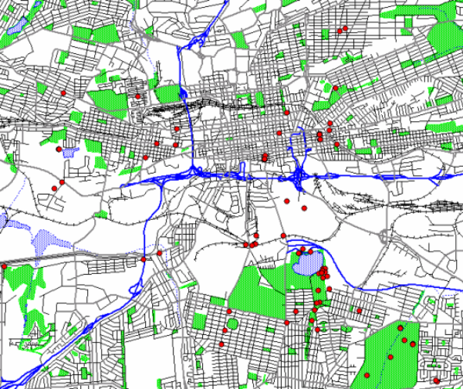
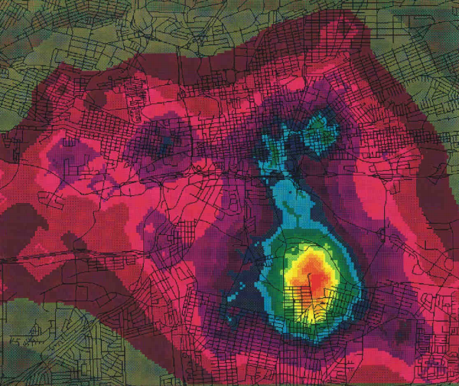
Geostatistics : examples of application
Criminology : using crime location to estimate criminal’s house
[Srivastava, 2015]

Slide 4
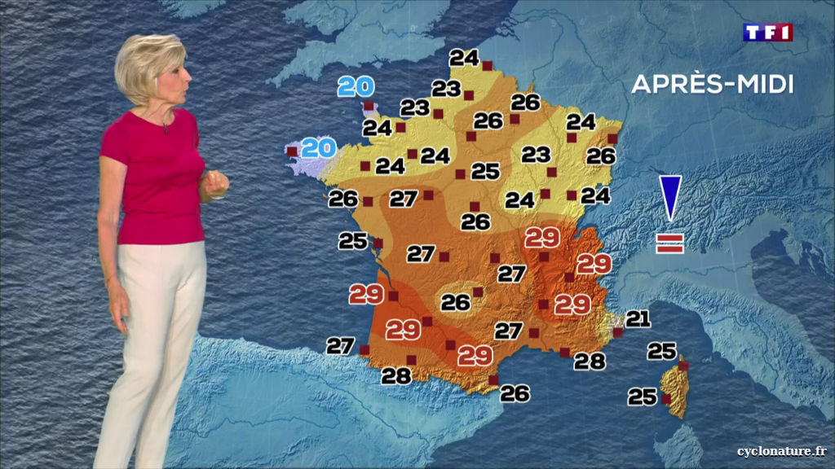
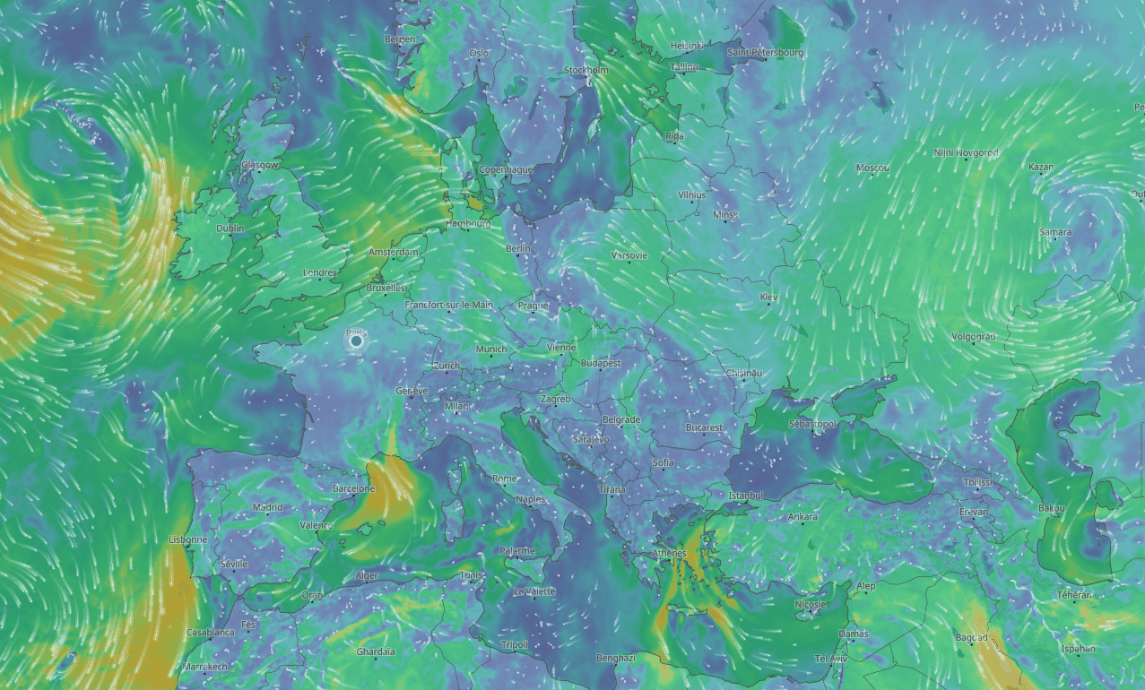
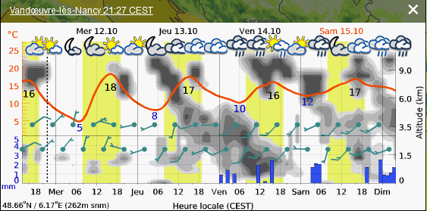
Geostatistics : examples of application
Weather forecast : wind,
temperature, humidity, pluviometry…
Climate Change scenarios

Slide 5
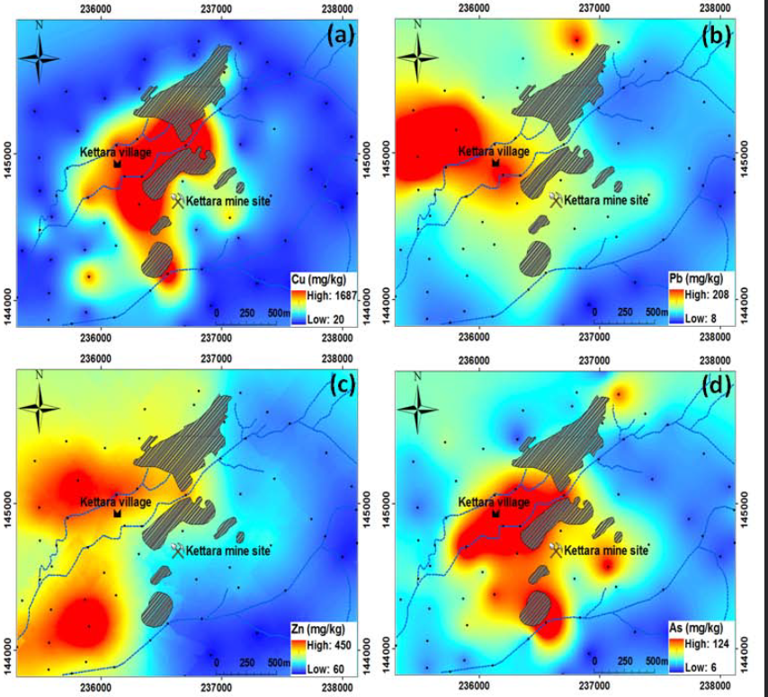
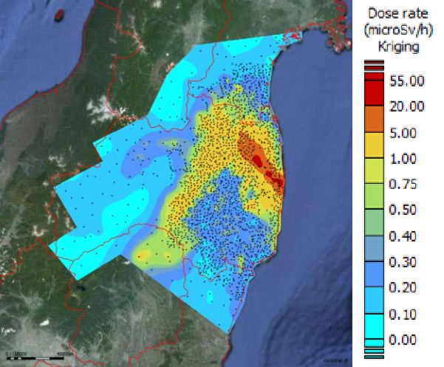
Geostatistics : examples of application
Multiple purposes :
Pollution & Risk assessment : after events, ...
After mine exploitation
Metals estimation in soil
after mine exploitation, [Khalil, 2013]
Fukushima, µSv estimation using kriging
[Jeannée, 2015]

Slide 6
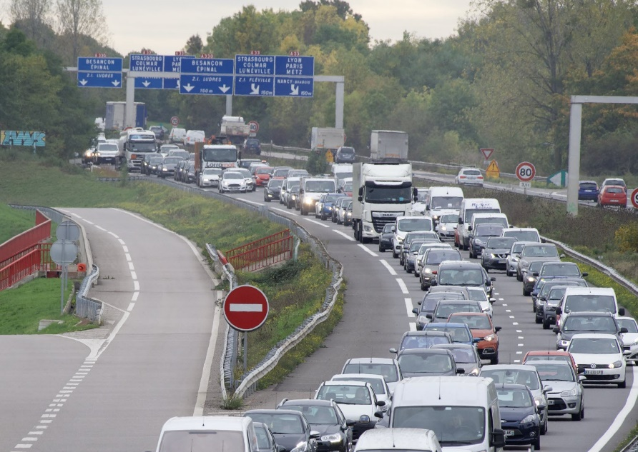
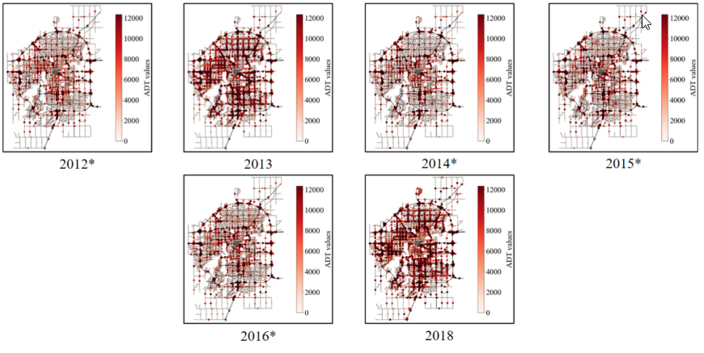
Exemples of applications …
Traffic Jam & Accident estimations
[A330, 2022]
[Wu, 2022]

Slide 7
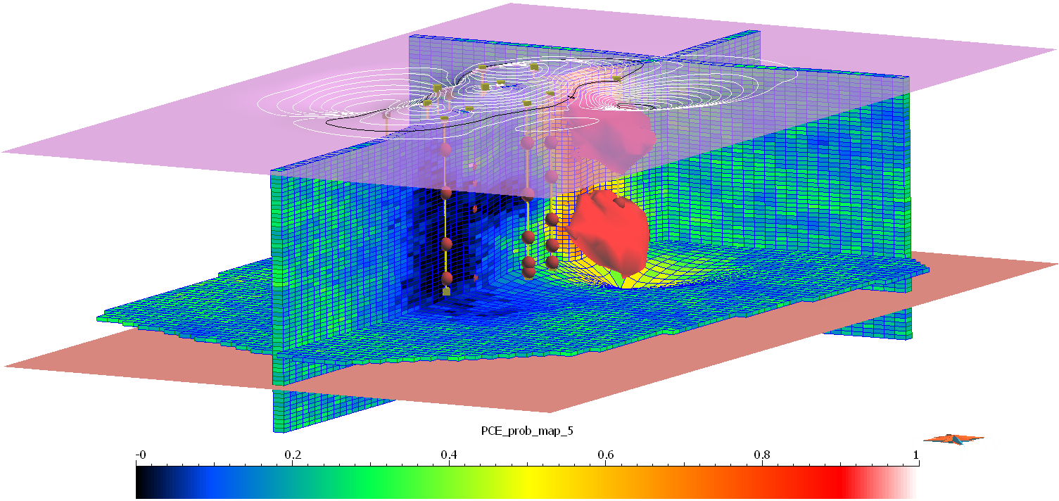
Geostatistics : examples of application
Resources/reserves estimation
Grade estimation
Volumes estimation
Location
Economic value of geological bodies
[Bazli et al, 2019]

Slide 8
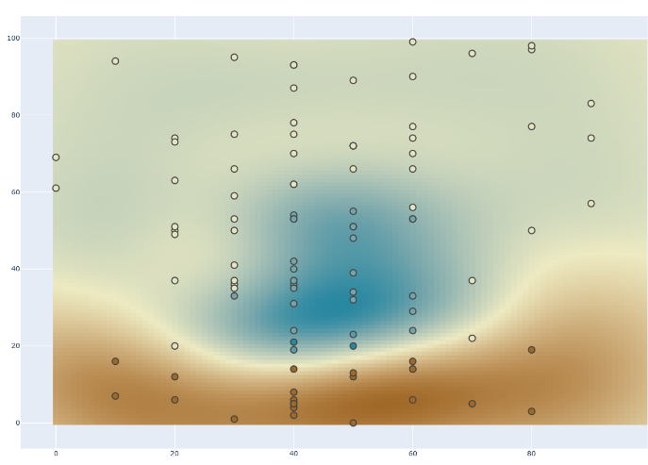
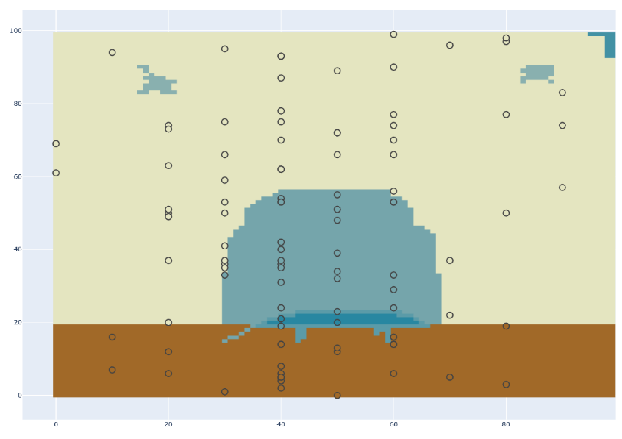
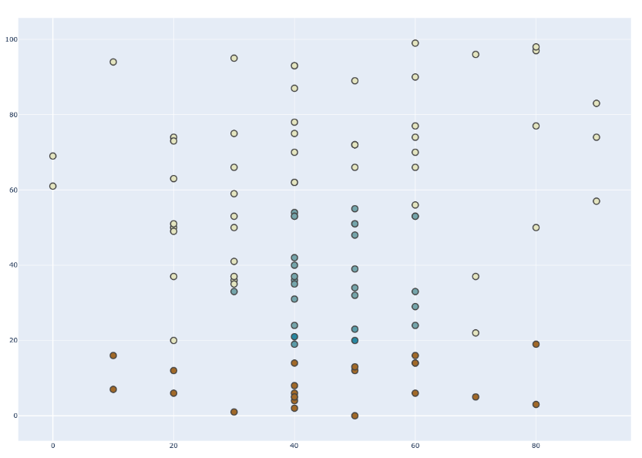
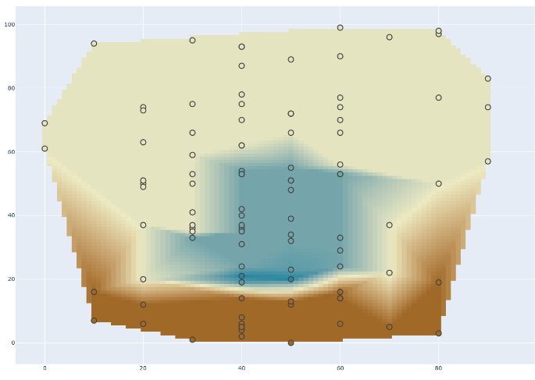
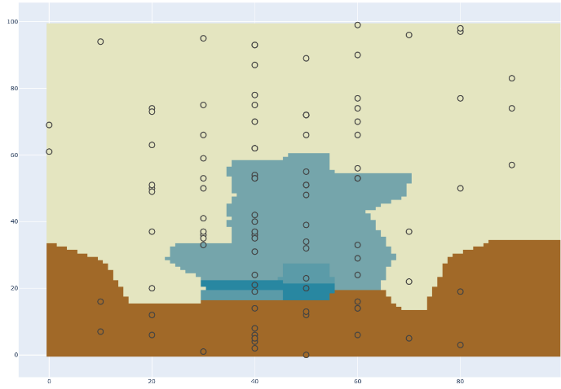
Geostatistics: what for?
Simple Kriging
Subsurface sampling is largely incomplete
Geological reality
Available Data
Cubic law
Unkwown values
estimation
Partial Sampling
Nearest neighbour
Data do not cover all the area of interest
  Interpolation, Representativity, Errors on volumes, Location Errors
31

Slide 9
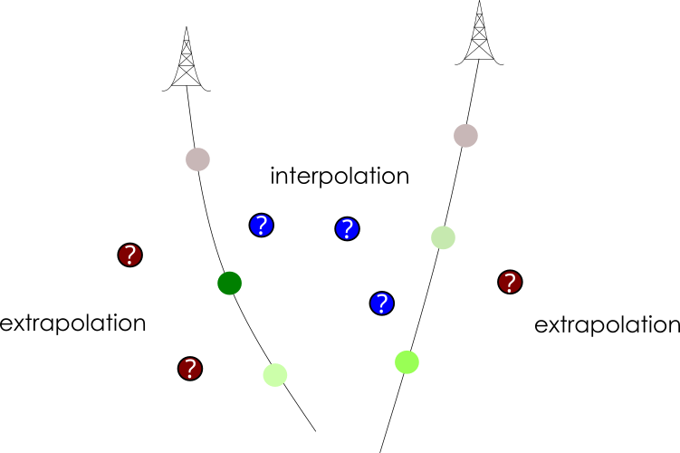
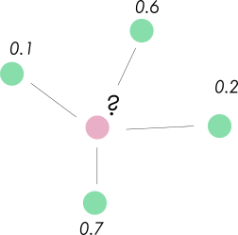
Modeling : Interpolation
How to fill gaps between points to build a model ?
Deterministics methods : IDW (Inverse Distance Weight), Triangulation, DSI ...
Geostatistical methods : Kriging, ....
=> Kriging : Spatial Interpolation using Variograms
35
Notes:
Ajouter extrapolation

Slide 10
Modelling : Interpolation
Deterministics methods :
Nearest neighbour
Constants results
Geostatistical methods :
Variables results : uncertainties taken into account

Slide 11
Aims
Characterize the subsurface statistically
  Regions, texture, anisotropy, etc
Estimate or simulate to predict
Manage the uncertainties
  To evaluate the risks
  To establish sampling strategies
33

Slide 12
So more precisely in our context:
Once spatial context is set with geological 3D model
Need to:
  Characterize ore grade spatial variability
  Estimate in situ ore reserves
  Define the cut-off
  Estimate recoverable reserves
34

Slide 13
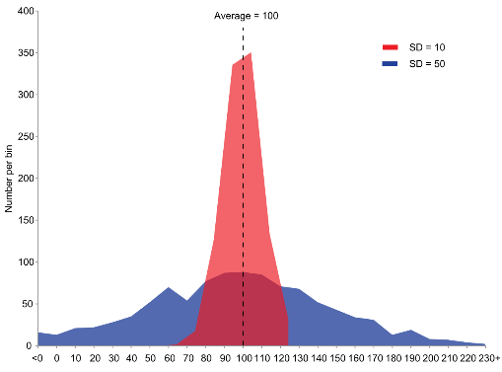
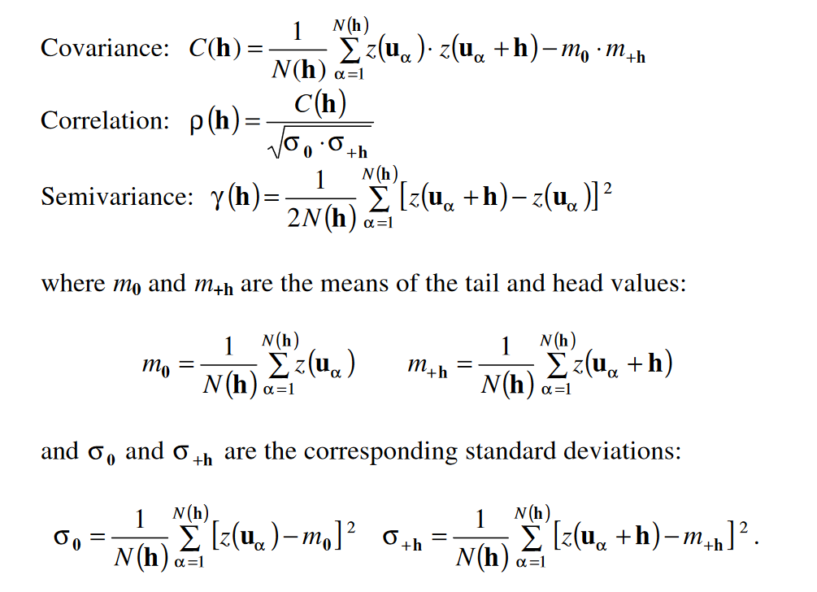
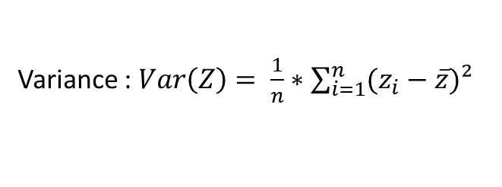
Geostatistics : Spatial statistics
How to take spatial variations of properties into account ?
Variance : $Var\left(Z\right)= \frac{1}{n}∗\sum_{i=1}^{n}{(z_{i}−\overline{z})²}$
Dispersion of a variable
Similarity measurement between 2 Variables
Extension of covariance principle for 1 VAR at different points in space
Kriging is based on “minimizing variance “ of the variable of interest => get rid of sampling bias

Slide 14
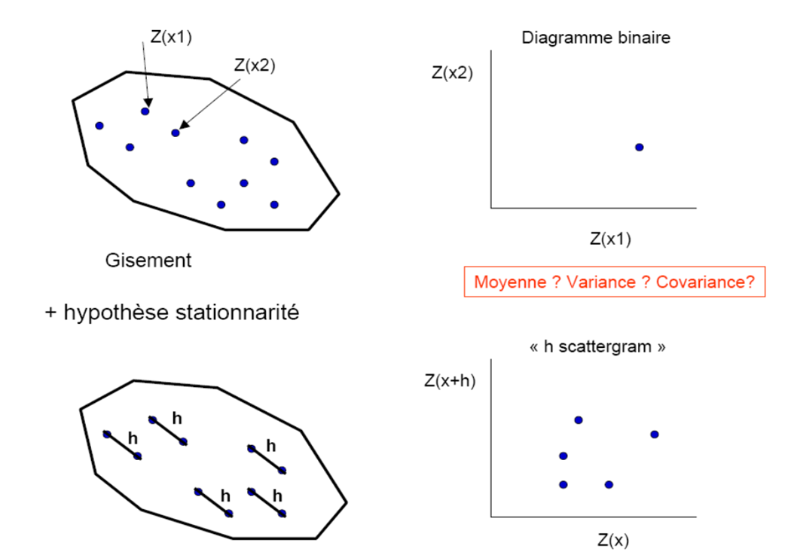
H-scattergram
Investigate if there is a relation between Z(x) and Z(x+h)
Stationnarity hypothesis : mean & variance stables in space
h : lag distance;
Z(x) property value at x
Repeat for several values of h distance
[from D. Marcotte]

Slide 15
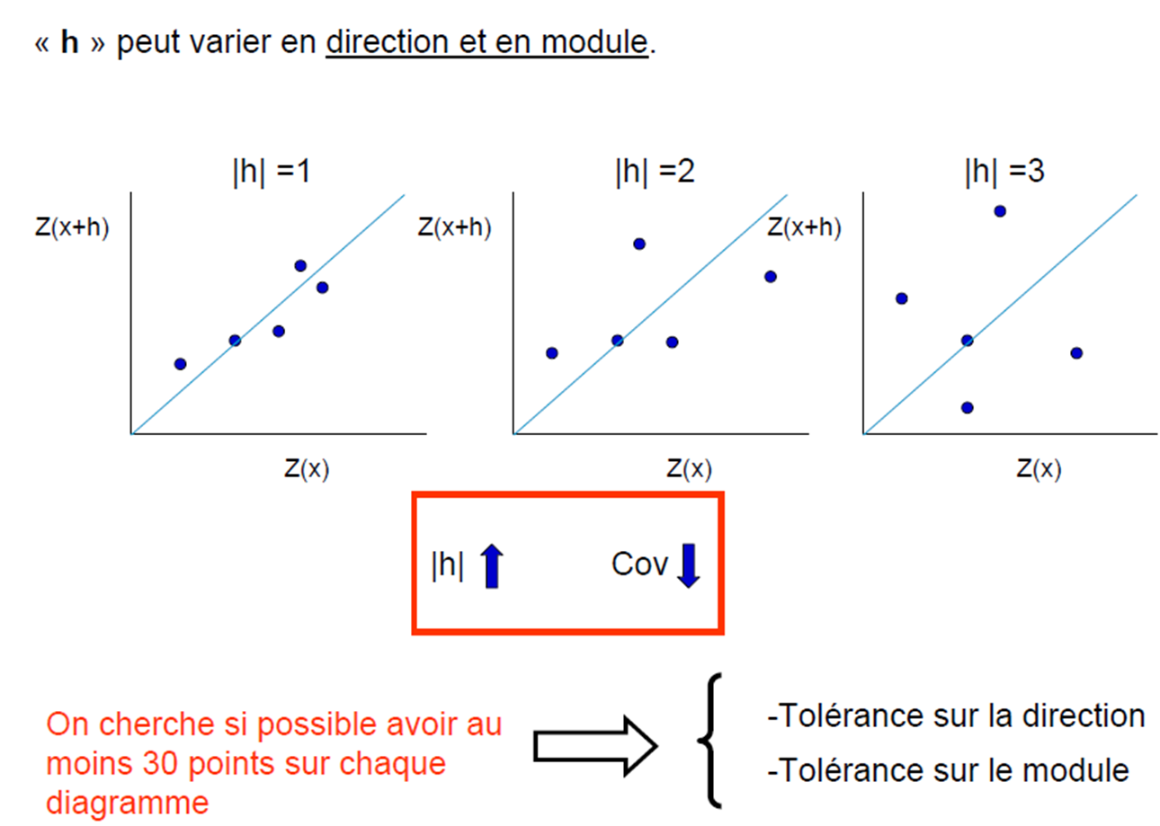
Application des h-scattergram
« h » can vary in direction and module
The aim is to have at least 30 points on each diagram if possible
Direction tolerance
Module tolerance
[D. Marcotte]
37

Slide 16
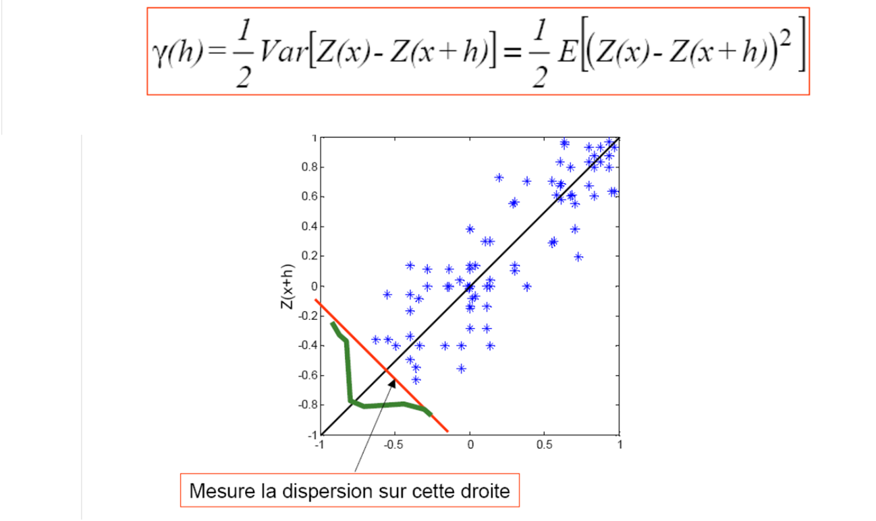
Definition of a variogram
Measure the dispersion on this straight line
[D. Marcotte]
316

Slide 17
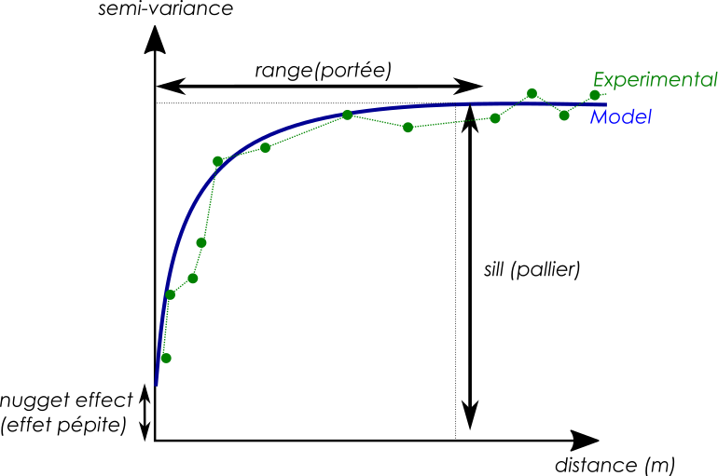

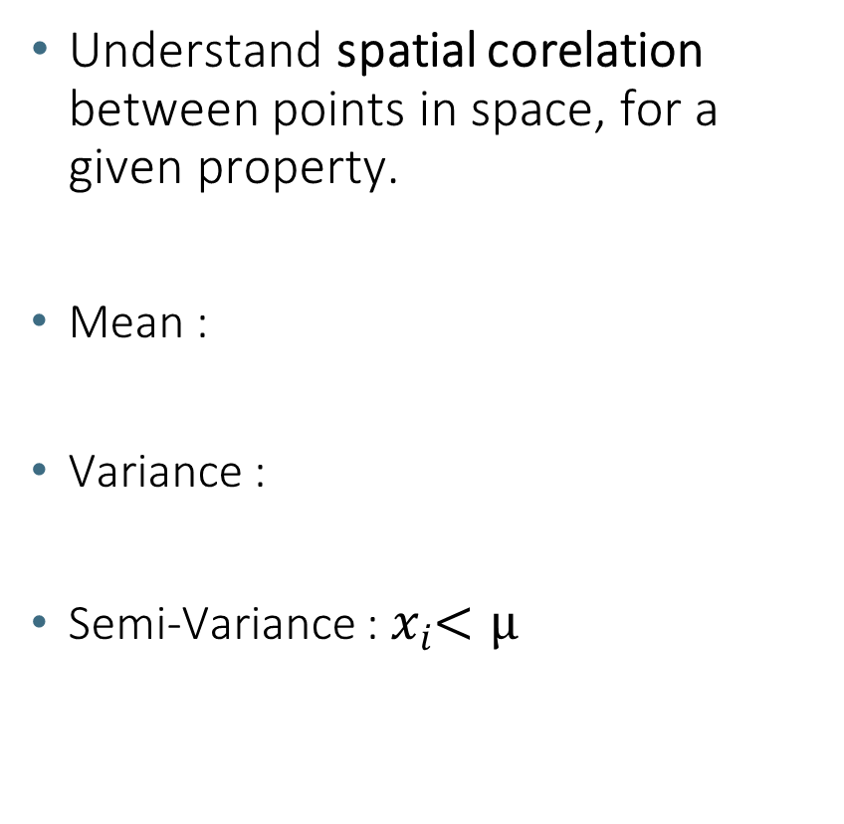
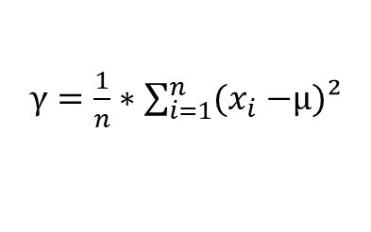
Geostatistics : What is a Variogram ?
Understand spatial corelation between points in space, for a given property.
Mean :
Variance :
Semi-Variance :${ x}_{i}<µ$
$$µ=\frac{1}{n}∗\sum_{i=1}^{n}{x_{i}}$$
$γ=\frac{1}{n}∗\sum_{i=1}^{n}{(x_{i}−}$µ)²
39

Slide 18
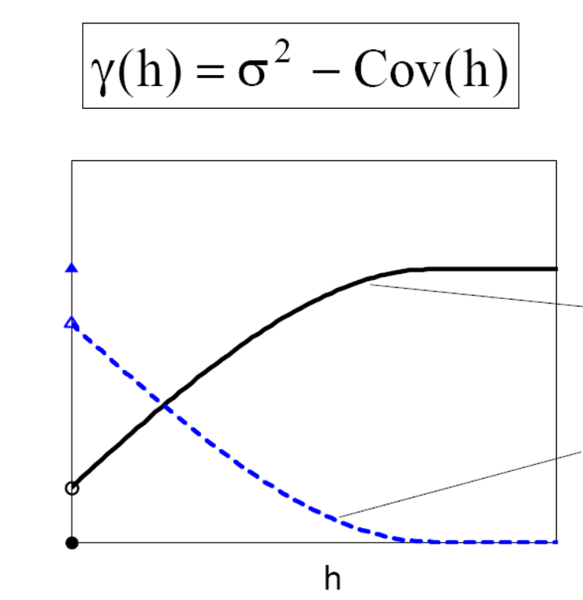
Relation between variogram and covariance
Variogram
Covariance
[Intro stat + variogrammes - D. Marcotte]
40

Slide 19
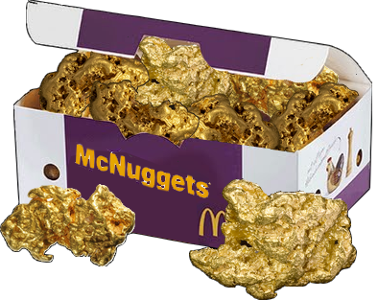
Geostatistics : What is a Variogram ?
Nugget effect : low-scale chaotic variations
Range : Maximal distance beyond there is no spatial correlation between points
41

Slide 20
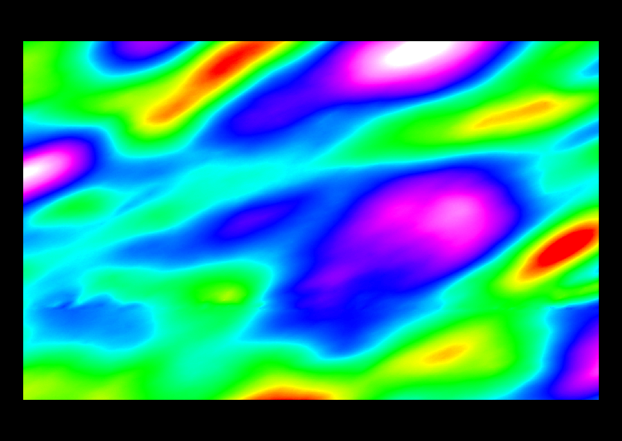
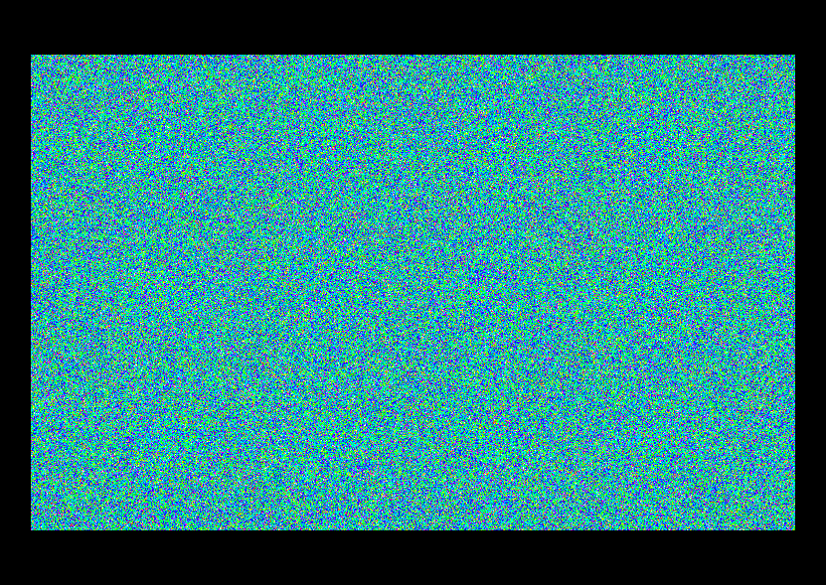
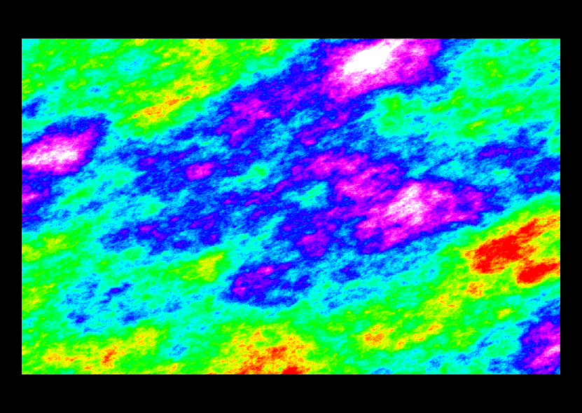
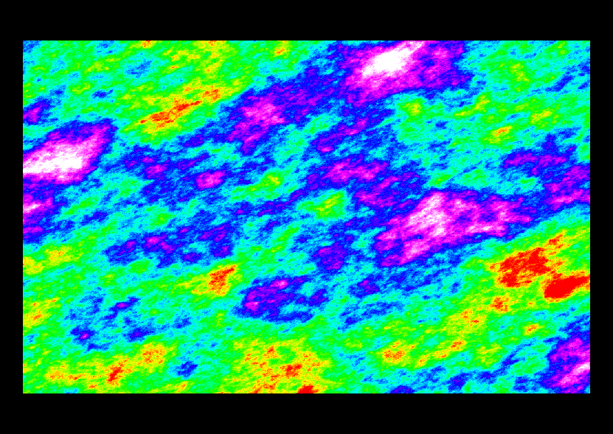
Theoretical variogram models
Nugget model
h
Exponential model
Spherical model
ɣ (h)
Gaussian model
C
Spherical : non-asymptotic
Nugget : no-spatial correlation
Gaussian : parabolic at origin: smooth variations
Spherical / Exponential : linear at origin : high variation at small scale
Power-law : Ø sill, fractal behaviour
All linear combinaison of these models are valables
h
a
[cours Royer & Caumon 2015]
42

Slide 21




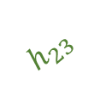





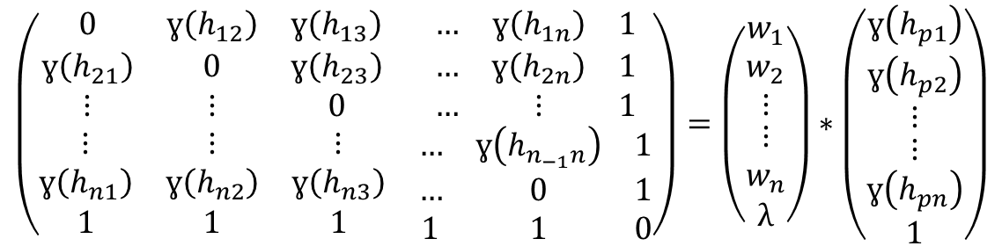


Kriging equations
$$\hat{Z}=\sum{W_{i}∗Z_{i}}$$
$$C=w∗D$$
Kriging
Unkwown value
weights
Known values
$$\left(\begin{matrix}\begin{matrix}0 & ɣ\left(h_{12}\right) & ɣ\left(h_{13}\right) \\ ɣ\left(h_{21}\right) & 0 & ɣ\left(h_{23}\right) \\ ⋮ & ⋮ & 0\end{matrix} & \begin{matrix}… & ɣ\left(h_{1n}\right) & 1 \\ … & ɣ\left(h_{2n}\right) & 1 \\ … & ⋮ & 1\end{matrix} \\ \begin{matrix}⋮ & ⋮ & ⋮ \\ ɣ\left(h_{n1}\right) & ɣ\left(h_{n2}\right) & ɣ\left(h_{n3}\right) \\ 1 & 1 & 1\end{matrix} & \begin{matrix}… & ɣ\left(h_{n_{−1}n}\right) & 1 \\ … & 0 & 1 \\ 1 & 1 & 0\end{matrix}\end{matrix}\right)=\left(\begin{matrix}\begin{matrix}w_{1} \\ w_{2} \\ ⋮\end{matrix} \\ \begin{matrix}⋮ \\ w_{n} \\ λ\end{matrix}\end{matrix}\right)∗\left(\begin{matrix}\begin{matrix}ɣ\left(h_{p1}\right) \\ ɣ\left(h_{p2}\right) \\ ⋮\end{matrix} \\ \begin{matrix}⋮ \\ ɣ\left(h_{pn}\right) \\ 1\end{matrix}\end{matrix}\right)$$
$$h_{12 }$$
2
1
$$h_{23 }$$
$$h_{2p}$$
$$h_{1p }$$
$$h_{13 }$$
p
$$h_{3p}$$
3
$h_{ij }$distance between input point i and j
$h_{pi }$distance between search point and input point i
$w_{i }$weight factor for input point i
$ɣ\left(x\right)$ semi-variogram value for x
$λ$Lagrange multiplier
43

Slide 22
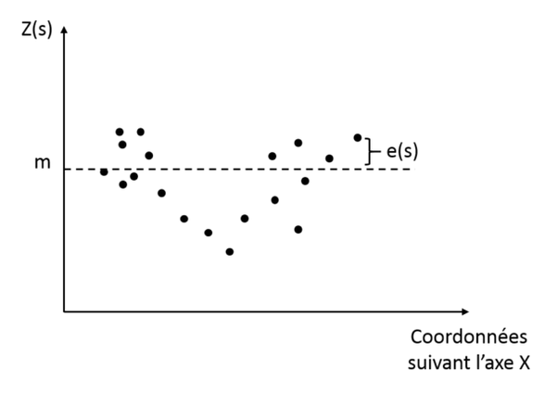
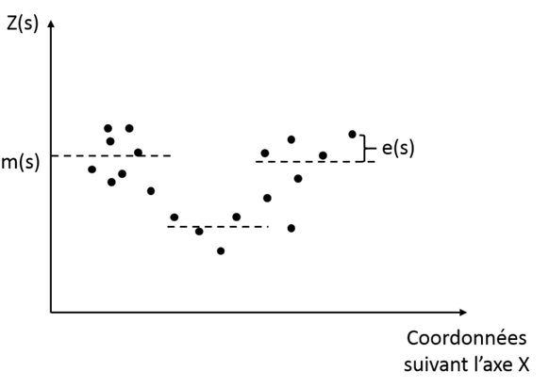
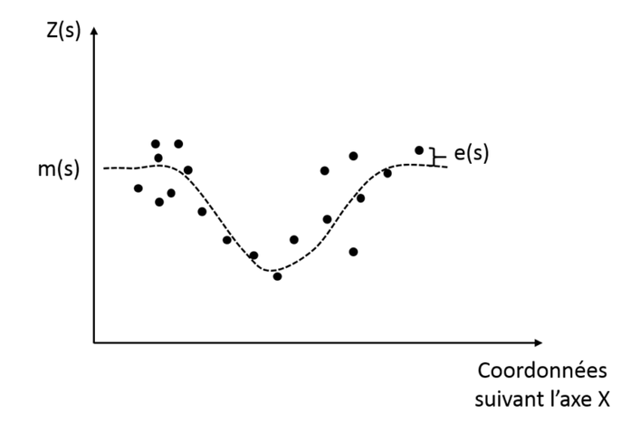
Type of Kriging : mean laws
Ordinary kriging
Simple kriging
Universal kriging / with drift
+ Co-kriging
Colocated kriging

Slide 23
Kriging is good but …
Kriging : minimize variance of variable : allows to reduce bias on data sampling for statistics
BUT smoothing effect → lower dispersion of values => it does not reproduce spatial variability but gives the conditional esperance
It can be an issue depending on what we want to know

Slide 24
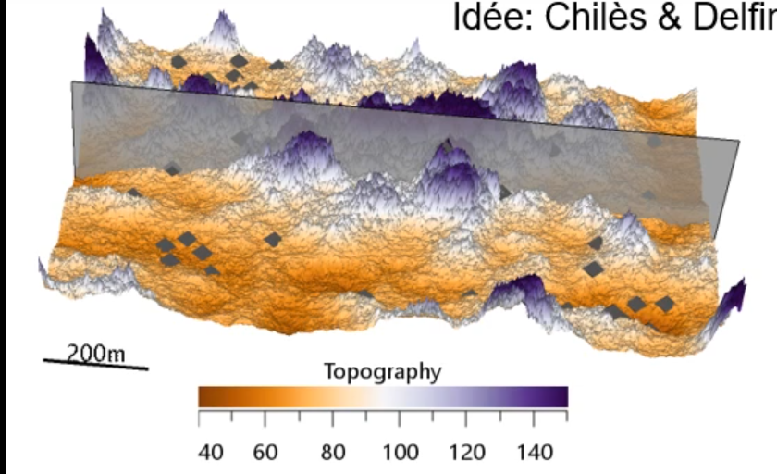


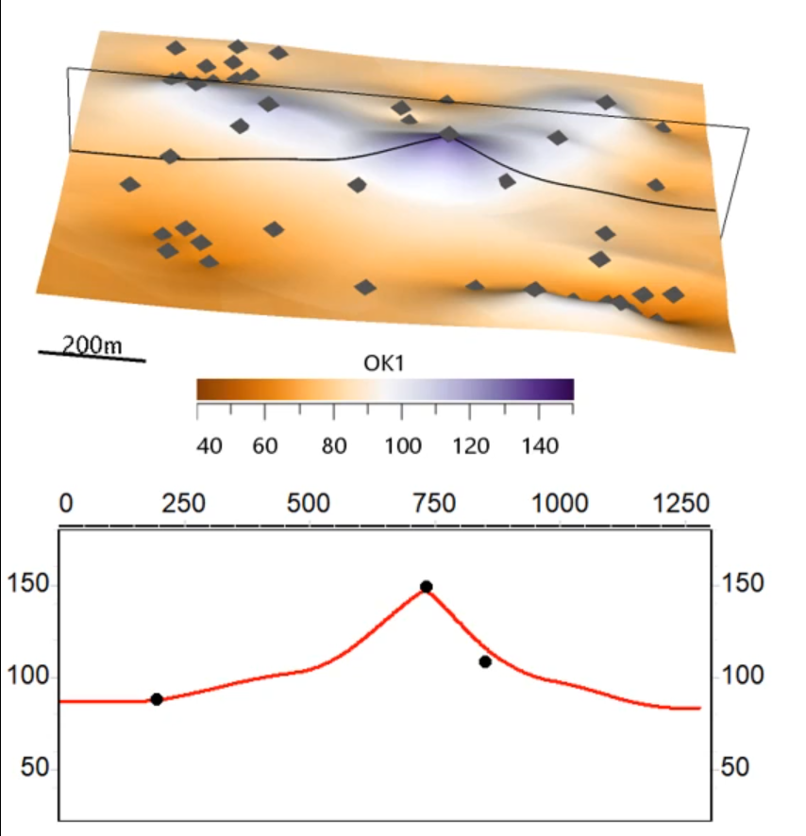
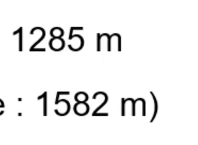
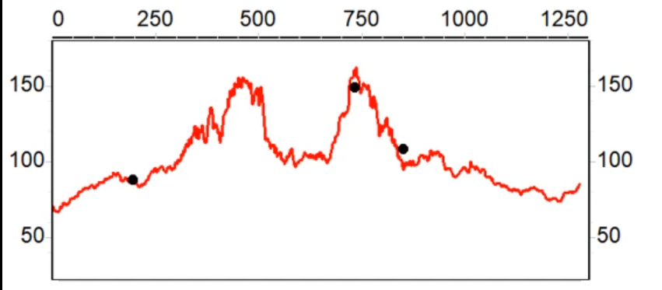
Kriging is good but …
Estimations methods
underestimates variability
Here surface and
distance are lower
than expected
=> It’s the same for every estimation methods
Reference topography model
[Caumon, 2017]
Model obtained by simple kriging

Slide 25
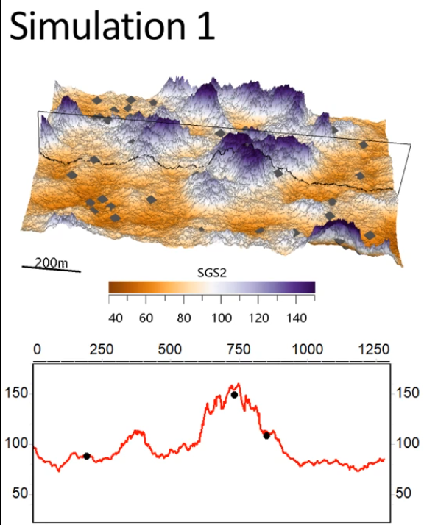
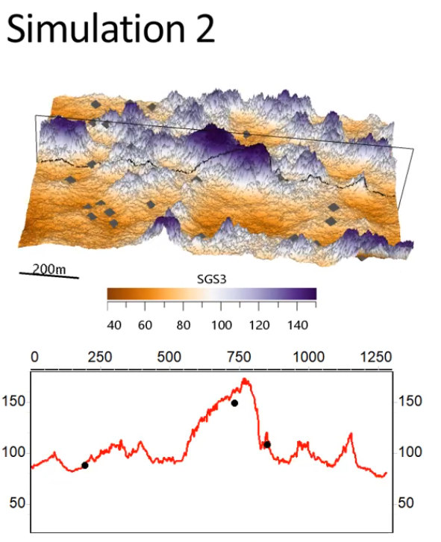
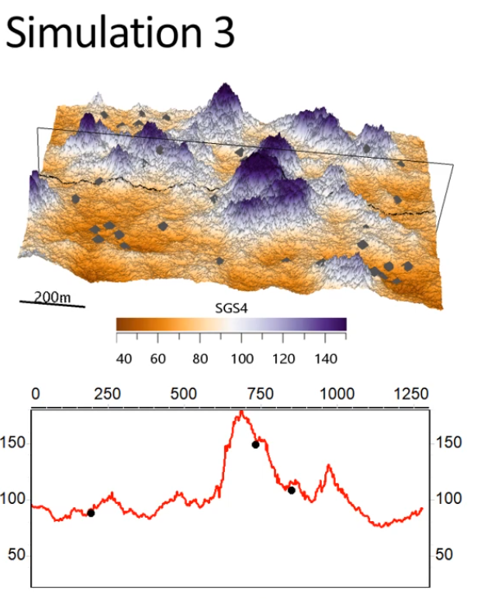
What about simulations ?

Slide 26
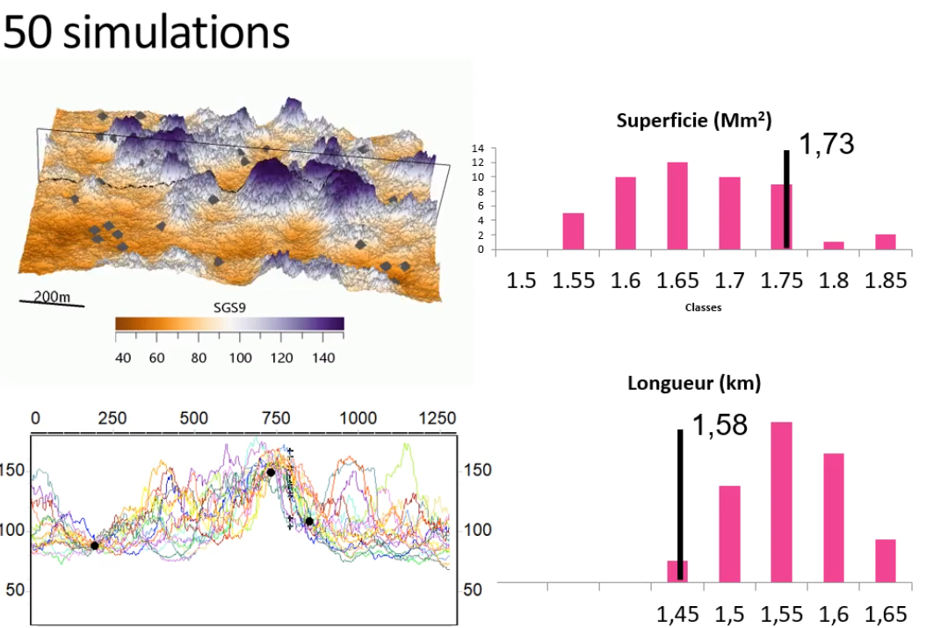
Simulation for uncertainties assessment
Reference Value
Kriging value
Main idea => reproduces variability of the property of interest
Assess uncertainties

Slide 27
What is a simulation ?
Sampling of probability density function of a variable
Numerous types of simulation depending on what kind of property you have :
Continuous : SGS : Sequential Gaussian Simulations, P-Fields, …
Discrete : Truncated Gaussians, Sequential indicator Simulation, …
Simulation generates several Realizations

Slide 28
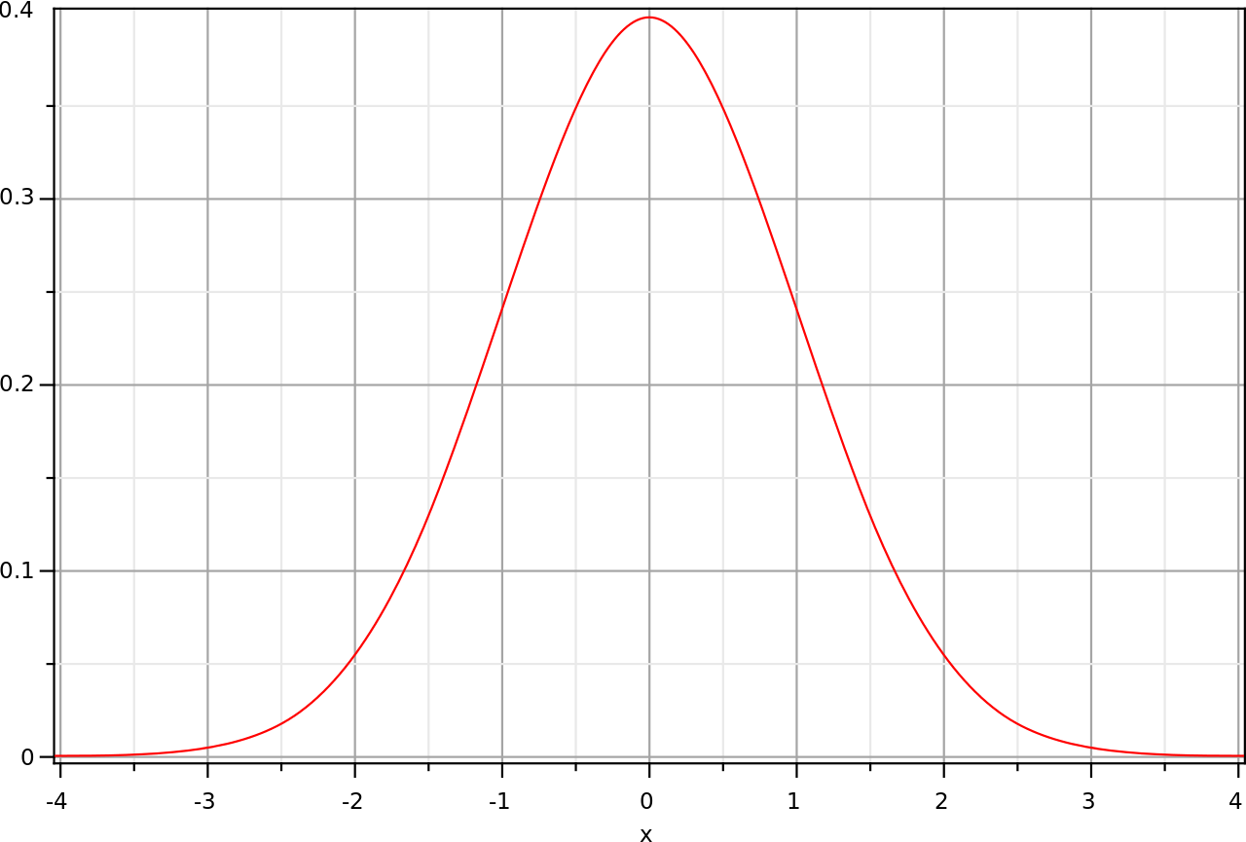

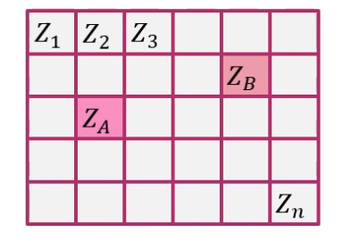
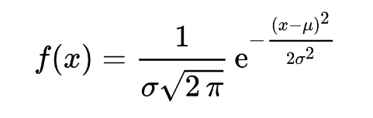


Sequential Gaussian Simulation
Gaussian function
To be calculated using kriging
[Caumon, 2017]
44

Slide 29




Sequential Gaussian Simulation
! To order of computation between Zn, Zn-1, Zn-2, ….
=> random order
[Caumon, 2017]
44

Slide 30

Sequential Gaussian Simulation
! To order of computation between Zn, Zn-1, Zn-2, ….
random order
If Z not follows Gaussian distribution -> Gaussian anamorphosis
[Caumon, 2017]
44

Slide 31




Truncated Gaussian simulations
Sampling of a Gaussian distribution and use of threshold
Useful of sequential deposits
Beucher 2015

Slide 32
Estimation Simulation
= Estimation + autocorrelated noise
One “optimal” deterministic model
Use variogram, mean models, data
Smooth model, does not respect : the input variogram, the histogram
Not realistic
Objectives :
understand & visualize data
Estimates linear combinations of values on all cells (total volumes of mineralisation, total porous volume, …)
Several stochastic models
Use variogram density function, data (optional)
Approx. respect distribution & variogram
Objectives :
Assess non-linear processes (front propagation, fluid flows, …)
432

Slide 33
Regionalisation and stationnarity
Strategies :
Global computation = global stationarity observation
Regional computation = local stationarity observation
First order observations:
How many regions have to be used to infer statistics?
How to define regions ?
  deterministically (for example, by mapping)
  stochastically (indicator, plurigaussians or multiple point simulations)
Which coordinates system to use? Which local anisotropy directions to respect?
Guidelines :
Statistics observations on data (multi-modals distributions, spatial trends)
Link with geological observations ( age, facies variations or other associated processes…)
49

Slide 34
Region definition
On data (deterministic):
  By layer
  By rock
  By value range (thresholding)
On 3D models / simulation grids
  Indicator kriging probability to fall into one category.
    Multi-scénarii on values of potential continuous variables, or on means of each category
  Indicator simulation, MPS, object methods → potential geometries for each region
    Simulation or estimation of continuous variables on each region
    Multiple realisations to represent the spatial uncertainty
50

Slide 35
Geostatistics and uncertainties
Tools to quantify uncertainties
Depends on the model (subjective)
  Explicit the used parameters
Impact of uncertains parameters on uncertainty :
Depends on the problematic
Validation strategies
  Cross validation
  Frequential interpretation on multiple studies
51

