Slide 1
Dulasp m4: final preparation

Slide 2
Final exam
Arrive 10 minutes early – do NOT arrive late. You will not be allowed to sit the exam after it has begun.
No phones, smartwatches, laptops. These must be left in your bags and switched off.
No dictionaries.
Bring a pen and your brains.

Slide 3
Test taking strategies
Before the test
Make sure you understand the directions.
Practice tests!
During the test
Time yourself – keep an eye on the clock.
Concentrate
Eliminate
Don’t leave a blank
Notes:
What do we have to do in part 1 of the listening? Part 2 of the grammar?

Slide 4
Test timings
The whole test will last 2 hours. (16h-18h)
Listening: 25 minutes
Reading comprehension: approx. 30 minutes
Grammar: approx. 30 minutes
Writing: approx. 35 minutes
You can divide your time how you see fit; these are just recommendations.

Slide 5
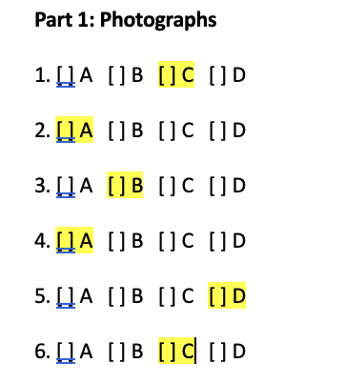
Listening section answers

Slide 6
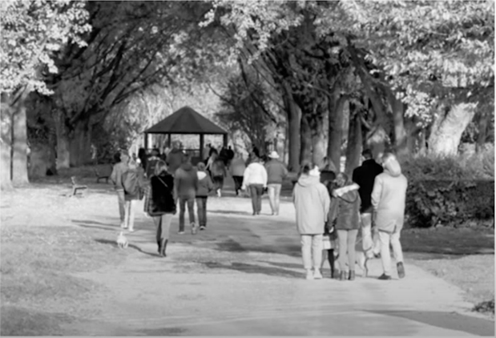
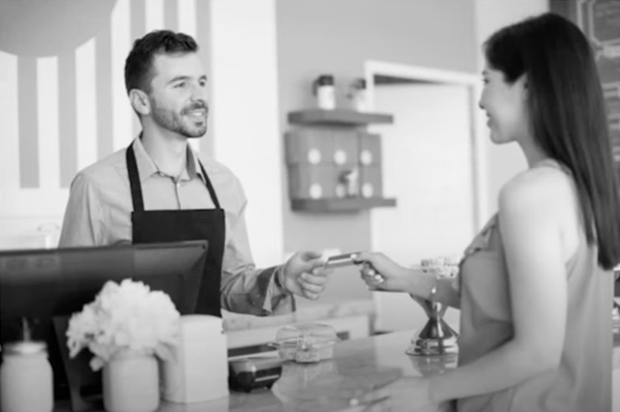
C) Pedestrians are walking on the path.
A) The guest is settling the bill.

Slide 7


B) The building is under construction.
A) The board has been placed in the room.

Slide 8

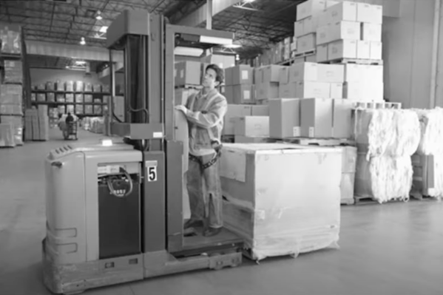
D) The merchandise is in the warehouse.
C) The people are talking in the stairway.

Slide 9
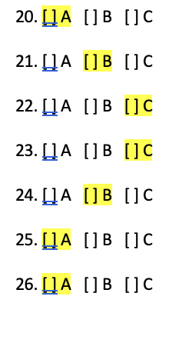
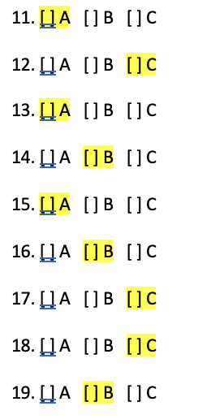
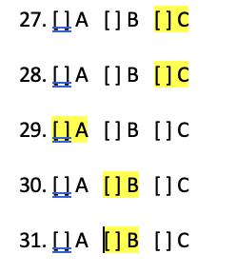

Slide 10
12: Could you work the morning shift?
A) We are moving next week
B) Following the weather forecast
C) I’ll let you know tomorrow

Slide 11
12: Could you work the morning shift?
A) We are moving next week
B) Following the weather forecast
C) I’ll let you know tomorrow

Slide 12
18: have you tried the chef’s special?
A) I’m a vegetarian
B) Take a look in the kitchen
C) No, not yet, but it sounds nice

Slide 13
24: whose parking space is this?
A) I’ve parked outside
B) It’s for company visitors
C) The CEO commutes by train.

Slide 14
28: when is the next board meeting?
A) The board weren’t present
B) We met them on Tuesday
C) No date has been agreed

Slide 15
30: which colour scheme should we choose?
A) We’ll decorate the lobby
B) Let’s have a vote
C) It should be finished soon

Slide 16
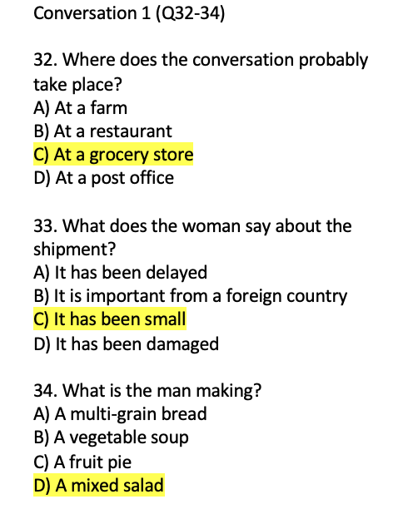
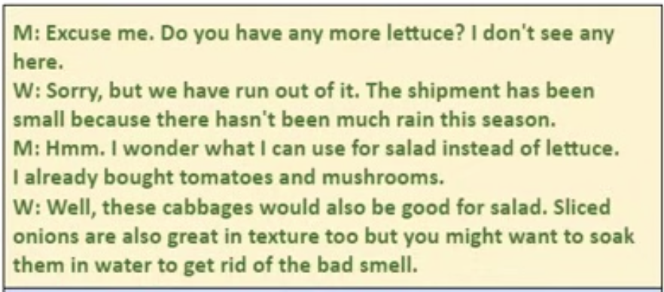

Slide 17
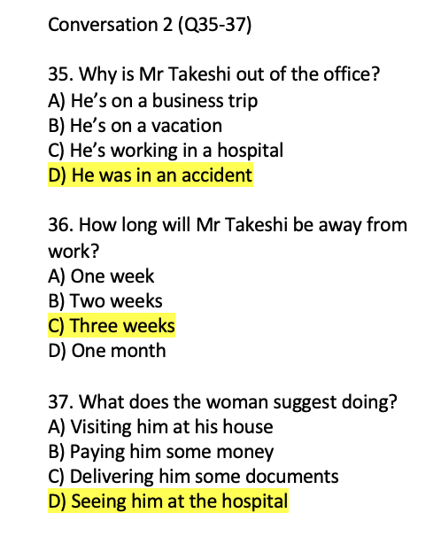
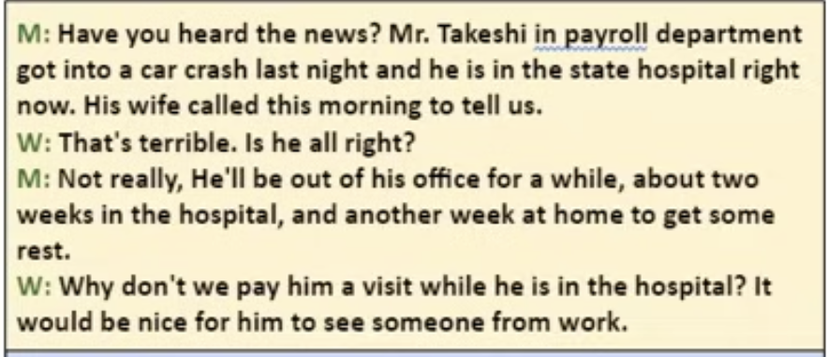

Slide 18
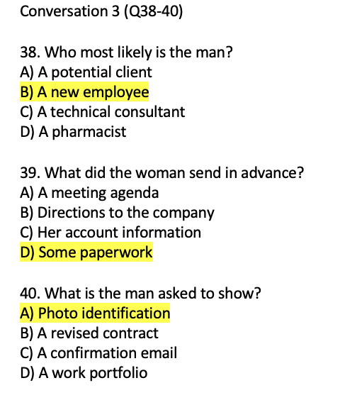
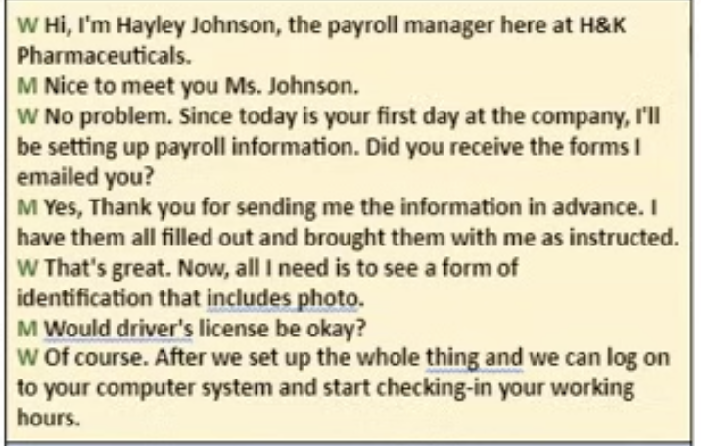

Slide 19
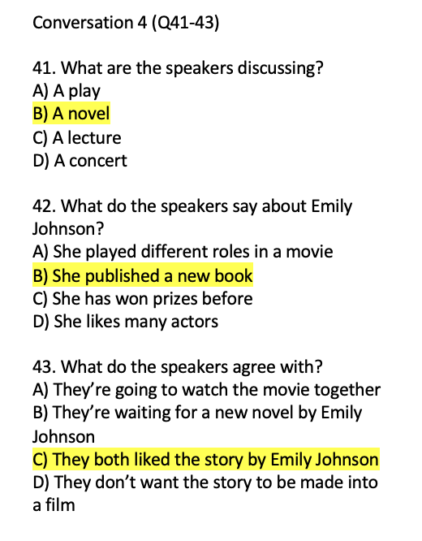
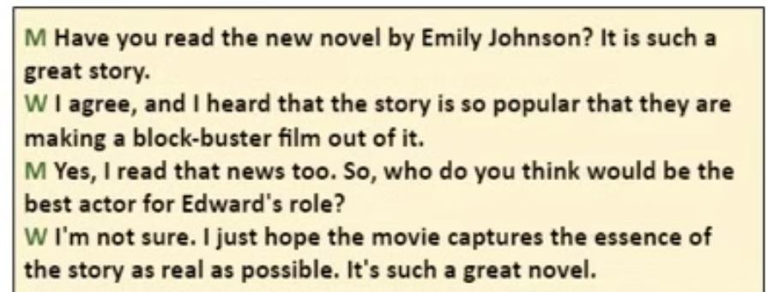

Slide 20
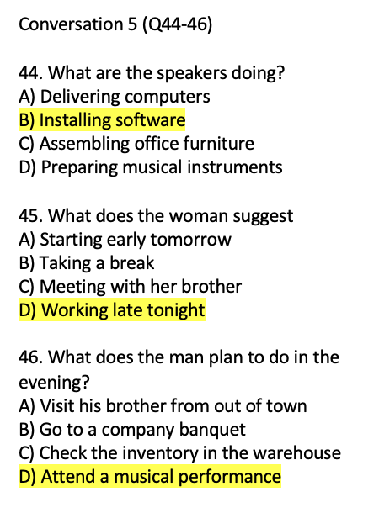
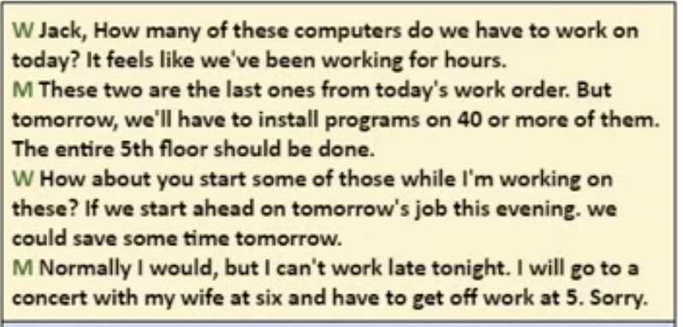

Slide 21
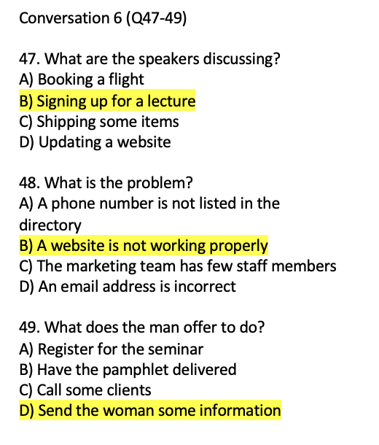
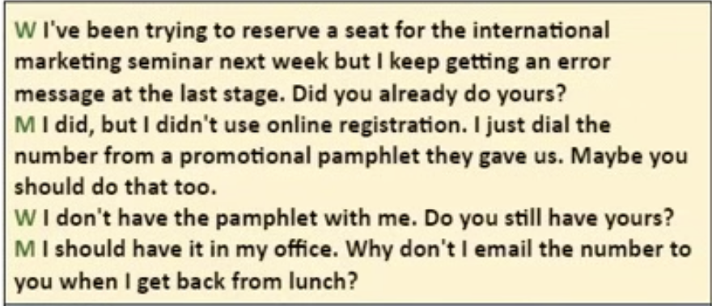

Slide 22
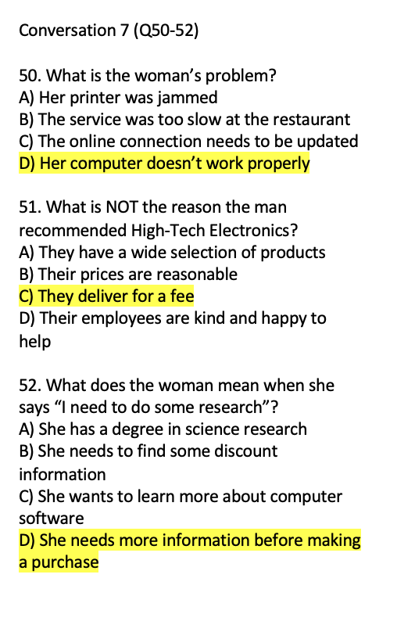
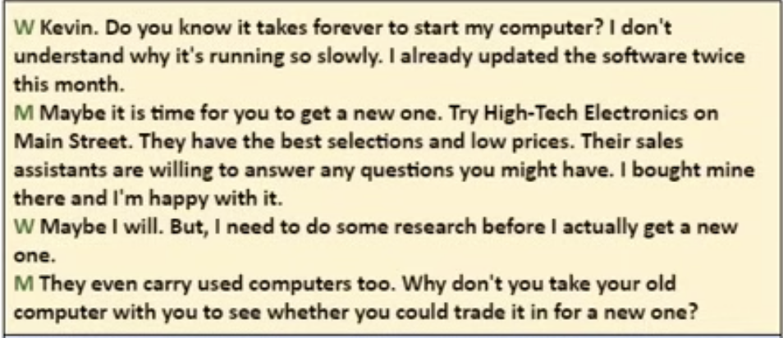

Slide 23
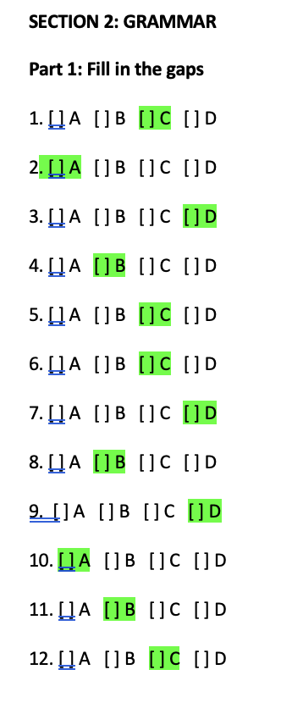

Slide 24
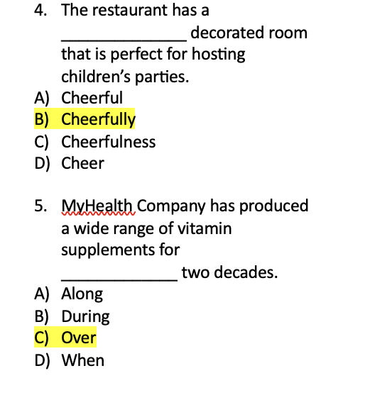
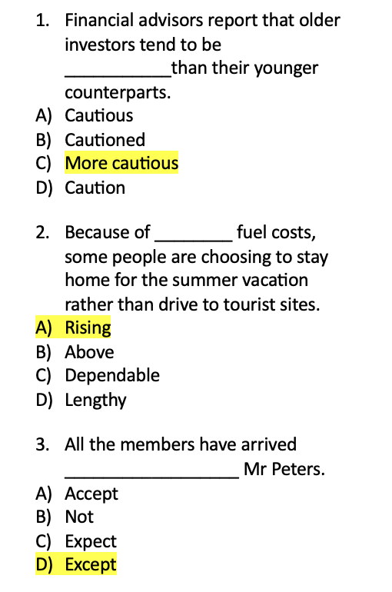
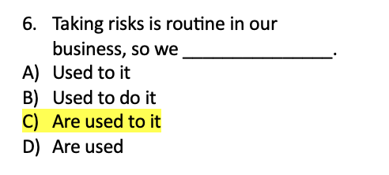

Slide 25
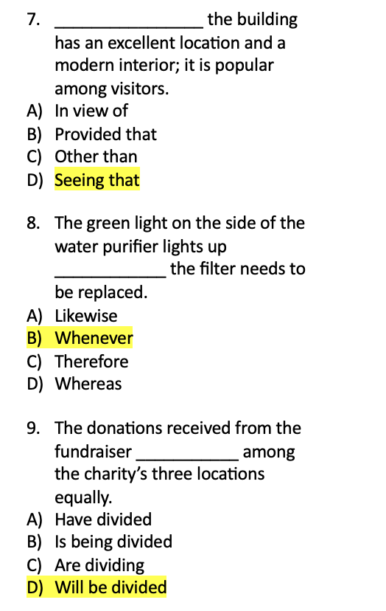
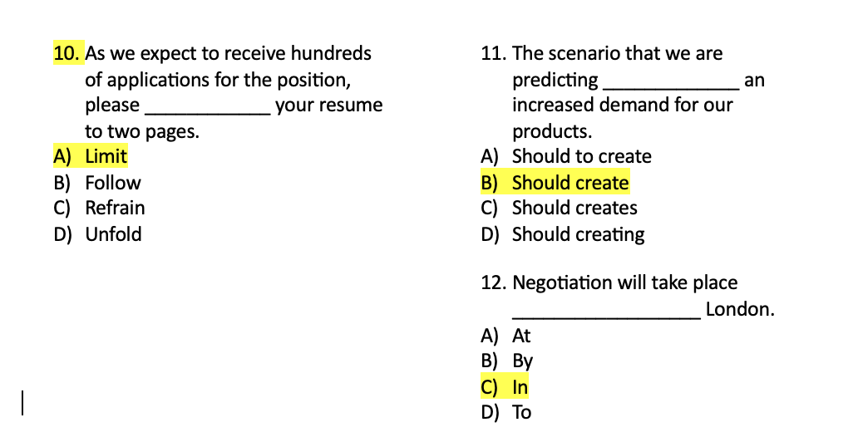

Slide 26
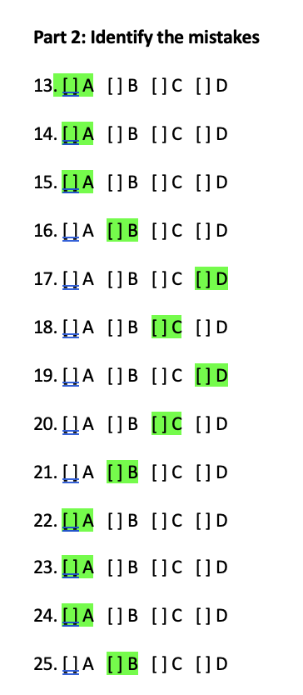

Slide 27
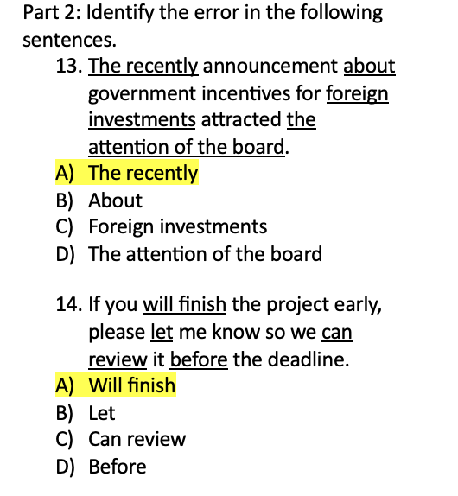
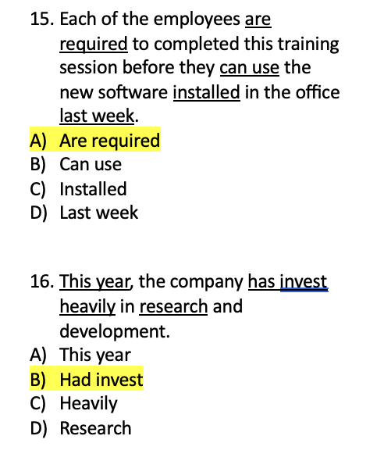

Slide 28
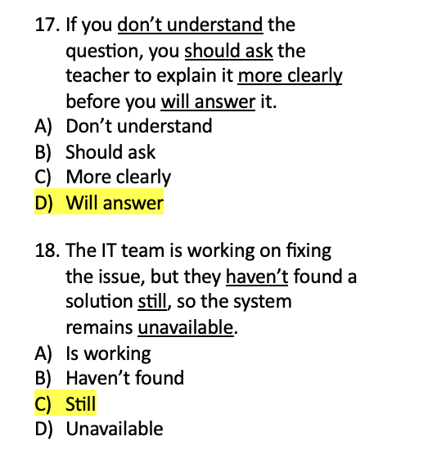
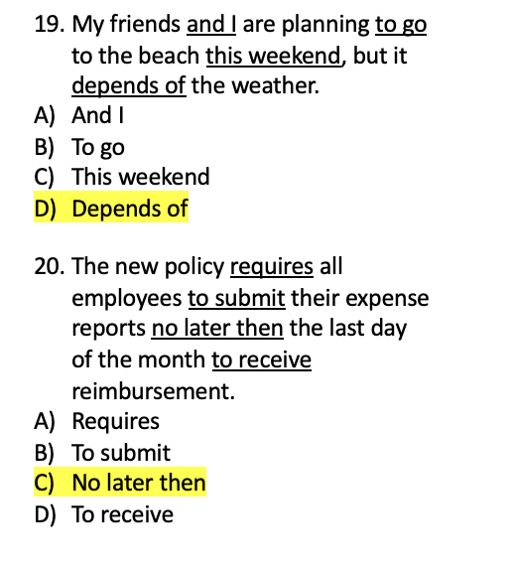

Slide 29
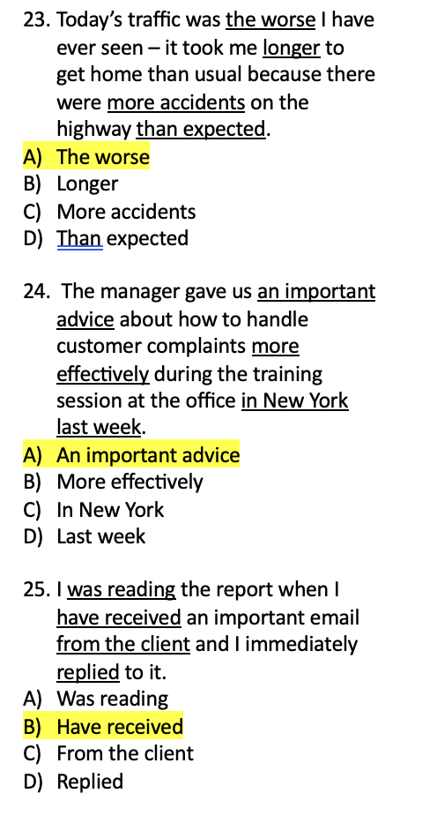
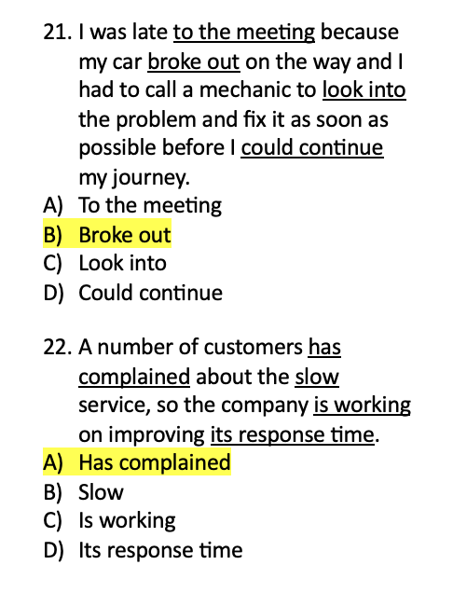

Slide 30
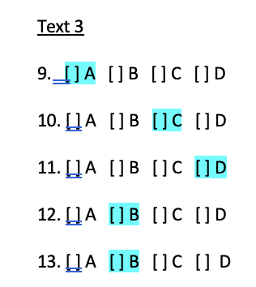
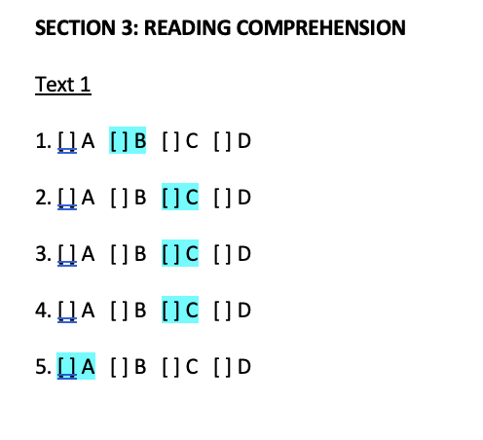
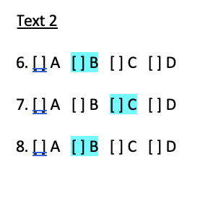
Reading section answers

Slide 31
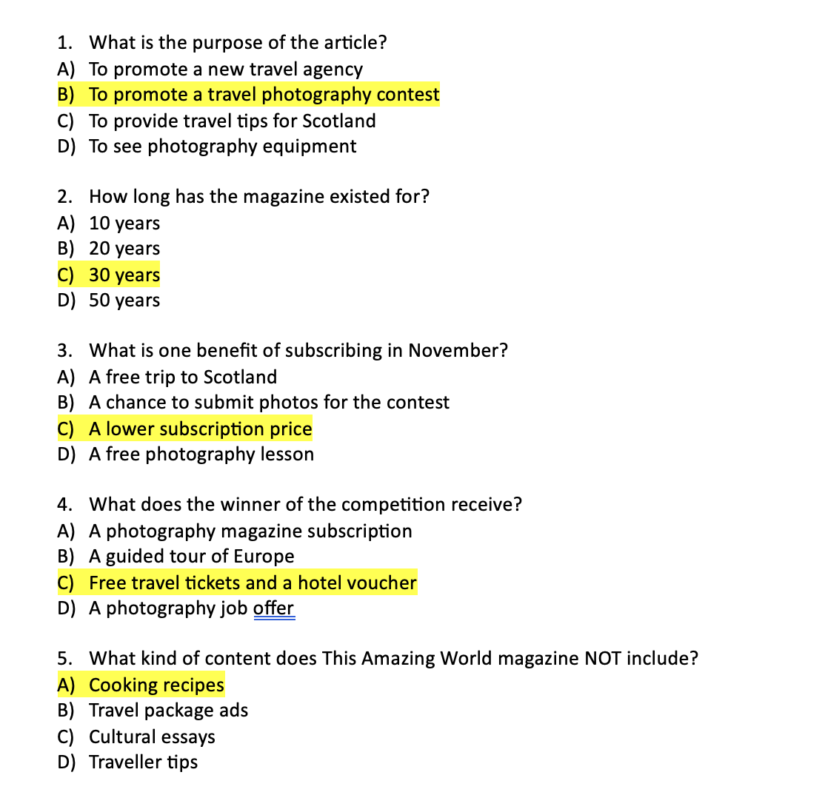
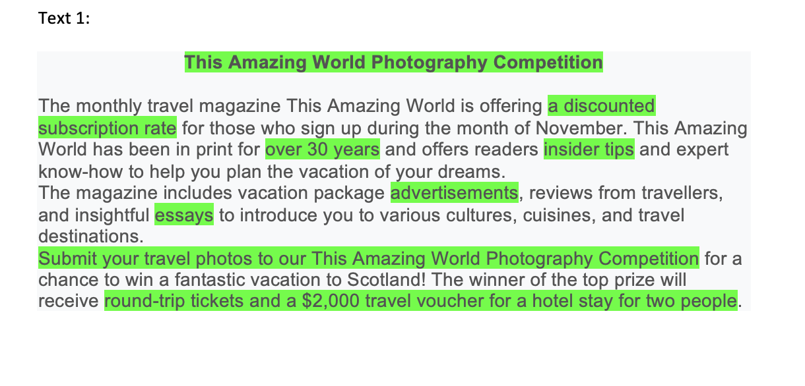

Slide 32
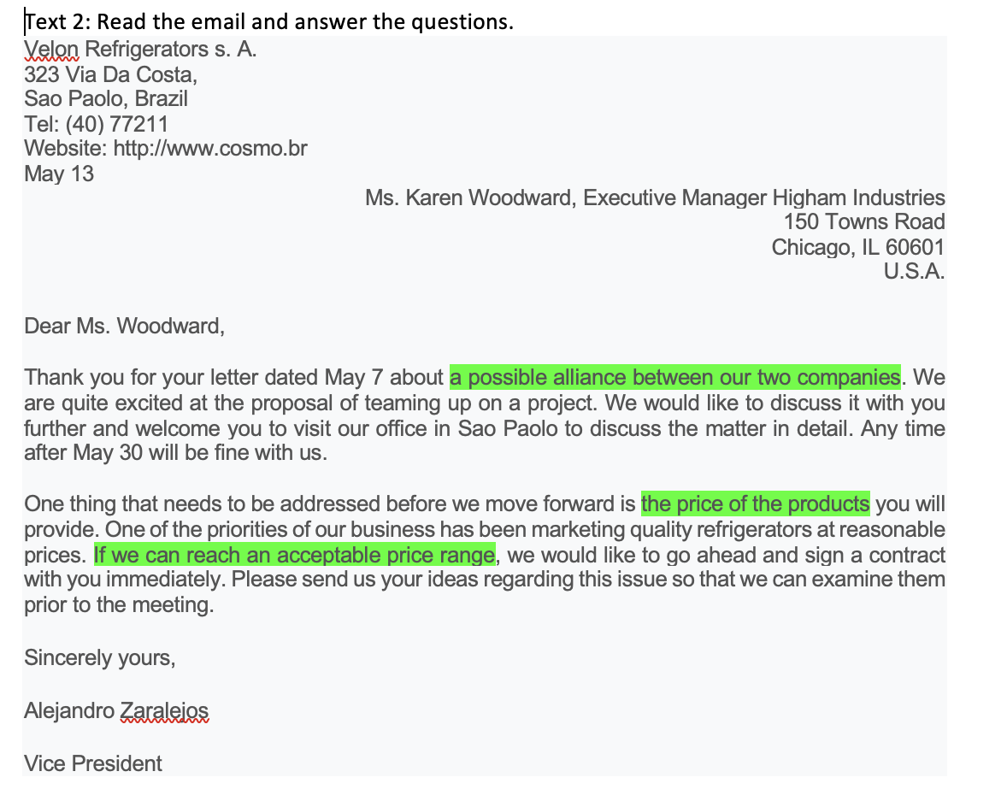
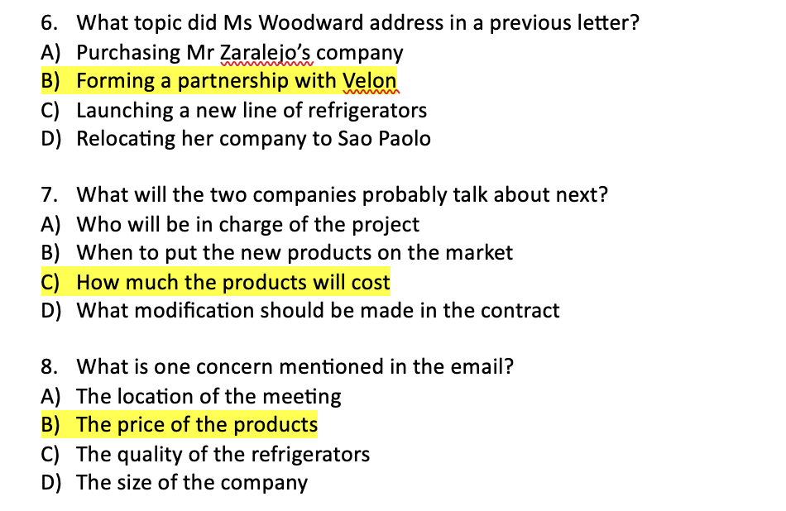

Slide 33
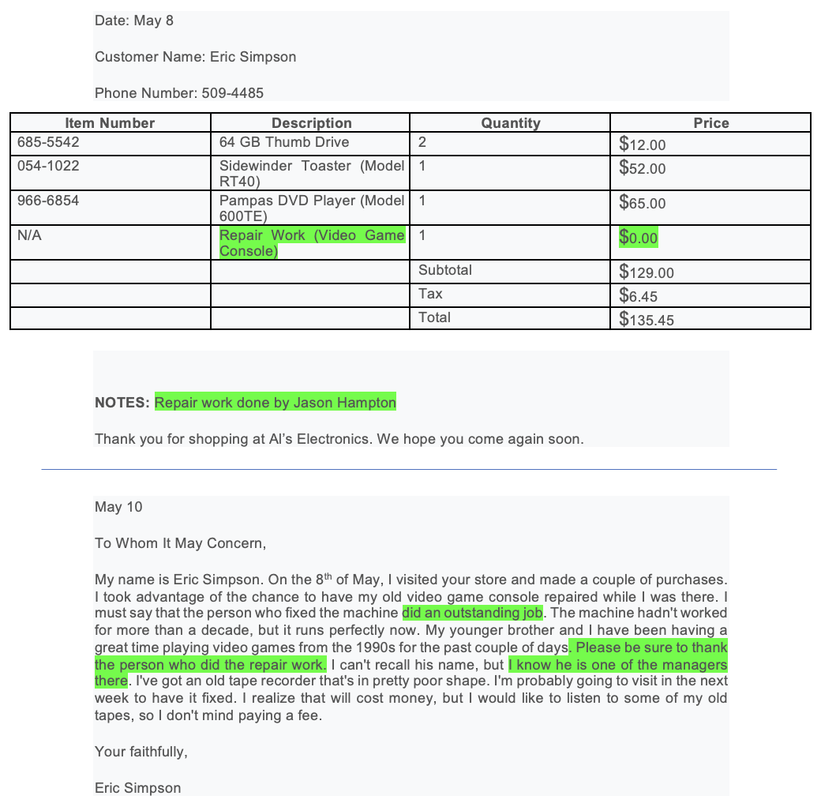
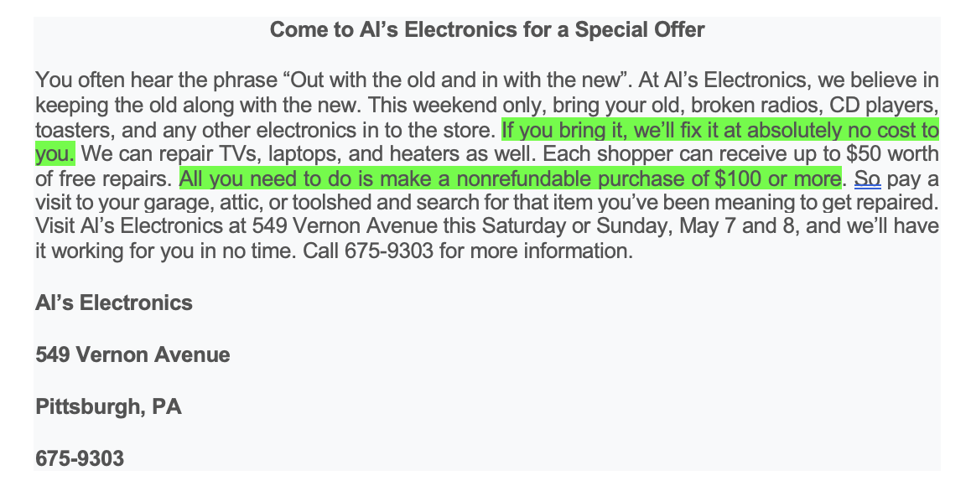

Slide 34
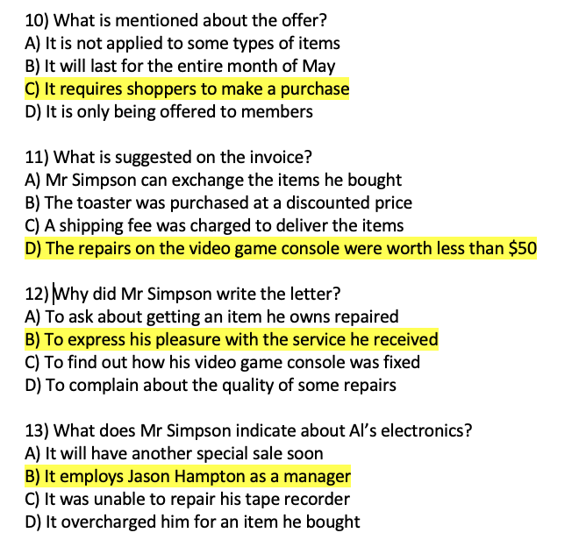
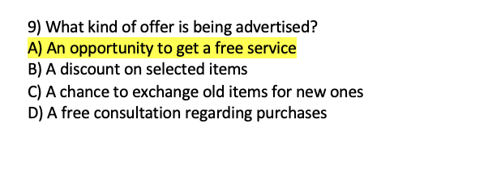

Slide 35
Writing – this needs work…
Better than the week 5 practice test but your essays still lack structure and are far too short.
You should leave about 30/35 minutes to write your essay in the exam. 5 minutes for planning and a whole 25/30 minutes to write.

Slide 36
Some people prefer shopping online, while others enjoy going to physical stores.
Which do you prefer: online shopping or shopping in stores? Explain your opinion with examples.
In 30 minutes, you should be able to write about 200 words.

Slide 37
In groups…
Discuss:
What do you need in an essay in terms of structure?

Slide 38
Structure
Introduction
Main body
Conclusion

Slide 39
1. Introduction
Don’t start by answering the question straight away (don’t start with ‘In my opinion’, I think that’)
You need 1 or 2 sentences to ease into the topic.
Thesis statement → the last sentence of the introduction that explains what the essay is about.
Total = 2/3 sentences (because of word limit)

Slide 40
Sentence with introduces topic.
“In today’s world, people have different preferences when it comes to shopping. Some enjoy the convenience of online shopping, while others prefer the experience of going to physical stores. In my opinion, shopping online is the better option because it is more convenient and offers more variety.”
Opinion statement – pick a side!

Slide 41
“The advent of IT and the internet has revolutionized the world of shopping. Several shopping websites have been created and, today, shopping can be done online and in physical stores. So, what option is the best?”
“Shopping online means getting the best option for so many people nowadays. However, others still prefer shopping in store. From my point of view, going to the store will always be the perfect choice for me.”
“In today’s world, shopping has become more accessible than ever, with the existence of both online and physical stores. While some people enjoy visiting store, I prefer online shopping because of its convenience, efficiency and greater variety.”

Slide 42
2. Main Body
At least 2 main points
  Word limit: 200 words so:
    Have 2 main points which are discussed in some depth
    One idea per paragraph!
    Develop on your ideas – give examples
Sign post → first, second, finally
Most important part of the essay!

Slide 43
Main body 1 – advantage of online shopping - convenience
First, online shopping saves time and effort. Instead of travelling to a store, I can simply use my phone or computer to buy what I need. This is especially useful when I am busy or when the weather is bad. Additionally, online stores are open 24/7, so I can shop at any time. For example, last month I bought a birthday gift for my friend late at night, which would not have been possible in a physical store.

Slide 44
Main body 2 – advantage of online shopping - choice
Second, online shopping provides more choices. Physical stores have limited space, so they may not have all the products I want. However, online stores offer a wide range of options, including items from different countries. For instance, I once bought a unique phone case from a website that I could not find in local stores.

Slide 45
3. Conclusion
Sum up what you have said in your essay but in a different way (do not repeat everything in the same way).
Make it clear that this is a conclusion – “In conclusion …”
1 ending sentence that ties it all up nicely
Total = 2/3 sentences (because of the word limit)

Slide 46
“In conclusion, while shopping in stores can be enjoyable for some people, I personally prefer online shopping. It suits my lifestyle and helps me to make better choices.”
“In conclusion, online shopping is my favourite because it is quick and offers more variety. Although shopping in stores can be enjoyable – with friends, for example - I prefer the comfort of shopping from home.”
“In summary, shopping in store may help us to enjoy the communication with staff, but I think that shopping online offers us the opportunity to enjoy a great shopping experience by finding special items at low prices and being able to save some tie in our daily schedule.”

Slide 47
“In conclusion, while shopping in stores can be enjoyable for some people, I personally prefer online shopping. It suits my lifestyle and helps me to make better choices.”
“In conclusion, online shopping is my favourite because it is quick and offers more variety. Although shopping in stores can be enjoyable – with friends, for example - I prefer the comfort of shopping from home.”
“In summary, shopping in store may help us to enjoy the communication with staff, but I think that shopping online offers us the opportunity to enjoy a great shopping experience by finding special items at low prices and being able to save some time in our daily schedule.”

Slide 48
In conclusion, I prefer online shopping because it is more convenient and offers more variety. Although shopping in stores can be enjoyable, online shopping is the best choice for me.

Slide 49
A poorly written response – improve it !
Shopping in stores is sometimes fun because you can see things. But online shopping is better because you don’t need to leave home. Also, online stores are open all the time, which is cool. But sometimes when you buy things online, you don’t know if they’ll be good, and it takes too long to get them. I like that in stores, you can touch stuff, but it’s a hassle to go. Online is easier, and there are many choices, but in stores, you can try things on.
Notes:
No introduction – clearly state preference and briefly introduce reasons for it
No conclusion – feels unfinished without
Unclear organisations – ideas are mixed together without clear development or logical flow – jumps from ‘shoppingin stores is fun to ‘online shopping is better without explaining why
No elaboration on points – shopping in stores is fun but doesn’t way why …
No supporting details or specific examples
Repetition – repeats similar ideas m;tiple times without developing on them
Weak language use – too infomal and lacks complexity – phrases like cool’ are too casual – some sentences too short and choppy
TO IMPROVE
Start with structure – intordic tion, clear paragraphs for each reason and a conclusion
Clarity and flow – arrange ideas logically and connect them with transitions
Development – provide specific examples and elaborate on each one to make arguments stronger
More formal language

Slide 50
Some people prefer to eat at home, while others like to eat at restaurants.
Which do you prefer: eating at home or eating at restaurants? Explain your opinion with reasons and examples.

Slide 51
Eating at home
Eating at a restaurant
Convenient (no cooking or cleaning)
Variety of choice
Social experience
Professional cooking
Expensive
Long wait times
No leftovers
Cost effective
Healthier options
Convenient
Comfortable
Effort required
Time-consuming
Lack of social interaction
Pick a ‘side’. Then pick 2 or 3 arguments to focus on in your essay.

Slide 52
Some people prefer to eat at home, while others like to eat at restaurants.
Which do you prefer: eating at home or eating at restaurants? Explain your opinion with reasons and examples.
Write a short response to this question. You have 10-12 minutes to do so.

Slide 53
Let the person next to you read your response.
Did they introduce the topic clearly?
Did they state their opinion?
Did they discuss one idea per paragraph?
Did they explain their opinion and use examples?
Did they include a conclusion?
How is their language?
Did they write enough?

Slide 54
Grammar worksheets on arche
Pick 2 or 3 of the grammar worksheets on ARCHE, depending on what you feel that you need to work on.
Spend the next 30 minutes working on grammar. I will come round to hear any concerns you have and answer your questions about the final exam.

