Slide 1
Dulasp M4
Preparation aux tests linguistiques
Week 2: 21 January 2026

Slide 2
agenda
Attendance
Grammar test review
Grammar points
Reading and comprehension
Writing

Slide 3



attendance
In DULASP, attendance is mandatory.
If you cannot attend a class, you MUST send a justification to your teacher (me) and to all-ncy-dulasp-contact@univ-lorraine.fr within 8 days of your absence.
Notes:
As they should know…..

Slide 4
Grammar test review
Incomplete sentences
Conditionals, verb tenses, prepositions, cause and effect connectors, modality, comparatives and superlatives, passive and active constructions.
Error recognition
Subject-verb agreement, articles, verb forms, word order, countable/uncountable nouns
Writing
Punctuation, structure, answering the question

Slide 5
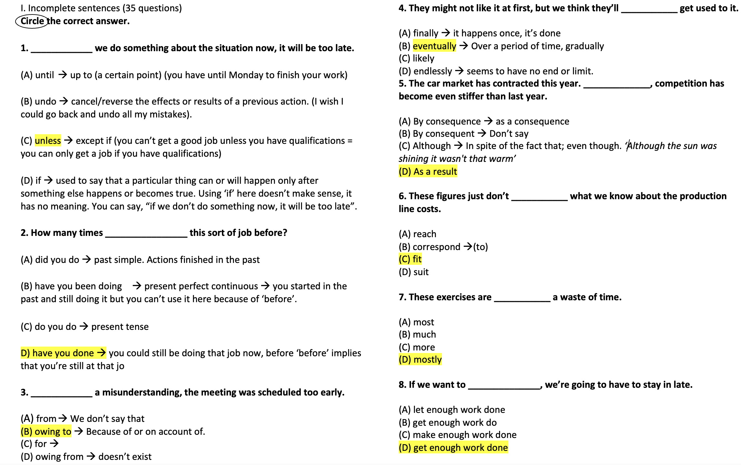

Slide 6
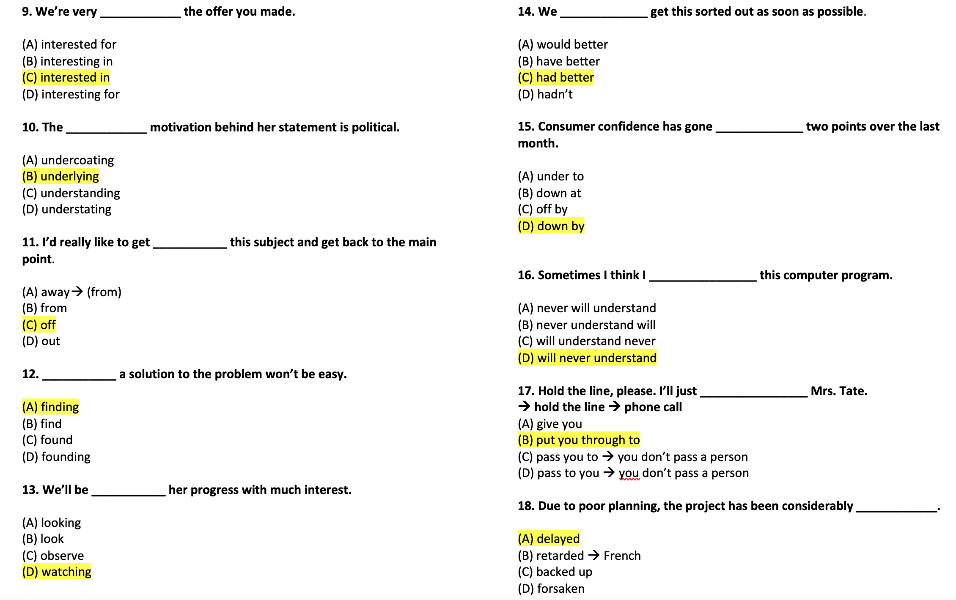

Slide 7
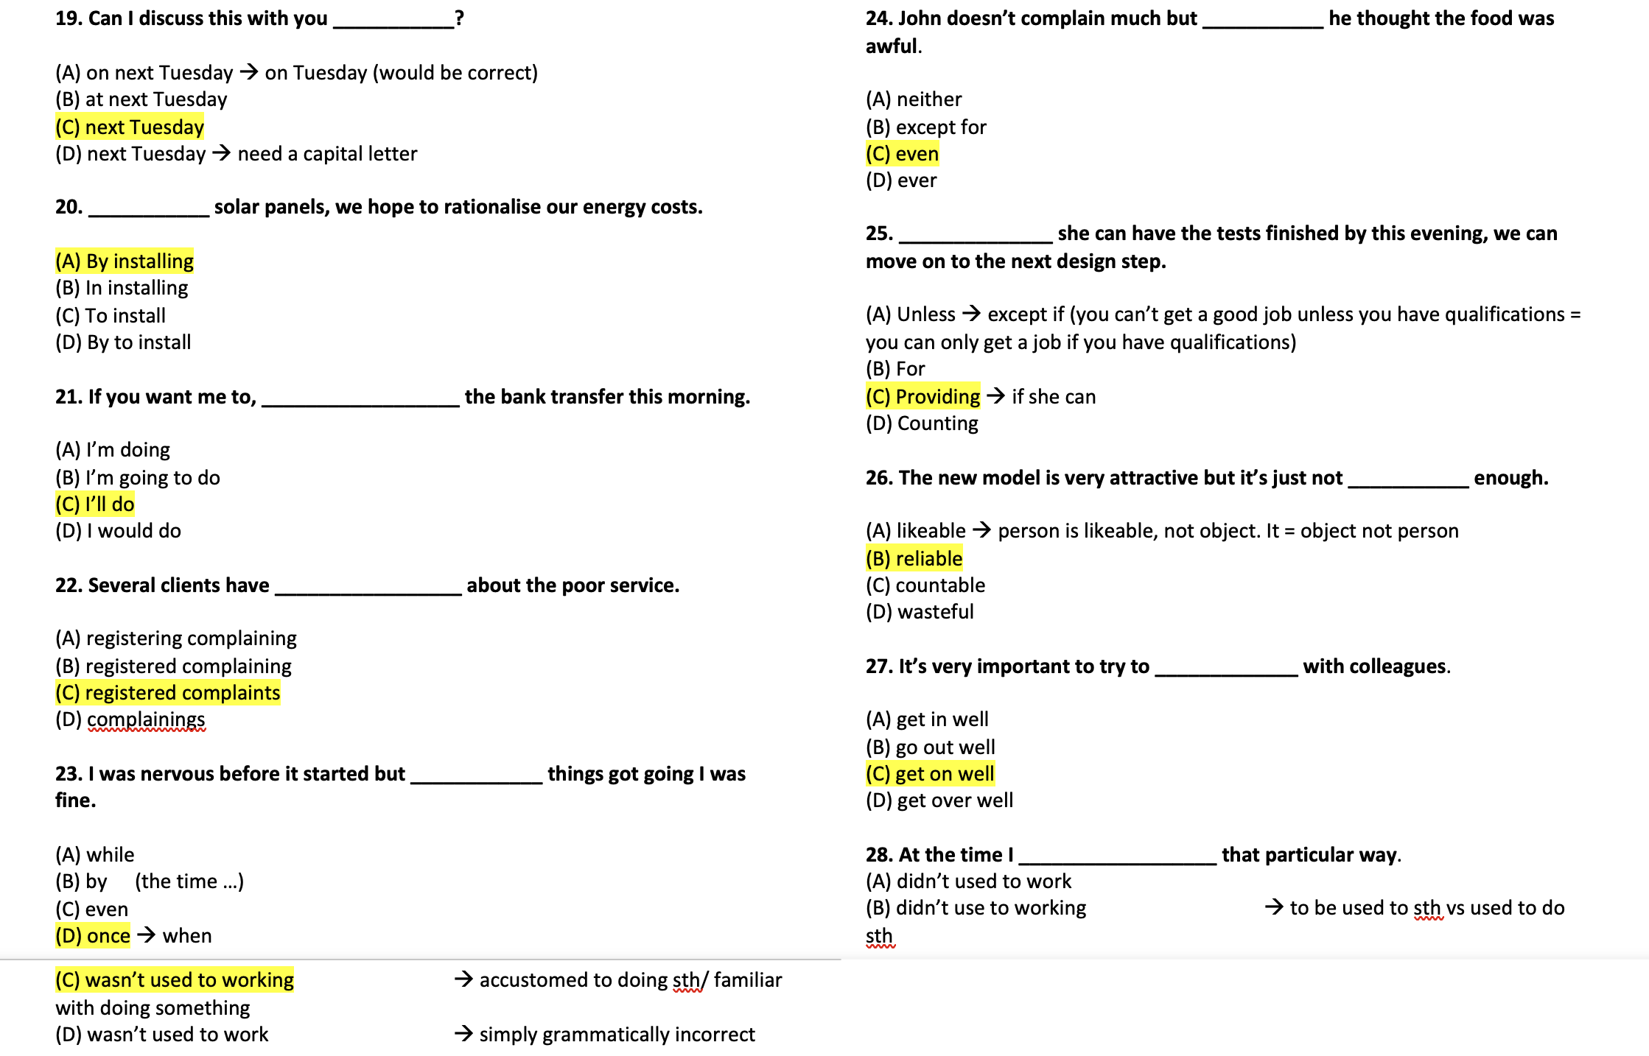

Slide 8
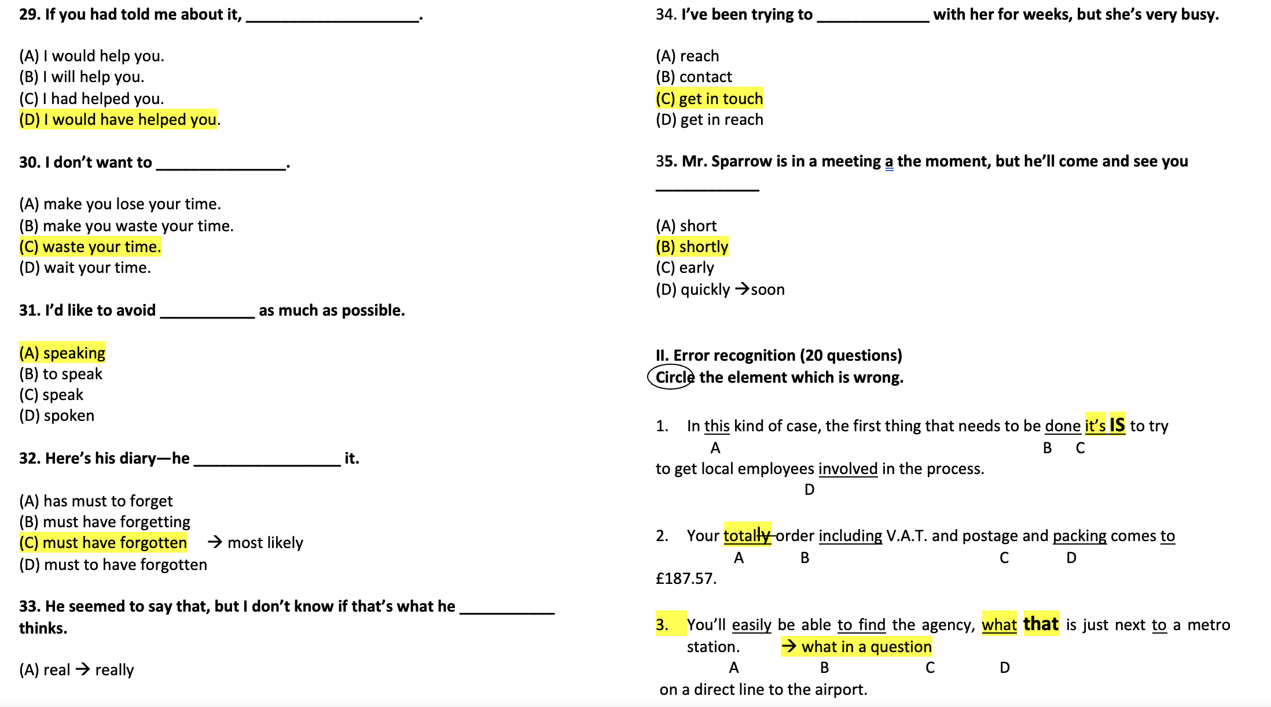

Slide 9
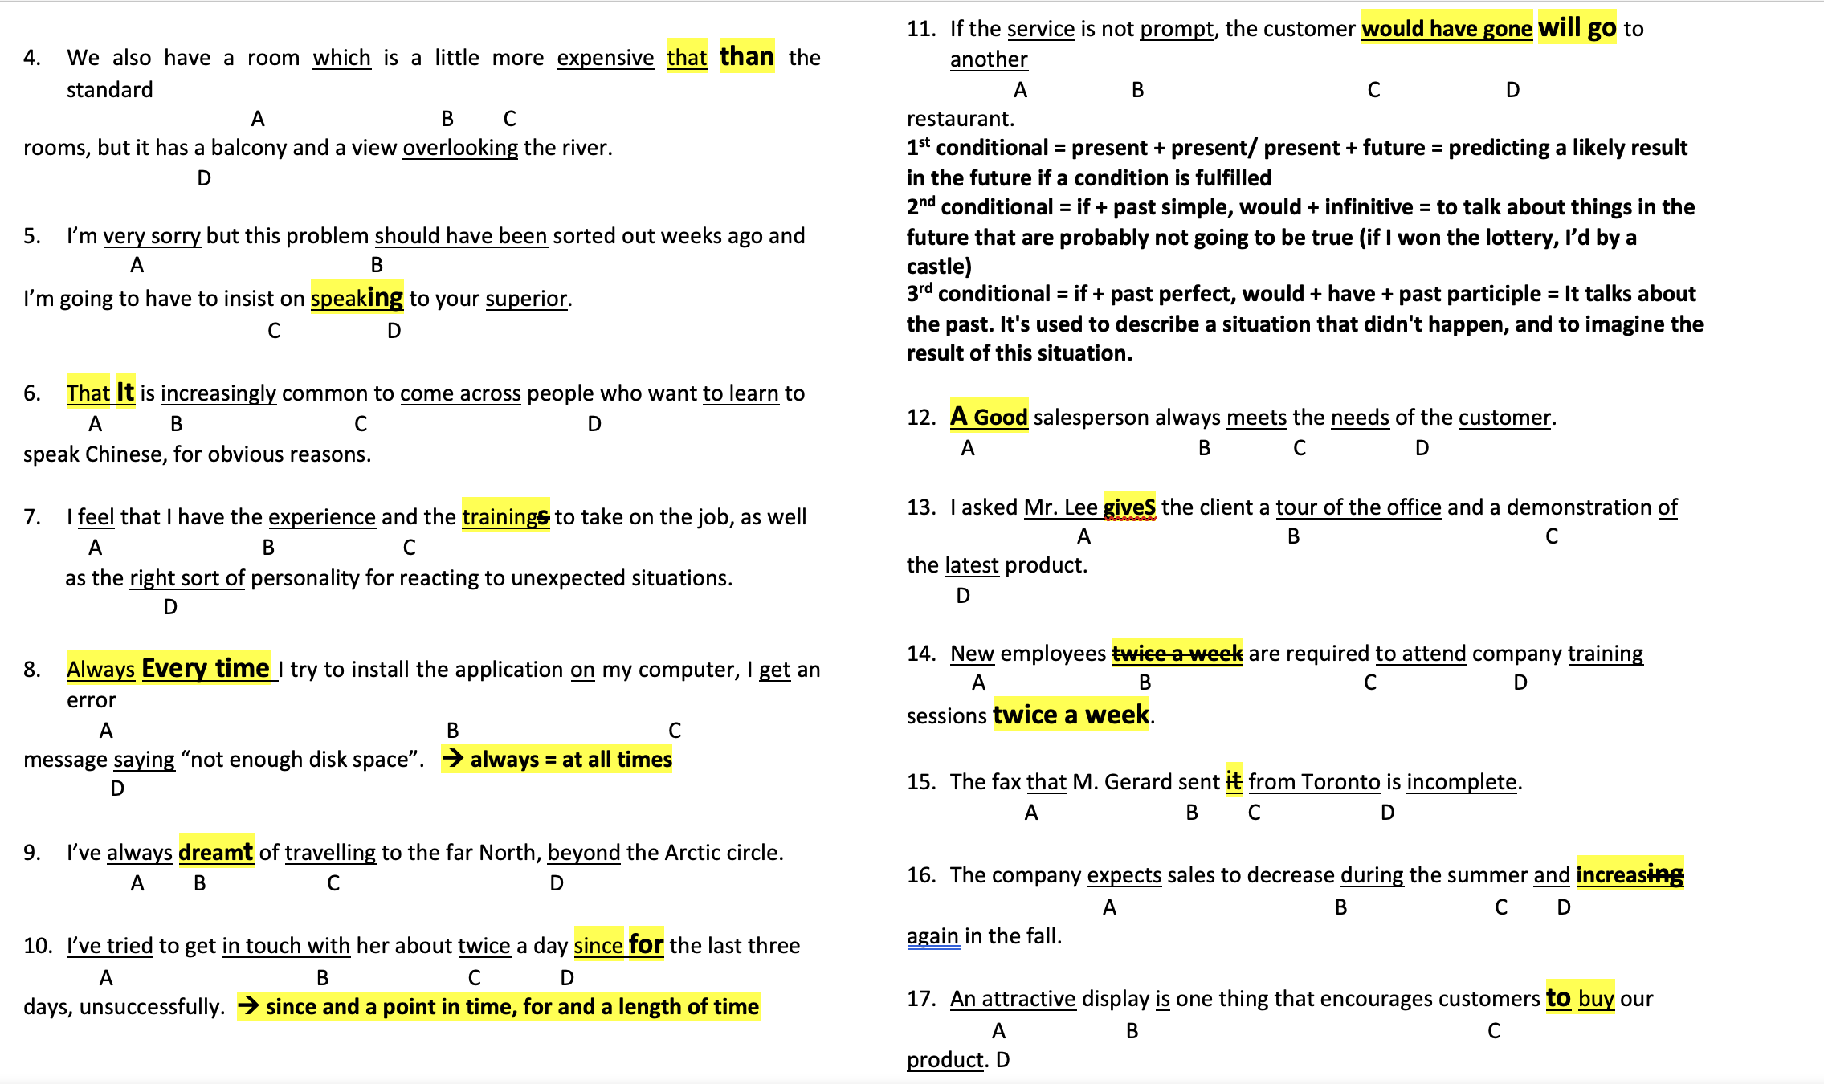

Slide 10
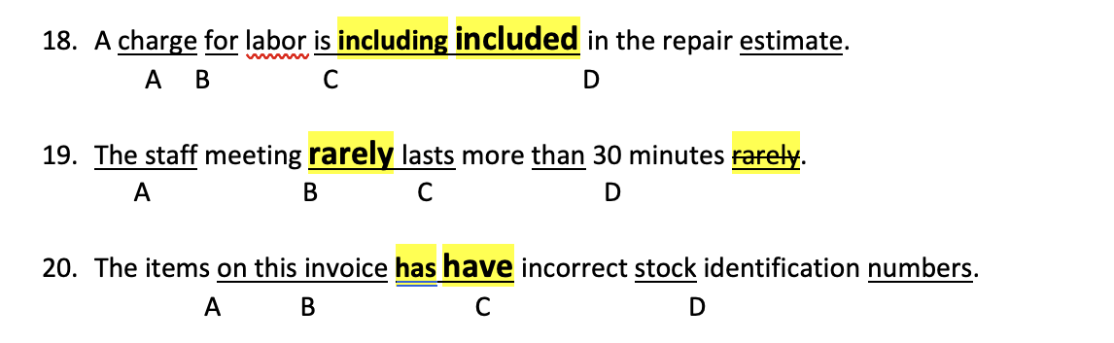

Slide 11
Capital letters, full stops and more…
 | Capitalise | Don’t capitalise
People | Names (and words derived from them); nationalities; titles when used as part of a name the works of Aristotle a Freudian psychoanalyst the Brazilian actor the campaign of Senator Sanders | Occupations; titles when not used as part of a name the magazine’s managing editor an elderly professor the left-wing senator
Places | Names of specific continents, countries, states, cities, regions, monuments and landmarks South America the West Coast of the US the Eiffel Tower the River Thames | Directions and general areas head north the west of the city the longest river in the world
Times | Days of the week and months of the year; historical eras and named events; holidays a Monday in July the Middle Ages the Napoleonic Wars Christmas Day | Centuries, decades, seasons an eighteenth-century painting the fashion of the fifties a summer vacation
Other | Organizations, companies and brand names Religions and deities Planets Languages | Animal and plant species Elements Minerals Theories and models Medical conditions

Slide 12
Exercise: add the capitals.
during spring break, my cousins and i travelled from chicago to new york city by train. we visited central park, the metropolitan museum of art, and times square, where we saw the bright lights and famous billboards. my cousin ella, who loves painting, was inspired by the art exhibits, while her brother liam enjoyed the food at a restaurant called the golden fork. on the last day, we took a ferry to see the statue of liberty and ellis island.

Slide 13
Exercise: add the capitals.
During spring break, my cousins and I travelled from Chicago to New York City by train. We visited Central Park, the Metropolitan Museum of Art, and Times Square, where we saw the bright lights and famous billboards. My cousin Ella, who loves painting, was inspired by the art exhibits, while her brother Liam enjoyed the food at a restaurant called the Golden Fork. On the last day, we took a ferry to see the Statue of Liberty and Ellis Island.

Slide 14
The 14 punctuation marks…

Slide 15
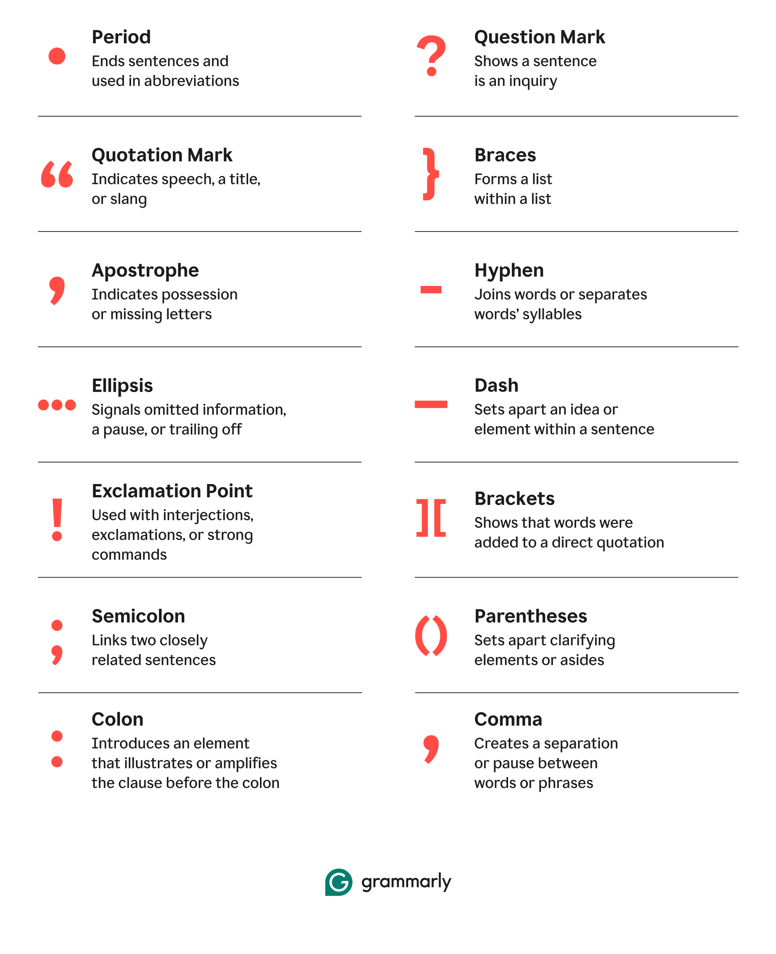

Slide 16
Some key rules…
1. All sentences must end in a full stop/period, exclamation mark or question mark.
2. Always use quotation marks, brackets and parentheses in pairs.
3. If an explanatory element of a sentence is not essential, set it apart with a comma.
Eg. Earth’s oldest tree Methuselah is over 4800 years old – insert the commas.
4. Introductory elements can be used at the beginning of a sentence to provide background for the main part of the sentence. Always put a comma after them.
Eg. Today, I discovered the meaning of life.

Slide 17
Exercise: punctuation
last weekend my friends and i went to the park we played soccer had a picnic and took photos while we were eating mia said this is the best day ever dont you think
everyone agreed it was so much fun after that we went to sarahs house to watch a movie her little brother asked can i watch with you but we said no because it was a scary movie

Slide 18
Exercise: punctuation
Last weekend, my friends and I went to the park. We played soccer, had a picnic and took photos. While we were eating, Mia said “This is the best day ever! Don’t you think?”
Everyone agreed it was so much fun. After that, we went to Sarah’s house to watch a movie. Her little brother asked, “Can I watch with you?” but we said no because it was a scary movie.

Slide 19
Reading comprehension 1
We are going to work on some reading comprehension questions together. Once you are confident in how to answer the questions, you will work individually or in pairs on the next questions.
On ARCHE, in the DULASP M4 intermediate section, you will find a folder called ‘Week 2’ and a document called ‘Reading comprehension 1’.

Slide 20
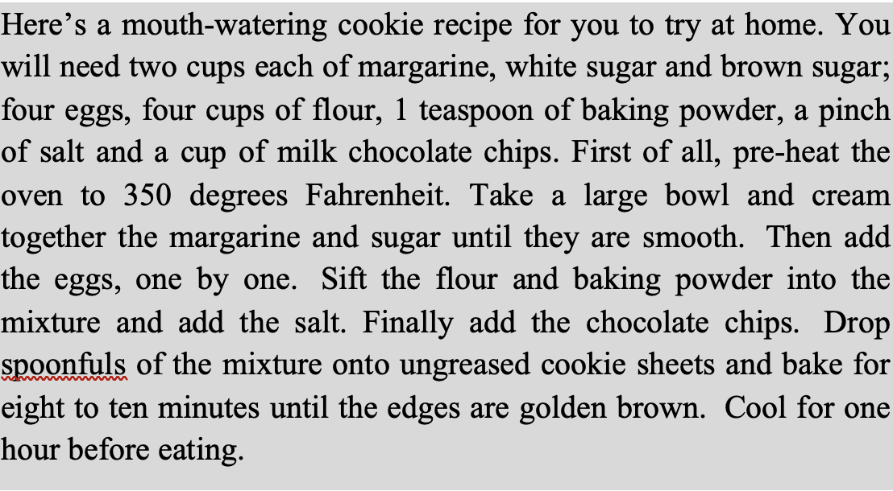
Read this recipe:

Slide 21
Questions
1. Which of the following is NOT an ingredient in the recipe?
a) Cream
b) Flour
c) Eggs
d) Margarine
2. What must the cook do first?
a) Put the margarine and sugar in a bowl
b) Turn on the oven
c) Sift the flour
d) Break the eggs
3. Which of the following items is needed to make this recipe?
a) A microwave
b) A sieve
c) A saucepan
d) A knife
4. Which of the following ingredients is added last?
a) Salt
b) Baking powder
c) Chocolate chips
d) Eggs

Slide 22
Questions
1. Which of the following is NOT an ingredient in the recipe?
a) Cream
b) Flour
c) Eggs
d) Margarine
2. What must the cook do first?
a) Put the margarine and sugar in a bowl
b) Turn on the oven
c) Sift the flour
d) Break the eggs
3. Which of the following items is needed to make this recipe?
a) A microwave
b) A sieve
c) A saucepan
d) A knife
4. Which of the following ingredients is added last?
a) Salt
b) Baking powder
c) Chocolate chips
d) Eggs

Slide 23
A key part of reading comprehension is understanding what the question is asking you to do.
Look for words that can help you narrow the scope of the question – here, words like ‘recipe’, ‘ingredients’ and ‘cook’ direct you to the right part of the text.
Highlight specific details – words like ‘NOT’, ‘first/last’, ‘needed’ etc tell you the specific type of information you need – exceptions, necessities, actions and order.
In intermediate reading comp questions, the answer is always in the text! Ask yourself: What specific information is this question looking for in the text?

Slide 24
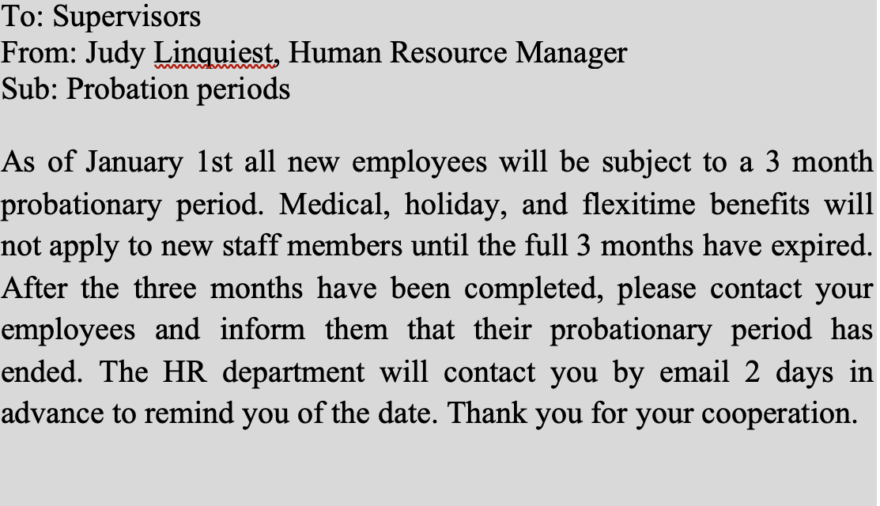
Read this memo:

Slide 25
questions
1. What is the main purpose of this memo?
A) To inform all employees of a new expiration date.
B) To put staff members on probation.
C) To introduce the HR department.
D) To inform supervisors of a change in policy.
2. When does the change come into effect?
A) Today.
B) In 2 days.
C) In 3 months.
D) On January 1st.

Slide 26
questions
1. What is the main purpose of this memo?
A) To inform all employees of a new expiration date.
B) To put staff members on probation.
C) To introduce the HR department.
D) To inform supervisors of a change in policy.
2. When does the change come into effect?
A) Today.
B) In 2 days.
C) In 3 months.
D) On January 1st.

Slide 27
READ THIS LETTER:
Dear Helen,
I would like to congratulate you on organising such an excellent and informative workshop. I know a lot of people learnt a great deal from it. Can you pass on my thanks to Doctor Friedman for his fascinating talk on Staff Motivation? I realise how lucky we were that he was able to find the time for us. The feedback from the staff was very positive. Let’s hope we actually see an improvement in staff motivation as a result!
By the way, I’m missing my list of addresses of the delegates who attended. Did I happen to leave it in your office? It’s just that I haven’t seen it since our meeting on Friday.
Thanks again for a great day,
Anne

Slide 28
questions
3. What can be implied about Dr Friedman?
a) He works in the same office as Anne.
b) He has a very busy schedule.
c) He is a leading expert on staff motivation.
d) Anne knows him better than Helen does.
4. What has happened to the address list?
a) Anne has lost it.
b) Anne has found it.
c) Anne has sent it to Helen.
d) Anne has completed it.
1. What is the main objective of the message?
a) To inform
b) To accuse
c) To make a request
d) To praise
2. What can be implied about the workshop?
a) All the delegates were staff from the same office.
b) It included several talks.
c) It lasted one day.
d) Motivation was the only topic discussed.

Slide 29
questions
3. What can be implied about Dr Friedman?
a) He works in the same office as Anne.
b) He has a very busy schedule.
c) He is a leading expert on staff motivation.
d) Anne knows him better than Helen does.
4. What has happened to the address list?
a) Anne has lost it.
b) Anne has found it.
c) Anne has sent it to Helen.
d) Anne has completed it.
1. What is the main objective of the message?
a) To inform
b) To accuse
c) To make a request
d) To praise
2. What can be implied about the workshop?
a) All the delegates were staff from the same office.
b) It included several talks.
c) It lasted one day.
d) Motivation was the only topic discussed.

Slide 30
I am interested in this job because I am currently looking for an opportunity to use the skills I learnt in my college. I have recently completed a 16-week part-time accounting course (AAT Level 2 Certificate). The course covered book-keeping, recording income and receipts and basic costing. We used a wide range of computer packages, and I picked up the accounting skills easily. I was able to work alone with very little extra help. I passed the course with merit. I believe my success was due to my thorough work, my numeracy skills and my attention to detail. During the course, I had experience of working to deadlines and working under pressure. Although this was sometimes stressful, I always completed my work on time. Unfortunately, the course did not include a work placement, so I have not practised my skills in a business setting, and I am now looking for an opportunity to do so. I am particularly looking for a job in a small company such as yours, as I believe I will be able to interact with a wider range of people, and as a result, learn more skills. I would like to progress within a company and gain more responsibilities over the years. Although I do not have work experience in finance, I have experience in working in an office environment. Before starting the accounting course, I worked for 6 months in a recruitment office as a receptionist. My duties involved meeting and greeting clients and visitors, taking phone calls, audio and copy typing and checking stock. I also had to keep the petty cash and mail records. Through this work, I developed my verbal and written communication skills. I had to speak confidently to strangers and deliver clear messages. I enjoyed working in a team environment. I believe the office appreciated my friendly manner and efficient work.

Slide 31
How to answer True or false questions
Read the statement carefully.
Find evidence in the text – use keywords to guide you.
Compare the statement to the text.
Watch for traps.
Handle statements with implications.
Be objective.

Slide 32
Are the following statements true or false? Write 'not in text' if the information is not there.
1. The candidate has a qualification in accounting.
2. The candidate has a university degree in accounting.
3. The candidate has worked as an accountant before.
4. The candidate worked with an accounting firm as a receptionist.
5. The candidate is familiar with some accounting software.
6. The candidate has worked as part of a team in an office environment.
7. The candidate has experience of record-keeping.
8. The candidate wants to learn on the job.
9. The candidate has a maths qualification.
10. The candidate can work by herself.
11. The candidate intends to study a further accounting course.
12.. The candidate believes herself to be a careful worker.
13. Deadlines do not stress the candidate.
14. The candidate is applying for a job in a large firm.

Slide 33
Are the following statements true or false? Write 'not in text' if the information is not there.
1. The candidate has a qualification in accounting. TRUE
2. The candidate has a university degree in accounting. FALSE
3. The candidate has worked as an accountant before. FALSE
4. The candidate worked with an accounting firm as a receptionist. FALSE
5. The candidate is familiar with some accounting software. TRUE
6. The candidate has worked as part of a team in an office environment. FALSE
7. The candidate has experience of record-keeping. TRUE
8. The candidate wants to learn on the job. TRUE
9. The candidate has a maths qualification. NOT IN TEXT
10. The candidate can work by herself. TRUE
11. The candidate intends to study a further accounting course. NOT IN TEXT
12.. The candidate believes herself to be a careful worker. TRUE
13. Deadlines do not stress the candidate. FALSE
14. The candidate is applying for a job in a large firm. FALSE

Slide 34
I am interested in this job because I am currently looking for an opportunity to use the skills I learnt in my college. I have recently completed a 16-week part-time accounting course (AAT Level 2 Certificate). The course covered book-keeping, recording income and receipts and basic costing. We used a wide range of computer packages, and I picked up the accounting skills easily. I was able to work alone with very little extra help. I passed the course with merit. I believe my success was due to my thorough work, my numeracy skills and my attention to detail. During the course, I had experience of working to deadlines and working under pressure. Although this was sometimes stressful, I always completed my work on time. Unfortunately, the course did not include a work placement, so I have not practised my skills in a business setting, and I am now looking for an opportunity to do so. I am particularly looking for a job in a small company such as yours, as I believe I will be able to interact with a wider range of people, and as a result, learn more skills. I would like to progress within a company and gain more responsibilities over the years. Although I do not have work experience in finance, I have experience in working in an office environment. Before starting the accounting course, I worked for 6 months in a recruitment office as a receptionist. My duties involved meeting and greeting clients and visitors, taking phone calls, audio and copy typing and checking stock. I also had to keep the petty cash and mail records. Through this work, I developed my verbal and written communication skills. I had to speak confidently to strangers and deliver clear messages. I enjoyed working in a team environment. I believe the office appreciated my friendly manner and efficient work.

Slide 35
QUESTION 5: THE COACH HOTEL REVIEWS
The question asks: Which reviewer(s) said the following? - what do you have to do?
1. The hotel was too expensive.
2. The decor was old-fashioned.
3. The service was poor.
4. The service was good.
5. The bed clothes were dirty.
6. The room was dirty.
7. The room was big.
8. The location was bad.
9. The shower was inadequate.
10. The food was bad quality.
11. The food was good.
12. The food portions were small.
13. The room did not have everything the reviewer expected.
14. The room wasn’t quiet.

Slide 36
QUESTION 5: THE COACH HOTEL REVIEWS
The question asks: Which reviewer(s) said the following? - what do you have to do?
1. The hotel was too expensive. 1
2. The decor was old-fashioned. ALL
3. The service was poor. 1+4
4. The service was good. 2
5. The bed clothes were dirty. 1
6. The room was dirty. 3
7. The room was big. 2
8. The location was bad. 4
9. The shower was inadequate.1
10. The food was bad quality. 4
11. The food was good. 1+2
12. The food portions were small. 1+3
13. The room did not have everything the reviewer expected. 1+2
14. The room wasn’t quiet. 2

Slide 37
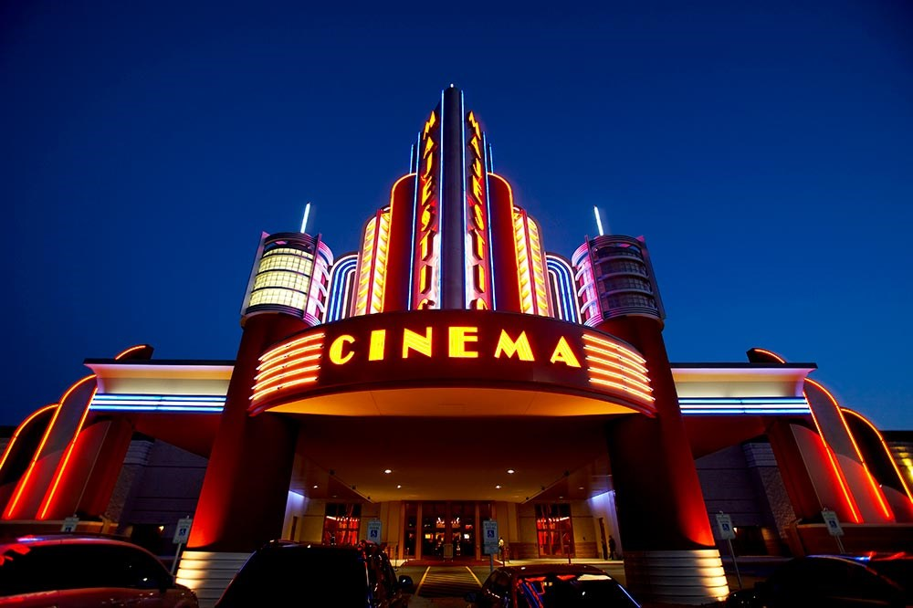
Writing task
Write a paragraph to answer the following questions:
What kind of films do you enjoy?
Do you prefer watching them at the cinema or at home? Why?

