Slide 1
Dulasp m4 intermediate

Slide 2
Important: Final exam!
Your final exam will take place on XXXX
You need to arrive ON TIME. Once the test begins, you will not be allowed to enter the room.
No dictionaries! Come with a pencil and your brains!
No phones, laptops, smartwatches…

Slide 3
agenda
Discussion regarding test.
Review of listening and reading sections.
Grammar review and activities.
Writing review and practice.

Slide 4
How did you find the practice test?
What part was hardest?
What part was easiest?
If the final exam was next week, how confident would you feel out of 10?

Slide 5
General results
Generally, you all did well in the reading section!
Listening, grammar and writing need some work… We’ll spend the most time on these sections for the rest of the course.
The sections in your final exam will be weighted evenly (25% per section) and your final grade will be out of 20.

Slide 6

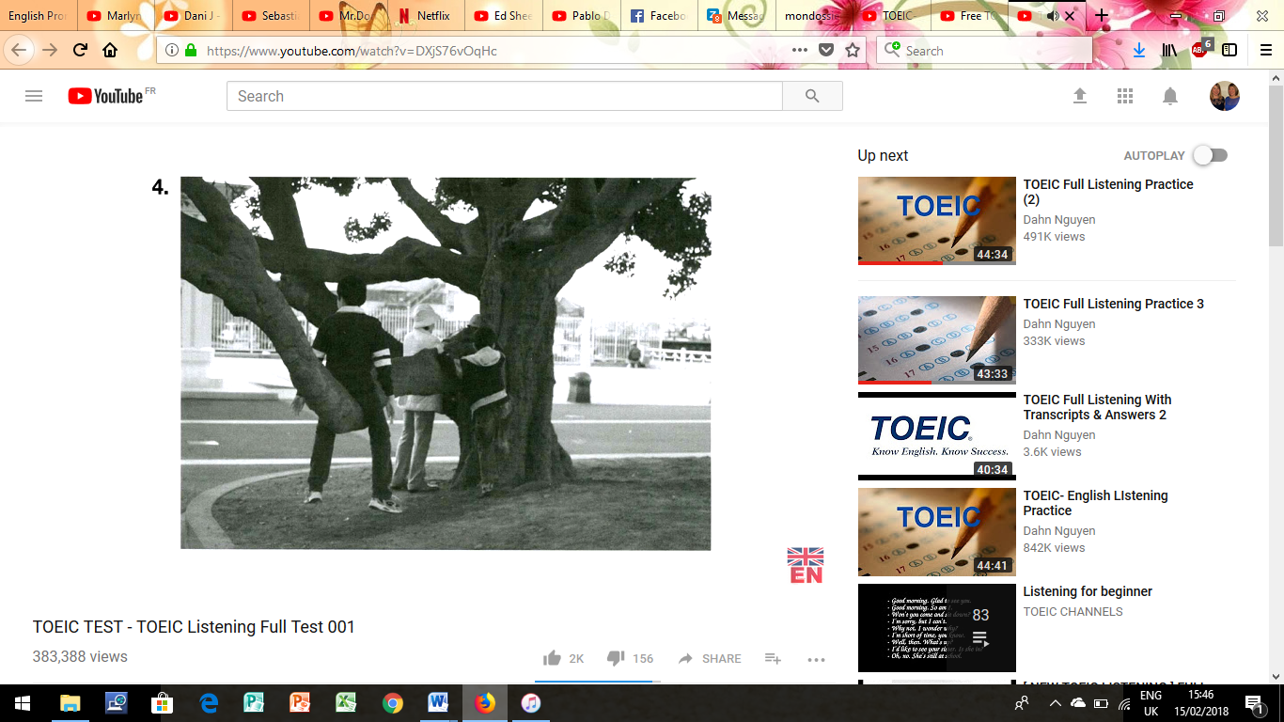
Part 1: Listening review
They are chopping wood
They’re putting on their jackets
They’re under a tree
They’re hiking in the woods.
Notes:
What is the right answer and why? Can they explain to me why the other 3 are wrong?
3.30

Slide 7
Part 1: Listening review
They are chopping wood. – no, no one is chopping wood.
They’re putting on their jackets. – no, they are wearing jackets already.
They’re under a tree. - yes, the people in the picture are underneath a tree.
They’re hiking in the woods. – no, they are in a town or a city, and are not hiking.
Notes:
.

Slide 8
What are distractors?
Distractors are answer choices that are designed to seem correct, but aren’t.
Vocabulary mismatch – similar sounding words or phrases that seem to match the conversation but the meaning is different.
Misleading context or focus – an answer based on the wrong part of the conversation or on an irrelevant detail.
Similar sounding statements – sounds similar to something in the conversation but is actually a twist on the information.
Tone or attitude mismatch – listen for emotions, is the speaker positive or negative – if the tone of the distractor doesn’t match the speaker’s, it is likely a trap!
Notes:
• Example: The conversation mentions “a conference,” but one distractor talks about a “training session,” which isn’t the same thing. – focus on the exact words used.
Example: A conversation is about the time of a meeting, but a distractor focuses on the location instead, leading the student to choose it because it seems related.
Example: If the conversation says, “The meeting is at 9:30 AM,” one distractor might say, “The meeting is at 9:00 AM.” This is a common distractor where the only difference is a small change (e.g., 30 minutes).
• Example: The speaker is enthusiastic and agrees to an early meeting, but a distractor suggests they are hesitant or unwilling.

Slide 9
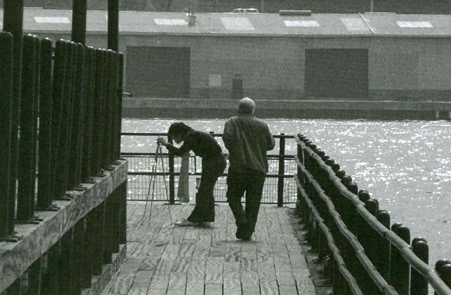
A) The boat is leaving the dock.
B) The people are near some water.
C) The people are getting into some water.
D) The boat is being loaded with cargo.
Notes:
3:52

Slide 10
A) The boat is leaving the dock. – no, we cannot see a boat.
B) The people are near some water. – yes, the people are on a dock which is next to or above some water.
C) The people are getting into some water. – no, the people are on land, not in the process of entering the water.
D) The boat is being loaded with some cargo. – no, again, there is not boat in the photo.

Slide 11
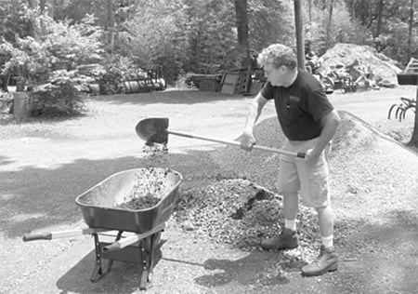
What are three possible distractor answers for this photograph?
Notes:
He is shoveling some soil
He is moving a wheelbarrow
He is cutting some grass
He is planting a tree

Slide 12
13. Parking is expensive here, isn’t it?
A) No, it’s over there.
B) It just arrived.
C) Yes, the rates just went up.
11. Who took my umbrella?
A) I’ll read it later.
B) The blue one.
C) I did, by mistake.
Notes:
11. 1:05 Question is asking about a person so answer needs to identify someone (as the one who took it)
13. 1:43 13. A tag question meaning the speaker is looking for confirmation or agreement.

Slide 13
13. Parking is expensive here, isn’t it?
A) No, it’s over there.
B) It just arrived.
C) Yes, the rates just went up.
11. Who took my umbrella?
A) I’ll read it later.
B) The blue one.
C) I did, by mistake.
Notes:
11. Question is asking about a person so answer needs to identify someone (as the one who took it)
Is not logical because it refers to reading which is irrelevant to the umbrella question.
Describes the colour of the umbrella but not who took it - distractor
13. A tag question meaning the speaker is looking for confirmation or agreement. C) directly responds with a confirmation and a reason.
Suggests a location but question is about cost not where it is
Doesn’t make sense because has nothing to do with parking costs

Slide 14
24. Do we get off at the next station, or the one after that?
A) Yes, I think so.
B) The week after next.
C) Let me look at the map.
25. Don’t you have to catch a 10 o’ clock flight?
A) No, I dropped them on the floor.
B) You can pick it up at the airport.
C) It’s been delayed until this afternoon.
Notes:
24. 5:20 Clarification on where to exit (logical response will be checking for information)
25. 5:42 25. Question asks whether the person has a specific flight they need to catch – reasonable answer will be related to the flight

Slide 15
24. Do we get off at the next station, or the one after that?
A) Yes, I think so.
B) The week after next.
C) Let me look at the map.
25. Don’t you have to catch a 10 o’ clock flight?
A) No, I dropped them on the floor.
B) You can pick it up at the airport.
C) It’s been delayed until this afternoon.
Notes:
24. Clarification on where to exit (logical response will be checking for information)
A) Question gives two options and a yes response is unclear
b) ‘weeks’ refers to time not stations.
25. Question asks whether the person has a specific flight they need to catch – reasonable answer will be related to the flight
Doesn’t relate to flight information at all – something else entirely so irrelevant
Suggests a different issue (luggage/a ticket?) doesn’t answer flight timing question

Slide 16
Part 3 review (Conversations)
Focus on listening for context (big picture) – topic, time, location, purpose.
Identify keywords (for specific details) – numbers, locations, dates, actions.
Eliminate distractors (wrong answers) – what answers don’t fit the context or are based on misleading details?
Practice active listening with full sentences – listen to the whole sentence to understand intention and specific information. You also need to look out for transition words (‘actually’, ‘by the way’) as these usually signal important information!
Notes:
These conversations typically cover routine work situations such as appointments, discussions, or simple tasks. The key to answering questions correctly is understanding the main context of the conversation first.
Questions are often based on exact details - times, numbers, locations, dates, actions.

Slide 17
Conversation 4: transcript
Man: If the rain doesn’t stop within the next two hours, we should consider postponing Maria’s retirement party.
Woman: I think it’s too late to postpone it. The caterer and florist are set to arrive in an hour so we’d better come up with an alternative to holding it in the garden.
Man: Why don’t we have them set up in the conference room instead? It’s a shame to move it indoors but what other choices do we have?
Woman: Ok, I’ll go to my office and call everyone to let them know that we’re moving the party from the garden to the conference room.
Notes:
4:20
General idea – discussing a party and what to do about the bad weather
Happening at the office
Moved from garden to conference room

Slide 18
50. What is the problem with the party?
A) The weather is bad. B) There is a shortage of food. C) Space is limited. D) There is a scheduling conflict.
51. Why is the party being held for Maria?
A) She received a promotion. B) She is retiring. C) She is relocating. D) She is getting married.
52. Where was the part originally scheduled to take place?
A) In a restaurant. B) In a conference room. C) In a garden. C) In an apartment.
Notes:
51 – b food as a distractor (caterer mentioned) 4:57
52. C a distractor – relocating the party
52. Both b and c mentioned – key word is originally – where was the party supposed to be to begin with…
4:20

Slide 19
Come up with 3 questions for this conversation…
A: Hi Mark, did you book the flight to Chicago for the conference?
B: Yes, I did. We’ll be leaving on Monday morning at 8:30 AM.
A: Oh, that’s earlier than I expected. What time do we need to be at the airport?
B: The airline recommends arriving two hours before departure, so we should be there by 6:30 AM.
A: Got it. What about the hotel? Did you confirm our reservation?
B: Yes, I booked us a hotel near the conference center. It has great reviews, and breakfast is included.
A: That sounds perfect. Thanks for handling everything!

Slide 20
Reading review
The new economy has created great business opportunities as well as great turmoil. Not since the Industrial Revolution have the stakes of dealing with change been so high. Most traditional organizations have accepted, in theory at least, that they must make major changes. Even large new companies recognize that they need to manage the changes associated with rapid entrepreneurial growth. Despite some individual successes, however, this remains difficult, and few companies manage the process as well as they would like. Most companies have begun by installing new technology, downsizing, restructuring, or trying to change corporate culture, and most have had low success rates. About 70 percent of all change initiatives fail.
The reason for most of these failures is that in their rush to change their organizations, managers become mesmerized by all the different, and sometimes conflicting, advice they receive about why companies should change, what they should try to accomplish, and how they should do it. The result is that they lose focus and fail to consider what would work best for their own company. To improve the odds of success, it is imperative that executives understand the nature and process of corporate change much better.
Most companies use a mix of both hard and soft change strategies. Hard change results in drastic layoffs, downsizing, and restructuring. Soft change is based on internal organizational changes and the gradual development of a new corporate culture through individual and organization learning. Both strategies may be successful, but it is difficult to combine them effectively. Companies that are able to do this can reap significant payoffs in productivity and profitability.

Slide 21
Speed reading: you have one minute to read this passage. Remember as much information as you can!
“A major technology company has announced that it will implement a four-day workweek for its employees starting next month. The company believes this change will improve productivity, reduce stress, and create a better work-life balance. Employees will still receive the same salary, but they will be expected to work slightly longer hours each day.
According to the CEO, the decision was made after a successful six-month trial. ‘Our data shows that employees completed their work more efficiently and reported higher job satisfaction,’ he stated. The company hopes other businesses will consider similar changes to support their workforce.”

Slide 22
Which of these would be a good headline for this article?
(A) “Company Announces Layoffs Due to Economic Crisis”
(B) “Tech Firm Cuts Working Week to Four Days”
(C) “Employees Required to Work Overtime After Policy Change”
• When does the new policy start?
• How will employee work schedules change?
• What was the reason for this decision?
What is the meaning of ‘trial’ in the article?
Notes:
Starts next months
They will work longer hours each day
Employees more efficient and higher job satisfaction

Slide 23
Grammar review
Top mistakes in the test included:
Verb tenses
Prepositions
Phrasal verbs
Verb + direct object
Comparatives
Word order
Subject-verb agreement
Notes:
Write 6 incorrect sentences on the board – students correct them

Slide 24
Comparatives: to compare two things
Basic structure is:
adjective + -er = for short adjectives (1 syllable)
If the adjective ends in a single consonant preceded by a single vowel, double the consonant and then add –er (eg. hot = hotter)
More + adjective – for longer adjectives (2+ syllables)

Slide 25
Irregular comparatives
Good -> better
Bad -> worse
Far -> farther (physical distance) or further (figurative distance)
When comparing two things, use ‘than’ directly after the comparative adjective to introduce the second item of comparison.
Notes:
We need to discuss this issue further before making a decision.”
We walked farther than expected.”

Slide 26
Subject-verb agreement
The VERB must agree in number (singular or plural) with the subject of the sentence.
1. Singular subject + singular verb.
She writes every day. (‘she’ singular, singular verb form ‘writes’)
2. Plural subject + plural verb.
The cats run quickly. (‘cats’ plural, plural verb form ‘run’)

Slide 27
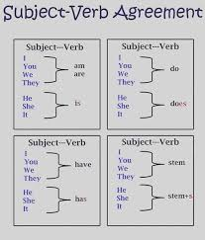

Slide 28
Common mistakes
Subjects with ‘or’
Rule: when two subjects are connected with ‘or’, the verb agrees with the subject closer to it.
Example: Either the teacher or the students are going to the meeting.
Neither the student nor the teacher was late.
Subjects joined by ‘and’
Rule: When two subjects are connected with ‘and’, the verb is usually plural.
Example: John and Mary are going to the park. (plural subject ‘John and Mary’)

Slide 29
Collective nouns
Rule: Collective nouns refer to a group of people or things but can take either a singular or plural verb depending on whether the group is acting together as a unit or individually.
Examples: The team is practicing hard. (acting as a single unit)
The team are arguing with each other. (acting individually)
Indefinite pronouns
Rule: Some indefinite pronouns (eg. everyone, somebody, nobody, each, either) always take singular verbs, even if they seem plural.
Examples: Everybody is here.
Each of the students has a book.

Slide 30
Special cases
There is vs there are
Rule: Use ‘there is’ when the subject is singular and ‘there are’ when the subject is plural.
Examples: There is a cat on the roof.
There are two cats on the roof.
Uncountable nouns
Rule: Uncountable nouns are treated as singular and take singular verbs.
Example: The information is useful.

Slide 31
tips
1. Identify the subject – look for the main subject first.
Eg. The books on the shelf are old.
2. Avoid distractions – words like ‘with’, ‘along with’, ‘as well as’ or ‘including’ so not change the number of the subject.
Eg. The teacher, along with the students, is excited.
3. Watch out for tricky subjects – words like ‘everyone’, ‘someone’ and ‘each’ always take singular verbs even though they seem plural.
Eg. Each of the participants has a badge.

Slide 32
1 minute responses…
Online shopping is better than in-store shopping.
Cats are more intelligent than dogs.
Winter is worse than summer.
Traveling by train is easier than flying.
Smartphones are more useful than laptops.

Slide 33
On arche…
There are two grammar worksheets on ARCHE (Week 6). Pick one to work on for the next 10-15 minutes.

Slide 34
Writing review
The most common mistakes in your writing are easy to fix!
Punctuation
Capital letters
Lack of clear structure
Subject-verb agreement
We are going to look at a ‘broken’ piece of writing and fix it together.
Notes:
Show a model answer – ask them to identify what makes it good – structure, clarity, grammar, vocab

Slide 35
work at home or in a office is good choice. many companys let workers do this. there is benefits for both but work at home is better. it is more flexible, people works more productively, and have good work life balance. One big benefit is flexibility, workers can choose when work and where. for example they dont need to travel and can take break anytime this help them relax. Also, people is more focus at home. in office they have distractions coworkers talk too much and meetings waste time. at home workers finish faster some study shows remote worker do better job. In conclusion, home work is better. it is more flexible more productive and better for health companys should let workers choose.
ONE IDEA, ONE PARAGRAPH RULE.
Notes:
Fix structure – how can we split this into introduction, main body and conclusion?
LOOK FOR LINK MARKERS TOO – FIRSTLY, ALSO, IN ADDITION, FURTHER, TO CONCLUDE

Slide 36
INTRODUCTION | FIRST PARAGRAPH | SECOND PARAGRAPH | CONCLUSION
Nowadays…
In conclusion…
Also…
To sum up…
Firstly…
To begin with…
In my opinion…
Overall…
One advantage/benefit is…
Furthermore…
In addition…
To conclude…
On one hand… on the other hand…
Moreover…

Slide 37
INTRODUCTION | FIRST PARAGRAPH | SECOND PARAGRAPH | CONCLUSION
Nowadays… In my opinion… | Firstly… One advantage/benefit is… On one hand… To begin… | Furthermore… Also… On the other hand… In addition… Moreover… | In conclusion… To conclude… Overall…

Slide 38
work at home or in a office is good choice. many companys let workers do this. there is benefits for both but work at home is better. it is more flexible, people works more productively, and have good work life balance.
one big benefit is flexibility, workers can choose when work and where. for example they dont need to travel and can take break anytime this help them relax.
also, people is more focus at home. in office they have distractions coworkers talk too much and meetings waste time. at home workers finish faster some study shows remote worker do better job.
in conclusion, home work is better. it is more flexible more productive and better for health companys should let workers choose.
Intro
1 - flexibility
2 - focus
Conclusion
ONE IDEA, ONE PARAGRAPH RULE.
Notes:
Fix structure – how can we split this into introduction, main body and conclusion?
LOOK FOR LINK MARKERS TOO – FIRSTLY, ALSO, IN ADDITION, FURTHER, TO CONCLUDE

Slide 39
CORRECT THE GRAMMAR:
work at home or in a office is good choice. many companys let workers do this. there is benefits for both but work at home is better. it is more flexible, people works more productively, and have good work life balance.
one big benefit is flexibility, workers can choose when work and where. for example they dont need to travel and can take break anytime this help them relax.
also, people is more focus at home. in office they have distractions coworkers talk too much and meetings waste time. at home workers finish faster some study shows remote worker do better job.
in conclusion, home work is better. it is more flexible more productive and better for health companys should let workers choose.
Notes:
Grammar -

Slide 40
SUBJECT-VERB AGREEMENT
ARTICLES (THE/A)
CONTRACTIONS
VERB FORMS
working at home or in an office is a good choice. many companies let workers do this. there are benefits to both but working at home is better. it is more flexible, people work more productively, and have a good work-life balance.
one big benefit is flexibility, workers can choose when to work and where to work. for example they don’t need to travel and can take a break anytime this helps them relax.
also, people are more focused at home. in an office they have distractions coworkers talk too much and meetings waste time. at home workers finish faster some studies show remote workers do a better job.
in conclusion, working from home is better. it is more flexible more productive and better for health companies should let workers choose.
Notes:
Working at home – a verb (to work) cannot be the subject of a sentence – use a gerund to make it a noun.
An office – office starts with a vowel sound so an instead of a
Many companies – correct plural form
There are benefits – benefits is plural so ‘are’ not ’is’
Working at home is better – again gerund instead of verb as subject
People work – plural so plural verb agreement
A good work-life balance – a because ‘work-life balance’ is a countable noun / hyphen because compound adjective
When to work and where to work – add to before verb because it follows ‘choose’
Don’t – apostrophe in contractions
Take a break – break is a countable noun so add a
This helps them – this is singular so helps not help
People are more focused – people plural so are / focus is a verb, use focused the adjective
In an office – office is singular and countable so an
Some studies show – study is singular but we need the plural form
Working from home – home work sounds like homework (for school)
Companies – plural form

Slide 41
Working at home or in an office is a good choice. Many companies let workers do this. There are benefits to both but working at home is better. It is more flexible, people work more productively, and have a good work-life balance.
One big benefit is flexibility. Workers can choose when to work and where to work. For example, they don’t need to travel and can take a break anytime. This helps them relax.
Also, people are more focused at home. In an office, they have distractions. Coworkers talk too much and meetings waste time. At home, workers finish faster. Some studies show remote workers do a better job.
In conclusion, working from home is better. It is more flexible, more productive and better for health. Companies should let workers choose.

Slide 42
Writing task
Some people prefer to live in a big city, while others enjoy living in a small town.
In your opinion, which is better: living in a big city or living in a small town?
Write 5 sentences in response to this question: one for the introduction, three different points for the main body and one for the conclusion. You have 7 minutes!
Next, swap papers with someone else. Read what they wrote and underline any parts you think are unclear.
Take your paper back and edit.

Slide 43
Pro small towns!
Although big cities have many fun attractions, living in a small town is a better choice fort a peaceful and comfortable life.
Small towns have less traffic and pollution, making them a healthier place to live.
Living in a small town is more affordable because housing is less expensive than in big cities.
People in small towns often know each other well, which creates a strong sense of community and safety.
Overall, small towns provide a quieter, healthier and more affordable lifestyle, making them the best place to live.

