Slide 1
Dulasp m4
Week 7

Slide 2
Agenda
Warm-up activity – subject-verb agreement
Practice paper 1
Listening (parts 1 and 2)
Grammar – verb tenses revision / part 1
Writing practice

Slide 3
Warm-up activity: choose the correct verb depending on the subject
1. Emily and Greg comes/come to my house every Friday for lunch.
2. There is/are time to watch the movie.
3. My friends who are in the band wants/want me to play a musical instrument.
4. My father or my brothers is/are coming with me to the ball game.
5. Everyone needs/need time to relax.
6. That bag of oranges looks/look fresh.
7. The football team hopes/hope to win the tournament next week.
8. Even though the students like the class, a few thinks/think that it is too complicated.

Slide 4
Warm-up activity: choose the correct verb depending on the subject
1. Emily and Greg come to my house every Friday for lunch.
2. There is time to watch the movie.
3. My friends who are in the band want me to play a musical instrument.
4. My father or my brothers are coming with me to the ball game.
5. Everyone needs time to relax.
6. That bag of oranges looks fresh.
7. The football team hopes to win the tournament next week.
8. Even though the students like the class, a few think that it is too complicated.
Notes:
Two singular subjects joined by ‘and’ form a plural subject = plural verb
Subject of the sentence is ‘time’ (there is a placeholder) – singular, uncountable noun = singular form
‘who are in a band’ doesn’t change the subject quantity – plural subject friends = plural verb
Compound subject formed by two subjects joined by ‘or’ – verb agreed with closest subject – plural brothers – plural verb
Everyone a singular indefinite pronouns always treated as singular -= singular verb
That bag is the subject (of oranges changes nothing) = singular verb
Team acting as a singular entity so singular subject = singular verb
A few refers to more than one person so is a plural subject = plural verb form.

Slide 5
For each photograph, identify an object, an action, a preposition…

Slide 6
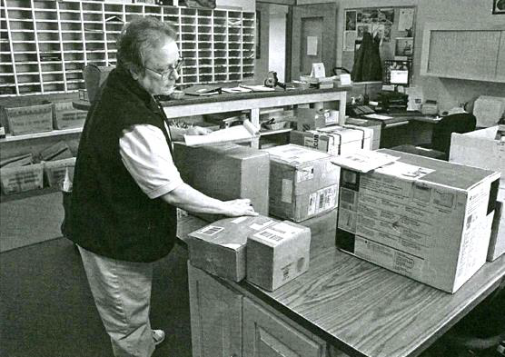

6
Notes:
4:16-end (questions 6-10)

Slide 7
6
A) She is reading the labels on some boxes.
B) She’s sorting mail into the slots on the wall.
C) She’s wrapping up a package.
D) She’s standing in line at the service window.
Notes:
4:16-end (questions 6-10)

Slide 8
6
A) She is reading the labels on some boxes.
B) She’s sorting mail into the slots on the wall.
C) She’s wrapping up a package.
D) She’s standing in line at the service window.
Notes:
4:16-end (questions 6-10)

Slide 9
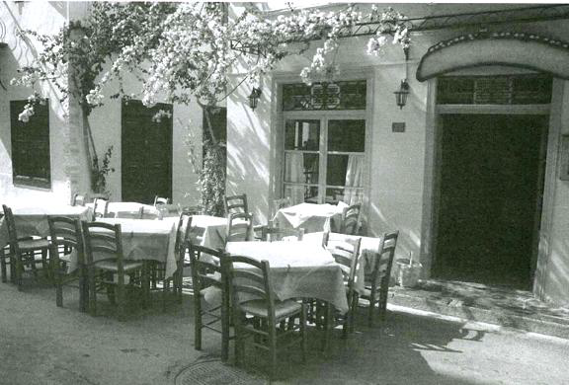
7
Notes:
4:54

Slide 10
7
A) The flowers have been arranged in vases.
B) The tables have been set for dinner.
C) The chairs are stacked against the wall.
D) The restaurant has an outdoor seating area.
Notes:
4:54

Slide 11
7
A) The flowers have been arranged in vases.
B) The tables have been set for dinner.
C) The chairs are stacked against the wall.
D) The restaurant has an outdoor seating area.
Notes:
4:54

Slide 12
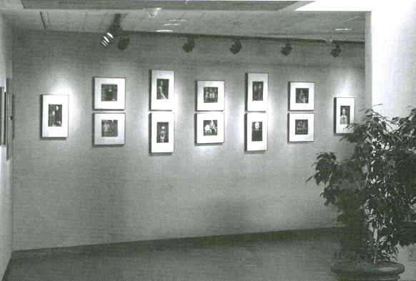
Notes:
5:20

Slide 13
8
A) The lights are being installed above the pictures.
B) There is a statue in the corner.
C) There are many visitors in the gallery.
D) The pictures are mounted on the wall.
Notes:
5:20

Slide 14
8
A) The lights are being installed above the pictures.
B) There is a statue in the corner.
C) There are many visitors in the gallery.
D) The pictures are mounted on the wall.
Notes:
5:20

Slide 15
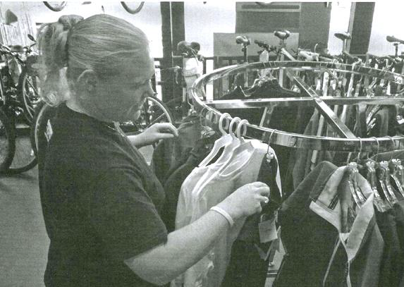
Notes:
5:49

Slide 16
9
A) She’s trying on a shirt.
B) She’s holding an item of clothing.
C) She’s cleaning out her closet.
D) She’s paying for some new clothes.
Notes:
5:49

Slide 17
9
A) She’s trying on a shirt.
B) She’s holding an item of clothing.
C) She’s cleaning out her closet.
D) She’s paying for some new clothes.
Notes:
5:49

Slide 18
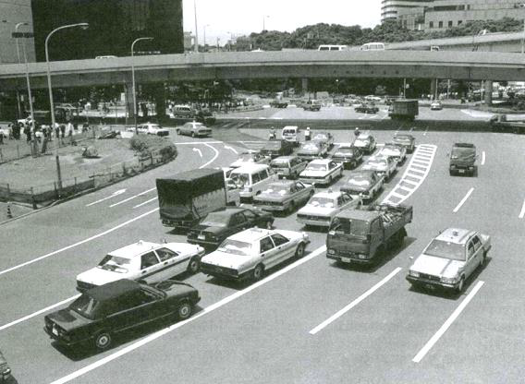
Notes:
6:12

Slide 19
10
A) A bridge is under construction.
B) A train has pulled into the station.
C) There are many lanes of traffic.
D) The people are getting out of their vehicles.
Notes:
6:12

Slide 20
10
A) A bridge is under construction.
B) A train has pulled into the station.
C) There are many lanes of traffic.
D) The people are getting out of their vehicles.
Notes:
6:12

Slide 21
Part 2 – question / response
Types of questions:
Information questions (‘wh-’ questions) – require specific details.
Yes/No questions – require affirmative, negative or indirect responses.
Choice questions (A or B questions) – indicate a preference or a decision.
Indirect questions (polite questions)
Tag questions – to confirm information – require agreement or correction.
Implied questions – rising intonation.
Hypothetical questions - ask about possible situations and require an imaginative response.
Notes:
6:02
1. “When is the deadline for the report?”
2. Did you send the email?
3. Would you like tea or coffee?
4. Would you mind opening the window?
5. You sent the request, didn’t you?
6. I heard the new manager is great.
7.What if we miss the last train?

Slide 22
Activity: with a partner, come up with possible responses to these questions
1. Is the printer working now?
2. Do you want to meet at 2:00 or 3:30?
3. Why was the meeting rescheduled?
4. Where is the new employee’s desk?
5. Could you please tell me where the nearest ATM is?
6. The report is due tomorrow, right?
7. Haven’t we met before?
8.What would you do if you lost your passport?
9.Would you prefer to take a taxi or walk to the restaurant?
10. Have you eaten yet?

Slide 23
comprehension
Notes:
6:02 q26-29

Slide 24
26. How long should we keep notices on the bulletin board?
A) About 5 centimeters long.
B) He said it would.
C) For about two weeks.
27. Why didn’t you come to the party?
A) I simply forgot about it.
B) That’s right, it didn’t.
C) The invitation was nice.
28. You sent that memo out last week, didn’t you?
A) It’s an attractive scent.
B) No, you told me to wait, remember?
C) She was out for a few days.
29. Why didn’t we get the Fuji Market contract?
A) Yes, I just heard the news.
B) We wanted too much money.
C) No, she hasn’t been contacted.
Notes:
Pause and predict together.

Slide 25
26. How long should we keep notices on the bulletin board?
A) About 5 centimeters long.
B) He said it would.
C) For about two weeks.
27. Why didn’t you come to the party?
A) I simply forgot about it.
B) That’s right, it didn’t.
C) The invitation was nice.
28. You sent that memo out last week, didn’t you?
A) It’s an attractive scent.
B) No - you told me to wait, remember?
C) She was out for a few days.
29. Why didn’t we get the Fuji Market contract?
A) Yes, I just heard the news.
B) We wanted too much money.
C) No, she hasn’t been contacted.

Slide 26
Listening comprehension
Notes:
7:23 q30-33

Slide 27
30. Can you make sure there’s a slide projector in the boardroom?
A) He’s on the board of directors.
B) No, not that I’m aware of.
C) I’ve already set it up.
31. Do you know who that man was?
A) I saw him too.
B) That was very meaningful.
C) The new assistant manager.
32. I can drive you to the airport tomorrow, if you need transportation?
A) Thank you but it’s been arranged.
B) Yes, I can take you there.
C) That’s the station, over there.
33. Do you need the afternoon to finalize the budget or can you help me plan the presentation?
A) He’s been planning on it.
B) The finance meeting is in the boardroom.
C) I should be able to help you by 3pm.
Notes:
7:23

Slide 28
30. Can you make sure there’s a slide projector in the boardroom?
A) He’s on the board of directors.
B) No, not that I’m aware of.
C) I’ve already set it up.
31. Do you know who that man was?
A) I saw him too.
B) That was very meaningful.
C) The new assistant manager.
32. I can drive you to the airport tomorrow, if you need transportation?
A) Thank you but it’s been arranged.
B) Yes, I can take you there.
C) That’s the station, over there.
33. Do you need the afternoon to finalize the budget or can you help me plan the presentation?
A) He’s been planning on it.
B) The finance meeting is in the boardroom.
C) I should be able to help you by 3pm.
Notes:
7:23

Slide 29
Listening comprehension
Notes:
8:50 q34-37

Slide 30
34. What kind of refreshments are they planning for the reception?
A) Reception is bad in this area.
B) Just dessert with coffee and tea.
C) That was very kind of him.
35. Aren’t we going to collect money for a gift?
A) Yes, we should do that.
B) It’s so nice of you to think of me.
C) I’ve been there.
36. How many callers responded to our radio advertisement?
A) More than we expected.
B) Sorry, I’ll lower the volume.
C) It’s a four-colour brochure.
37. Did you get the pay raise you asked for?
A) No, I don’t have any questions.
B) Yes, effective as of next week.
C) Yes, four people are coming.
Notes:
8;50

Slide 31
34. What kind of refreshments are they planning for the reception? (precision)
A) Reception is bad in this area.
B) Just dessert with coffee and tea.
C) That was very kind of him.
35. Aren’t we going to collect money for a gift? (confirmation)
A) Yes, we should do that.
B) It’s so nice of you to think of me.
C) I’ve been there.
36. How many callers responded to our radio advertisement? (number)
A) More than we expected.
B) Sorry, I’ll lower the volume.
C) It’s a four-colour brochure.
37. Did you get the pay raise you asked for? (confirmation)
A) No, I don’t have any questions.
B) Yes, effective as of next week.
C) Yes, four people are coming.
Notes:
8;50

Slide 32
Listening comprehension
Notes:
10:15 q38-40

Slide 33
38. Can you handle incoming phone calls while I go to lunch?
A) Yes, he came in early this morning.
B) No, it broke off when I dropped the cup.
C) Yes, I’ll be free in an hour.
39. Hasn’t she read the market share report yet?
A) But she has brown hair.
B) She’s been too busy.
C) I bought it in a shop.
40. I hear you’ll be retiring soon.
A) Yes, in about a month.
B) I always get sleepy after lunch.
C) No, he missed his flight.
Notes:
10:15

Slide 34
38. Can you handle incoming phone calls while I go to lunch? (are you able to?)
A) Yes, he came in early this morning.
B) No, it broke off when I dropped the cup.
C) Yes, I’ll be free in an hour.
39. Hasn’t she read the market share report yet? (confirmation)
A) But she has brown hair.
B) She’s been too busy.
C) I bought it in a shop.
40. I hear you’ll be retiring soon. (implied question)
A) Yes, in about a month.
B) I always get sleepy after lunch.
C) No, he missed his flight.
Notes:
10:15

Slide 35
Present tenses
Present simple
Present continuous
Used for:
Facts and general truths.
Routines and habits.
Fixed schedules.
FORMULA: [subject] + [base verb] (+s/es for he/she/it)
Examples:
The train leaves at 6pm.
She works in HR.
Water boils at 100C.
Used for:
Actions happening right now.
Temporary actions.
Future plans.
FORMULA: [subject] + [am/is/are] + [verb+ing]
Examples:
He is working on a project.
They are coming to the party tonight.
She is staying with her friend this week.

Slide 36
Past tenses
Past simple
Past continuous
Used for:
Completed actions at a specific time in the past.
A sequence of past actions.
FORMULA: [subject] + [verb in past form]
Examples:
She finished the report yesterday.
They moved to Canada in 2010.
I saw my friend last night.
Used for:
An action in progress at a specific time in the past.
An interrupted past action.
FORMULA: [subject] + [was/were] + [verb+ing]
Examples:
At 8pm, I was watching TV.
She was talking on the phone when I arrived.

Slide 37
Perfect tenses
Present perfect
Past perfect
Used for:
Past action with an effect on now. (I have lost my keys)
Experiences. (She has travelled to Japan)
Ongoing actions from the past until now. (I have lived here for 5 years)
FORMULA: [subject] + [have/has] + [Past Participle]
Examples:
She has worked her for 5 years.
Used for:
An action that happened before another past action. (The meeting had already started when I arrived)
FORMULA: [subject] + [had] + [Past Participle]
Examples:
By the time we arrived, they had left.
She had finished her homework before dinner.

Slide 38
Future tenses
Future simple (‘will’)
Future continuous
Used for:
Predictions
Promises
Spontaneous decisions
FORMULA: [subject] + [will] + [base verb]
Examples:
She will call you tomorrow.
We will finish the project next week.
Used for:
Actions that will be in progress at a specific future time.
FORMULA: [subject] + [will be] + [verb+ing]
Examples:
At 8pm, I will be having dinner.

Slide 39
Verb tenses worksheet on arche…
Take 10/15 minutes to work on the verb tenses worksheet on ARCHE (week 7/8).

Slide 40
Grammar part 1: fill in the gaps
1. All the orders were ____________ on schedule.
A) delivering
B) delivered
C) to deliver
D) to be deliver
2. The new law will encourage growth in the export market _____________.
A) next year
B) in fact
C) sometimes
D) possible

Slide 41
3. Property taxes ________ about 40% of the overall tax revenue the state collects.
A) make
B) are at least
C) account for
D) are raised by
4. The report showed that overall prices are up 3.1% _________ 12 months.
during the last
in the following
since the last
periodically over

Slide 42
5. The flight arrives __________ Tokyo in three hours.
into
in
at
on
6. Strong exports ___________ in boosting company growth, rising 35% from a year earlier.
played a big role
played a hand
instrumental
effectively

Slide 43
7. He is excited about the new promotion and looking forward to ________ more responsibilities.
taking on – need gerund form (accepting more responsibilities)
take on
taking in
getting up
8. My line manager wants the meeting __________ immediately.
A) to arrange
B) arrange
C) arranged – wants + object + past participle (passive voice)
D) be arranged

Slide 44
9. While the stock ________, the staff worked in the evenings.
A) was checked
B) check
C) has been checked
D) was being checked - past continuous tense
10. Company revenue _________ $45.1 billion from $44.7 billion a year earlier.
increased
rose to – increased and reached a specific amount
declined from
expanded at

Slide 45
11. ________ the end of year results were published; the managers got their bonuses.
When – one action followed by another
While
Because
If
12. The new service was expected to be a success; __________ very few customers upgraded their accounts.
although
Yet – shows contrast between two ideas or situations
just
moreover

Slide 46
13. Commercial builders downplayed __________ a problem in the housing market.
the concern of
concerned that
concerns about – worries related to a specific topic
concerning
14. The company plans to make ___________ improvements to its customer service next month.
A) small
B) quickly
C) heavy
D) slowly

Slide 47
15. The software developers __________ investigated the latest problem.
are just
still
have yet
have already – present perfect tense (at an unspecified time before now)
16. The executives pointed to immigration __________ the biggest drivers of the domestic market.
rather than
as one of – referring to something as part of a group or category
resulting in
as leading

Slide 48
Writing practice
Some people think that learning a second language is very important, while others believe it is not necessary in today’s world.
What is your opinion? Do you think learning a second language is useful? Why or why not? Give at least 2 reasons to support your answer.

Slide 49
Some people think that learning a second language is very important, while others believe it is not necessary in today’s world.
What is your opinion? Do you think learning a second language is useful?
In pairs, make a list of arguments for and against learning a second language. For each argument, also write down one example or piece of evidence to support your point.

Slide 50
Learning a second language
For
Against
Career opportunities – international business
Better brain health – better memory and problem-solving abilities
Understanding of other cultures – music, literature, traditions
Travel – local language means discussion with locals
Better communication skills – some cities have large immigrant populations
Everyone speaks English – international business language…
Technology can translate for us – Google Translate
Too much time and effort – over 600 hours of study necessary
Not useful for all careers

Slide 51
Writing practice
Some people think that learning a second language is very important, while others believe it is not necessary in today’s world.
What is your opinion? Do you think learning a second language is useful? Why or why not? Give at least 2 reasons to support your answer.

