Slide 1
DULASP M4
WEEK 8

Slide 2
Agenda
Continue practice paper 1
Listening comprehension (part 3)
Grammar (parts 1 and 2)
Prepositions recap
Reading comprehension in timed conditions
Writing task – full essay

Slide 3
Listening comprehension: part 3
Before listening to the conversations, we are going to guess what sort of things the people will be talking about, based on the questions and answers printed in the paper.
Underline key words in the questions.

Slide 4
Conversation 1:
32. Where are the speakers?
(A) In an office
(B) At a restaurant
(C) At the airport
(D) In the parade
33. Why is the traffic jam expected?
(A) Many people are going on a picnic.
(B) Construction is ongoing.
(C) There will be a street parade.
(D) There was an accident on the street.
34. What time will the speakers leave?
(A) At 5 p.m.
(B) At 6 p.m.
(C) At 7 p.m.
(D) At 9 p.m.
Notes:
Based on these questions, the conversation is likely about something causing a traffic jam and the speakers discussing when they should leave.
Who are the speakers? - the people who we hear talking in the audio recording (no speakers like for music)

Slide 5
Conversation 1:
32. Where are the speakers?
(A) In an office
(B) At a restaurant
(C) At the airport
(D) In the parade
33. Why is the traffic jam expected?
(A) Many people are going on a picnic.
(B) Construction is ongoing.
(C) There will be a street parade.
(D) There was an accident on the street.
34. What time will the speakers leave?
(A) At 5 p.m.
(B) At 6 p.m.
(C) At 7 p.m.
(D) At 9 p.m.
Notes:
Based on these questions, the conversation is likely about something causing a traffic jam and the speakers discussing when they should leave.
q32 where - location of the people speaking?
q33 why - the reason fir the traffic
q44 - what time - a time (number)

Slide 6

As we listen:
Listen for synonyms and paraphrasing – TOEIC often uses other wording than what is written in the question.
Take notes on keywords (dates, times, names, actions).
Be aware of distractors!
Notes:
Beginning to 1:10

Slide 7
transcript
Man: Did you hear that there will be a street parade today in celebration of the holiday in front of our building?
Woman: I saw the news this morning too. We’d better hurry to the airport since heavy traffic is expected all over the city. Should we leave right after the meeting?
Man: Good idea! Since the flight departure time is 9 in the evening, we should arrive there 2 hours before, at the latest.
Woman: We’re finishing a little over 5 so we can leave at 6. That should give us enough time.
Man: Alright! Just remind me when we should get ready.

Slide 8
transcript
Man: Did you hear that there will be a street parade today in celebration of the holiday in front of our building?
Woman: I saw the news this morning too. We’d better hurry to the airport since heavy traffic is expected all over the city. Should we leave right after the meeting?
Man: Good idea! Since the flight departure time is 9 in the evening, we should arrive there 2 hours before, at the latest.
Woman: We’re finishing a little over 5 so we can leave at 6. That should give us enough time.
Man: Alright! Just remind me when we should get ready.

Slide 9
Conversation 1:
32. Where are the speakers?
(A) In an office
(B) At a restaurant
(C) At the airport
(D) In the parade
33. Why is the traffic jam expected?
(A) Many people are going on a picnic.
(B) Construction is ongoing.
(C) There will be a street parade.
(D) There was an accident on the street.
34. What time will the speakers leave?
(A) At 5 p.m.
(B) At 6 p.m.
(C) At 7 p.m.
(D) At 9 p.m.
Notes:
Based on these questions, the conversation is likely about something causing a traffic jam and the speakers discussing when they should leave.

Slide 10
Conversation 1:
32. Where are the speakers?
(A) In an office
(B) At a restaurant
(C) At the airport
(D) In the parade
33. Why is the traffic jam expected?
(A) Many people are going on a picnic.
(B) Construction is ongoing.
(C) There will be a street parade.
(D) There was an accident on the street.
34. What time will the speakers leave?
(A) At 5 p.m.
(B) At 6 p.m.
(C) At 7 p.m.
(D) At 9 p.m.
Notes:
Based on these questions, the conversation is likely about something causing a traffic jam and the speakers discussing when they should leave.

Slide 11
Conversation 2
36. According to the woman, what was the problem?
(A) She was not aware of the new services.
(B) She could not meet the deadline.
(C) She was unfairly treated by a staff member.
(D) She may have forgotten to notify some change.
37. What will the man probably do next?
(A) Call a colleague
(B) Provide her with a discount
(C) Explain the procedure
(D) Update some information
35. What is the purpose of the call?
(A) To promote a new service
(B) To make a complaint
(C) To inform a customer of unpaid bills
(D) To confirm a schedule
Notes:
What is this conversation probably about? - someone calling a woman to discuss a problem and taking action to fix it

Slide 12
Conversation 2
36. According to the woman, what was the problem?
(A) She was not aware of the new services.
(B) She could not meet the deadline.
(C) She was unfairly treated by a staff member.
(D) She may have forgotten to notify some change.
37. What will the man probably do next?
(A) Call a colleague
(B) Provide her with a discount
(C) Explain the procedure
(D) Update some information
35. What is the purpose of the call?
(A) To promote a new service
(B) To make a complaint
(C) To inform a customer of unpaid bills
(D) To confirm a schedule
Notes:
1:17

Slide 13
Transcript:
Man: Hi Ms Casey, this is Brandon Alexander from Pablo Water Company. We found out that you haven’t paid your bill for the last 3 months.
Woman: I know but there was a problem. I haven’t been receiving my bills since I moved into my new apartment. Didn’t I give you my new address before?
Man: Let me check. According to our database, your address is 809 Orchard Avenue – is that correct?
Woman: No, that’s my old apartment. I thought I had informed every company of the new address but I must have forgotten your company. Let me tell you the new one.
Notes:
1:17

Slide 14
Conversation 2
36. According to the woman, what was the problem?
(A) She was not aware of the new services.
(B) She could not meet the deadline.
(C) She was unfairly treated by a staff member.
(D) She may have forgotten to notify some change.
37. What will the man probably do next?
(A) Call a colleague
(B) Provide her with a discount
(C) Explain the procedure
(D) Update some information
35. What is the purpose of the call?
(A) To promote a new service
(B) To make a complaint
(C) To inform a customer of unpaid bills
(D) To confirm a schedule

Slide 15
Conversation 3:
39. What does the man say he wants to do?
(A) Register for a management class
(B) Work as a cashier
(C) Hire a new loan officer
(D) Open a new account
40. What do the women say they will send the man tomorrow?
(A) Handouts from a presentation
(B) Brochures for financial services
(C) An application for the new position
(D) A list of some names
38. Where do the speakers most likely work?
(A) At a bank
(B) At a supermarket
(C) At an employment firm
(D) At a business school
Notes:
2:36-
Likely colleagues talking at work, the man mentions something and the women offer to help
38 - train several new bank cashiers this year
39 - do you think some might be interested in training to become a loan officer? Loan officers transferring
40 - i'll send you the names of anyone interested

Slide 16
Conversation 3:
39. What does the man say he wants to do?
(A) Register for a management class
(B) Work as a cashier
(C) Hire a new loan officer
(D) Open a new account
40. What do the women say they will send the man tomorrow?
(A) Handouts from a presentation
(B) Brochures for financial services
(C) An application for the new position
(D) A list of some names
38. Where do the speakers most likely work?
(A) At a bank
(B) At a supermarket
(C) At an employment firm
(D) At a business school
Notes:
38 - train several new bank cashiers this year
39 - do you think some might be interested in training to become a loan officer? Loan officers transferring
40 - i'll send you the names of anyone interested

Slide 17
Conversation 4
42. What does the man say about the restaurant?
(A) It was too expensive.
(B) It was as good as its reputation.
(C) It was below his expectations.
(D) It was far away from the office.
43. What will the speakers probably do?
(A) Go out to eat
(B) Leave for the day
(C) Take a walk
(D) Order some food
41. Where is the conversation probably taking place?
(A) In a restaurant
(B) In the office
(C) On the street
(D) At the park
Notes:
4:18 -
41 - almost our lunchbreak , down the street from our office
42 - not as impressive as people say
43 - why dont we just have some delivery food and eat here

Slide 18
Conversation 4
42. What does the man say about the restaurant?
(A) It was too expensive.
(B) It was as good as its reputation.
(C) It was below his expectations.
(D) It was far away from the office.
43. What will the speakers probably do?
(A) Go out to eat
(B) Leave for the day
(C) Take a walk
(D) Order some food
41. Where is the conversation probably taking place?
(A) In a restaurant
(B) In the office
(C) On the street
(D) At the park
Notes:
41 - almost our lunchbreak , down the street from our office
42 - not as impressive as people say
43 - why dont we just have some delivery food and eat here

Slide 19
Conversation 5
45. How long did it take for the man to make a reservation?
(A) Three hours
(B) One week
(C) Two weeks
(D) Three weeks
46. What does the man say he will do?
(A) Cancel his appointment with his client
(B) Look for some reviews
(C) Book another time
(D) Finish the work early
44. Where does the woman work?
(A) At a theatre
(B) At a dental clinic
(C) At a travel agency
(D) At a restaurant
Notes:
5:40
44 - Dr Henry's office
45 - two weeks to make this reservation
46 - try to conclude everything quickly in the meeting

Slide 20
Conversation 5
45. How long did it take for the man to make a reservation?
(A) Three hours
(B) One week
(C) Two weeks
(D) Three weeks
46. What does the man say he will do?
(A) Cancel his appointment with his client
(B) Look for some reviews
(C) Book another time
(D) Finish the work early
44. Where does the woman work?
(A) At a theatre
(B) At a dental clinic
(C) At a travel agency
(D) At a restaurant
Notes:
44 - Dr Henry's office
45 - two weeks to make this reservation
46 - try to conclude everything quickly in the meeting

Slide 21
Conversation 6
48. What does the woman mean when she says, “I knew that he would be promoted soon.”?
(A) She was notified about the news before.
(B) She is very close to Mr. Russell.
(C) She wants to get promoted, too.
(D) She thinks Mr. Russell has worked hard.
49. What will the woman do next?
(A) Call Mr. Russell
(B) Talk to a former colleague
(C) Interview an applicant
(D) Make a reservation
47. What is the conversation mainly about?
(A) A vacation trip
(B) Office supply purchase
(C) Changes in personnel
(D) Software installation
Notes:
7:04
47 - promoted/replacement/recruitment
48 - deserbed for dedication and effort
49 - a friend i used to work with

Slide 22
Conversation 6
48. What does the woman mean when she says, “I knew that he would be promoted soon.”?
(A) She was notified about the news before.
(B) She is very close to Mr. Russell.
(C) She wants to get promoted, too.
(D) She thinks Mr. Russell has worked hard. – he deserves the position.
49. What will the woman do next?
(A) Call Mr. Russell
(B) Talk to a former colleague – the woman has a friend looking for work and says she will call her.
(C) Interview an applicant
(D) Make a reservation
47. What is the conversation mainly about?
(A) A vacation trip
(B) Office supply purchase
(C) Changes in personnel – man promoted and woman asks what will happen to the position.
(D) Software installation
Notes:
47 - promoted/replacement/recruitment
48 - deserbed for dedication and effort
49 - a friend i used to work with

Slide 23
Grammar part 1: fill in the gaps
Ask yourself: What type of word fits here? Is it an action? A description? A person or thing?
Check for subject-verb agreement – make sure the subject and the verb match in number.
Check for pronoun agreement – ensure the pronouns match the nouns in terms of gender and number (”She lost his keys”).
Pay attention for time markers like “yesterday”, “tomorrow”, ”already” – these can help you decide what tense to use.
Consider articles (to give context to nouns) and prepositions (the choice depends on the context).
Check the word order (question or negative sentence?).
Eliminate wrong options!

Slide 24


Prepositions: words that show the relationship between a noun and other words in a sentence.
Prepositions of location (where?)
in: for enclosed spaces (a room, a box)/within a city or country
on: for surfaces (a table, a wall)
at: for specific places or points (a place, an event)
Prepositions of time (when?)
in: for months, years, centuries, long periods
on: for days and specific dates
at: for specific times
Notes:
I’m in the room
The book is on the table
I’m at the park
We’ll meet in May
The meeting is on Monday
The train leaves at 3pm.

Slide 25


Prepositions of movement (where to?)
to: moving towards a place or goal
into: entering something (into an enclosed space)
onto: moving towards a surface
Others
for: purpose or reason
with: connection or association
about: topic of subject
during: something that continued from the beginning to the end of a particular period
since: a specific starting point in time
from: the starting place of movement
Notes:
I’m going to the store
She walked into the room
The cat jumped onto the table
This gift is for you
I’m talking with my friend
We’re talking about the weather
I slept during the movie.
She has lived here since 2010.
I travelled from London to Paris.

Slide 26
Prepositions practice
No one else was …………….. the room at that moment.
What’s he doing ……………. London?
His mother put her hand …………… his arm.
I’ve been …………. work all day.
Sometimes there was no light ……………. her kitchen.
6. Sally was born ………. 1991.
7. Goodbye! See you ………………… Monday.
8. I always start work …………… 8am.
9. ……………. 2020, the Covid-19 pandemic spread.
10. ……………. the end of the day, we go back home and rest well.
Here we need some prepositions of place and some prepositions of time. Fill in the gaps with on/in/at.

Slide 27
Prepositions practice
No one else was in the room at that moment.
What’s he doing in London?
His mother put her hand on his arm.
I’ve been at work all day.
Sometimes there was no light in her kitchen.
6. Sally was born in 1991.
7. Goodbye! See you on Monday.
8. I always start work at 8am.
9. In 2020, the Covid-19 pandemic spread.
10. At the end of the day, we go back home and rest well.
Here we need some prepositions of place and some prepositions of time. Fill in the gaps with on/in/at.

Slide 28
Prepositions practice
Make sentences using the following prepositions:
Into: ___________________________________________________________
After: __________________________________________________________
Under: __________________________________________________________
From: ____________________________________________________________
With: ___________________________________________________________
Notes:
He walked into the room.
We will go out after dinner.
The cat is under the sofa.
I took the train from Glasgow to Edinburgh this morning.
The house with the red door is mine.

Slide 29
Work on the grammar section of the practice test – parts 1 and 2. You have 15 minutes max!

Slide 30
Grammar part 1: fill in the gaps
1. All the orders were ____________ on schedule.
A) delivering
B) delivered
C) to deliver
D) to be deliver
2. The new law will encourage growth in the export market _____________.
A) next year
B) in fact
C) sometimes
D) possible

Slide 31
3. Property taxes ________ about 40% of the overall tax revenue the state collects.
A) make
B) are at least
C) account for
D) are raised by
4. The report showed that overall prices are up 3.1% _________ 12 months.
during the last
in the following
since the last
periodically over

Slide 32
5. The flight arrives __________ Tokyo in three hours.
into
in
at
on
6. Strong exports ___________ in boosting company growth, rising 35% from a year earlier.
played a big role
played a hand
instrumental
effectively

Slide 33
7. He is excited about the new promotion and looking forward to ________ more responsibilities.
taking on – need gerund form (accepting more responsibilities)
take on
taking in
getting up
8. My line manager wants the meeting __________ immediately.
A) to arrange
B) arrange
C) arranged – wants + object + past participle (passive voice)
D) be arranged

Slide 34
9. While the stock ________, the staff worked in the evenings.
A) was checked
B) check
C) has been checked
D) was being checked - past continuous tense
10. Company revenue _________ $45.1 billion from $44.7 billion a year earlier.
increased
rose to – increased and reached a specific amount
declined from
expanded at

Slide 35
11. ________ the end of year results were published; the managers got their bonuses.
When – one action followed by another
While
Because
If
12. The new service was expected to be a success; __________ very few customers upgraded their accounts.
although
Yet – shows contrast between two ideas or situations
just
moreover

Slide 36
13. Commercial builders downplayed __________ a problem in the housing market.
the concern of
concerned that
concerns about – worries related to a specific topic
concerning
14. The company plans to make ___________ improvements to its customer service next month.
A) small
B) quickly
C) heavy
D) slowly

Slide 37
15. The software developers __________ investigated the latest problem.
are just
still
have yet
have already – present perfect tense (at an unspecified time before now)
16. The executives pointed to immigration __________ the biggest drivers of the domestic market.
rather than
as one of – referring to something as part of a group or category
resulting in
as leading

Slide 38
Grammar part 2: find the mistake
17. The company will hold a meeting on next Monday to discuss the recent changes in policy.
A) will hold
B) on
C) to discuss
D) recent changes
18. The employees was asked to submit their reports before the deadline, but some have not finished yet.
A) employees
B) was
C) before
D) have not
Notes:
We do not use ‘on’ before next Monday, next week, next year.
‘Next’ already implies a specific time so ‘on’ is unnecessary.
Eployees is plural so the verb should be ‘were; instead of ‘was’.

Slide 39
19. The manager told us that the new software was much more easy to use than the previous version.
A) was
B) much more easy
C) to use
D) version
20. The company’s profits have increased significantly since the last quarter, despite of the economic slowdown.
A) have increased
B) since
C) despite of
D) economic
Notes:
We use the comparative form of adjectives when comparing things. ‘Easy’ becomes ‘easier’.
‘Despite’ is a preposition, and is not followed by ‘of’. We simply say ‘despite’ followed by a noun/noun phrase.

Slide 40
21. Neither the manager nor the employees was aware of the policy changes until the announcement was made last week.
A) nor
B) was
C) until
D) was made
22. We are looking forward to meet you at the conference next month.
A) looking
B) to meet
C) at
D) next month
Notes:
When subjects are connected by ‘neither… nor’, the verb should agree with the nearest subject. ’Employees’ is plural so the verb should be ‘were’ not ‘was’.
After the phrase ‘looking forward to’, we use a gerund.

Slide 41
23. We will go to the park if the weather will be nice tomorrow.
A) go
B) if
C) will be
D) tomorrow
24. The project manager, along with his team, are working late to finish the task.
A) project
B) are
C) working
D) the
Notes:
In conditional sentences, we use the simple present in the if-clause. The future tense is only used in the main clause.
The subject of the sentence is ‘the project manager’ so the verb should be ‘is’ rather than ‘are’, even though ‘his team’ is plural.

Slide 42
Reading comprehension
Work on reading comprehension questions 2 and 3 for the next 15 minutes. We will discuss the answers together afterwards.

Slide 43
Hi,
Sorry for sending this to all the staff in the company, but my list of people who are going to the Signmakers’ Conference in Dartmouth is not up-to-date, so I thought I’d mail it to everyone just to be on the safe side.
The company has agreed to pay for transport by rail which means you won’t have to drive there yourselves. We’ve booked seats on the 0630 from Stanton Heath which goes direct to Dartmouth. We should arrive there by 0845, and we can then share taxis to get to the venue, which I understand is just a 15-minute drive, so we should easily make the 0930 start.
Hotel accommodation has been booked at the Premium Inn, Dartmouth. The management have agreed that all delegates should have their own rooms. It’s likely that some of you will have singles, while others will have doubles and twins. I can’t take request for double rooms, I’m, afraid. It will be the luck of the draw. All rooms will have ensuites, and should be very comfortable.
We’re planning return transport on the 2010 from Dartmouth which will get us back to Stanton Heath at 2200.
I’ll be booking transport on Friday morning (14th March), so if you have any queries or problems, make sure you contact me before then.
James Roxford
Dear James
Sorry, I didn’t get back to you in time. I was off sick last week and didn’t get your message until this morning. I hope you haven’t booked the train tickets yet. I’m planning to go to the conference by car, as I’m not returning to Stanton Heath after the conference. I’m going on to visit my family.
Is there any chance you can reserve a double room for me at the Premium Inn? I find it hard to sleep in single beds.
Thanks
Mindy Jacques

Slide 44
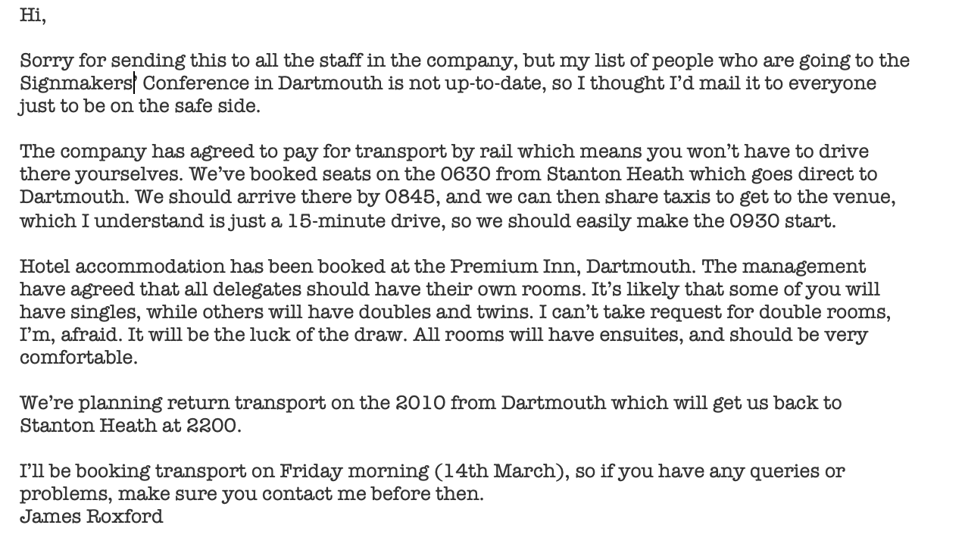
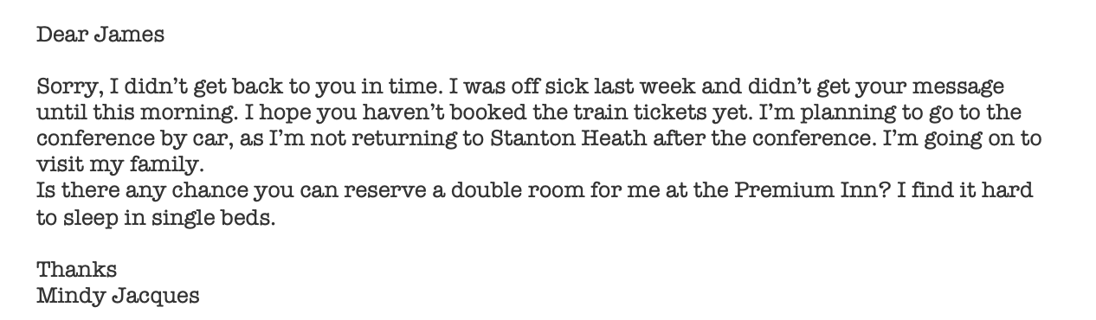
James’s email was sent to:
Mindy Jacques
Staff who are attending a conference
Visitors to James’s company
Everyone in the company
2. Which of the following is true about the journey James has planned?
Delegates will take a different route on the return journey
The delegates will arrive just after the conference starts.
The return journey is faster than the outbound journey.
The delegates will need to change trains on the outbound journey.

Slide 45
James’s email was sent to:
Mindy Jacques
Staff who are attending a conference
Visitors to James’s company
Everyone in the company
2. Which of the following is true about the journey James has planned?
Delegates will take a different route on the return journey
The delegates will arrive just after the conference starts.
The return journey is faster than the outbound journey.
The delegates will need to change trains on the outbound journey.

Slide 46
3. When did Mindy send her email?
Monday (17th March)
Thursday (13th March)
Friday morning (14th March)
Friday afternoon (14th March)
4. What is James likely to do after receiving Mindy’s message?
Reserve a double room.
Buy another conference ticket.
Phone a taxi company.
Cancel a train ticket.

Slide 47
Question 3 answers
1. The hotel was too expensive. - Patsy190
2. The decor was old-fashioned. - Patsy190/JadeUnicorn/MellowBunny/TomWheeler
3. The service was poor. - Patsy190/JadeUnicorn
4. The service was good. - MellowBunny
5. The bed clothes were dirty. - Patsy190
6. The room was dirty. - TomWheeler
7. The room was big. - MellowBunny
8. The location was bad. - JadeUnicorn
9. The shower was inadequate. – Patsy190
10. The food was bad quality. - JadeUnicorn
11. The food was good. - Patsy190/MellowBunny
12. The food portions were small. - Patsy190/TomWheeler
13. The room did not have everything the reviewer expected. - Patsy190/MellowBunny
14. The room wasn’t quiet. – TomWheeler

Slide 48
Writing practice: write the essay!
Some people think that learning a second language is very important, while others believe it is not necessary in today’s world.
What is your opinion? Do you think learning a second language is useful? Why or why not? Give at least 2 reasons to support your answer.

