Slide 1
Report Structure and Formatting
WEEK 2

Slide 2

Imagine you are a detective looking at a mysterious document. How would you figure out who wrote it, why they wrote it, and who should read it? What clues would you look for?
This session will focus on understanding the essential components of a professional report and learning basic formatting conventions (e.g. headings, bullet points, tables, …)

Slide 3
Detective Investigations…
Nancy Traffic Study – 2025
This report examines traffic congestion in the city center. The study analyzes traffic data collected between January and June 2025 and identifies the main causes of delays during peak hours.
The findings show that traffic congestion increased by 18% compared to the previous year. The main causes include road construction, limited public transport options, and an increase in private vehicle use.
Based on these findings, the report recommends improving public transportation services, adjusting traffic light systems, and encouraging carpooling to reduce congestion.

Slide 4

Warm up: Match the sections!
1. Title Page | a. This section includes additional information that supports the report, such as charts, graphs, or detailed data.
2. Executive Summary | b. This section provides actionable steps based on the report’s findings.
3. Table of Contents (TOC) | c. This section appears at the very beginning and includes the report’s title, author(s), date, and the organization it’s for.
4. Introduction | d. This is the main part of the report, divided into sections. It contains data, analysis, and discussion related to the report’s purpose.
5. Body | e. This section summarizes the key findings of the report but does not introduce new information.
6. Conclusion | f. This part summarizes the whole report and includes the key findings and recommendations. It is written last but read first
7. Recommendations | g. This section provides the background and context for the report. It also explains the purpose and scope of the report.
8. Appendices | h. This section provides an organized list of all the sections in the report with corresponding page numbers.

Slide 5

Components of a Report
Title Page
Elements:
Title, author(s), date, organization.
Importance:
Sets the first impression and provides essential information.

Slide 6
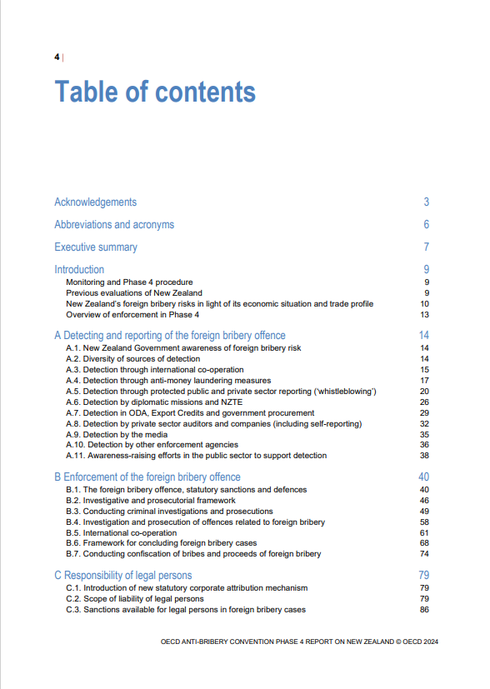
Components of a Report
Table of Contents
Lists all sections with page numbers;
Helps readers navigate the report.

Slide 7
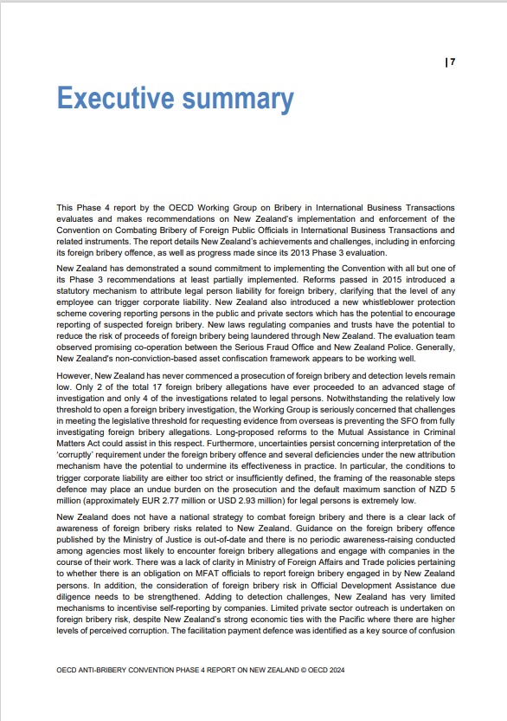
Components of a Report
Executive Summary
Purpose: Brief overview of the entire report (objective, findings, recommendations).
Length: 1–2 paragraphs, written last but placed at the beginning.

Slide 8
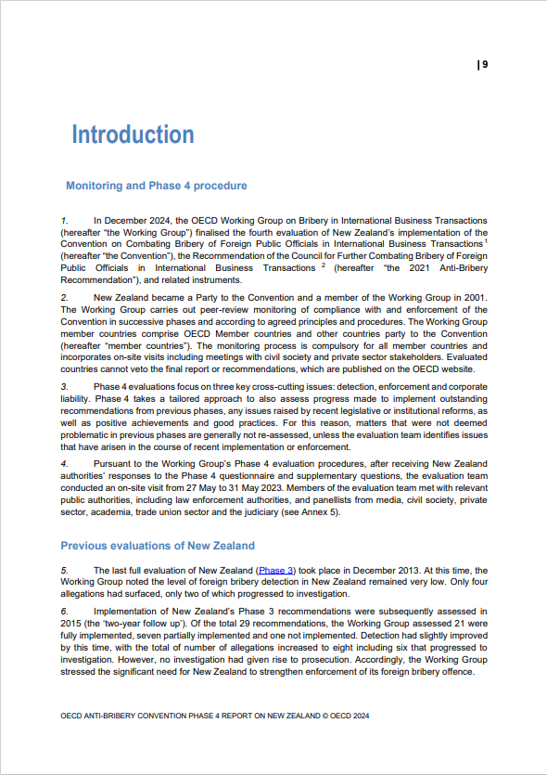
Components of a Report
Introduction
Elements: Context, purpose, scope, and structure of the report.
Sets the stage for the reader.

Slide 9
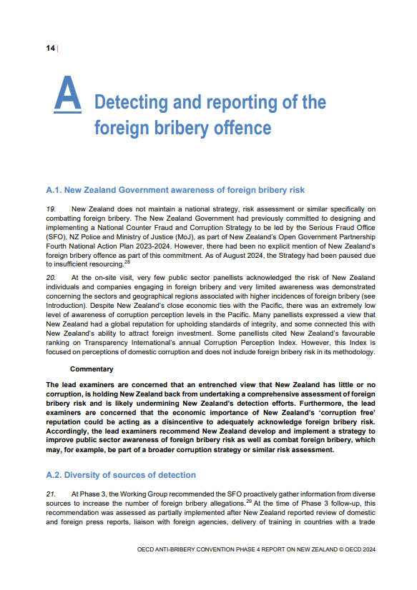
Components of a Report
Body
Divided into sections with headings and subheadings;
Includes the main content: data, analysis, and discussion.

Slide 10
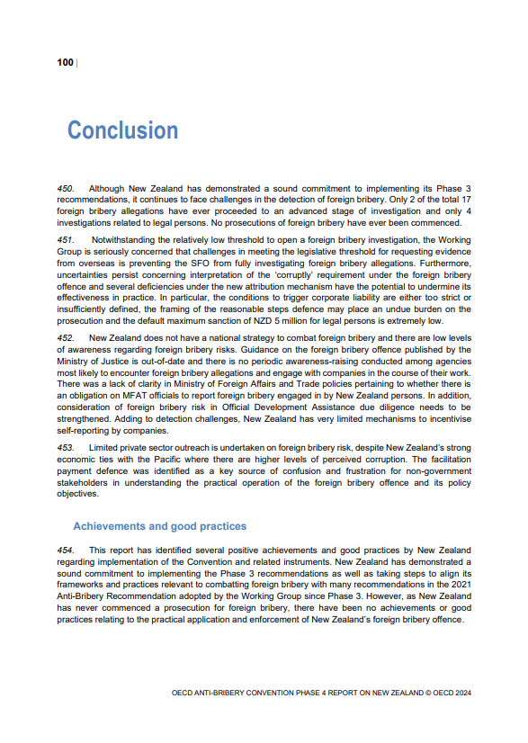
Components of a Report
Conclusion
Summarizes key findings and insights without introducing new information.

Slide 11
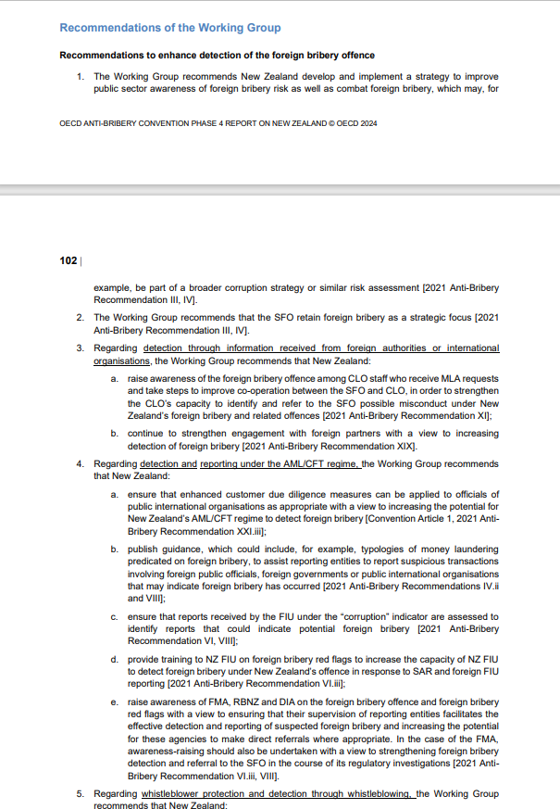
Components of a Report
Recommendations
Offers actionable steps based on the findings.

Slide 12
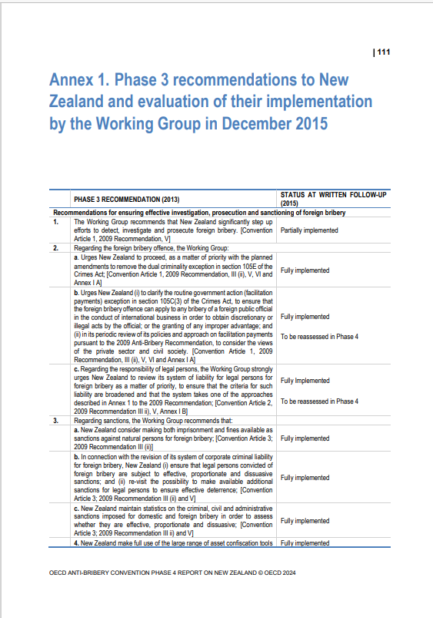
Components of a Report
Appendix:
Provides supplementary material directly related to the report (e.g., raw data, charts, or additional explanations).
Helps the reader understand or verify the main content but is not essential to the report's primary argument.
Annex:
Includes additional documents or information that are separate but relevant to the report (e.g., legal agreements, reference documents).
Often stands independently and supports the report contextually.

Slide 13
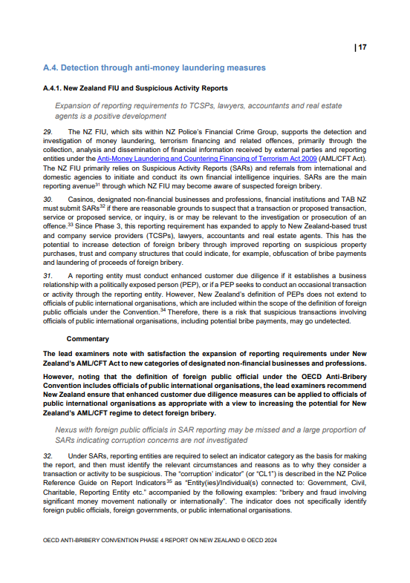
Formatting Conventions and
Practical Demonstration
Key Formatting Principles:
Headings and Subheadings
Use consistent levels (e.g., bold for main headings, italic for subheadings).

Slide 14
Formatting Conventions and
Practical Demonstration
Key Formatting Principles:
Bullet Points and Numbering
For lists, use bullet points for non-sequential items and numbers for sequences.

Slide 15
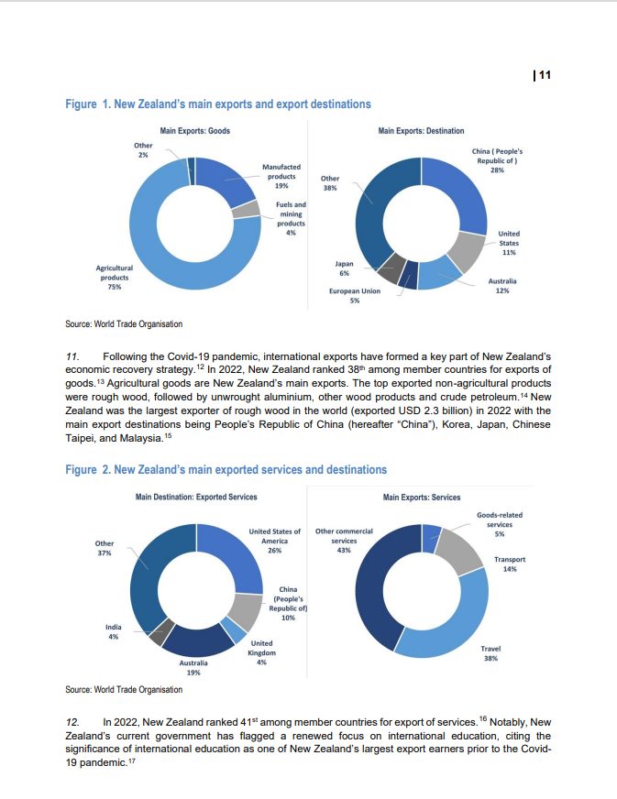
Formatting Conventions and
Practical Demonstration
Key Formatting Principles:
Tables and Visuals
Insert clear labels (e.g., "Table 1: Sales Data");
Add brief captions to explain relevance.

Slide 16
Formatting Conventions and
Practical Demonstration
Key Formatting Principles:
Fonts and Margins
Professional fonts like Arial or Times New Roman;
Use normal margins (2,54cm) and align text to the left.

Slide 17
Report Structure and Formatting
Why Structure Matters?
Ensures clarity for the reader;
Provides a logical flow of information;
Makes the report easy to navigate with sections and subheadings.

Slide 18

Over to you: Report Section Sorting
1. Title Page
Title: Improving Recycling Practices in Our Community
Author: Green Future Initiative
Date: January 15, 2025
2. Body
Our research showed that 60% of recyclable waste is not being sorted correctly. The main reasons are a lack of awareness and limited access to recycling bins. Communities with recycling education programs had 40% better outcomes compared to those without.
3. Recommendations
Launch a community awareness campaign about proper recycling practices.
Install additional recycling bins in public areas.
Partner with local schools to teach students about recycling.
4. Conclusion
Recycling rates in our community can be improved through education and better infrastructure. By implementing these changes, we can reduce waste and create a more sustainable environment.
5. Introduction
Recycling is a key way to reduce waste and protect the environment. This report looks at recycling practices in our community, identifies challenges, and suggests solutions to improve outcomes.
6. Executive Summary
This report examines recycling practices in our community. It highlights that 60% of recyclable waste is not sorted correctly and recommends launching awareness campaigns, adding recycling bins, and involving schools to address the issue.

Slide 19

Over to you: Editing &Formatting a Report Draft
The following draft comes unformatted (plain text, no headings, inconsistent formatting).
Add:
Headings and subheadings;
Format bullet points;
Insert a sample table or figure with a caption;
Conduct a peer review session with your neighbour.

Slide 20
In recent years, the use of public transportation in urban areas has become a major concern for both governments and citizens. This report looks at the benefits of increasing public transportation options, the challenges cities face, and recommendations for improving these systems. Public transportation systems, such as buses, subways, and trams, offer many advantages. They reduce traffic congestion, lower pollution levels, and provide affordable travel options for people from all income levels. For example, a study in 2022 found that cities with well-developed public transportation systems saw 25% fewer traffic jams compared to cities that rely mainly on private vehicles. Despite these benefits, many cities face challenges in improving their public transportation. One of the main issues is funding. Building and maintaining transport systems can be expensive. In addition, older infrastructure often requires costly repairs. Another problem is overcrowding, which can discourage people from using buses or trains. In some cases, poor planning and a lack of reliable schedules can make public transport inconvenient.
The lack of coordination between different modes of transportation also creates problems. For example, in some cities, bus schedules do not align with train schedules, leading to long waiting times for commuters. Cities can take several steps to improve public transportation and make it more attractive for users. Governments should increase investments in public transport infrastructure. This includes building new routes, maintaining vehicles, and upgrading facilities. Planners should also focus on improving the user experience by making services more reliable and comfortable. For example, adding air conditioning to buses and providing real-time updates on schedules can encourage more people to use public transportation. Another recommendation is to create better connections between different modes of transportation. Cities should design schedules that minimize waiting times between buses, trains, and trams. This will make travel more convenient and efficient for commuters. Finally, governments should run campaigns to promote the benefits of public transportation. These campaigns can focus on reducing environmental impact, saving money, and improving quality of life.
To conclude, public transportation offers many benefits, including reducing traffic and pollution. However, challenges such as funding and overcrowding must be addressed to improve these systems. By investing in infrastructure, improving user experience, and promoting public transport, cities can create systems that are both efficient and attractive for citizens.

Slide 21

Over to you: Draft a Report Outline
Create a detailed outline for a report on:
  The Importance of Learning English: Why English is important for Education and work.
and organize it into appropriate sections with headings and subheadings.

