Slide 1
Incorporating Data and Visuals
WEEK 4

Slide 2

What do data and visuals add to a professional report?
This session will focus on to integrating visuals such as charts, graphs, and tables into reports effectively as well as interpreting and describing data using clear and concise language.

Slide 3
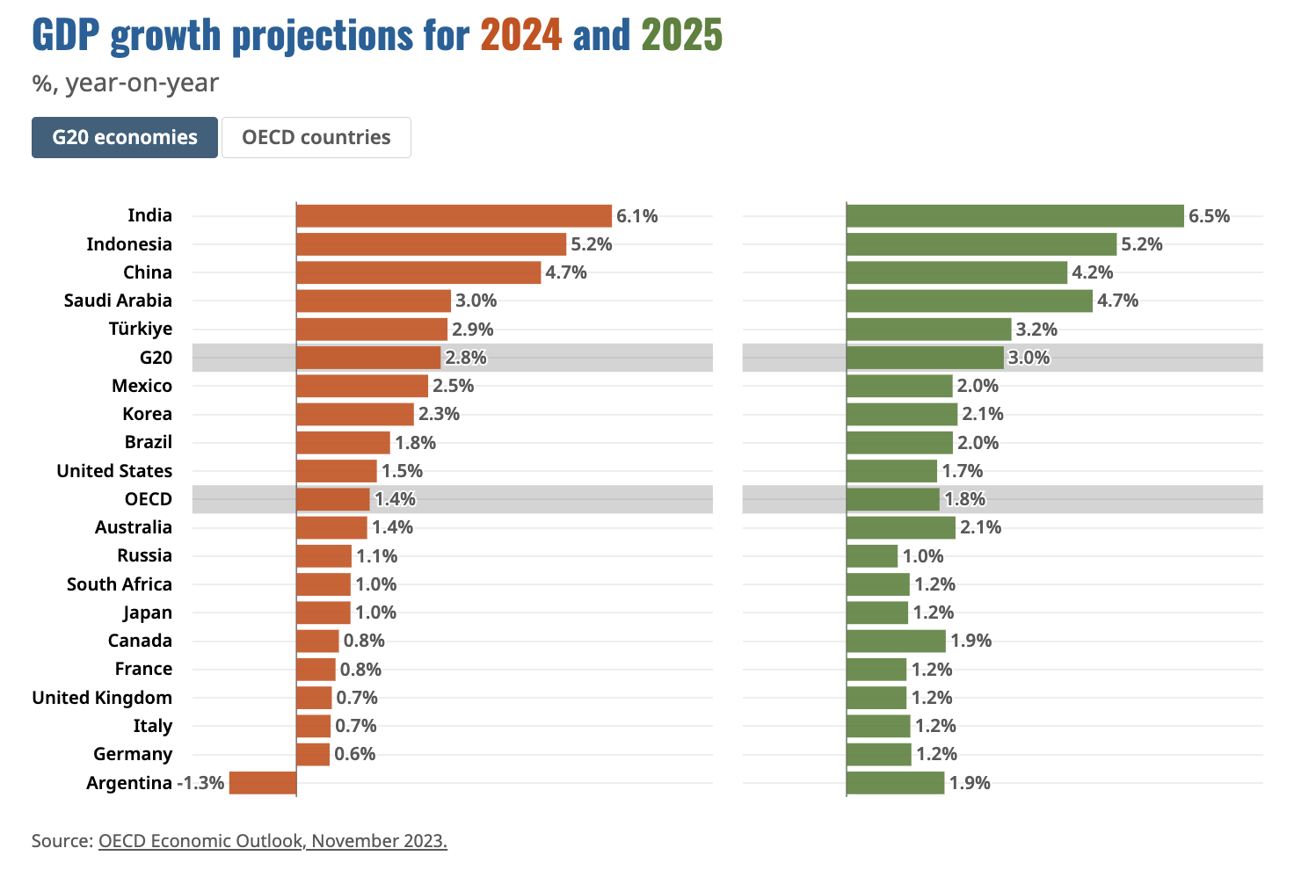
Warm up: Spot the Trend
Review and discuss the visual:
What type of visual is that?
What data does it depict?
What trend or pattern do you see?
What is the most significant piece of information in this visual?
In which kind of report could you come across this visual and what doesthe the data visualization add to such a reports?

Slide 4
Best Practices for Presenting Data
Why Use Visuals?
Simplifies complex data;
Engages the reader and makes the report visually appealing;
Highlights trends, comparisons, and key points.

Slide 5
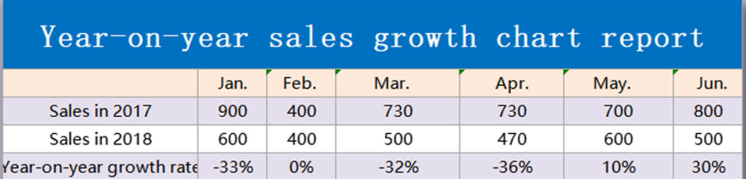
Types of Visuals
1. Tables: Best for presenting precise numerical data (e.g., annual sales figures).

Slide 6
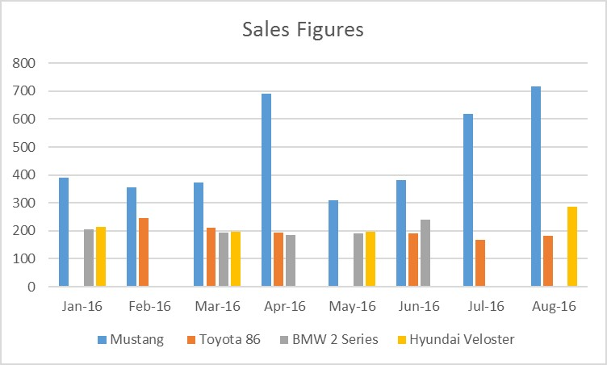
Types of Visuals
2. Charts and Graphs:
Bar Charts: Compare categories (e.g., product sales in different regions);
Line Graphs: Show trends over time (e.g., monthly temperatures);
Pie Charts: Display proportions or percentages (e.g., market share).

Slide 7
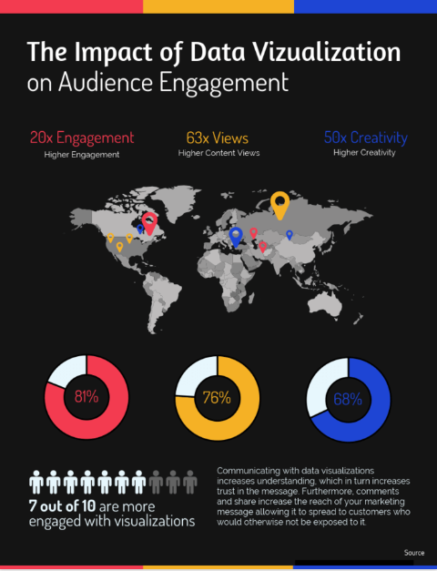
Types of Visuals
3. Infographics:
Combine visuals with minimal text to simplify data (e.g., customer demographics).

Slide 8
Best Practices for Using Visuals
1. Choosing the Right Visual:
  Match the visual to the data:
  Use tables for exact numbers.
  Use line graphs for trends over time.
  Use pie charts for showing parts of a whole.
2. Labeling and Titles:
Every visual should have:
  A clear title (e.g., “Figure 1: Monthly Sales Data for 2023”).
  Labeled axes for charts and graphs.
  A legend if needed (e.g., colors representing categories).

Slide 9
Best Practices for Using Visuals (continued)
3. Keep It Simple:
  Avoid overcrowding with too much information;
  Focus on the key message you want to convey.
4. Add Captions:
  Describe what the visual shows and explain its relevance;
  Example: “Figure 2 shows a steady increase in sales from January to June, peaking in December due to holiday promotions.”
5. Place Visuals Strategically:
  Position visuals near the text that explains or refers to them.

Slide 10
Interpreting and Describing Data in Visuals
Key Questions to Answer:
  What does the data show?
  What is the most important trend, difference, or observation?
  How does this data relate to the report’s purpose?

Slide 11
Interpreting and Describing Data in Visuals
Language for Describing Data:
Trends Over Time:
  “Sales increased steadily from January to June.”
  “There was a sharp decline in sales during April.”
Comparisons:
  “Product A outperformed Product B by 20%.”
Proportions:
  “60% of respondents preferred Option A, while only 15% chose Option B.”

Slide 12
Interpreting and Describing Data in Visuals
3. Avoiding Misinterpretation:
Be precise and avoid overgeneralizing.
  Example: Instead of “The graph shows sales are high,” say, “The graph shows sales reached their highest point in December.”

Slide 13

Over to you
In pairs with your classmate, read and discuss the two following examples:
Is the visual appropriate for the data?
Are the labels, titles, and captions clear?
Does the visual make the information easier to understand?

Slide 14
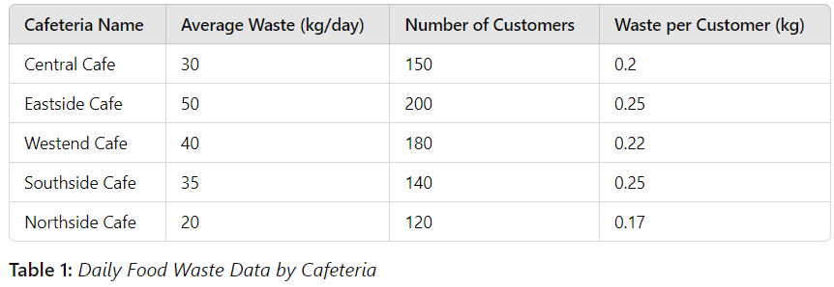
Example 1: Report with a Line Table
Improving Food Waste Management in Urban Cafeterias
Executive Summary
(…)
Introduction:
This report evaluates food waste levels in five urban cafeterias over the past year. The goal is to identify patterns and suggest measures to reduce waste and improve efficiency.
Findings:
Food Waste Data:
The table below presents the average food waste (in kilograms) per day at each cafeteria.
  Eastside Cafe has the highest waste per day and per customer.
  Northside Cafe produces the least waste both overall and per customer.
2. Key Observations:
  Cafeterias with smaller portion sizes, such as Northside Cafe, waste less food.
  Lack of proper meal planning contributes to higher waste levels.
Conclusion:
  (…)
Recommendations:
Implement portion control strategies in all cafeterias.
Train staff to improve meal planning and reduce excess food preparation.
Introduce food donation programs for leftover edible food.

Slide 15
Class Debrief
Which visual is easier to interpret?
How could the visuals or descriptions be improved?

Slide 16

Visual Match-Up
Match data sets to appropriate visuals
1. Monthly rainfall | a. Bar Chart
2. Annual Sales report (e.g. by region) | b. Pie Chart
3. Survey Result | c. Line Graph

Slide 17

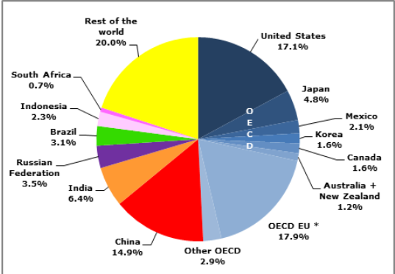
Label and Describe
.
This visual came unlabeled:
Task 1: Add a title, labels, and a legend
Task 2: Write 2–3 sentences describing the data.

Slide 18

Group Analysis
&
Presentation
Analyse a dataset your group will be assigned and present findings:
Choose the best visual to represent the data;
Create the visual and write a description;
Present your findings to the class.

Slide 19
Always shoot for the Moon.
Even if you miss it, you’ll land among the stars.
Oscar Wilde
Best of luck for the first exam next week!!

