Slide 1
Modélisation des gisements miniers
- Mining geomodelling -
Application to metallogeny, mining exploration and exploitation :
stakes and methods
Marie-Cécile Febvey
Lou Declercq

Slide 2
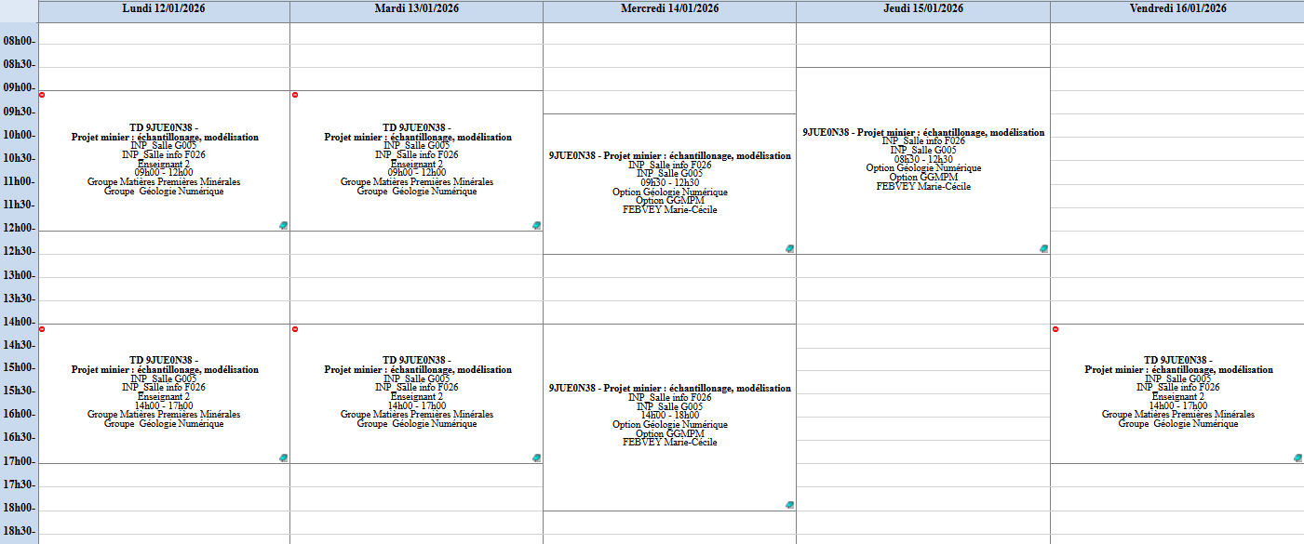
Outline of the course / Schedule
Mining geomodelling course
Mining geostatistics course
Project San Nicolas
Oral & Synthetic report
AF1 | – Analyze and process multi-source data to address a mining exploration problem, given an ore genesis problem
AF2 | – Perform a mineral resource assessment.

Slide 3
Outline of the course / Schedule
Skua Gocad
F026
F026
F026
F026
Isatis.neo
F026
F026
F026
Oral exam

Slide 4
Geomodelling course outline
Theory (~1h)
TD1 : Implicit & Explicit Modelling
TD2 : Property Modelling & Ore Body construction
Project : San Nicolas

Slide 5
Courses main objectives
Understand the role and limits of modelling in geology/mining industry
Know the main workflows of geological modelling
Understand the dedicated vocabulary
Know the main concept of Geostatistics applied to mining geomodelling

Slide 6
Introduction

Slide 7
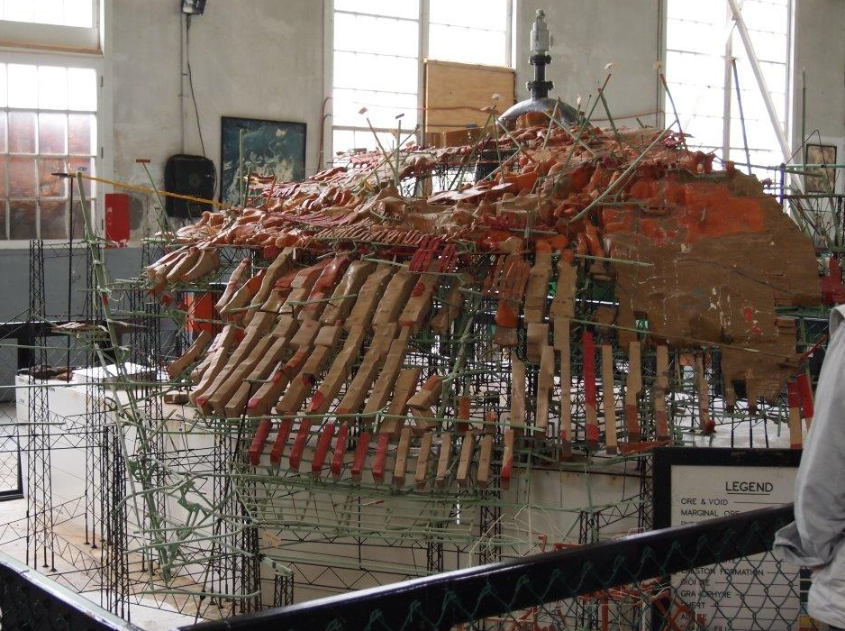
What’s the point behind modelling ?
3D Geological Model of the Sullivan Mine, 1940s
Principle:
Numerical approximation of geological reality
Aim:
Better understand subsurface (phenomena, organization, …)
Sullivan Mine Model
in Skua Gocad
Montsion et al., 2015

Slide 8
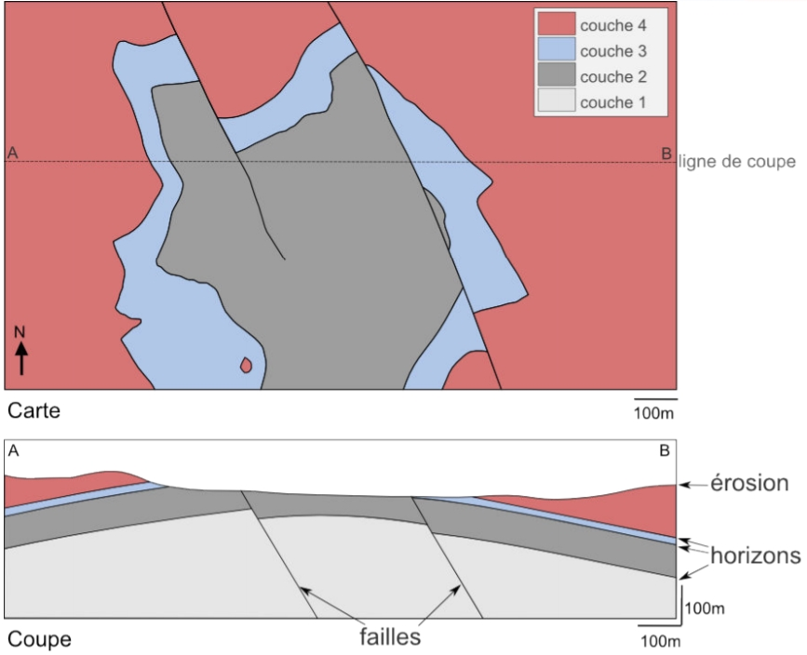
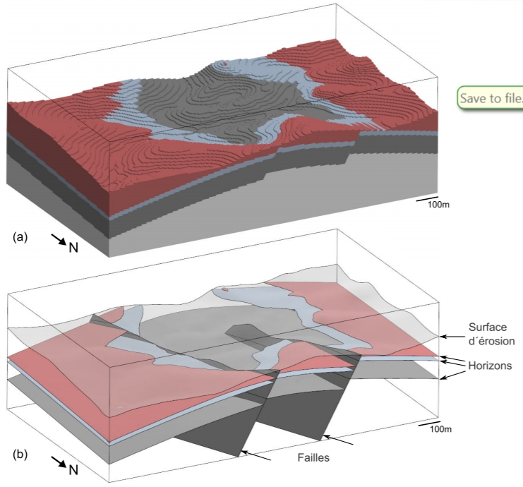
What’s the point behind geomodelling ?
Volumetric representation
Boundary representation
[Pellerin, 2014]

Slide 9
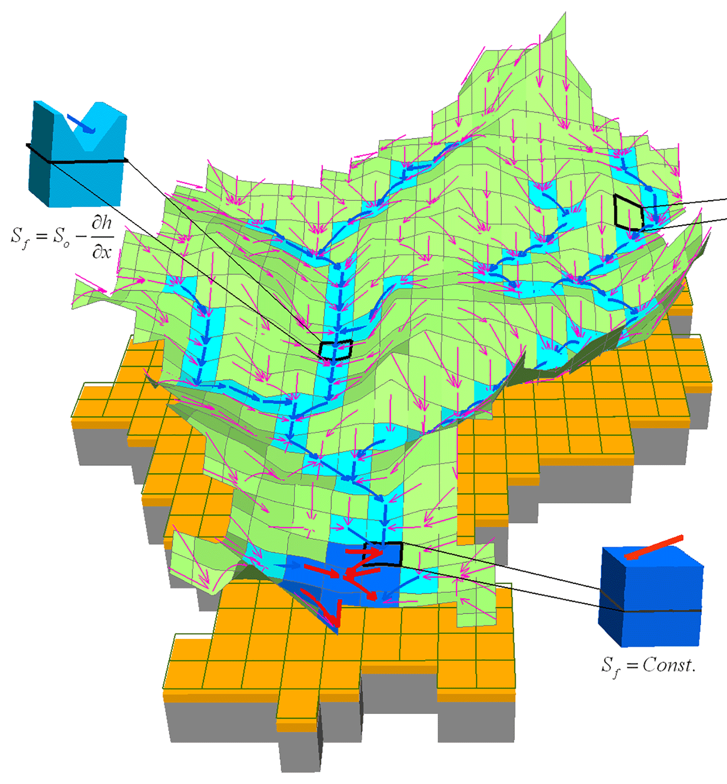
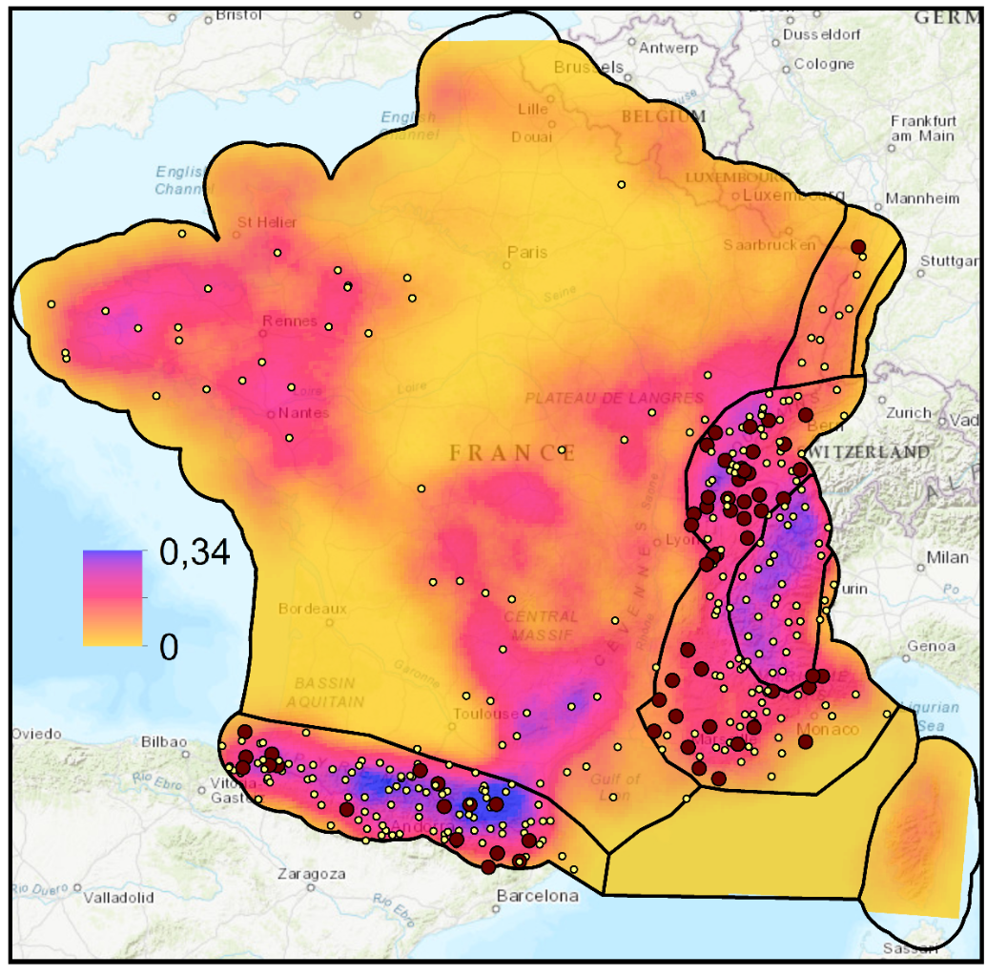
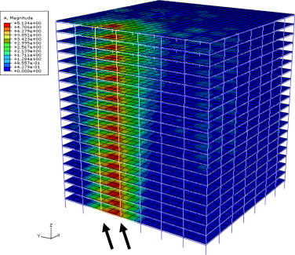
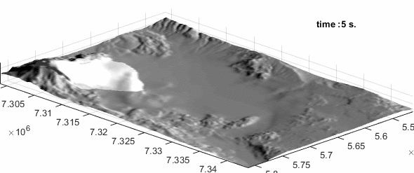
Numerical geology modelling, what for?
Risk assessment for natural phenomenon : Understand, monitor & predict hazards
=> frequency, location, flows, intensity, …
STAKE: safety, durability, economy
Earthquakes
Volcanoes
Collapses
Floods
  [Kelfoun, LMV]
  [Fu, 2009]
  [Gouache, 2021]
  [Li, 2018]

Slide 10
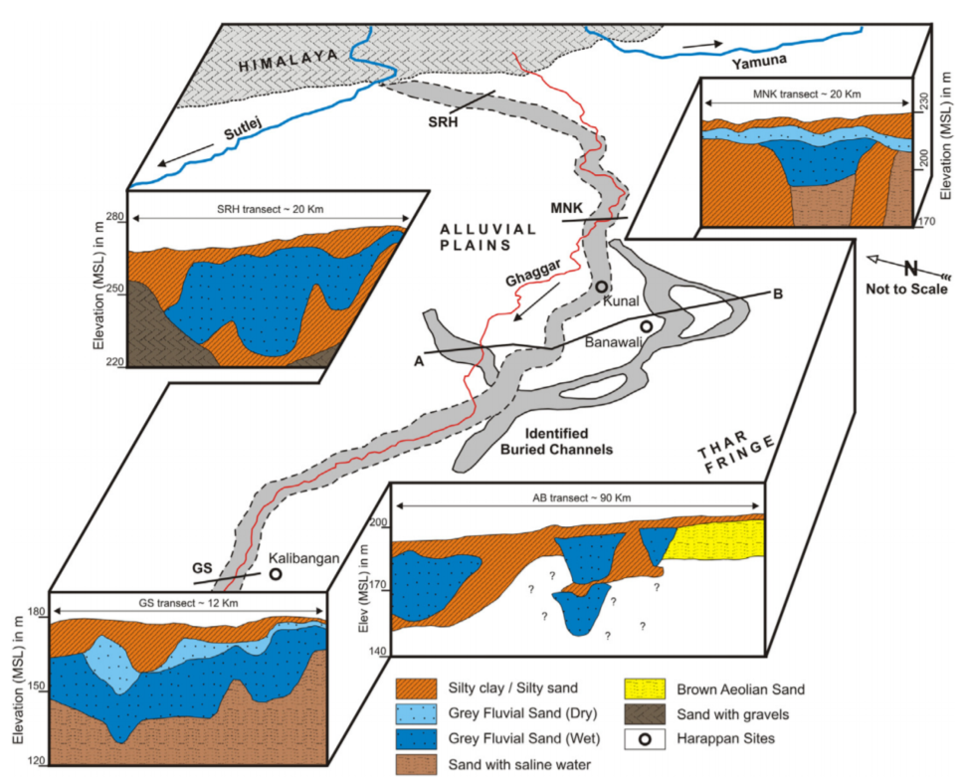
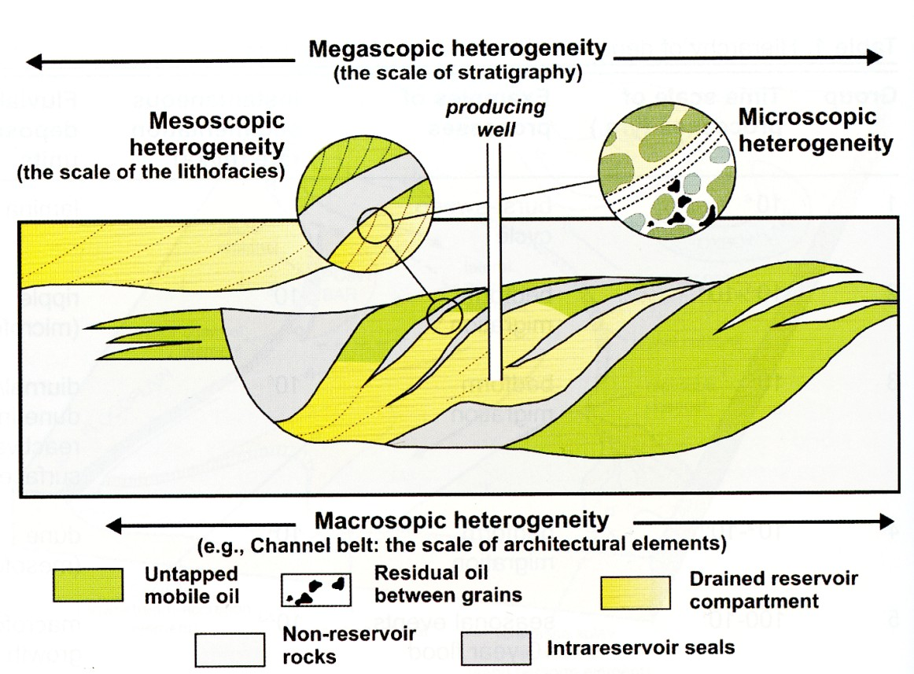
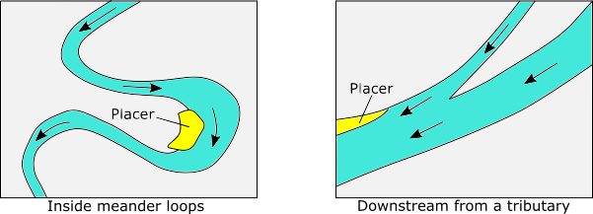
Numerical geology modelling, what for?
Natural resources assessment :
  Locate, Estimate, Characterize connectivity of reservoirs
STAKE: resources, profitability, targeting
Hydrocarbons
Water
Mineral deposits
[Tyler, 1988]
[John Wiley and sons, 1990, all rights reserved]
[Sinha et al., 2013]

Slide 11
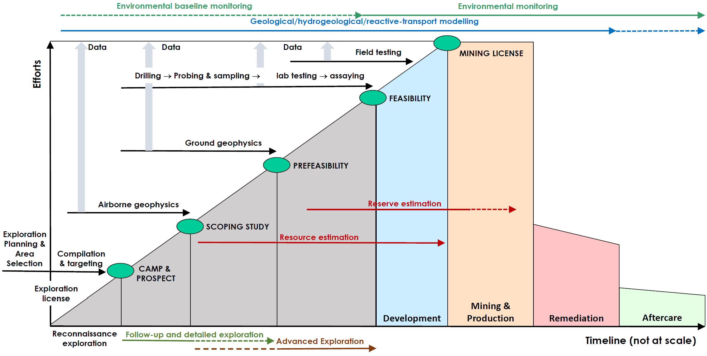
modelling in mine cycle life
© IAEA
Pollutants concentration
Evaluate flows
Penalizing factors location and concentration
Ore extractability
Grades determination
Determine resources location

Slide 12
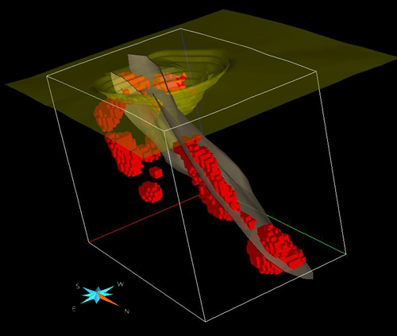
Geomodelling in mining, what for?
Geometry ⬄ Structures
Grades
1. Orebody characterization
Volumes
Connectivity
Location
[Marchive & Verlhac, 2017]
=> Orebody profitability?

Slide 13
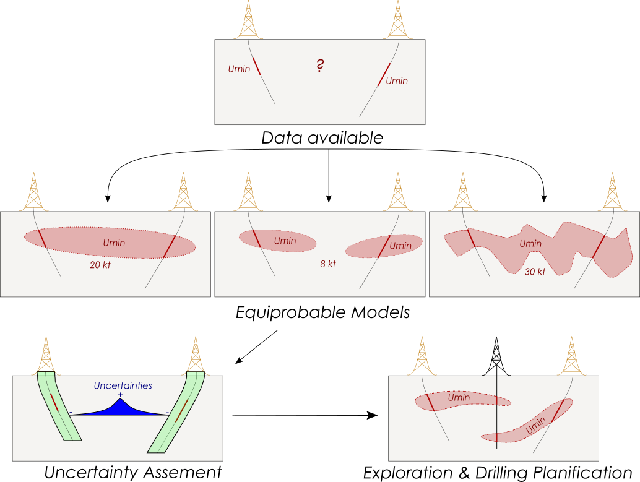
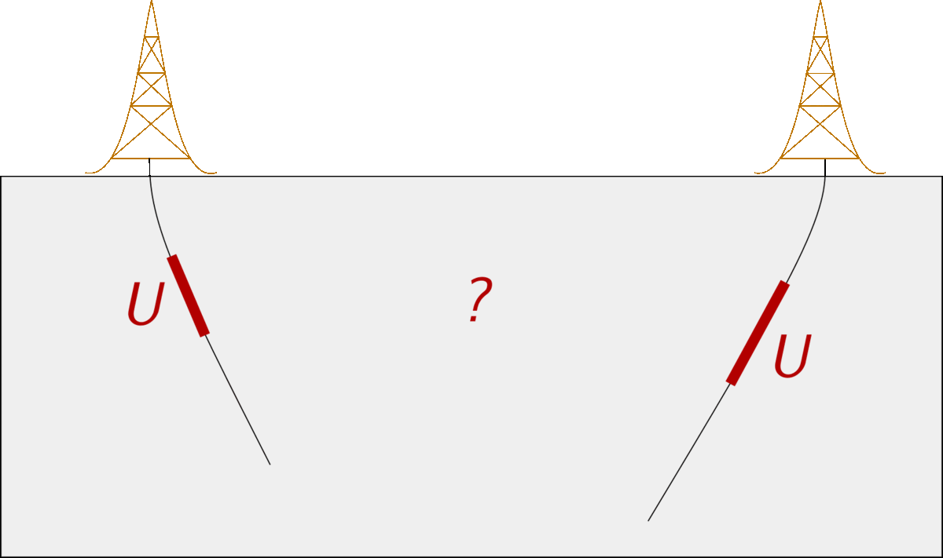
Geomodelling in mining, what for?
2. Uncertainties characterization
Exploration strategy : drilling

Slide 14
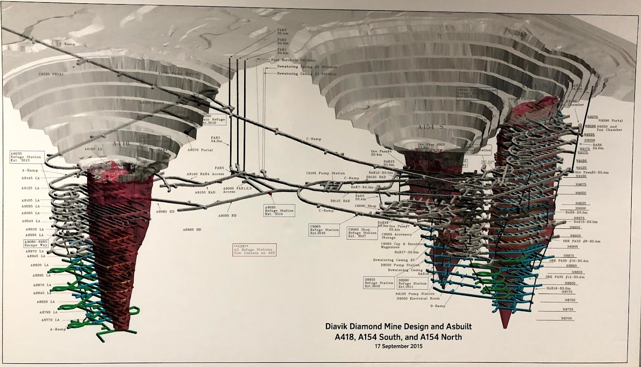
Geomodelling in mining, what for?
3. Design and planning of the mine
Orebody?
Penalizing factors?
[Courtesy of Diavik Diamond Mine]
Gangue?
+ Surrounding infrastructures and possible satellite deposits?

Slide 15
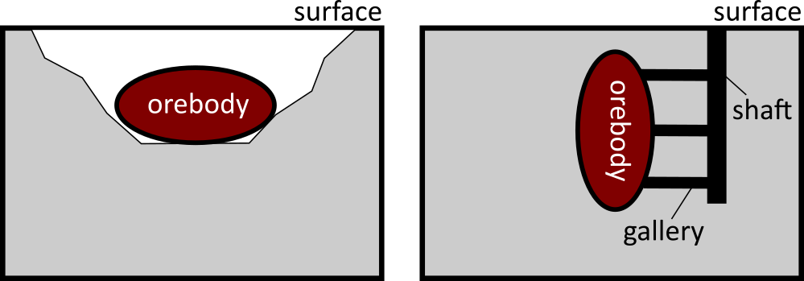
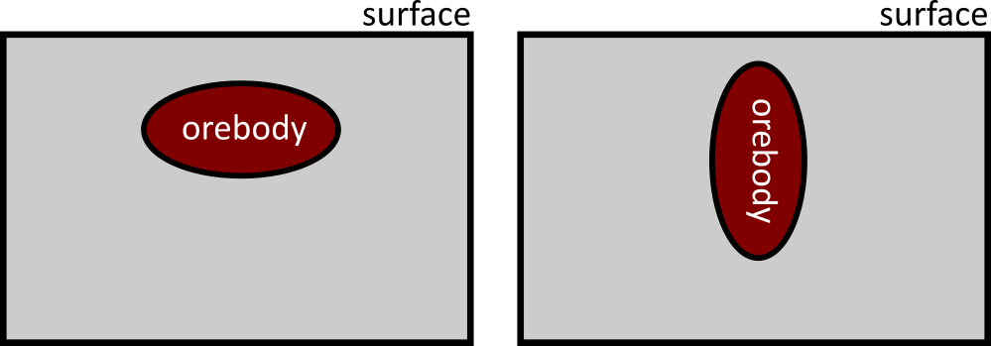
Mine planification
Open-pit mine
Underground mine
Needs to characterize orebody geometry to choose mining strategy
Shallow orebody with mainly horizontal extension
Deep orebody with mainly vertical extension

Slide 16
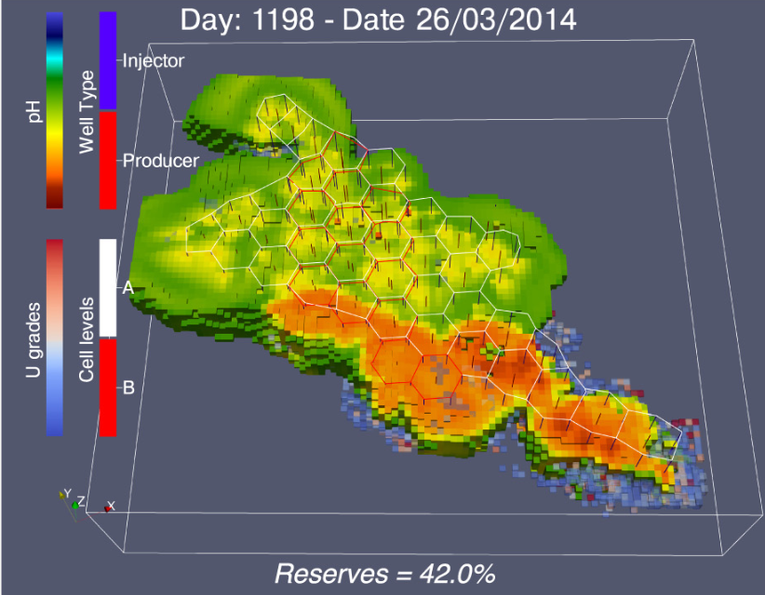
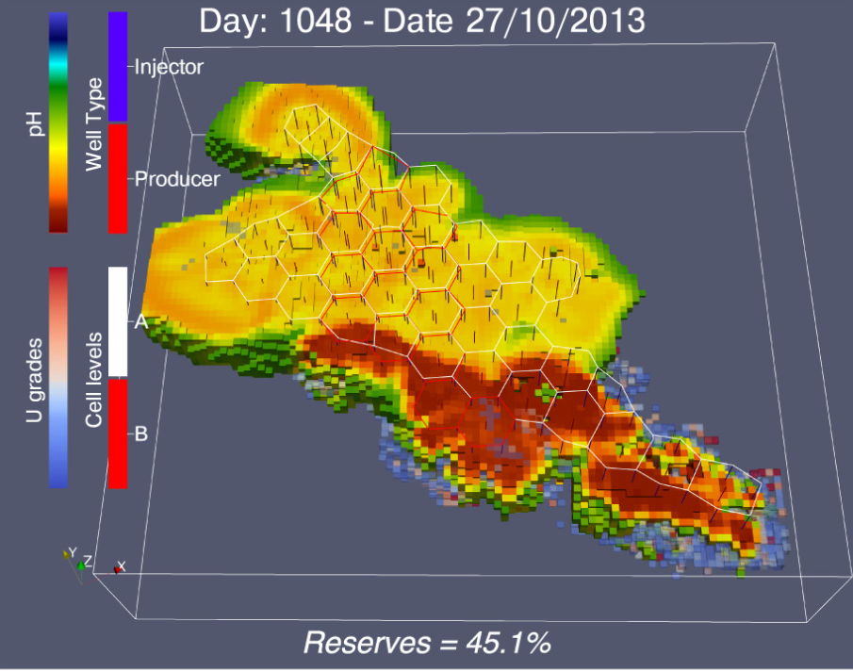
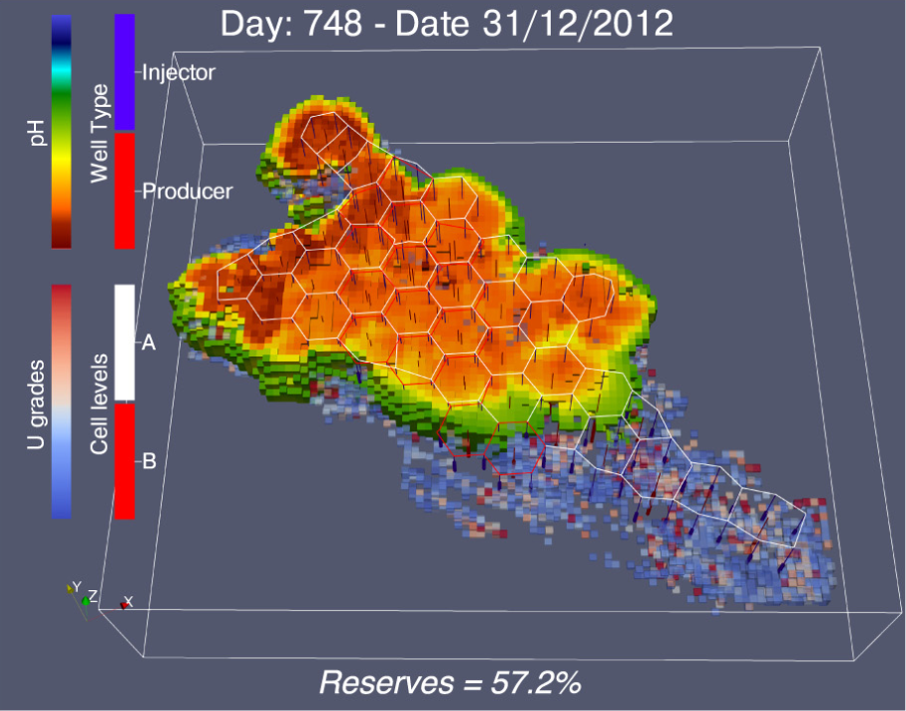
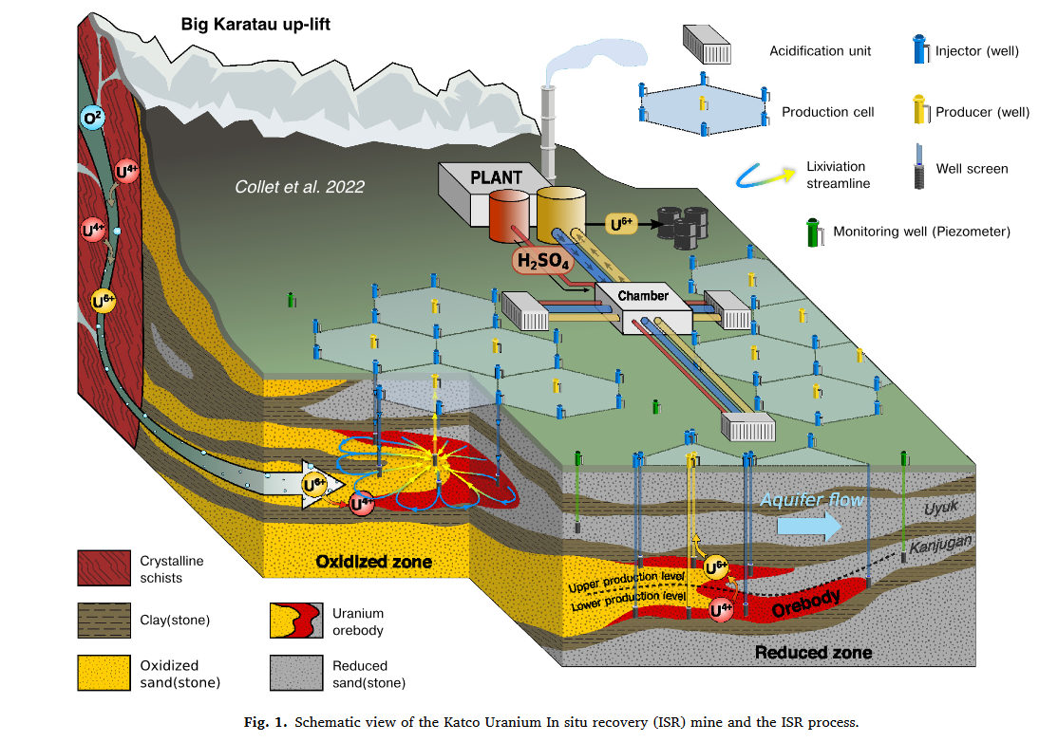
Numerical Geology modelling in Mining, what for ?
4. Production forecasting
Mine production estimation : ISR (In Situ Recovery)
Fluid flow simulations
Chemical reactions simulations
[Collet, 2022]

Slide 17
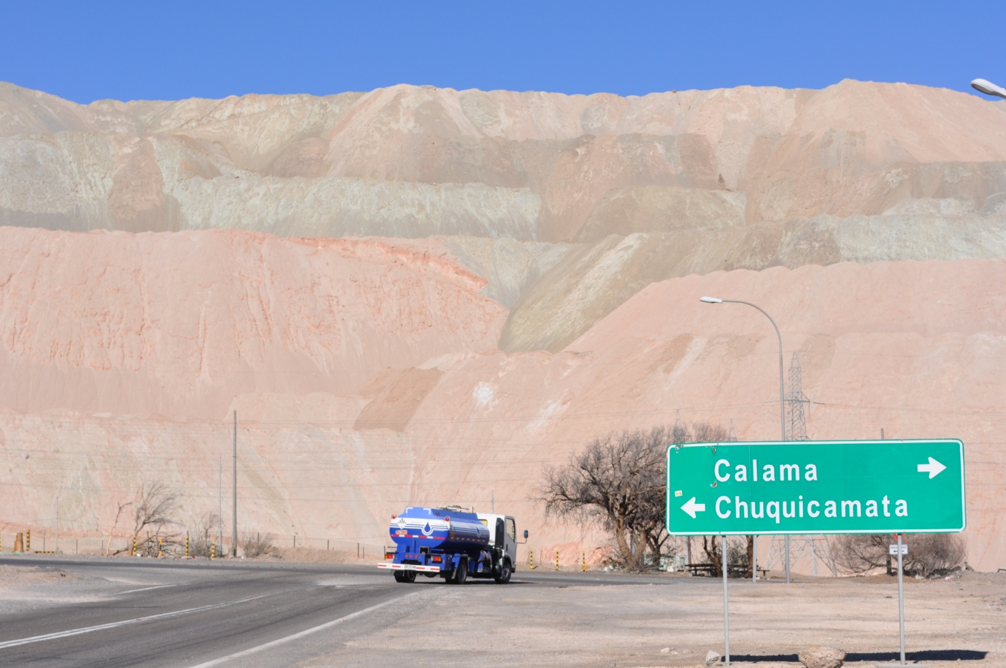
Size of Mining Projects
Tailings

Slide 18
Mining modelling chain in, outs & softwares

Slide 19
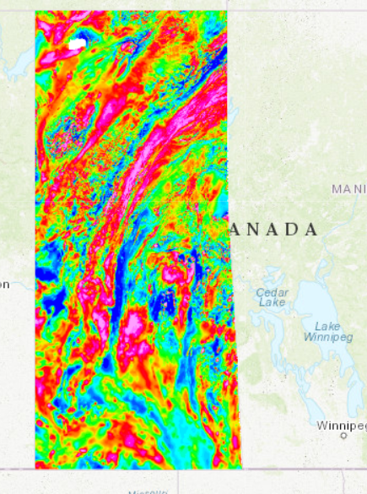

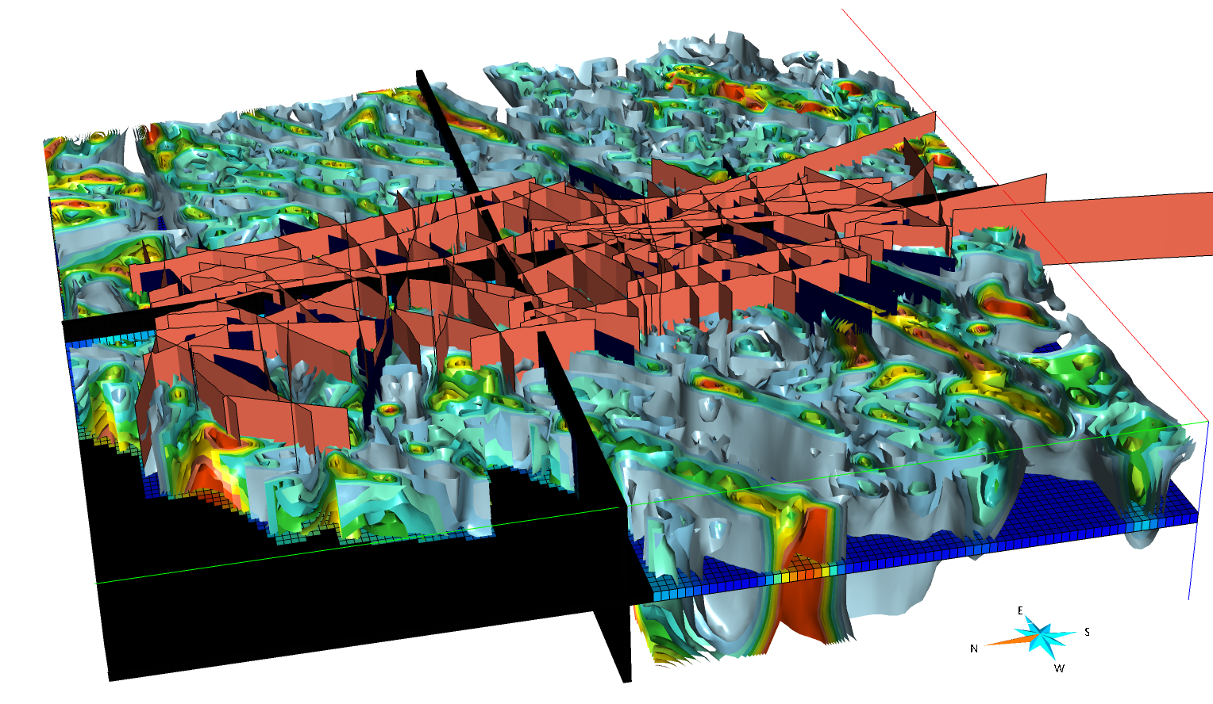




Overview of processes
Field work & data
Geological interpretations
Numerical tools
Numerical models
Many possible models!

Slide 20
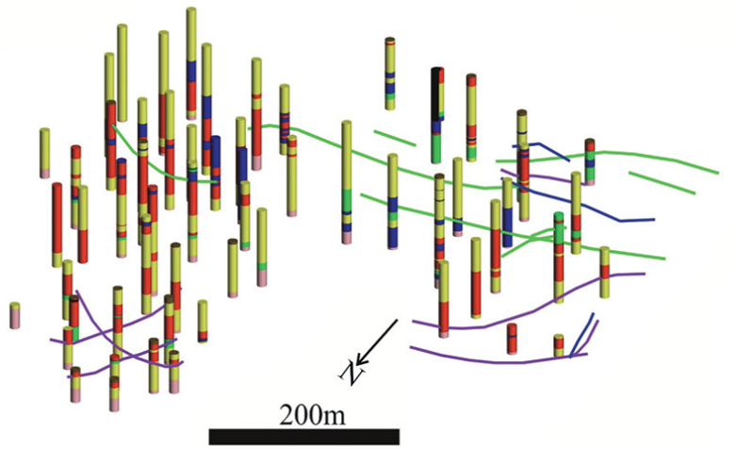
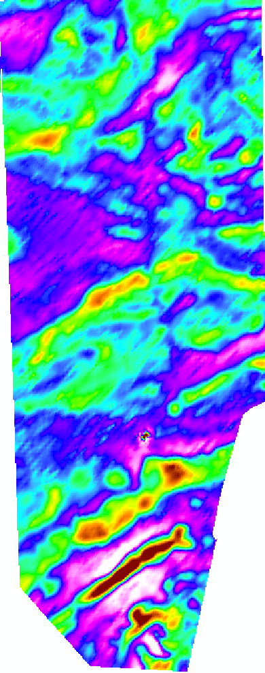
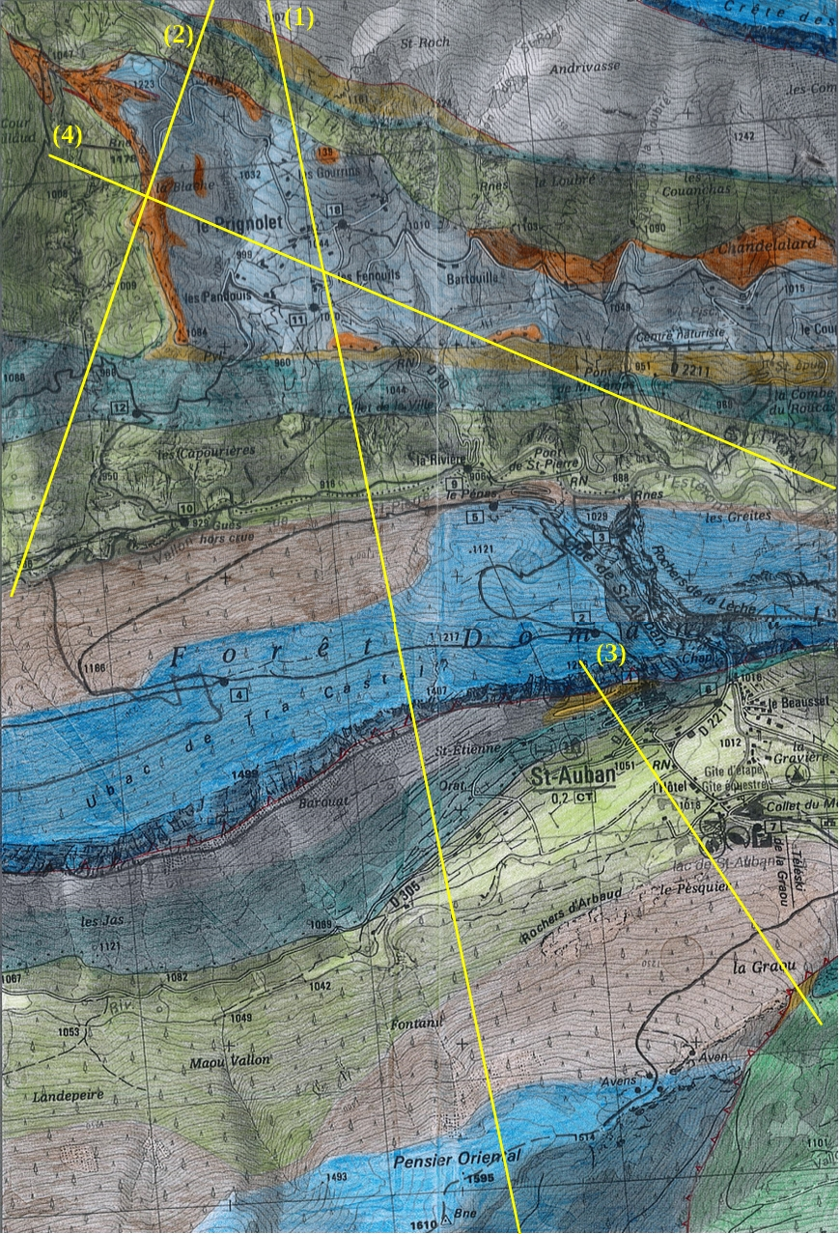
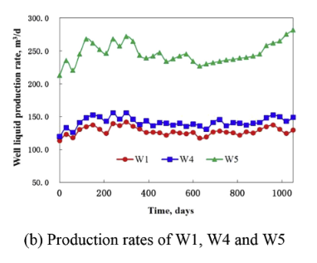
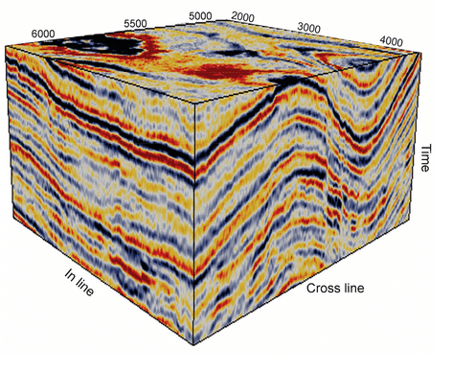
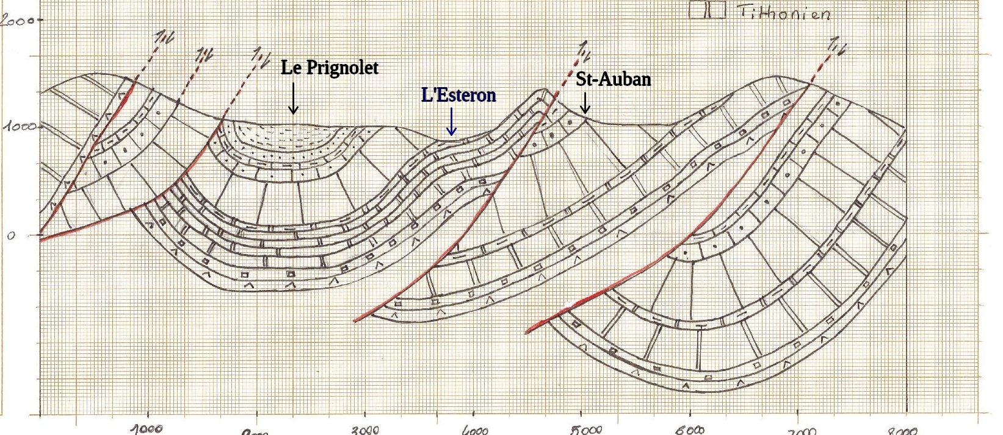
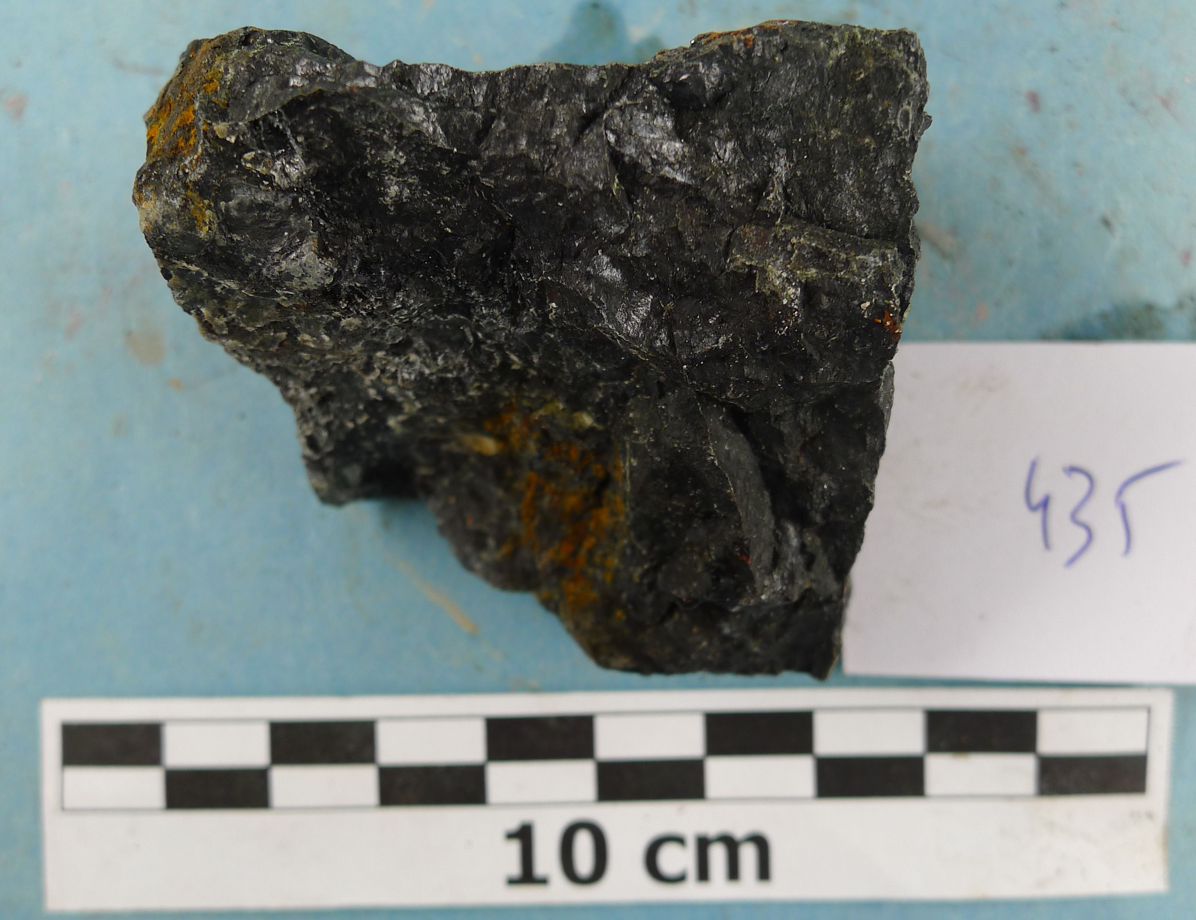
What are the field work input data?
Drillcore & samples
Geophysical survey
Geological interpretations
Time series
[Braga, 2019]
[Nejad, 2021]
[Zhao, 2016]
[Courtesy of Orano]
[Martz, 2016]
[Marchal, 2017]
Geology, Geochemistry & petrophysical data, markers
EM, seismic, radiometric, resistivity
Maps, cross sections, outcrop digitation
Well injection, production data

Slide 21
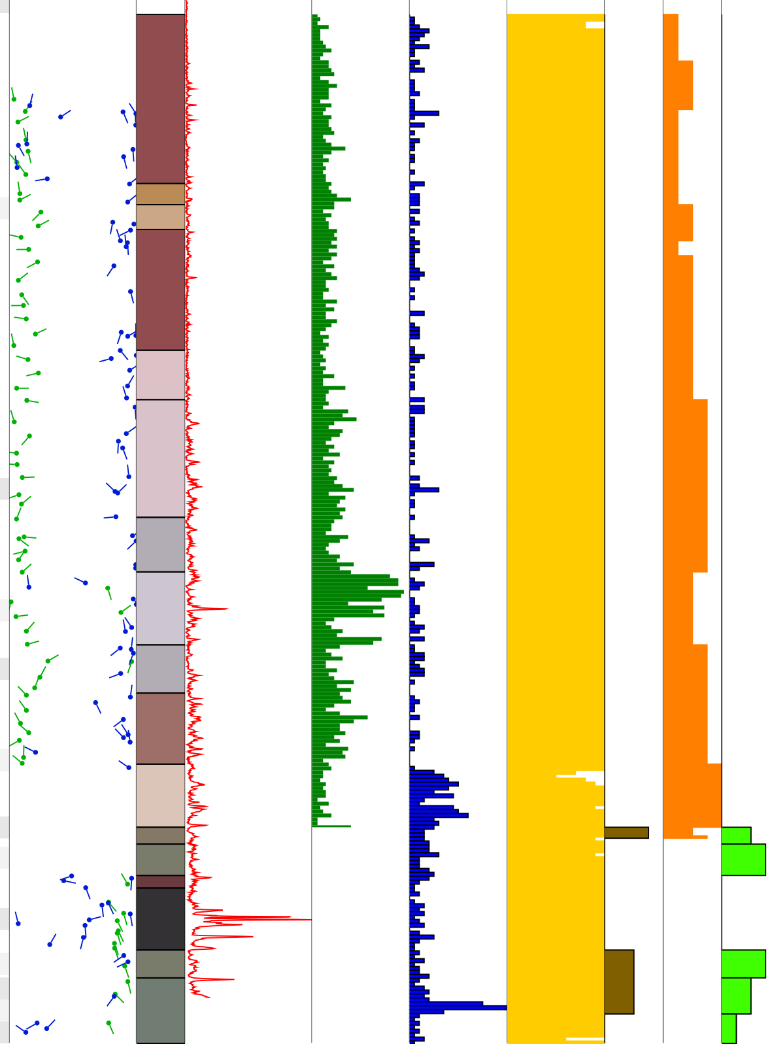
Drillcore Data
Continuous log properties: geochemical data, spectral data, gamma-ray
Discrete log properties: fracture degree, argillization, bleaching, but also Au grades (every meter), geochemical data…
Sparse
structural data:
stratigraphy,
faults

Slide 22
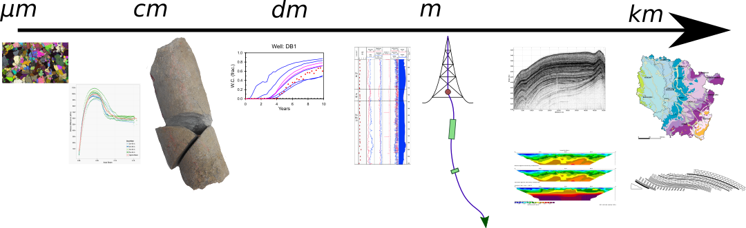
About Data Heterogeneities
Multi-scale: from µm to km
Multi-dimensional: 1D, 2D, 3D, 4D
Various range of uncertainties
Different quality of interpretation

Slide 23
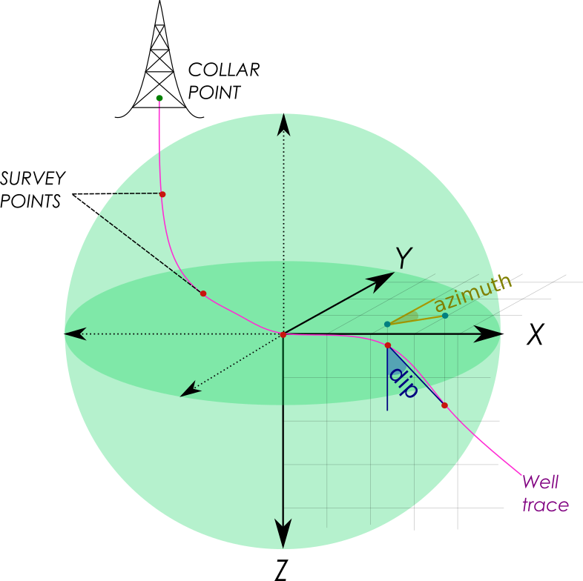
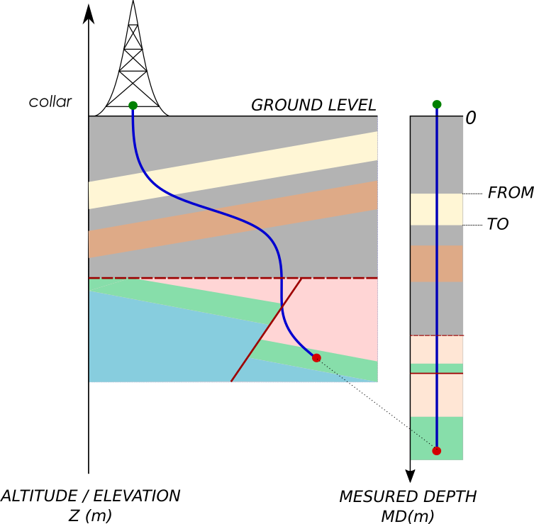

Well Data Overview
Curvilinear length ≠True trace of wells

Slide 24
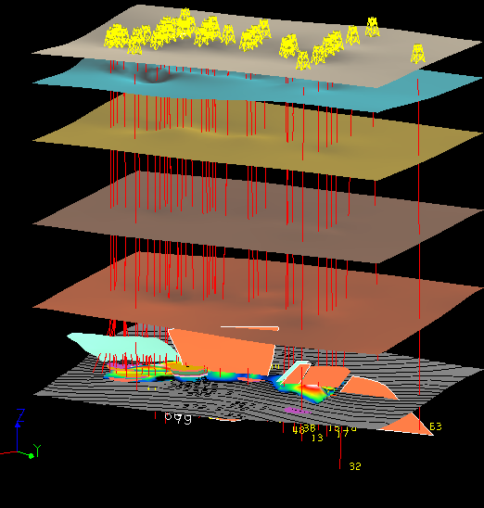
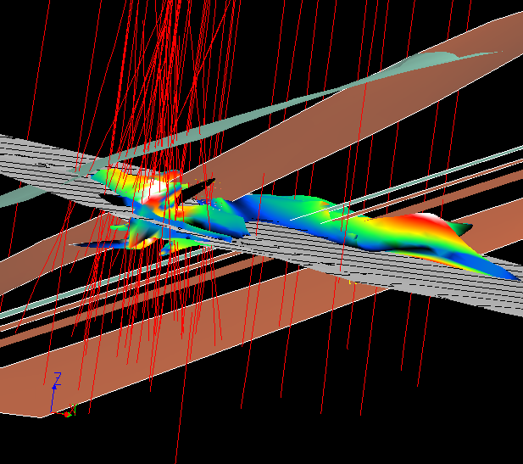
What are the output?
3D geomodels: structural models,
petrophysical grids
Detailing the spatial architecture
of the surbsurface
Highlighting the location and
extension of the orebody
Temporal models, …

Slide 25
Geomodelling softwares
Petrel
Leapfrog
Geomodeller
Surpac Vision
SKUA-Gocad
Isatis Neo

Slide 26
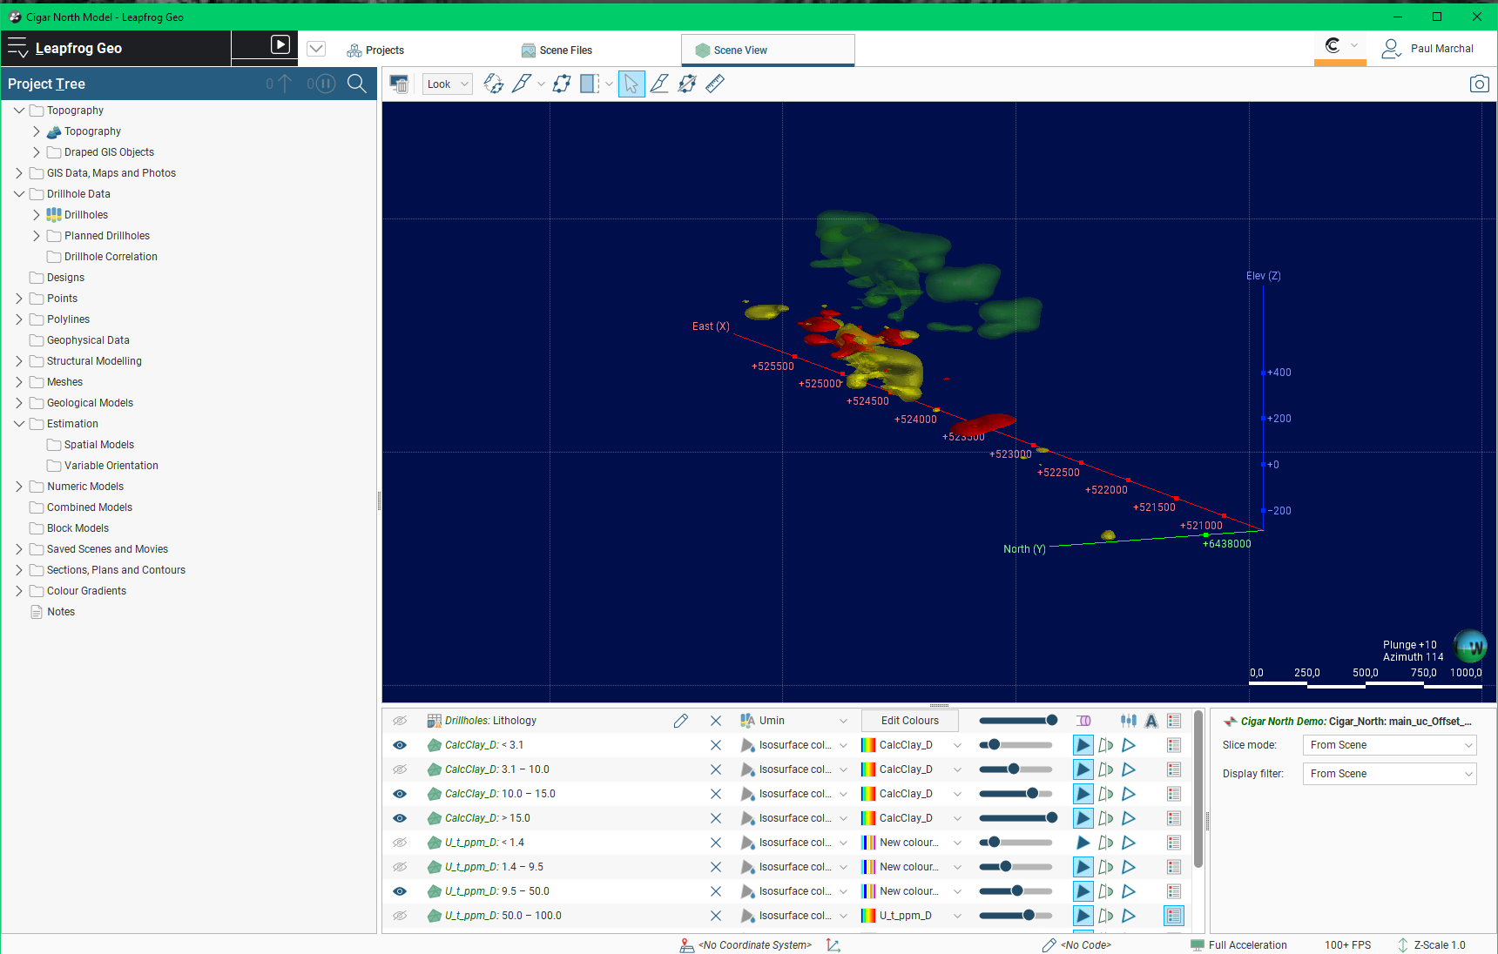

About Leapfrog
Commonly used geomodelling software in mining industry
Project tree: where objects are stored, created and imported
View bar: slicer, view selection, measurements
3d viewer
View selector: where you select objects you want to display (after drag and drop to view area) + display parameters

Slide 27
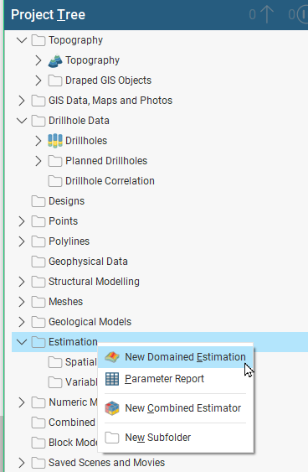
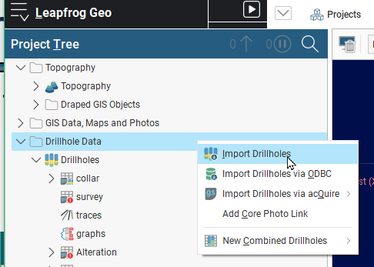
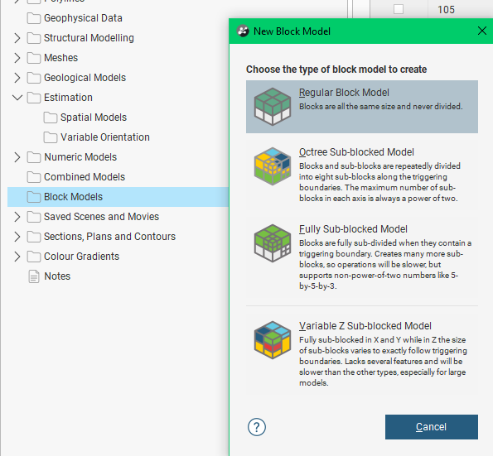
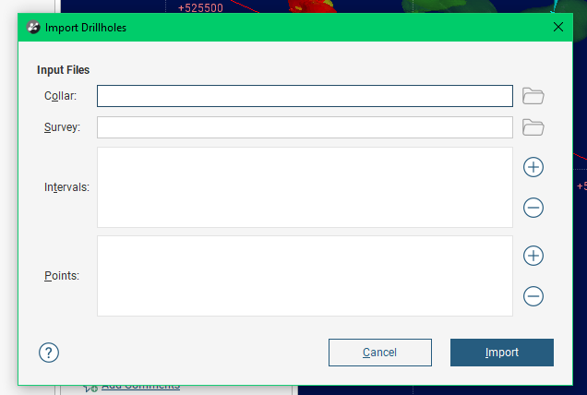
Project tree
To import, create or vizualize objects: go to the right category and click on it
New estimation
Import data
New model

Slide 28
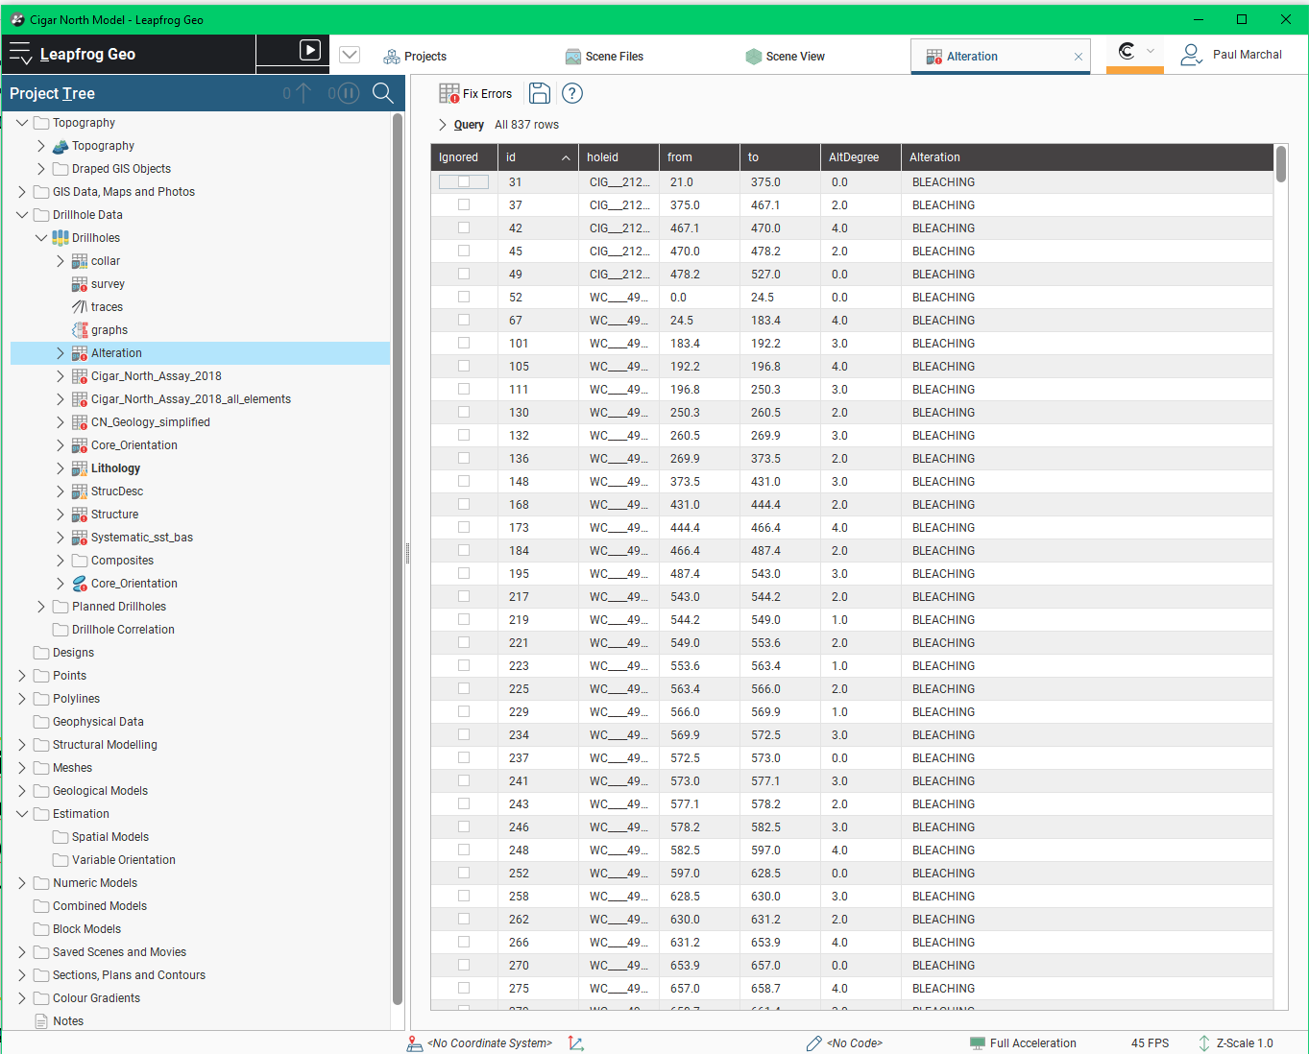
Access table
Pros:
Easy to use
Basic geostatistic tools
Modern UI
Cons:
Only deterministic approaches
Only Mining (the whole point for Leapfrog)

Slide 29


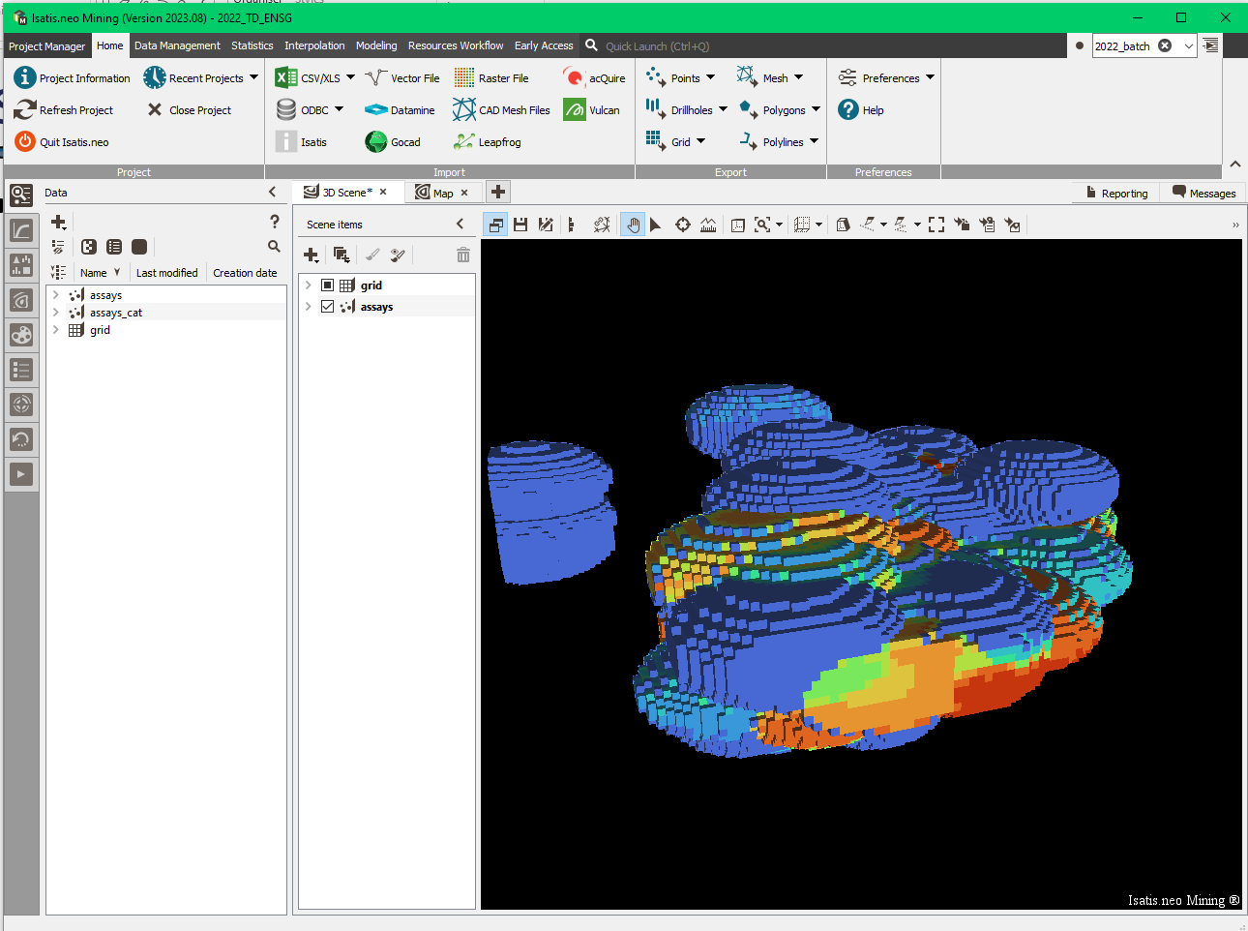
Isatis.neo
Geostatistics software (second part of the week)
Pros:
Easy to use
Modern UI
Complete geostatistic tool
Easy bridge to other software
Cons:
Not a modelling software

Slide 30

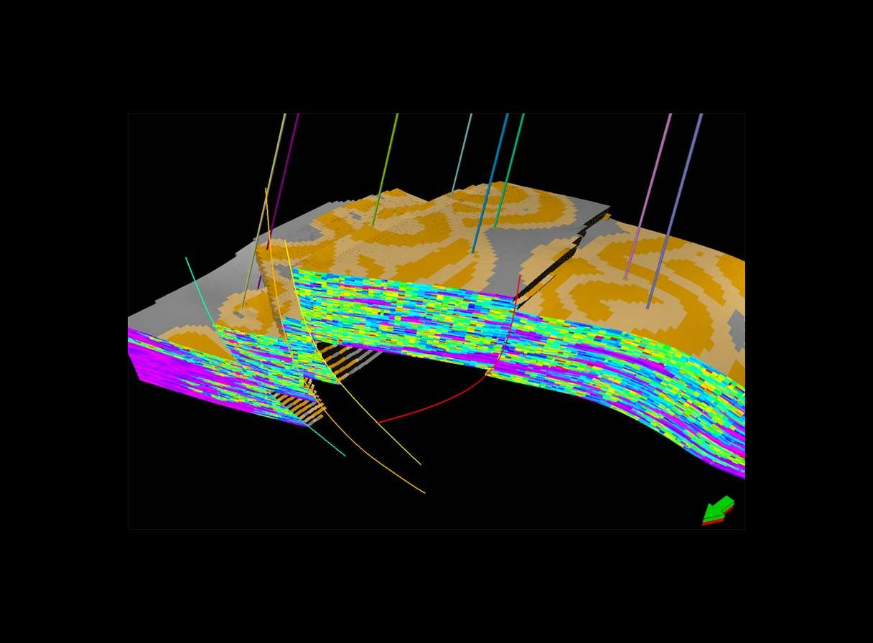
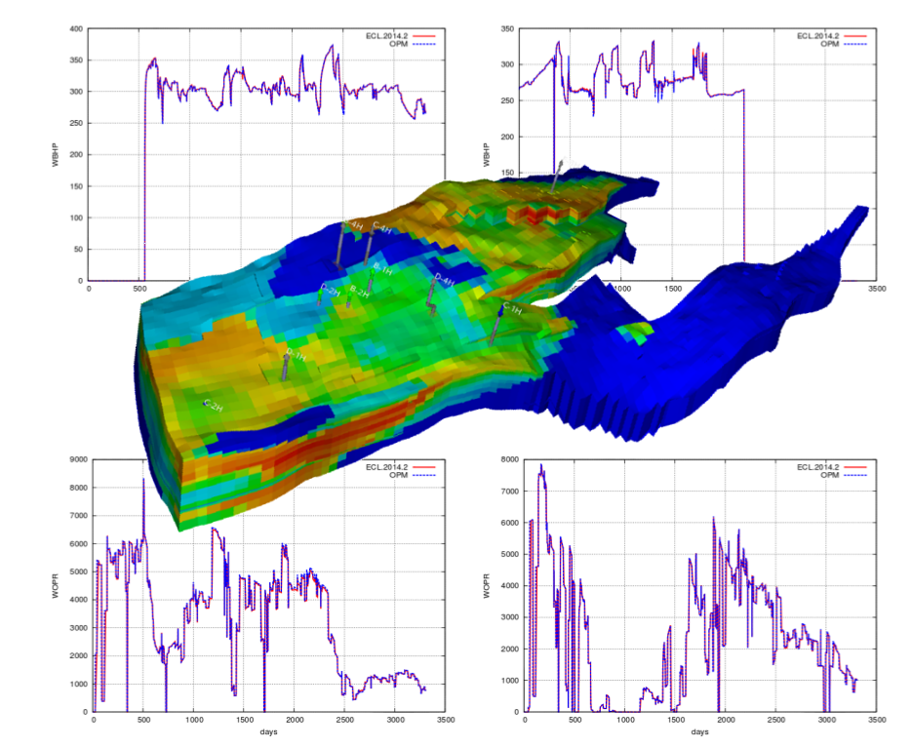
Petrel and Eclipse
Petrel: Petroleum modelling software
Eclipse: Fluid flow simulation tool

Slide 31
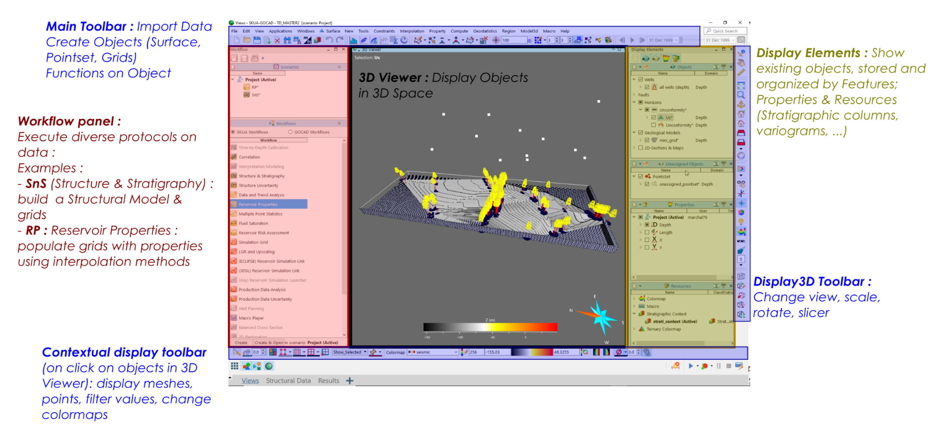
SKUA Gocad (Aspen Gocad)
Generic modelling tool (but mostly petroleum)
Pros:
Huge amount of functionalities
Good demonstration tool
Cons:
Hard to manage
Old software

Slide 32
Short Gocad Story
Prof. Mallet (Nancy School of Geology) discovers a new interpolation technique
T-Surf Corp is created
Earth Decision
Sciences
Pradigm
Gocad Consortium 1
Gocad Consortium 2
Gocad Consortium 3
C Version
C++ version
Version 2
Version 2.2
1988
1995
1998
2002
2006

Slide 33
SKUA Gocad
Gocad software created at ENSG in 1989
Spin-off company in 1997
Ongoing research at ENSG / GeoRessources:
  Gocad Research Consortium, 12 Companies, 139 universities
Exploration going under cover
  Need for geophysics
  Need for geology, Geophysics and business question integration

Slide 34
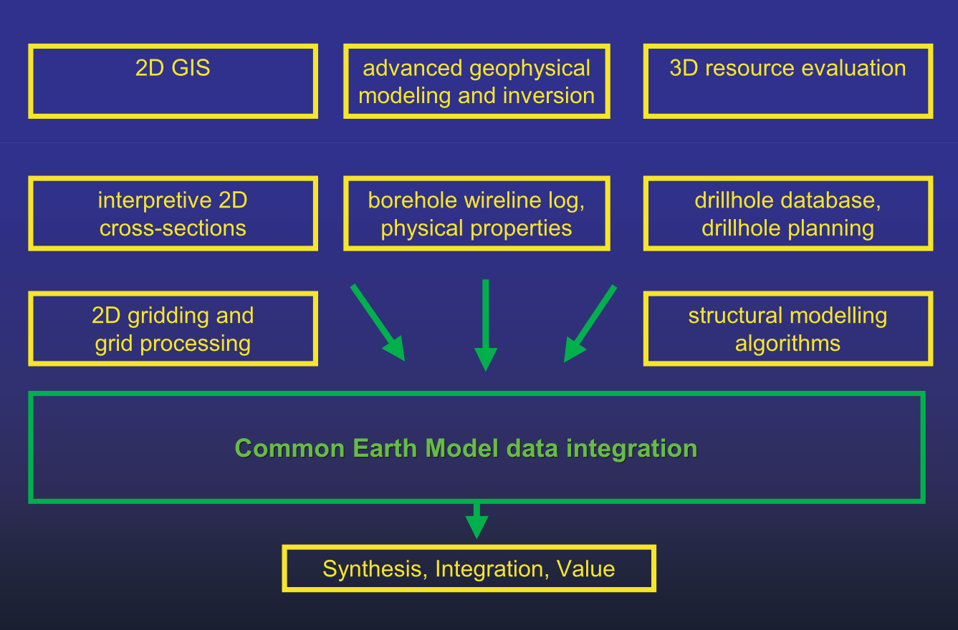
Common Earth Model / Shared Earth Model
Concept From Oil Industry circa 1997
Quantitative model of all available data (drillholes, geophysics, GIS, …)
Shared & Updated model between teams (geophysicists, geomodellers, geologists, chemists, etc.)
Somewhat outdated concept, comes out naturally between branches of a company (especially for geometallurgy)
Or in certain projects (a whole country or a mining district)
[McGaughey, 2006]

Slide 35
Implicit and explicit modelling

Slide 36
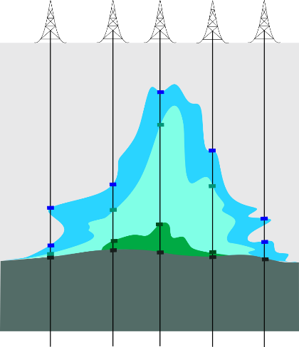





2 main types of geomodelling approaches
Explicit Modelling
Implicit Modelling
3D surfaces construction using interpolation between data points: parametric surfaces
Digitation of contacts
Closer to the data
3D surfaces extracted as iso-values of 3D scalar fields: equipotential surfaces
Need a scalar-field
Smooth the data

Slide 37



2 main types of geomodelling approaches
[Renaudeau, 2019]

Slide 38


Implicit modelling with several fields
Using several scalar fields combination to reproduce complex geometry
[Grose, 2021]
[Laurent, 2016]

Slide 39


Combined approaches
Simple interpolation
Topological robustness (no holes, self-intersection, etc.)
Uncertainties gestion (no constraints => low gradients)
New information added => new surface calculated
Drillcore data
Signed distance field function
f=0 : lithological contact
f<0 : inside the volume (ore body)
f>0 : outside
Signed distance field of drillholes
Constrained interpolation
[Zhong, 2019]

Slide 40
Modelling workflows steps in mining studies

Slide 41




Most common geomodelling workflow
inversion
From [Mazuyer, 2018]

Slide 42



Most common workflow
1. Acquisition of data (on field or remotely)
  Drilling
  Geophysical surveys
  Geological mapping
[www.erdenedrilling.mn]
[www.energymining.sa.gov.au]

Slide 43

Most common workflow
2. Processing the acquired data
  Analysis of the cores
  Analysis and cleaning of the signals obtained
[Annesley et al, 2013]
[Serdoun, 2021]
[Declercq, 2025]

Slide 44




Most common workflow
Geological interpretation
  One data set = multiple possibilities
+ stratigraphic log
[cours Royer & Caumon 2015]

Slide 45



Most common workflow
Structural modeling : understanding fault network and horizons

Slide 46


Petrophysical modeling
Need of a grid
  A Voxet object is a regularly spaced, 3D grid consisting of volume elements called cells (or voxels).
Petrophysical grid
Geostatistical calculations on the grid => the deformation and other structural features are taken into account
Structural model

Slide 47



UVT Transform
Transform grid to deposition space
Z_{d}
Deposition space
Y_{d}
X_{d}
Simple transformation example :
X = X_{d}
Y = Y_{d}
Z = (Z_{d} – Z_{mur}) / (Z_{toit} – Z_{mur})
Actual space

Slide 48



Regionalization
Global variogram
4
3
2
1. Different data resolutions
2. Different parameter distributions/spatial variations
1
Permeability grid

Slide 49






Effect on histogram
4
1
Global histogram
2
3
4
1
2
3

Slide 50





About grids, cells & meshes
Various type of cells :
Various type of grids :
About regularity
Structured
Unstructured
Hybrids..
regular/irregular connectivity & pattern
Computing efficiency
Geological realism

Slide 51


Petrophysical modelling
  Geostatistics on each region
    Properties can be continuous or categorical
    Methods: estimation or simulation

Slide 52




Some examples
Simulations … (SGS)
Nearest neighbour
Indicator kriging (simple)
Indicator kriging (ordinary)

Slide 53
Most common workflow
Numerical simulations
  Need for a specific grid
  Physical simulations: rock stress, flow, wave propagation
[Raguenel et al., RING Meeting 2019]

Slide 54
Most common workflow
Creation of ore geobodies
How to draw relevant volumes of interest ? Mean ? Max ? Min ?
=> Dependent on the context
Notion of cut-off (teneur de coupure):
minimal grade for economical profitability
Cut-off = f(market price, extraction cost)
Mine design varies based on the cut-off: several projections must be made during the late exploration stage to prepare for potential variations in commodity prices.

Slide 55




Cut-off
Cut-off 10%
Uranium %
Cut-off 4%
Cut-off 5%

Slide 56
Most common workflow
Computation of the reserve/resources volumes
  Profitability → Cut-off grade
  Reserves vs resources :
Exploration results
Mine development
Resources
Reserves
Resources Re
Reserves Rs<Re
Increasing level of geological knowledge and confidence
Total amount of ore, oil, etc.
present in an area
Initial Re = identified Re + non-profitable Re + non-identified Re +…
Inferred
Indicated
Probable
Measured
Proved
Cost of production, market prices, accessibility, etc.
Consideration of modifying factors (mining, processing, metallurgical, economical, environmental, social, infrastructural, marketing, governmental…)
Total amount of profitable recoverable resources

Slide 57



Most common workflow
Block model
  Kind of upscaling: idea is to consider bigger block and not just samples
  Variability on block is smaller than on samples
  Selectivity performed on sample histogram over-estimates reserves
Samples
Block
Average Grade of
Selected Blocks

Slide 58
Récapitulatif
Notions clefs Cours :
Applications modélisation en Géologie
Applications modélisation en Géologie Minière
Données en entrée d’un logiciel de modélisation
Objets en sortie d’un logiciel de modélisation
Modélisation explicite vs implicite
Common Earth Model
Notion de grille, de cellule, de maillage (+ régulier, irrégulier)
Notion de repères cartésien X, Y, Z vs espace de dépôt U, V, T
Cut-off, ressources, réserves, rentabilité

Slide 59
Case study
San Nicolas vms
Context and Objectives
Lou DECLERCQ
Marie-Cécile FEBVEY

Slide 60
Objectifs du projet
Work in groups of 3 or 4, mixed between GN & GGMPM students (~1 GN + 2/3 Mines)
Using San Nicolas deposits models & data, estimate ore volumes & grades for different metals. Note that you have to select what data you want to model and justify your choice. Ensure you have listed every data available.

Slide 61
Acquis d'apprentissage fondamentaux (AF)
AF1 | – Analyze and process multi-source data to address a mining exploration problem, given an ore genesis problem
AF2 | – Perform a mineral resource assessment.

Slide 62
Deliverable
On Friday 15/11: ~12/15 min presentation by group on Friday 16/01 on how you answer the previous problematic. (AF1)
Report around 5/7 pages maximum for the 30th of January. This report should take the form of a technical report and be as synthetic as possible. (AF2) In this report you should recap the mineral resource assessment. And also detail where you propose to drill new wells and why.

Slide 63
Key points of your work/presentation:
  Geological contextualisation
  Concerning Cu mineral body, compare different estimations of volumes (using drillholes and density geophysical data as a proxy of the mineralized zone)
  As you have done with Cu property during TDs, compute and fill Ag, Au, Pb and Zn properties in the grid. Justify your choices of interpolation and/or simulation methods, variograms if needed, …
  Compare ore volumes for other metals. Economic grades are 0.5 g/t for Au, and 30 g/t for Ag. Is it worth changing the processing unit to extract Au and Ag in areas mined for Cu (>1.4%Cu) and Zn (> 2% Zn)?
  And what if you change Ag/Au cut-off values?
  What about Pb?
  Where would you drill (< 2500m) to have a better idea of mineable reserves of Cu/Zn? Of Au/Ag?

Slide 64


VMS deposits (Volcanogenic massive sulfides)
Polymetallic (Cu, Pb, Zn, Fe…) sulfides deposits
Hydrothermal deposits often linked to
underwater volcanic environments
Low volume but high grade
Structural control +++
A geometry that is often quite
complex (+ posterior deformation)
[Galley, 2007]

Slide 65

VMS deposits (Volcanogenic massive sulfides)
VHMS sample from the Iberian Pyrite Belt
[SGA Student Chapter Prague]

Slide 66

Geological context
Stratiform Zn-Cu-Ag-Au volcanogenic massive sulfide (VMS)
Located in central Mexico, southern Zacatecas
Late Jurassic-Early Cretaceous
Mineralization age (U/Pb) ~ 148 Ma
Resource estimation: 100 Mt at
  1.36% Cu,
  1.64% Zn,
  0.15% Pb,
  0.41 g/t Au,
  24.0 g/t Ag

Slide 67

Geological context
Geological setting
Related to a graben-horst – extension – opening of the Gulf of Mexico
The « LaPanza » fault controls the mineralization
Vassalo et al. 2015

Slide 68


Proposed model for the volcanic structure
Pyritization, chloritization,
sericitization – feldspar and carbonate dissolution -
Vassalo et al. 2015

Slide 69


Case study
[Vassalo et al. 2015]

Slide 70

Tertiary conglomerates and volcanoclastic breccias (Tcg) (32,3Ma)
Mafic Flows and Tuff (TUF)
Mafic flows & breccias (XLT) (117,94Ma)
Mafic flow & sediments (MVS)
Rhyolite
Flow-Dome
(146.5 Ma)
(RFD)
Massive
Sulfides
(MS or ore)
Mafic volcanics (MVT) (≈149Ma)
Late Triassic Graphitic mudstone
(Gsed)
Vassalo et al. 2015

